Slide 1
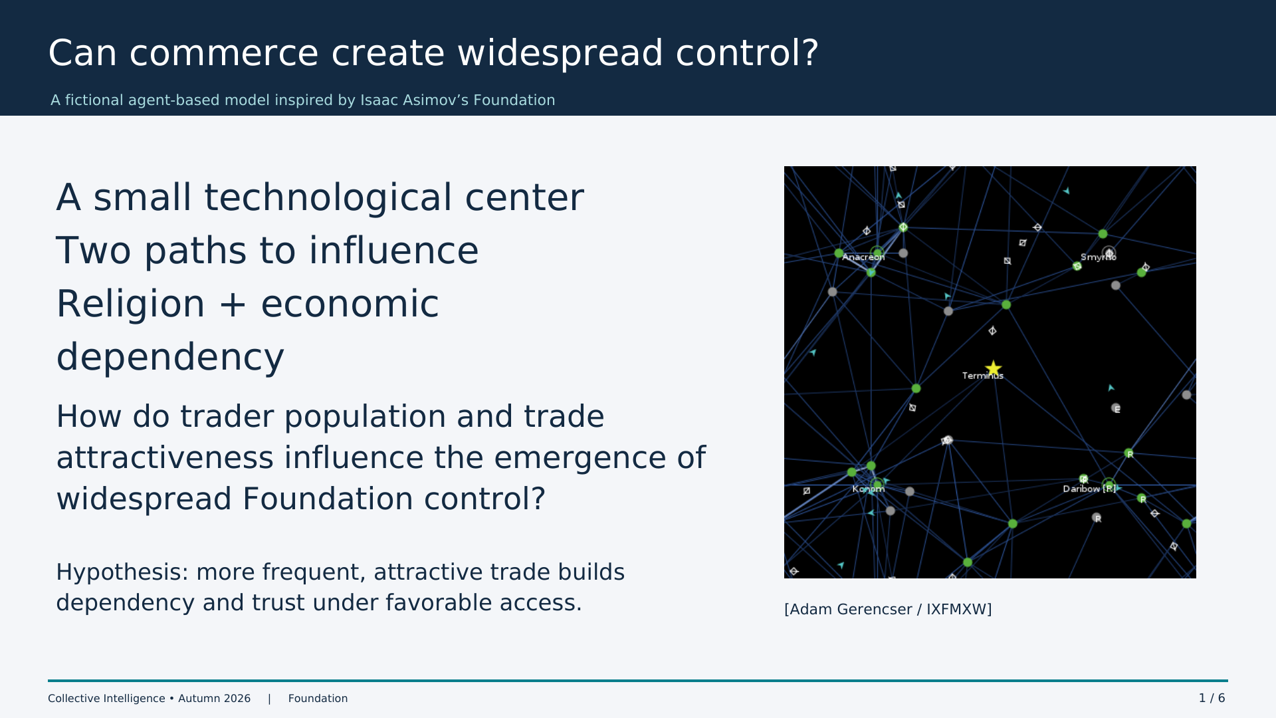
Notes:
0:00–0:50
Asimov imagined a small technologically advanced Foundation gaining influence without military conquest. We abstract this into religion and commerce, rather than reenacting the novels. Ask the question on the slide. Our hypothesis is that frequent, attractive trade creates dependency under favorable access. The result describes this fictional simulation, not real societies.

Slide 2
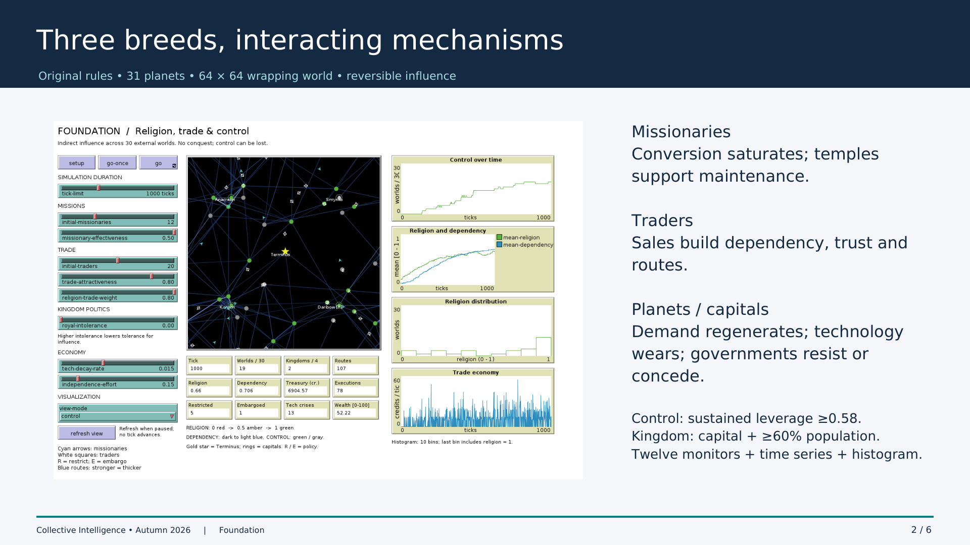
Notes:
0:50–1:45
Planets are stationary; missionaries and traders travel. Missions saturate religious influence, and temples maintain technology. Sales build dependency and trust, while links connect markets. Technology wears out and demand returns. Capitals react with restrictions, but economic pressure can soften policies. Control is reversible leverage: five ticks above the local criterion, and a controlled capital plus 60 percent population for a kingdom. Point out the genuine interface, duration slider, plots and histogram.

Slide 3
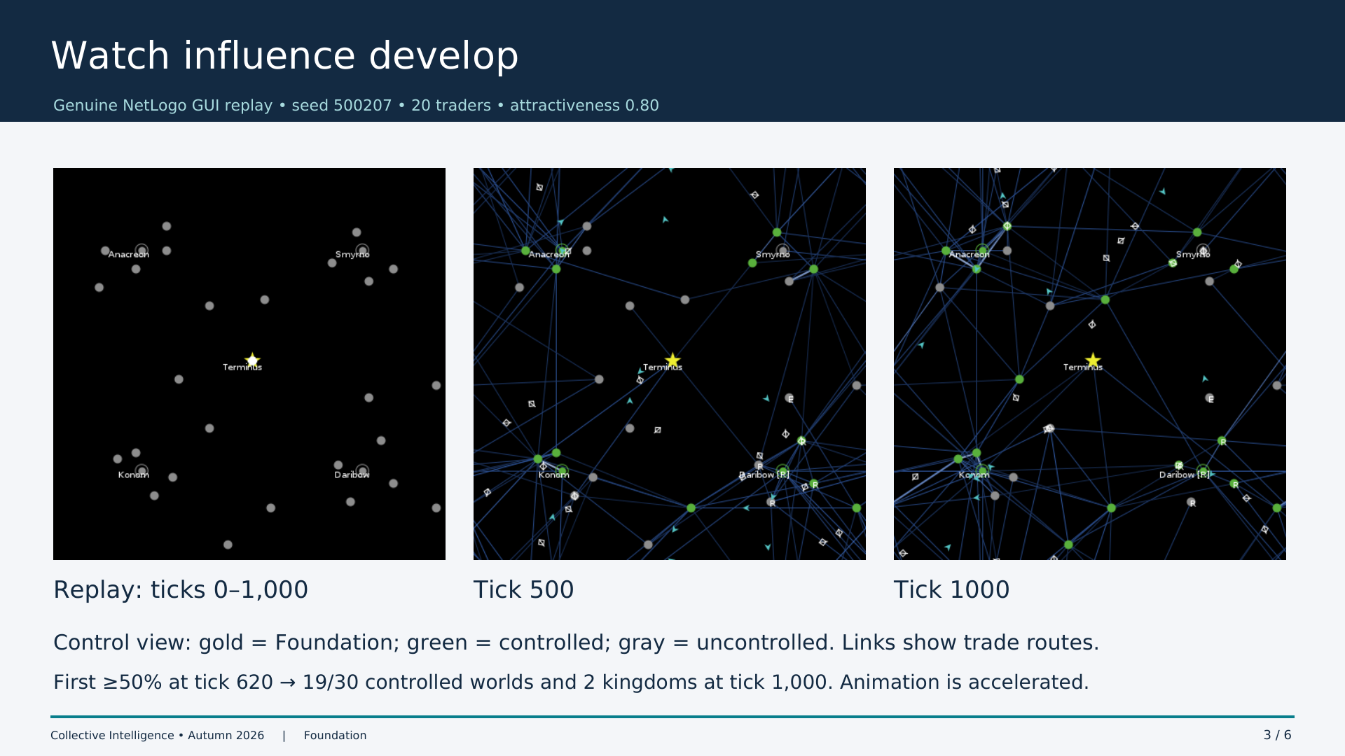
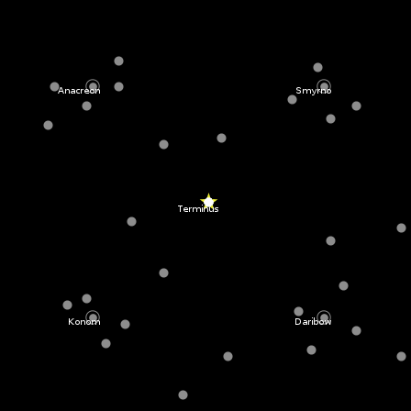
Notes:
1:45–2:40
The animation and stills come from the actual NetLogo GUI with seed 500207, 20 traders and attractiveness 0.80. GIF time is accelerated. Show initial, middle and terminal states; describe the color legend. Religion opens access, then economic ties and control accumulate. This replay crosses 50 percent at tick 620 and finishes with 19 of 30 planets and two kingdoms. Replay is illustrative, not an extra independent observation.

Slide 4
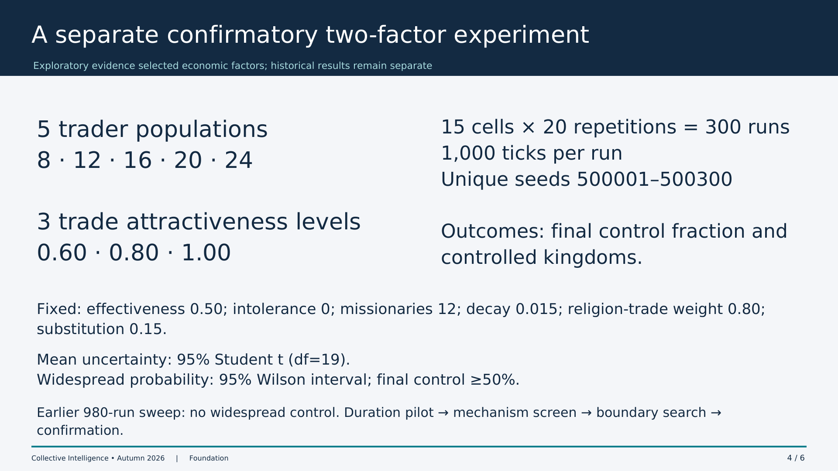
Notes:
2:40–3:30
The original 49-cell missionary versus intolerance experiment found no widespread control in 980 runs at 450 ticks. Duration tests, factorial screening and a boundary search pointed toward economic variables. We then used a separate 15-cell design with 20 unique seeds per cell and a finite 1000-tick horizon. Settings are favorable and fixed. Explain Student t intervals for continuous means and Wilson intervals for crossing probability. We do not pool search data with confirmation.

Slide 5
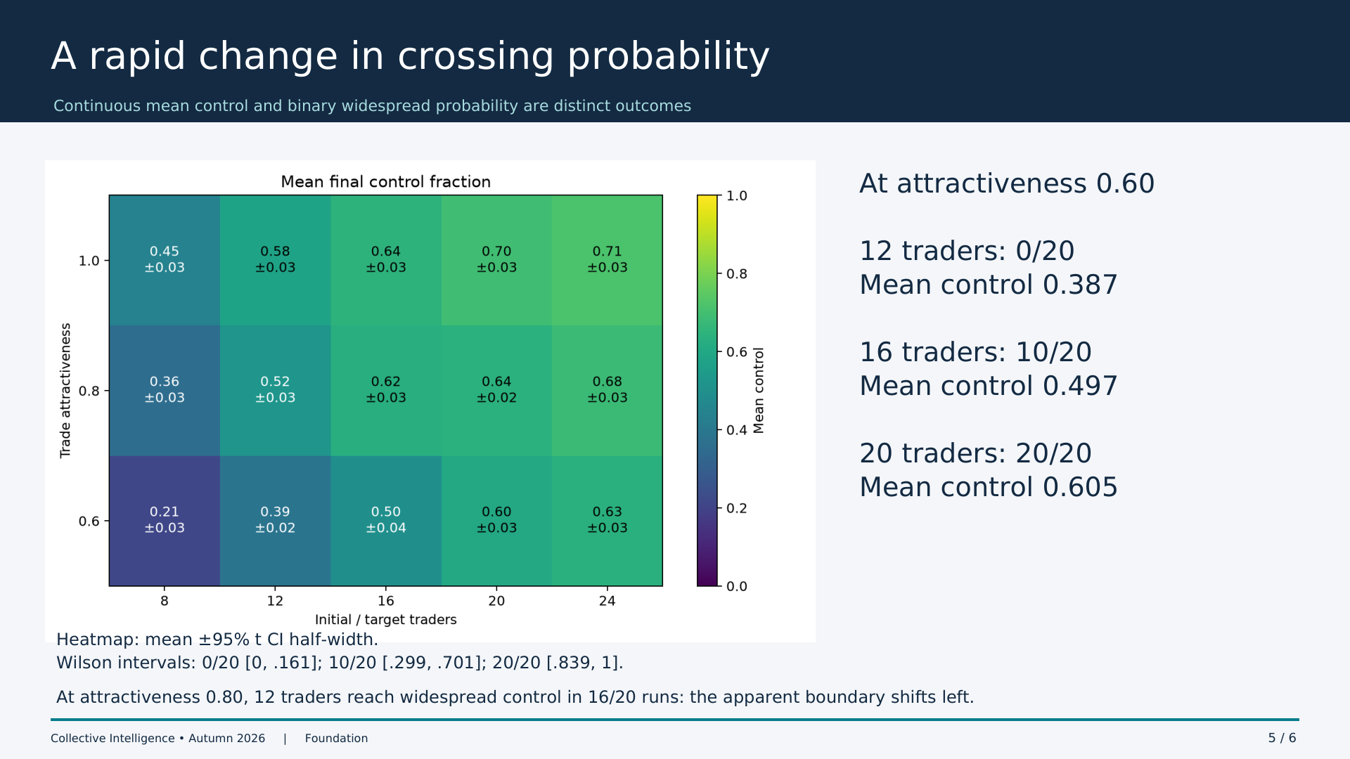
Notes:
3:30–4:35
Read the bottom heatmap row at attractiveness 0.60. Twelve traders: 0 of 20 widespread runs, mean control 0.387. Sixteen: 10 of 20, mean 0.497. Twenty: 20 of 20, mean 0.605. Zero and twenty successes still have uncertainty: Wilson upper 0.161 and lower 0.839. At 0.80, twelve traders produce 16 of 20 widespread runs. Mean control grows more smoothly than the threshold-crossing probability. A 50 percent cutoff makes the transition appear sharper.

Slide 6
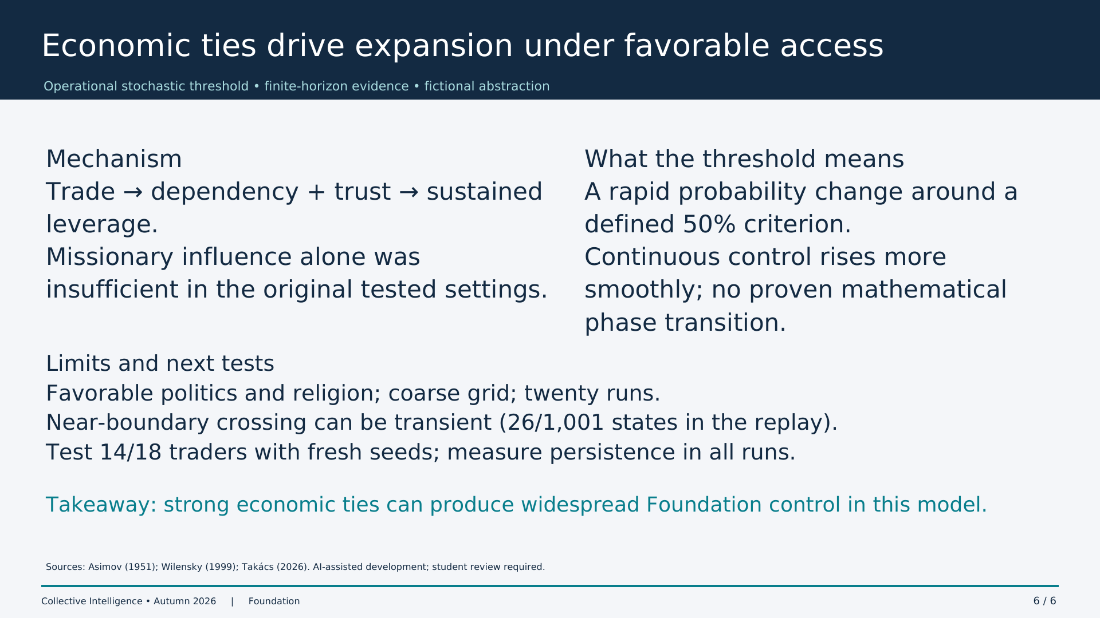
Notes:
4:35–5:30
Dependency and trust are major mechanisms, under favorable missionary and political settings. This is a stochastic operational threshold, not proof of a mathematical phase transition. The boundary replay crosses late and fluctuates: only 26 of 1001 observed states are widespread. Terminal outcomes do not prove lasting control. End with the takeaway. Future work should use fresh validation seeds at 14 and 18 traders and record persistence for every run. Invite questions.

