Slide 1

The best GENE database in the world!
Nico Heiniger | Gabriel Massaro | Rinson Mankudiyil | Hsaine El Ali

Slide 2
Agenda
Data overview
System landscape
Implementation
Gene Service (API)
Gene Webapp (Java PrimeFaces)
Gene Reactapp (React.JS Webapp)
Demo
Outlook

Slide 3
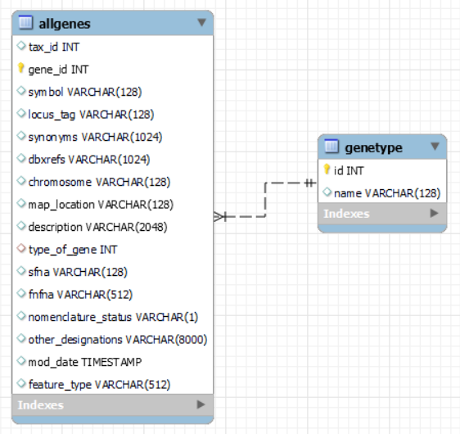
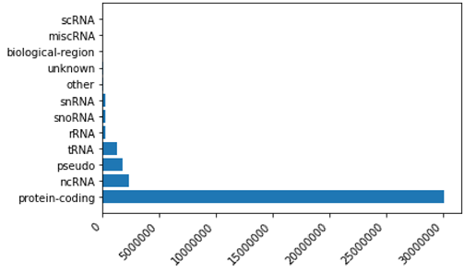
Data
Gene data (~36.5M records, ~5GB) downloaded from here: ftp://ftp.ncbi.nlm.nih.gov/gene/DATA/gene_info.gz
Gene types
MySQL - ERD

Slide 4
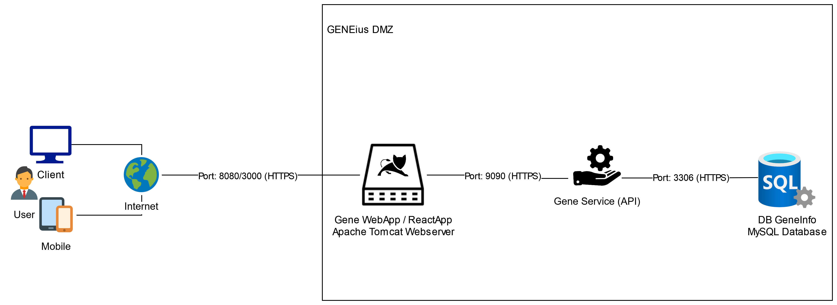
System landscape
Notes:
Service: port 9090
Webapp: tomcat 8080 /mscmi_geneinfo_webapp/
Reactapp: 3000
MySql database 3306 (DB geninfo)
Dataloader -> to input data

Slide 5
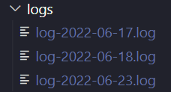
Implementation – Basic Features
Basic functionality working:
Searching by ID, symbol and description
Webapp calling API to retrieve data
Displaying Gene results in table
Logging in the API (Logback) with RollingFileAppender

Slide 6
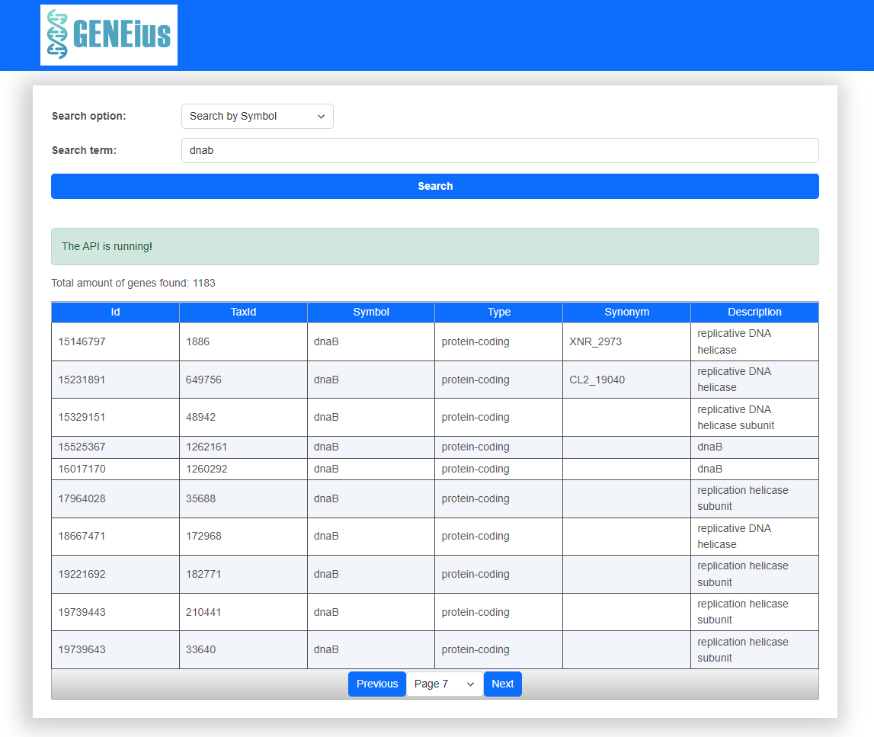
Implementation – Additional Features
Added new column «TaxId»
Extended Gene model class in API and in the Webapp with additional taxId field

Slide 7
Implementation – Additional Features
Added Pagination
server- and client-side to improve performance and readability
http://localhost:9090/geneservice/bysymbol?symbol=dnab&offset=0&pageSize=10

Slide 8

Implementation – Additional Features
Added custom styling with Bootstrap 5:
HTML, CSS, and JS UI-framework for creating responsive, mobile-first websites

Slide 9
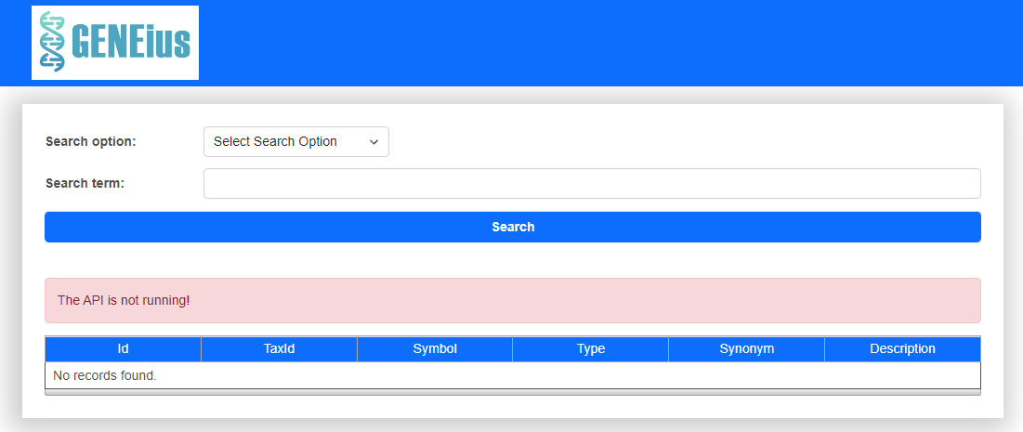
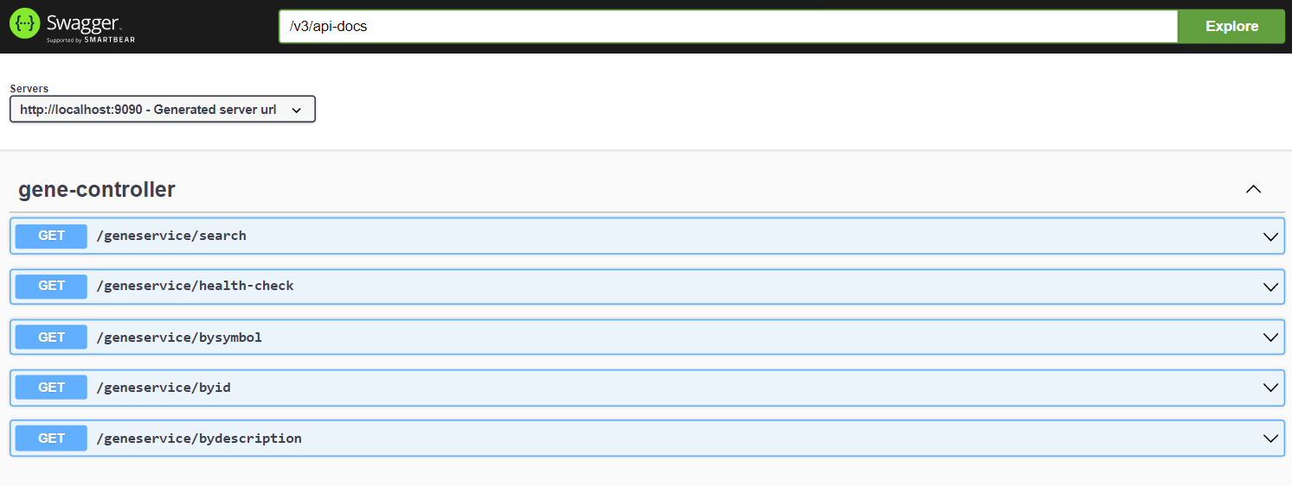
Implementation – Additional Features
Added Error Handling
Health Check Endpoint in the API
http://localhost:9090/geneservice/health-check --> „OK“ or ERROR

Slide 10
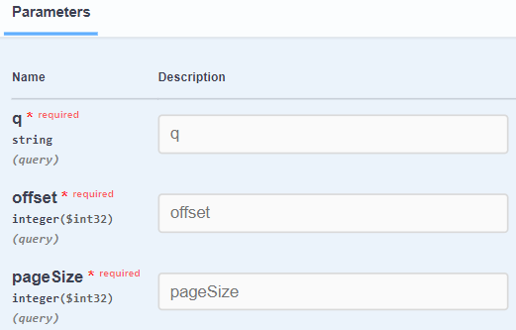
Implementation – Additional Features
Google-like search API Endpoint “/search”
ALTER TABLE allgenes ADD FULLTEXT(`description`);
SELECT * FROM allgenes
WHERE allgenes.gene_id = :intSearchQuery
OR allgenes.symbol = :searchQuery
OR MATCH(`description`) AGAINST(:searchQuery IN BOOLEAN MODE);
Problem: Performance still not optimal (~ 20-30sec per query) when used with count query (pagination)

Slide 11
Implementation – Additional Features
Swagger

Slide 12
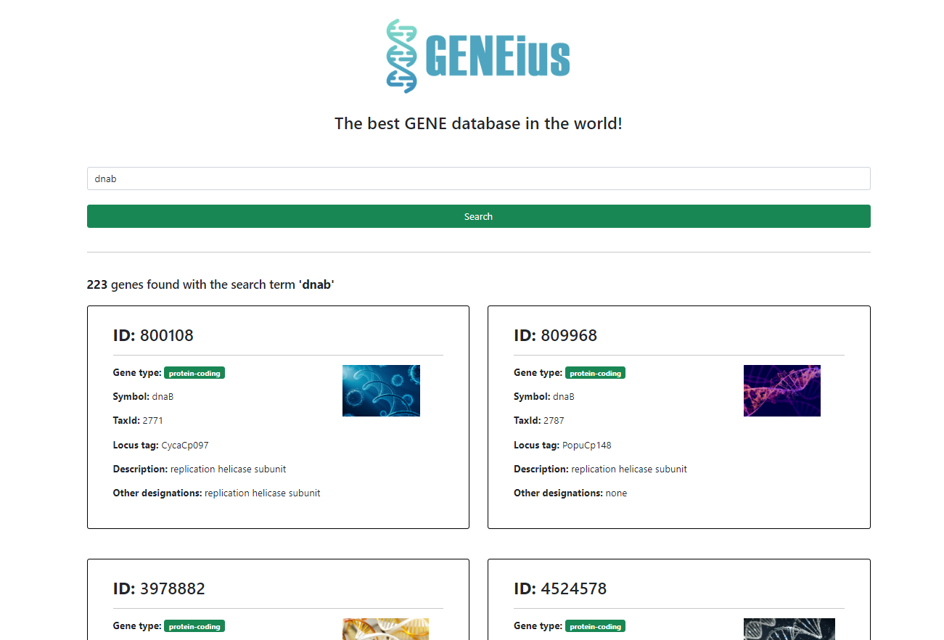
Implementation React aPP
Gene overview as list view
Infinite scroll for performance reasons (lazy loading)
Responsive design (optimized for mobile devices)

Slide 13
Demo

Slide 14
Conclusion of team GENEius
Highlights:
Custom Styling of the Webapp
Pagination
React Webapp optimized for mobile devices
Outlook:
Planned to do a sprint planning every 2 weeks for continuous releases
Improve Performance of description search
Host the MySql in the Cloud (Azure, AWS…)
Integrate more genes from other data sources

