Slide 1

The best GENE database in the world!
Nico Heiniger | Rinson Mankudiyil | Hsaine El Ali | Gabriel Massaro

Slide 2
Agenda
Data overview
System landscape
Implementation
Gene Service (API)
Gene Webapp (Java PrimeFaces)
Gene Reactapp (React.JS Webapp)
Demo
Outlook

Slide 3
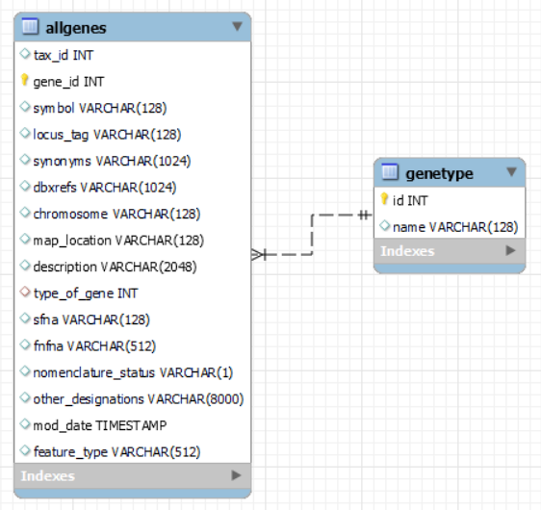
Data
Gene data (~36.5M records, ~5GB) downloaded from here: ftp://ftp.ncbi.nlm.nih.gov/gene/DATA/gene_info.gz
protein-coding 30142041 ncRNA 2314143 pseudo 1780387 tRNA 1333433 rRNA 297066 snoRNA 288629 snRNA 241286 other 78773 unknown 60416 biological-region 9463 miscRNA 5979 scRNA 21

Slide 4
System landscape (Rinson)
Service: port 9090
Webapp: tomcat 8080 /mscmi_geneinfo_webapp/
Reactapp: 3000
MySql database 3306 (DB geninfo)
Dataloader -> to input data

Slide 5
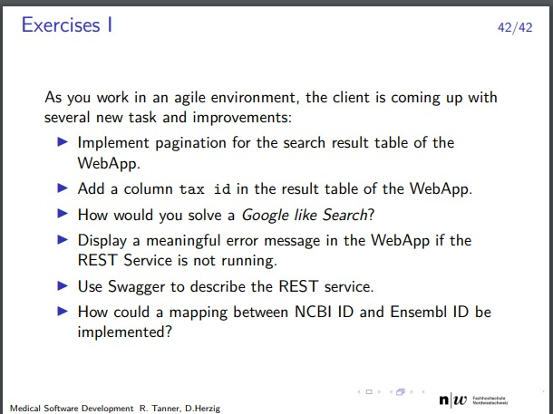
Implementation
Mention additional features in Gene Service und Genewegapp 1-3 slides

Slide 6
Implementation
Gene React app (mention features)

Slide 7
Demo

Slide 8
Why you should choose GENEius
Because we are genius - seriously ;)

Slide 9
Outlook
Because we are genius - seriously ;)

