Slide 1
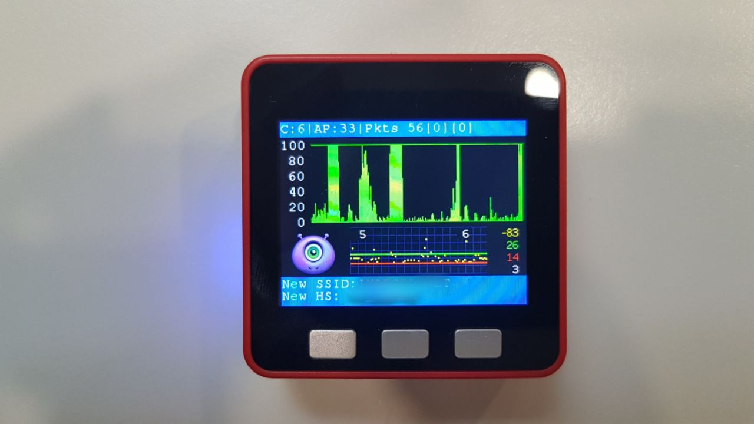
ESP32 WiFi Hash Monster
Total AP
Packets/Deauths/Hashes per second
WiFi Channel
SD Card
Purple Hash Monster
RSSI
Total Hashes
Total Deauths
Latest SSID :
Total AP Hash
Latest Hash (EAPOL/PMKID):
Short Press: Change Channel
Long Press: Record Hash on SD
SP: Adjusts backlight brightness
LP: Adjusts LED bar brightness
LED bar: Red Glow: Deauth Green Glow: Hash

Slide 2
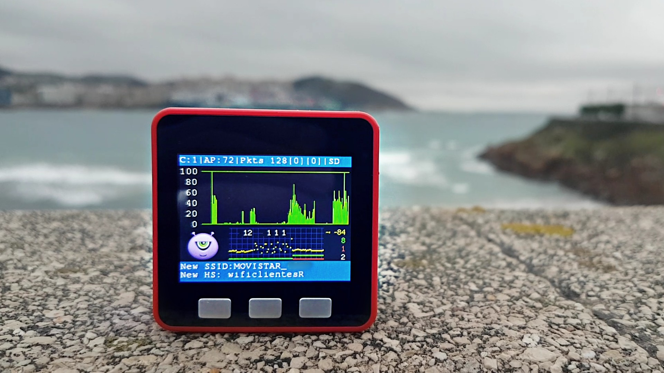
ESP32 WiFi Hash Monster
Total AP
Packets/Deauths/Hashes per second
WiFi Channel
#OSHWDem19
SD Card
Purple Hash Monster
RSSI
Total Hashes
Total Deauths
Latest SSID :
Total AP Hash
Latest Hash (EAPOL/PMKID):
SP: Adjusts backlight brightness
LP: Adjusts LED bar brightness
Short Press: Incognito mode
Long Press: Enable/Disable SD
Short Press: Change Channel
LP: Auto-Channel / Smart-Channel
LED bar: Red Glow: Deauth Green Glow: Hash

