Slide 1


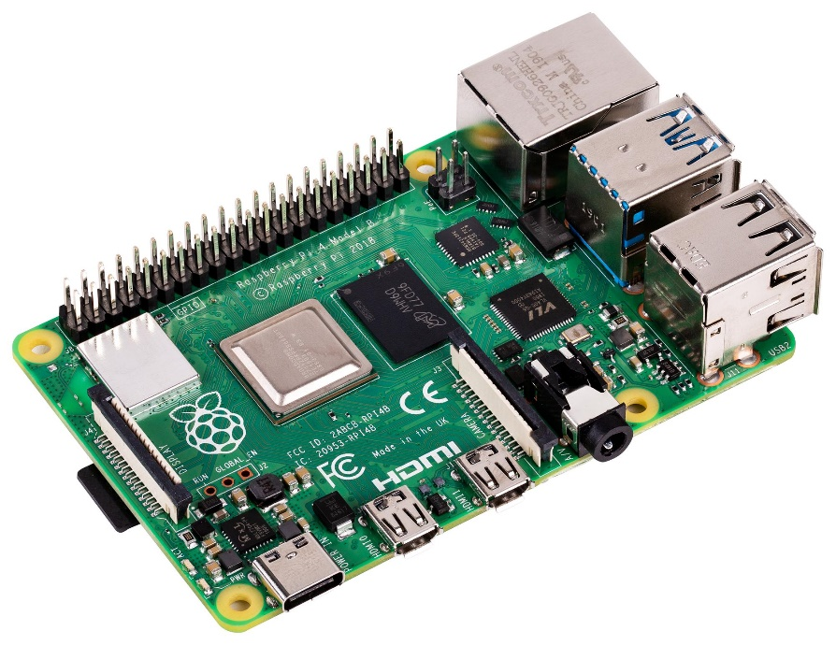











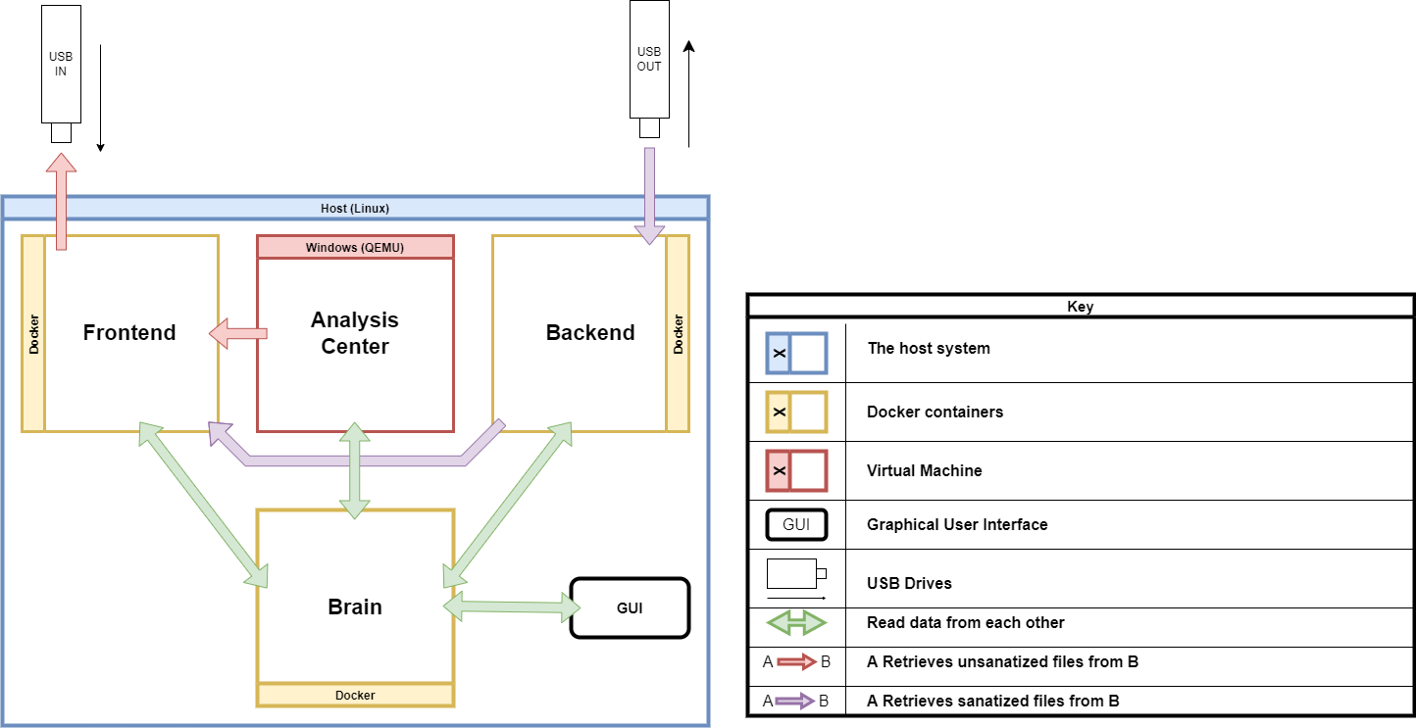



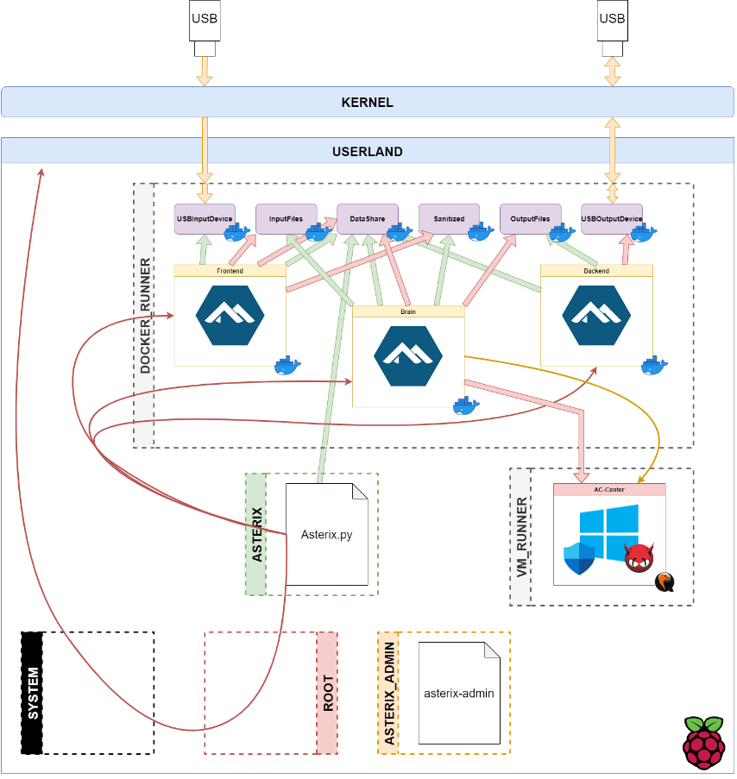





ASTERIX
(Station Blanche)
Universiteit Van Amsterdam (Pays-Bas)
EV2 REPPELIN, EV2 ROYER Promotion EN 2020
The Goal : Developing a small Open Source USB Malware Cleaner Kiosk satisfying the ANSSI requirements.
The Project :
Hardware:
Software:
Raspberri Pi 4B/8GB
SSD SAMSUNG EVO 512GB
PC Lenovo IDEAPAD Intel Core I5 8th Gen/20GB
SSD Crucial 500Gb
Operating Systems :
Linux RaspberryPi OS (ARM64)
Linux Alpine (Docker Image)
Linux Ubuntu (x64)
Windows 10 PRO (ARM/x64)
Virtualization:
QEMU KVM
LibVirt
DOCKER Engine
Anti-Viral Solutions:
Windows Defender
ClamAV (Windows x86/x64)
Kaspersky (Windows x64)
System Architecture:
Performance:
Real Case Scenario : 13 Innocuous Documents – 1 Malware
 | Fast Scan | Complete Scan
Raspberry PI 4B/8Gb | 00:00:34 (Defender) | 01:00:40 (Defender & ClamAV)
PC Lenovo IDEAPAD | 00:00:20 (Defender & Kaspersky) | 00:08:48 (Defender, Kaspersky & ClamAV)
Theoretical
Real
Malware Detection : 100%
 | A | u | t | o | m | a | t | e | d
 | S | a | n | i | t | i | z | i | n | g
 | T | e | r | m | i | n | a | l |  | w | i | t | h
 | E | m | b | e | d | d | e | d
 | R | e | l | e | v | a | n | t
 | I | n | f | o | r | m | a | t | i | o | n
e | X | t | r | a | c | t | i | o | n
Project Website
Project GitHub
Feeling like a Hacker ? There is a CTF challenge hidden in this poster. Find the flag !
(The poster is available on GitHub)

