Slide 1
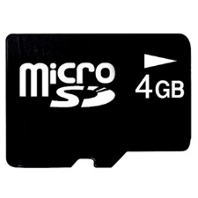
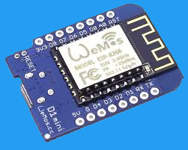
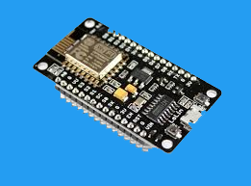
Serial Peripheral Interface Flash File System
3M Byte SPIFFS
Flash Storage
Program Memory
1M Byte Program
ESP8266 and using SPIFFS
in-place of SD-Card storage

Slide 2
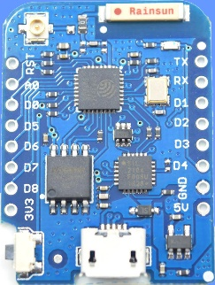

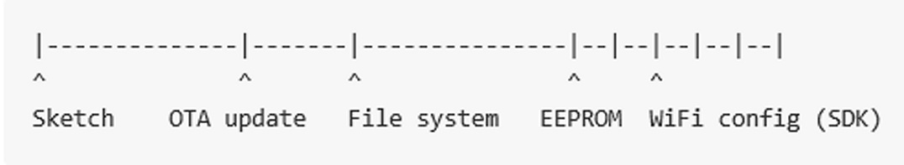
Filing System Implemented in Flash Storage
Unused Flash Memory Space
ESP8266
PRO
15M-Byte (120M-bit)
Used by
SPI
Flash
Filing System
Unused Flash Memory Space
3M-Byte (24M-bit)
ESP8266
Program Space
1M-Byte (8M-bit)
SPIFFS – the SPI bus Flash memory File System

Slide 3
Filing System Comparison SD v SPIFFS
Filing System Objects
File Objects
SD-CARD
begin
exists
open
remove
rmdir
mkdir
SPIFFS
begin
exists
open
remove
exists
format
openDir
rename
info
SD-CARD
seek
position
size
close
print
println
read
write
available
flush
peek
isDirectory
openNextFile
rewindDirectory
SPIFFS
seek
position
size
close
print
println
read
write
name
See here for SPIFFS Documentation

Slide 4
Filing System Comparison SD v SPIFFS
// SD Card Write then Read to a file example
#include <SD.h>;
void setup() {
SD.begin(D8);
}
void loop() {
char filename [] = "datalog.txt";
File myDataFile = SD.open(filename, FILE_WRITE);
myDataFile.println("ABCDEFGHIJKLMNOPQRSTUVWXYZ");
myDataFile.println(3.141592654);
myDataFile.close();
myDataFile = SD.open(filename, FILE_READ);
while (myDataFile.available()) {
Serial.write(myDataFile.read());
}
myDataFile.close();
}
// SPIFFS Write then Read to a file example
#include <FS.h>
void setup() {
SPIFFS.begin();
}
void loop() {
char filename [] = "datalog.txt";
File myDataFile = SPIFFS.open(filename, "a");
myDataFile.println("ABCDEFGHIJKLMNOPQRSTUVWXYZ");
myDataFile.println(3.141592654);
myDataFile.close();
myDataFile = SPIFFS.open(filename, "r");
while (myDataFile.available()) {
Serial.write(myDataFile.read());
}
myDataFile.close();
}
Program output/results (File is 34-bytes)
ABCDEFGHIJKLMNOPQRSTUVWXYZ
3.141592654
Program output/results (File is 34-bytes)
ABCDEFGHIJKLMNOPQRSTUVWXYZ
3.141592654

Slide 5
Filing System Comparison SD v SPIFFS
Implementation Examples/Differences
SD-CARD SPIFFS
File myDataFile = SD.open(filename, filemode);
File myDataFile = SD.open(filename, filemode);
r Open text file for reading. The stream is positioned at the
beginning of the file.
r+ Open for reading and writing. The stream is positioned at the
beginning of the file.
w Truncate file to zero length or create text file for writing.
The stream is positioned at the beginning of the file.
w+ Open for reading and writing. The file is created if it does
not exist, otherwise it is truncated. The stream is
positioned at the beginning of the file.
a Open for appending (writing at end of file). The file is
created if it does not exist. The stream is positioned at the
end of the file.
a+ Open for reading and appending (writing at end of file). The
file is created if it does not exist. The initial file
position for reading is at the beginning of the file, but
output is always appended to the end of the file.
File myDataFile = SD.open(filename, FILE_READ);
File myDataFile = SD.open(filename, FILE_WRITE);

Slide 6
Filing System Comparison SD v SPIFFS
SPIFFS Things to Note
SPIFFS is not a FAT filing system
Filenames are ‘absolute’ and contain the full address
e.g. “/DATA/filename.dat”
Directories are NOT implemented, however they are simulated
SD-Card system allows a Directory containing files, SPIFFS does not
E.g. an SD-Card directory container file called [DATA] can exist and contain a file called ‘filename.dat’
SPIFFS uses absolute filenames and is implemented as myFile.OPEN(“/DATA/filename.dat”,”r”)
Using Dir dir = SPIFFS.openDir("/DATA"); effectively appends a path filter to files
Using the example above, File myFile = dir.openFile("r"); then myFile.openFIle(“filename.dat”,”r”); actually opens the file “/DATA/filename.dat”
See here for SPIFFS Documentation

Slide 7
Filing System Comparison SD v SPIFFS
SPIFFS Things to Note
Filenames path are not case-sensitive and limited to 32 chars. One character is reserved for C string termination (‘\0’), leaving 31 usable characters for filenames (and path)
SPIFFS does not warn you when the 31-character filename limit is exceeded
Flash memory will fail after ~10,000 writes! So keeping writing to a minimum e.g. read many, write few!
Example: If data logging temp and humidity readings every 10-mins (tt.t,hh.h,dd/mm/yy,hh,mm 25-bytes) then the 3MB flash would be full when 3.1024.1024/25=125829 readings had been recorded. At 10-mins per reading that’s 2.4 years when the data could be overwritten again ~10,000 times, which is more than enough life (2.4x10,000 years) for most applications!
Overall SPIFFS is more versatile than the SD filing system
See here for SPIFFS Documentation

Slide 8
GitHub Example Files
Example-1 Writing and Reading from SD-Card file system
Example-2 Writing and Reading from SPIFFS file system
Example-3 Combined SD and SPIFFS Writing and Reading
See here for GitHub SPI File Repository

