Slide 1


DATA SCIENCE FOR MINING PROTEIN
Prepared by A1 Team

Slide 2
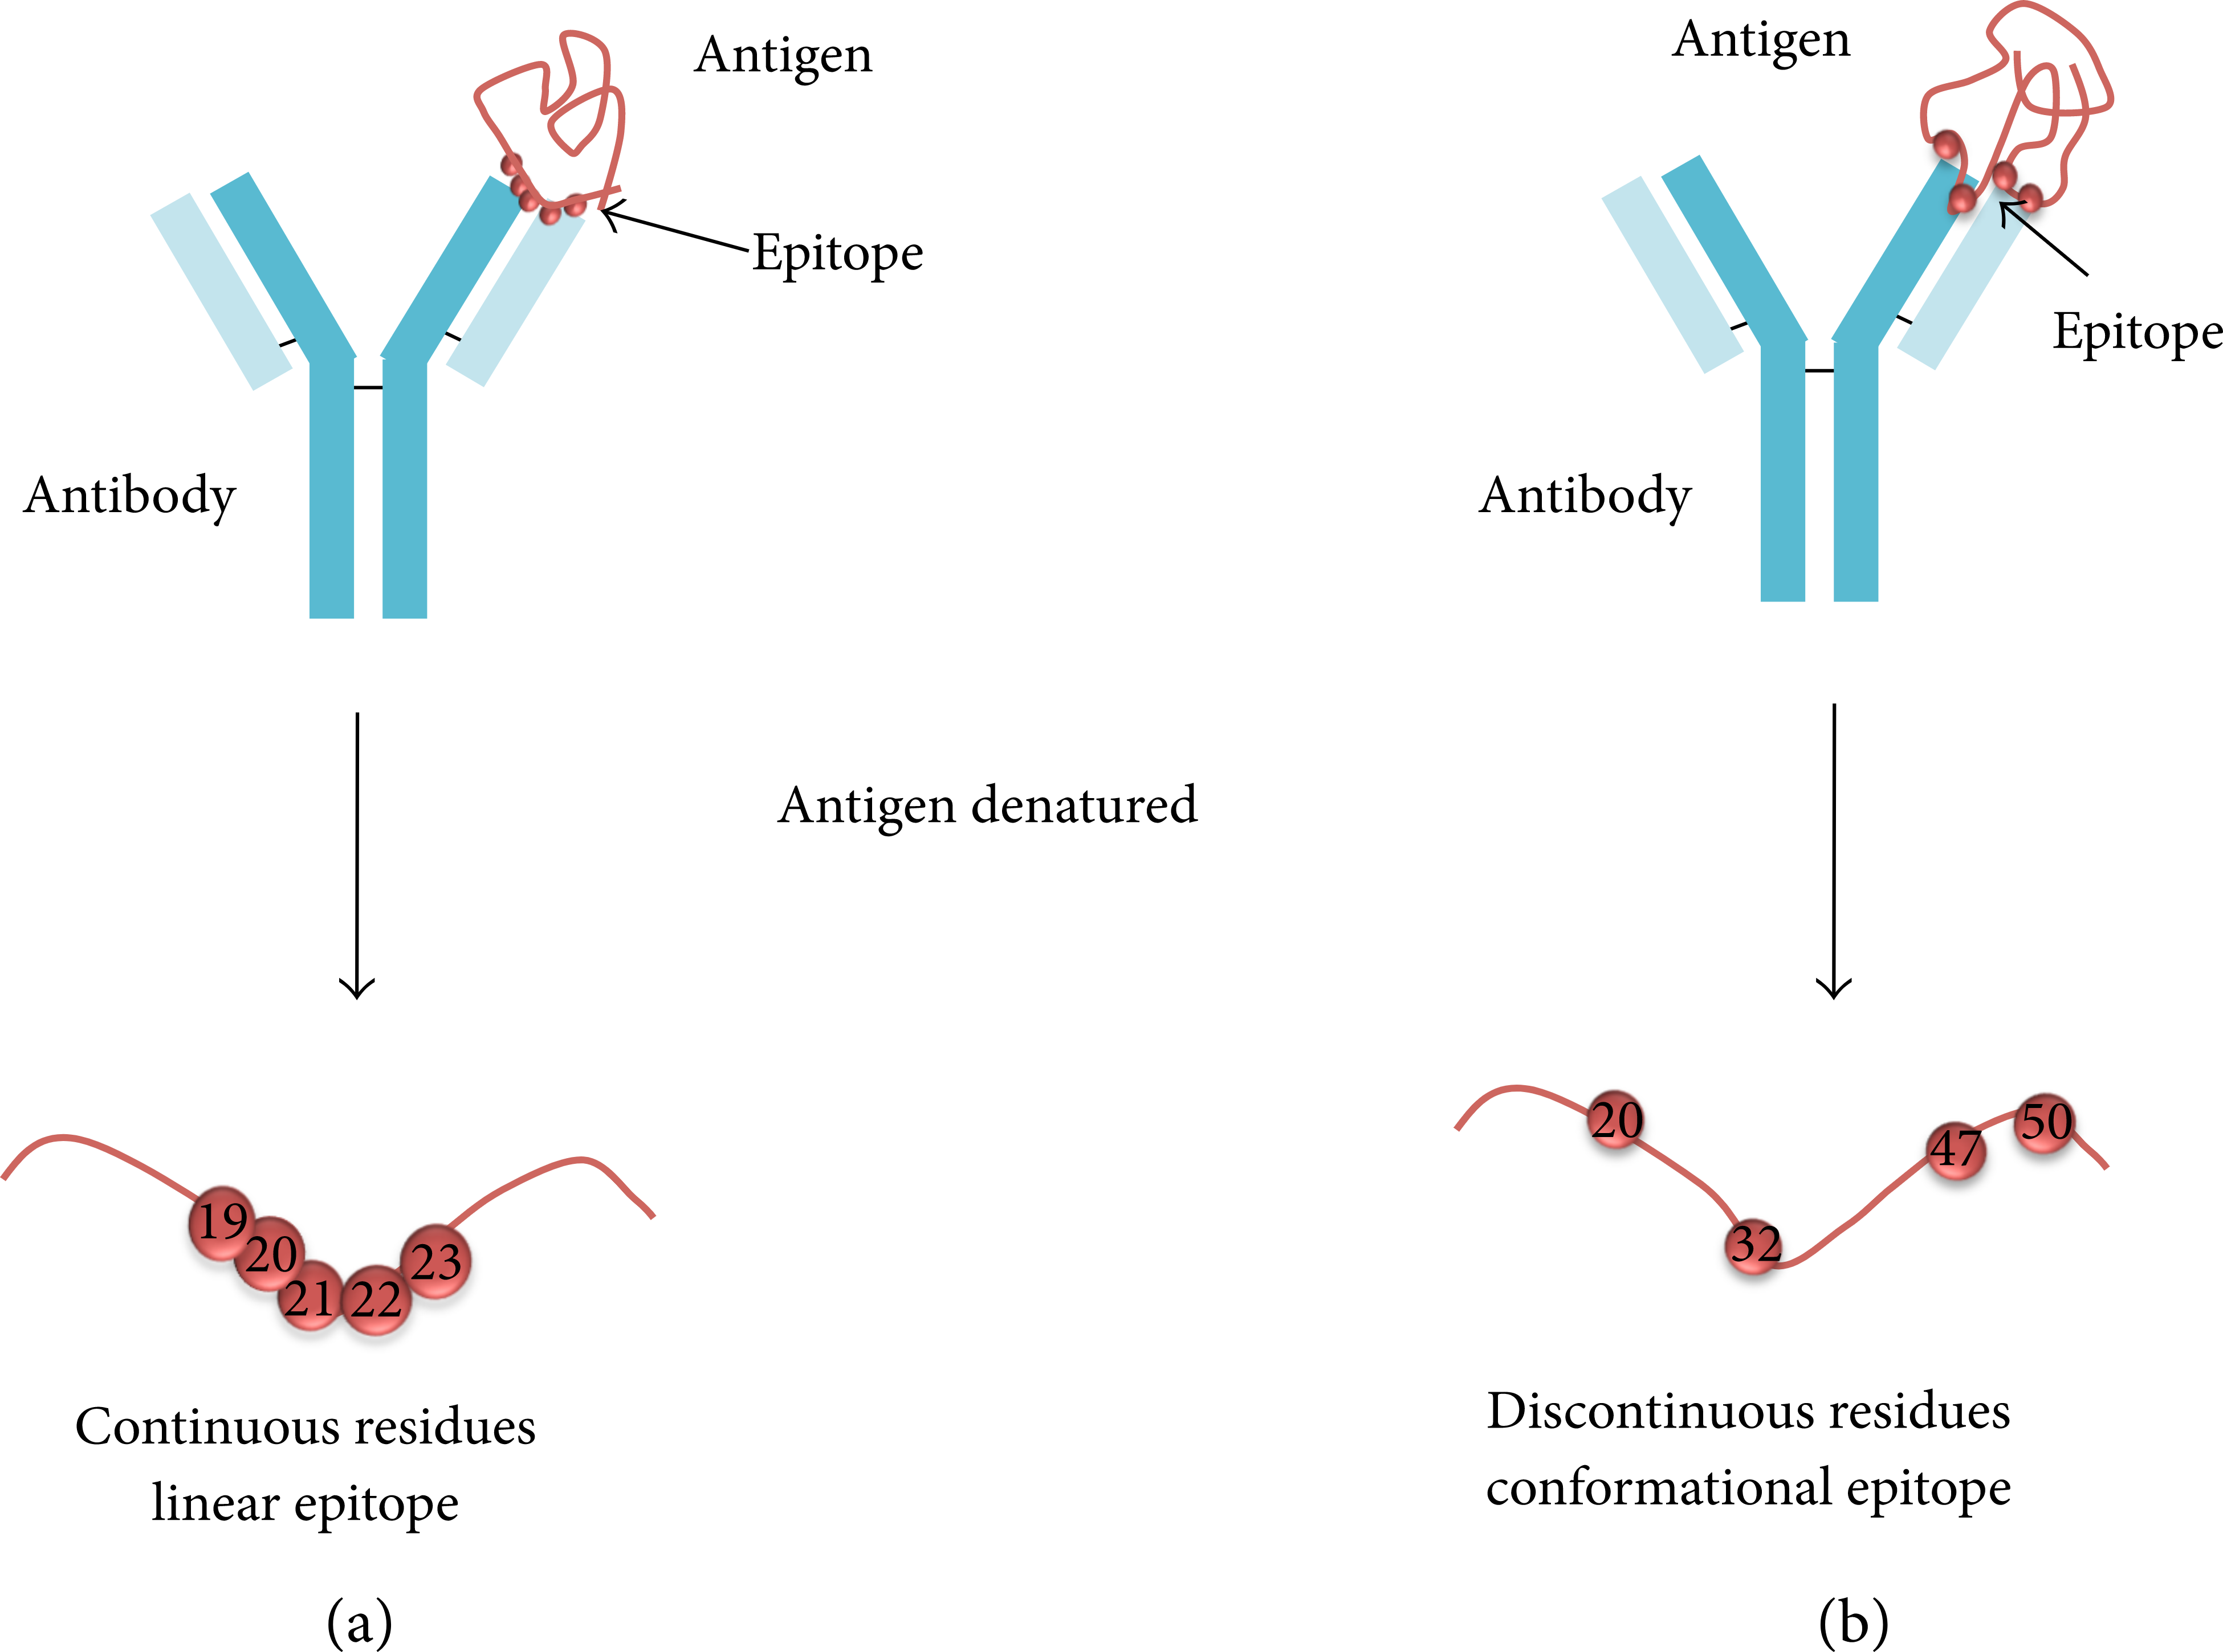
The Problem
The prediction of linear B-cell epitope to identify potential candidates for the development of diagnostic.
Linear epitopes are commonly short protein fragments that are recognized by certain components of the immune system.
Hackathon
Page 2

Slide 3
Solution
X_TRAIN
GROUP BY Info_PepID
Normalization
MinMaxScaler
Log Transformation
Skeweness
Dimensionality Reduction PCA
Y_TRAIN
GROUP BY Info_PepID
Model Fit
X_train_pca
y_train
Classification Models LogisticRegression
DecisionTree
RandomForest
Model Evaluation
X_test_pca
y_test
DATASET
X_TEST
GROUP BY Info_PepID
Normalization
MinMaxScaler
Log Transformation
Skeweness
Dimensionality Reduction PCA
Y_TEST
GROUP BY Info_PepID
Hackathon
Page 3

Slide 4
Model building Steps
X_train
Pipeline to shortlist 3 model based on f1 score
Using grid search to do hyperparameter tuning
DATASET
Y_train
X_test
Model Evaluation
Y_test
Comparing the results of the model on testset against actual ytest
Running the model on blind testset without target variable
Saving the best model found using grid search in local folder
Hackathon
Page 3

Slide 5
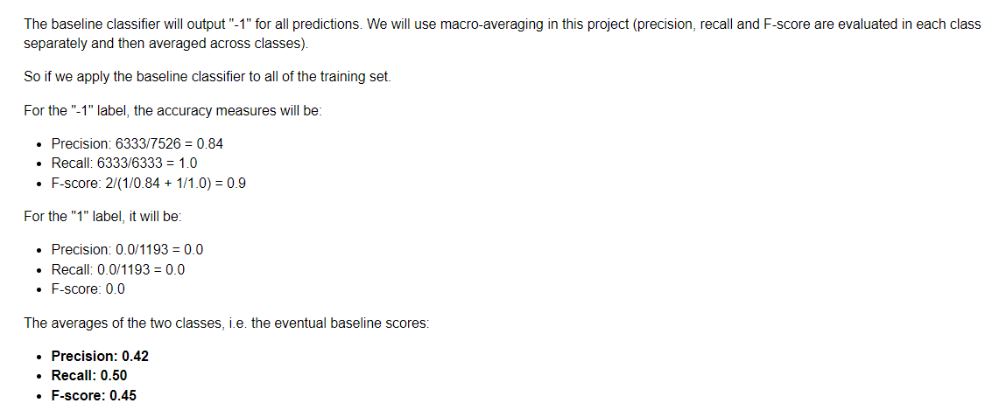
Solution comparison

Slide 6
Future recommendation

Slide 7
Preprocessing Building
Algorithm | OverSampling Technique | Cost Sensitive balance
Logistic Regression
Decision Tree
Random Forest
Hackathon
Page 4

Slide 8
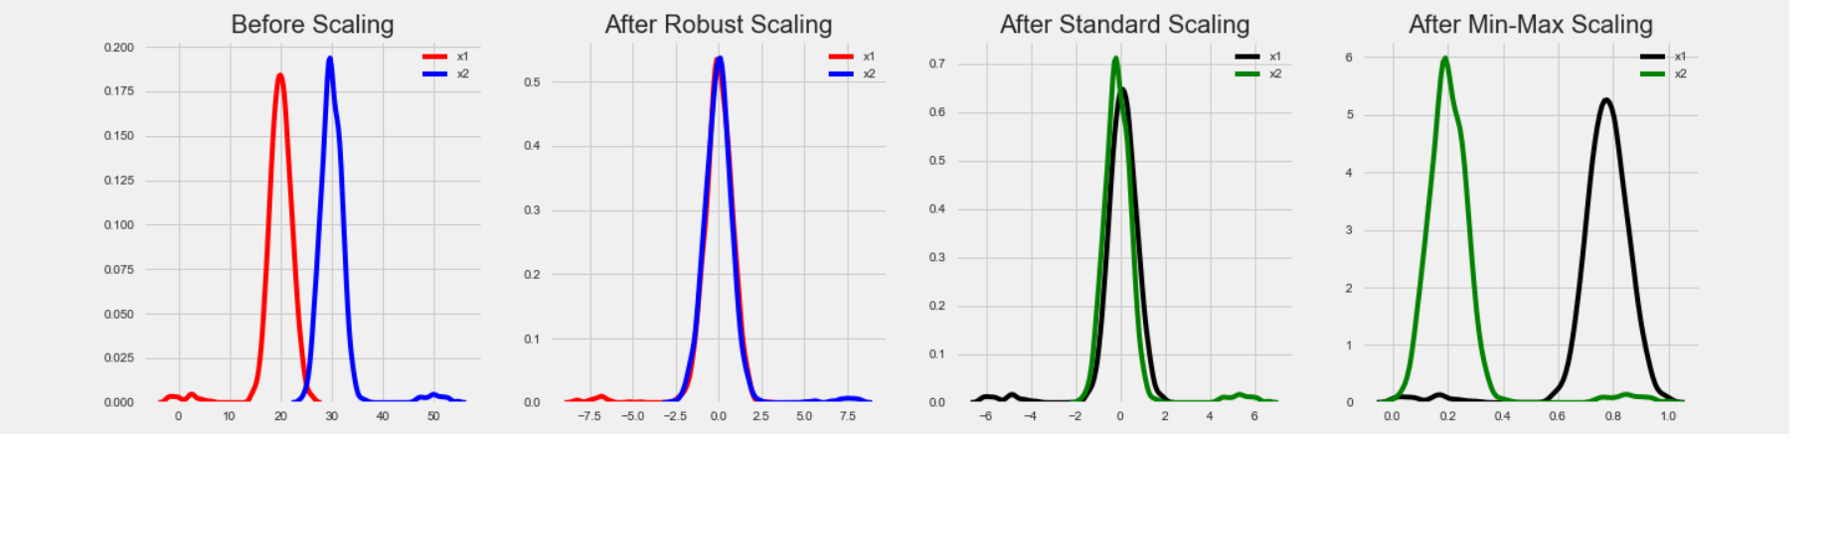
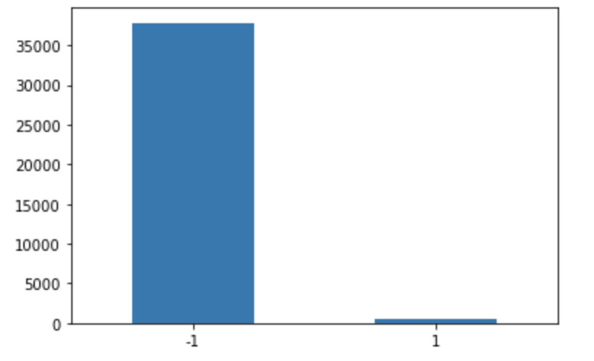
Data Transformation
Normalisation
Imbalancend Classification
MinMaxScaler() scales all data features in the range [0, 1] or else in the range [-1, 1] if there are negative values in the dataset. This scaling compresses all the inliers in the narrow range [0, 0.005].
Cost-sensitive learning for imbalanced Classification showed better results than under-sampling and over-sampling techniques. The scikit-learn Python machine learning library provides algorithm extension via the class_weight = Balance
Hackathon
Page 5

Slide 9
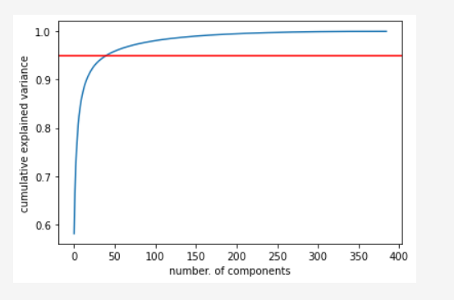
Dimensionality Reduction
Normalisation
PCA() has been fitted to training data, and the number of components has been selected as 75 based on the cumulative explained variance chart.
X_train_pca has 75 features.
PCA transformed the test features
X_test_pca has 75 features now.
80% reduction in data features.
Hackathon
Page 6

Slide 10

THANK YOU!
CS4710: AI Vision & Reality

