Slide 1
BIO-MATRIX

Slide 2
Meet the team
Gauri Vinod
Athul TA
Edwin Joy
Bharath Sudheesh

Slide 3
Stack used
Front end: HTML
Back end: JavaScript

Slide 4
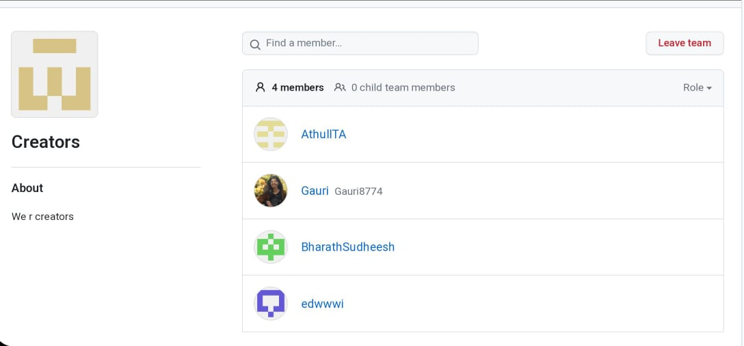

Slide 5



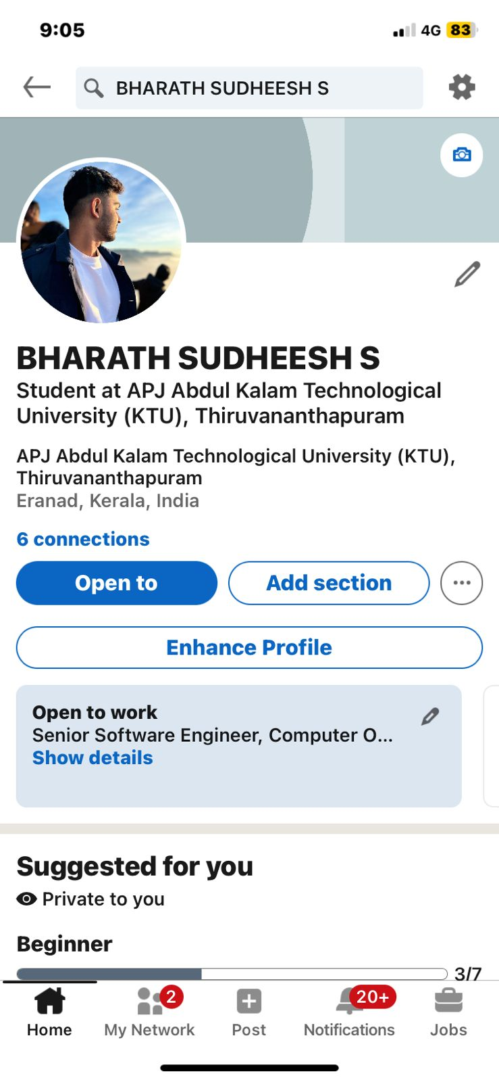

Slide 6
What’s Bio-MAtrix?
Bio-matrix is a security system that uses physical characteristics of individuals such as iris patterns or facial features to verify their identity.
This system can later be used in applications or websites for access control and identity verification.

Slide 7
Drive Link that contains all input faces
https://drive.google.com/drive/folders/1DytFcJyxR5O8Y8-Gm8qrVawqjgSTl1X6

Slide 8

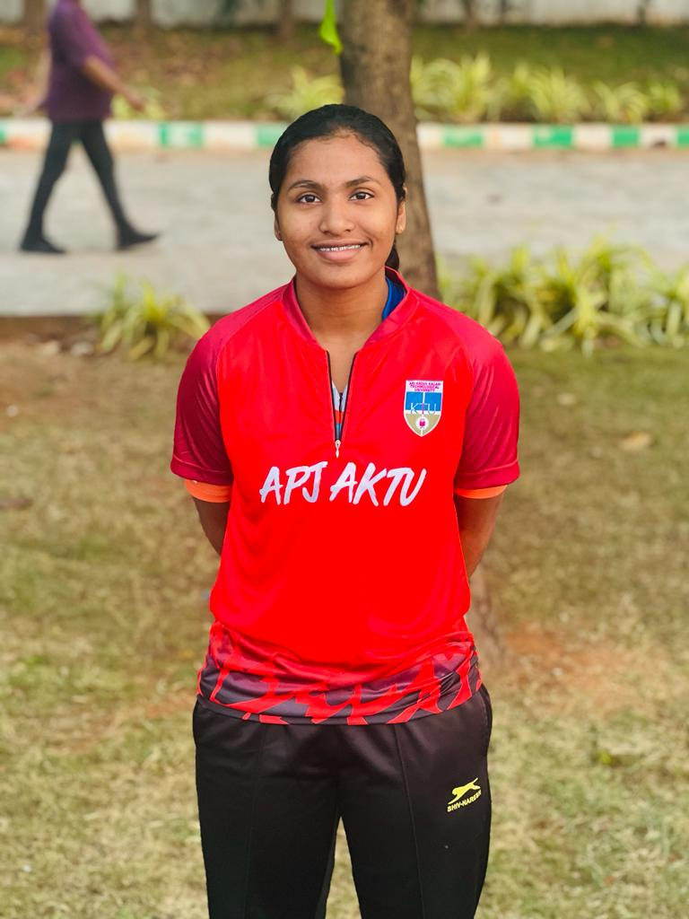
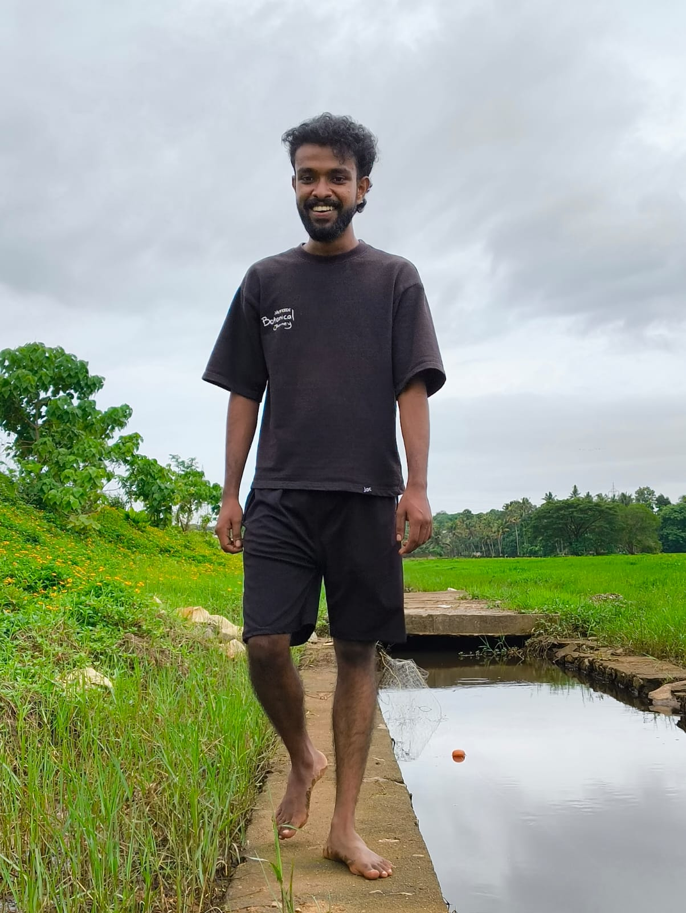
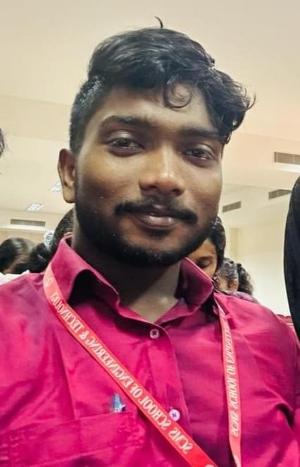
Faces used for checking prototype

Slide 9

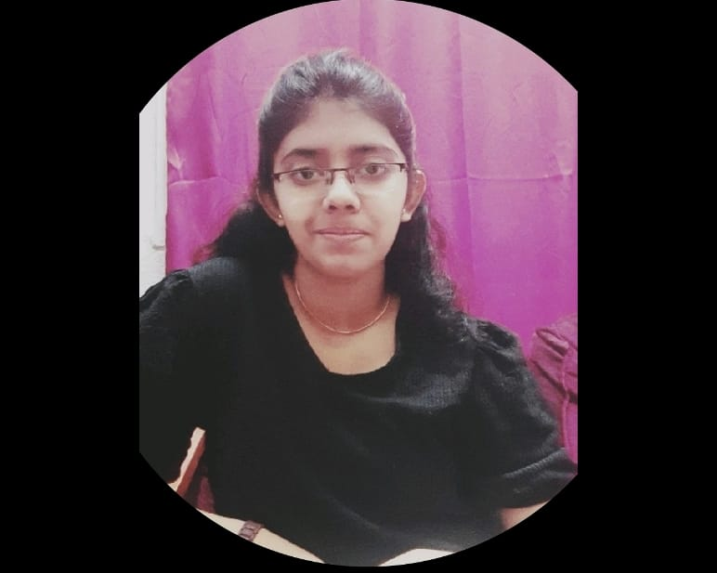


Faces used for checking prototype

Slide 10
Face that gives accession
PHYSICAL RESOURCES
The project team is responsible for the successful execution of the project. Our team is composed of experienced professionals with the necessary skills and expertise to complete the project on time and
within budget
Our project budget is $100,000. This budget includes all expenses associated with the project, including salaries and equipment. We have allocated these resources to ensure that we are able to complete the project within budget
Our project requires a number of specialized pieces of equipment. We will be using [insert equipment and their functions]. All equipment is in good working condition and has been tested and calibrated prior to use
FINANCIAL RESOURCES
HUMAN RESOURCES

