Slide 1
Integrating Kickstart and Windows Deployment Services
George Beech
Stack Exchange, Inc.
@GABeech

Slide 2
Deployment Options
Image Based Deployment
Ghost
RDS
CloneZilla
Manual
Do I need to go into this? Really?
Kickstart/Seeding/etc

Slide 3
Deploying Windows Is No Fun
Image Based Deployment
Updates
SSID
Drivers
HALs

Slide 4
Deploying Windows Gets Better
Windows Deployment Services
Both installer and image based
Completely automated
Scripted
Microsoft Deployment Workbench
Used to manage installed application
Used to manage installation sequences

Slide 5
How Does WDS/MDT Work
WDS
PXE Boot Server
Manages OS install Images
MDT
Manages Task Sequences
Manages Application Packages

Slide 6
MDT is where the power is
Task Sequences
Allows you to fully script your install
Applications
Manage install time applications
Operating Systems
Available install images
Drivers
Packages
Language Packs
Security Updates
.cab & .msu files
Advanced Config
Database connectivity
Selections
Media

Slide 7
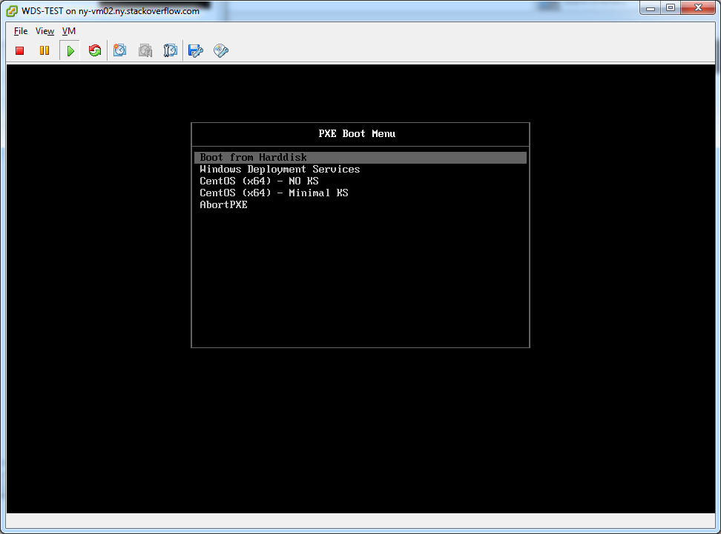
The WDS/MDT Process (in pictures)

Slide 8
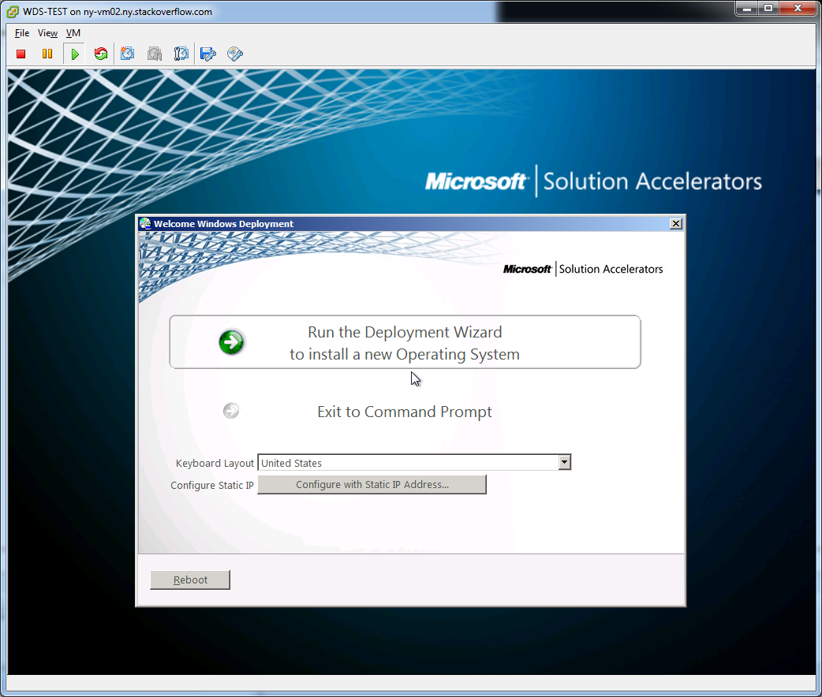
The WDS/MDT Process (in pictures)

Slide 9
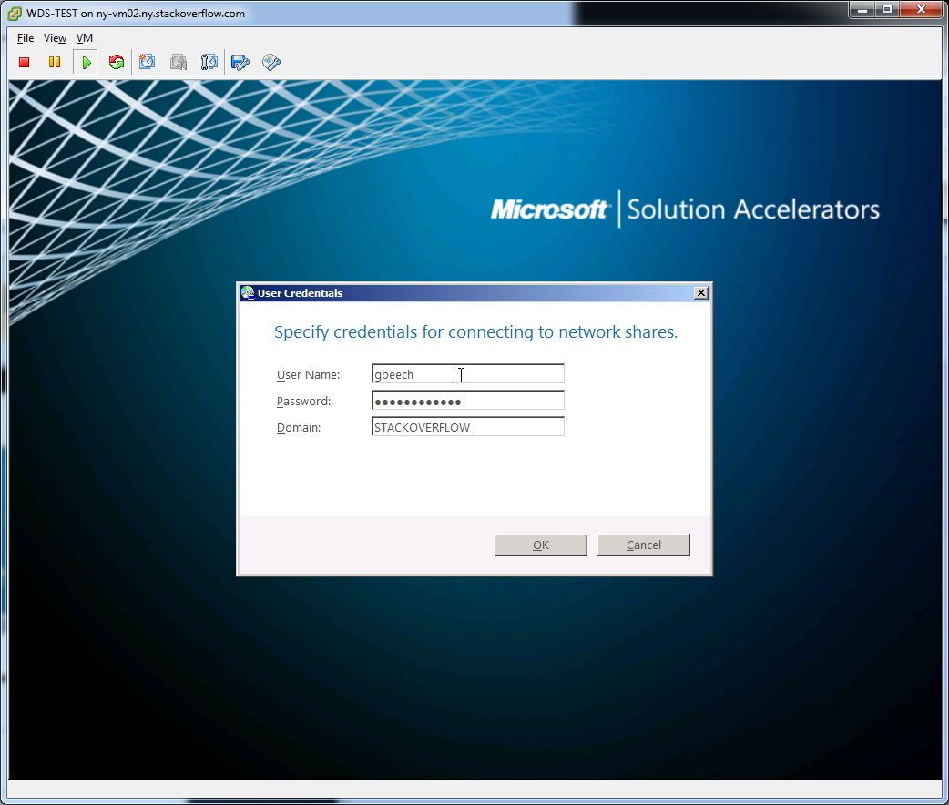
The WDS/MDT Process (in pictures)

Slide 10
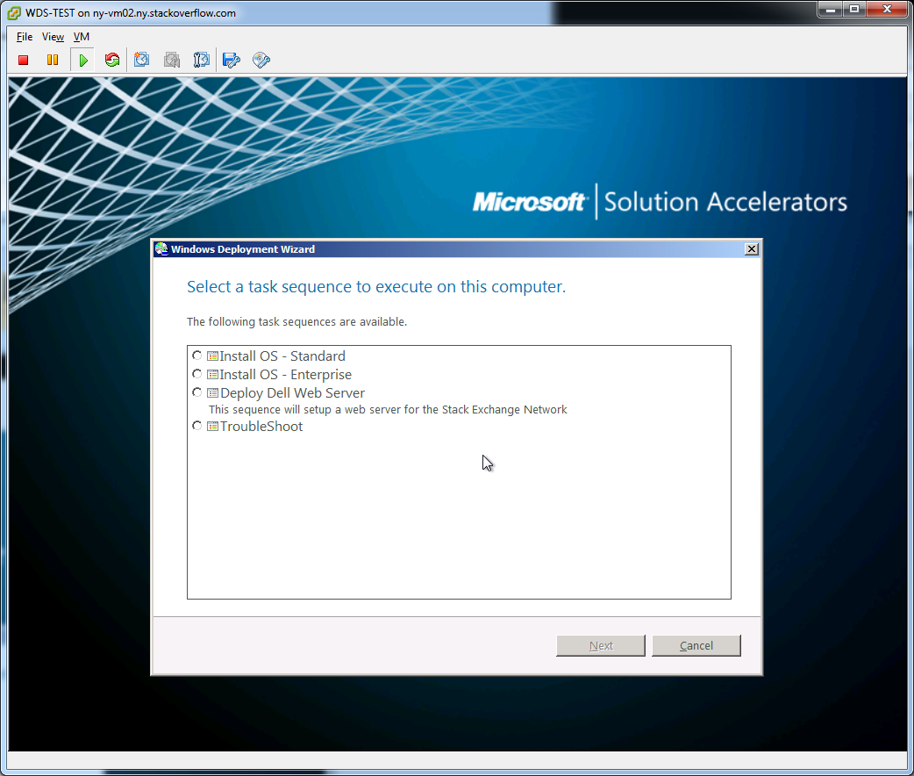
The WDS/MDT Process (in pictures)

Slide 11
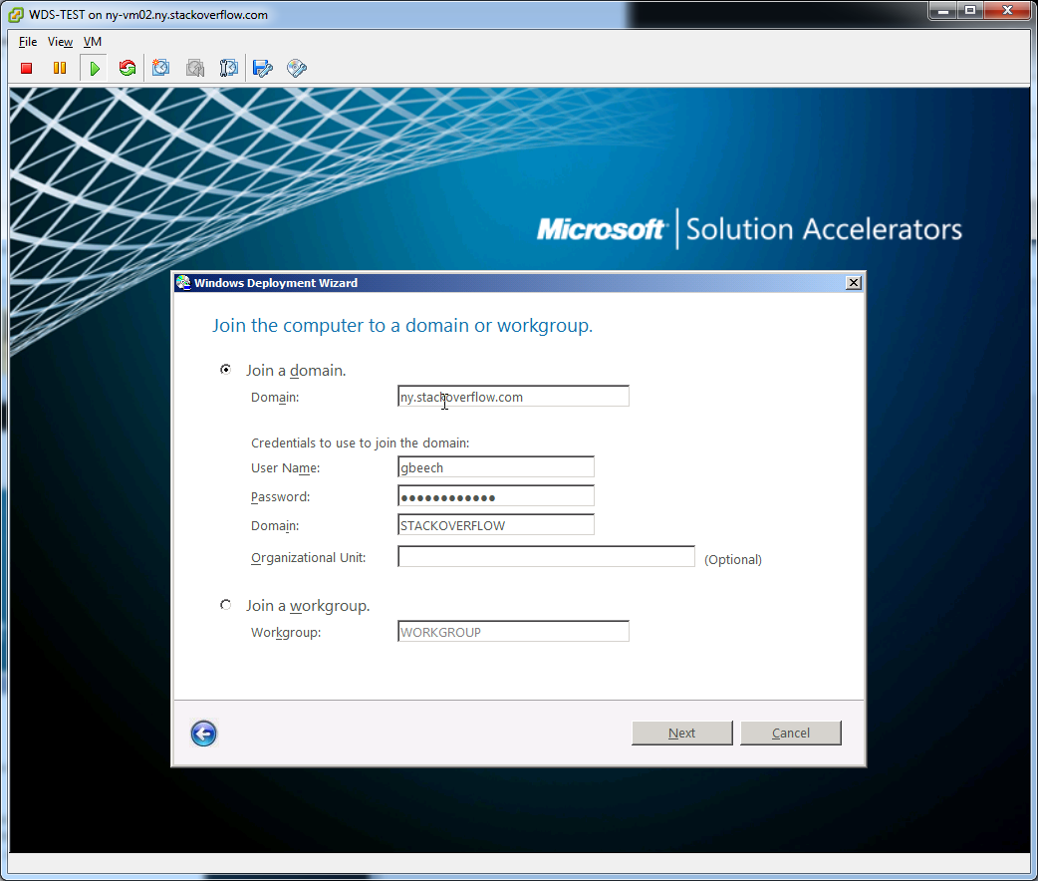
The WDS/MDT Process (in pictures)

Slide 12
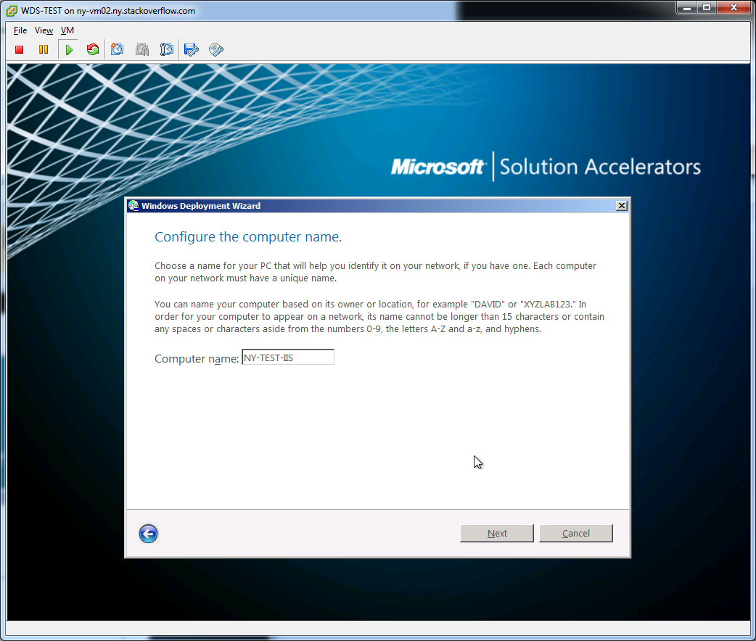
The WDS/MDT Process (in pictures)

Slide 13
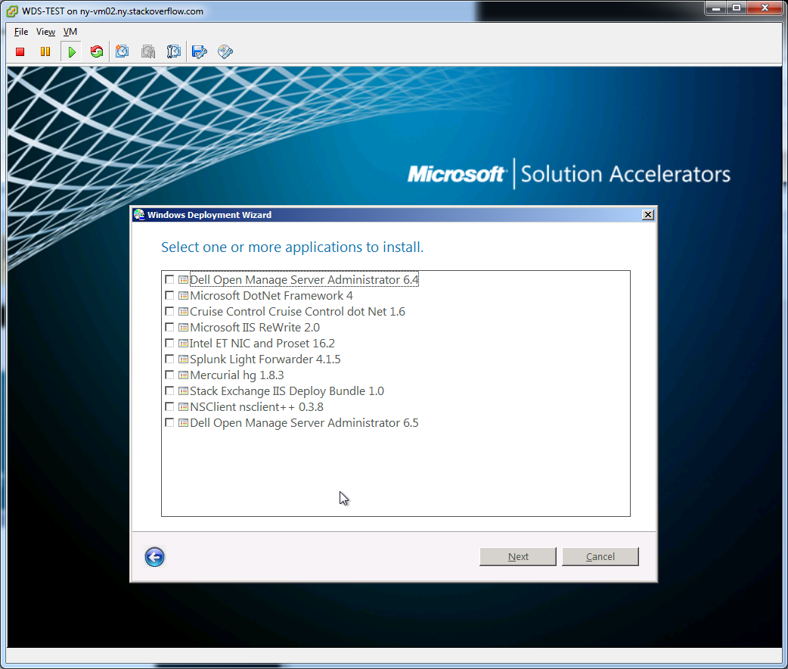
The WDS/MDT Process (in pictures)

Slide 14
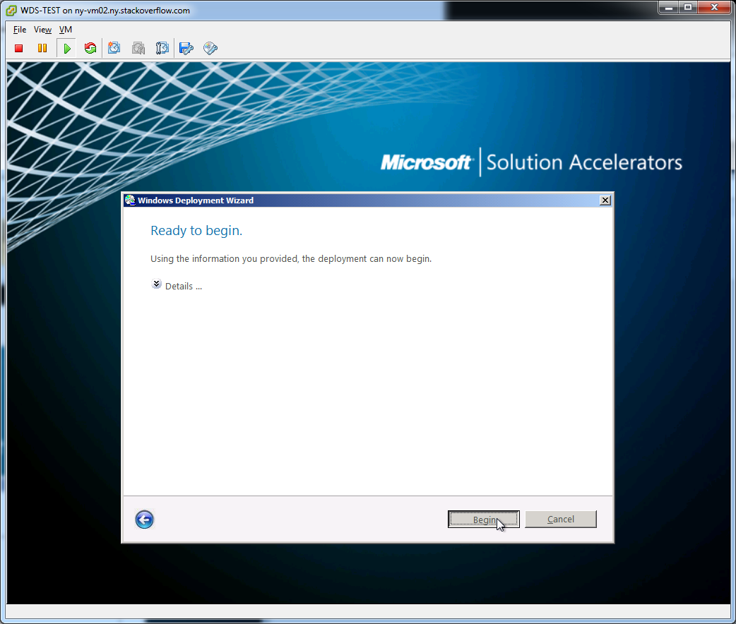
The WDS/MDT Process (in pictures)

Slide 15
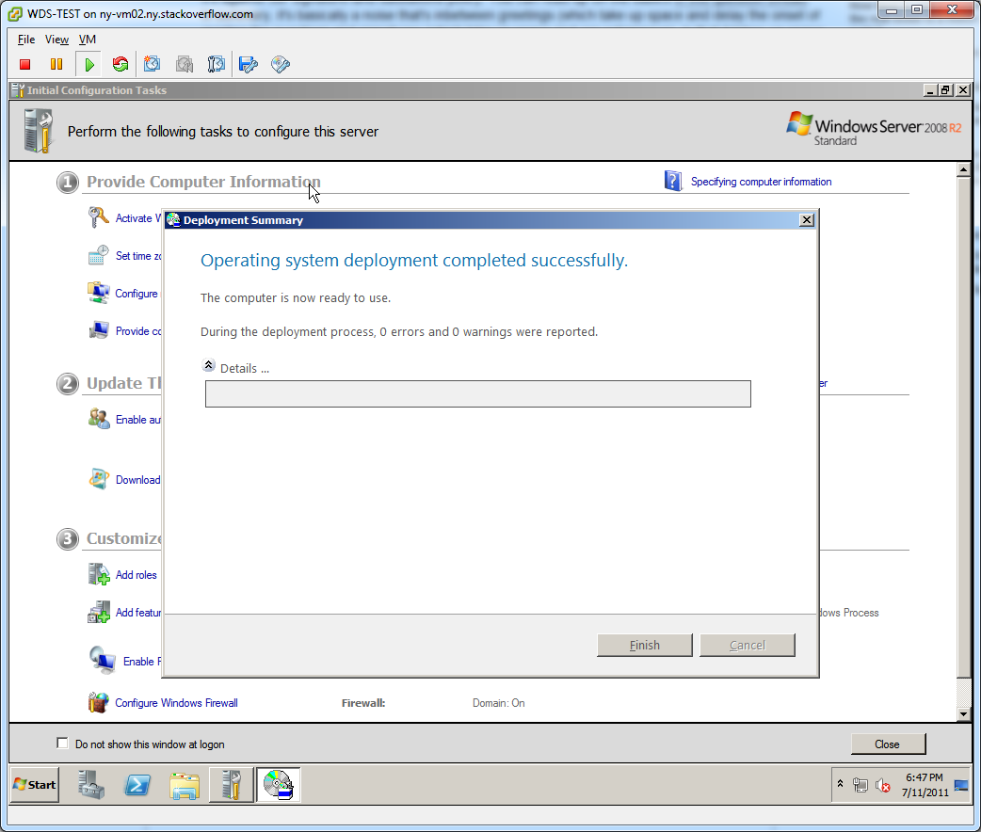
The WDS/MDT Process (in pictures)

Slide 16
WDS customsettings.ini
[Settings]
Priority=Default
Properties=MyCustomProperty
[Default]
OSInstall=Y
SkipAppsOnUpgrade=YES
SkipCapture=YES
SkipAdminPassword=YES
SkipProductKey=YES
SkipBitlocker=YES
SkipLocaleSelection=YES
KeyboardLocale=en-US
UserLocal=en-US
UILanguage=en-US
SkipTimeZone=YES
TimeZone=085
TimeZoneName=UTC
SLShareDynamicLogging=\\ny.stackoverflow.com\DFSRShare\SysAdmin\Logs\Deploy

Slide 17
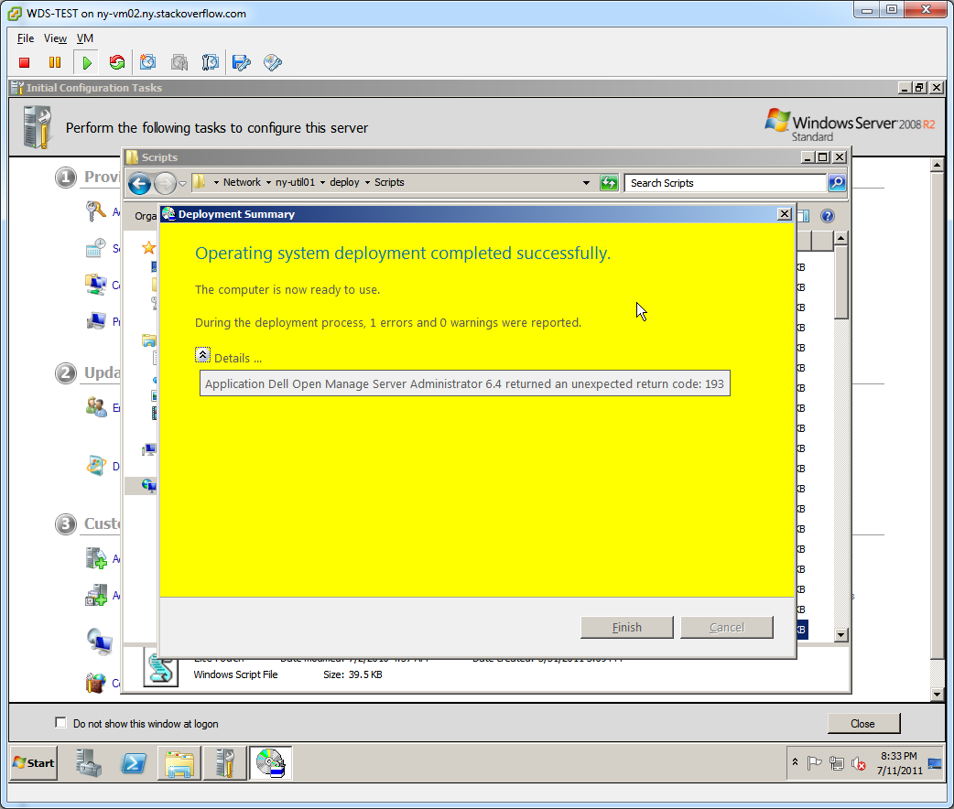
On Error … wha?
WDS error messages are
Not helpful
Confusing
Dumb

Slide 18
First, lets log
Turning on WDS logging
$DeploymentShare\Control\CustomSettings.ini
SLShareDynamicLogging=<Path_to_log>
Lets you log every part of the deploy
Chatty

Slide 19
Second, Read
Reading the log
SMS Standard Log format
Use Trace32 to read
Part of SCCM Toolkit
http://www.microsoft.com/download/en/details.aspx?id=9257

Slide 20
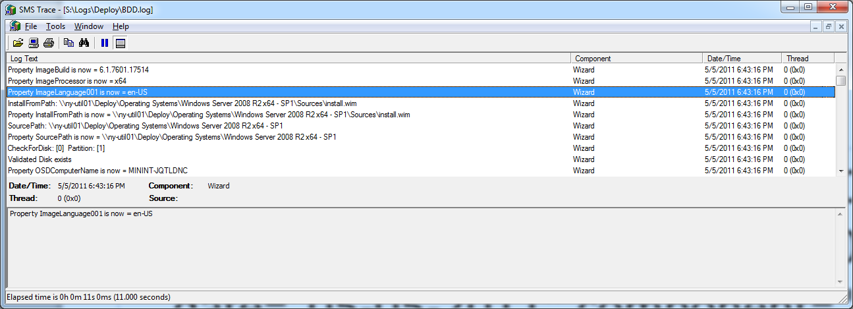
What does the log look like?
<![LOG[Property ImageLanguage001 is now = en-US]LOG]!><time="18:43:16.000+000" date="05-05-2011" component="Wizard" context="" type="1" thread="" file="Wizard">

Slide 21
Kickstart
Used RedHat based distros
Scripted Deployment
Flexible
(somewhat) Easy to get going

Slide 22
How we Setup Kickstart
Local Repositories
CentOS
EPEL
Served via HTTP
Install Files
Kickstart files
Supporting files

Slide 23
Kickstart File
install
url --url http://ny-man01.ny.stackoverflow.com/centos/5/os/x86_64/
lang en_US.UTF-8
keyboard us
%include /tmp/nic-include
rootpw --iscrypted <encrypted_root_pw>
firewall --enabled --port=22:tcp
authconfig --enableshadow --enablemd5 --enablekrb5
selinux --disabled
timezone --utc Etc/UTC
bootloader --location=mbr --driveorder=sda
# The following is the partition information you requested
# Note that any partitions you deleted are not expressed
# here so unless you clear all partitions first, this is
# not guaranteed to work
clearpart --all --drives=sda
part /boot --fstype ext3 --size=100 --ondisk=sda
part pv.5 --size=0 --grow --ondisk=sda
volgroup VolGroup00 --pesize=32768 pv.5
logvol / --fstype ext3 --name=LogVol00 --vgname=VolGroup00 --size=1024 --grow
logvol swap --fstype swap --name=LogVol01 --vgname=VolGroup00 --size=1000 --grow --maxsize=18048
firstboot --enable
repo --name=EPEL --baseurl=http://ny-man01.ny.stackoverflow.com/epel/5/x86_64/
services --enabled ntpd,snmpd
reboot
%packages
@base
@core
keyutils
trousers
fipscheck
device-mapper-multipath
firstboot
mercurial
epel-release-5-4
ntp
net-snmp
%pre
echo "# `grep /proc/net/dev eth| cut -d: -f1 | cut -d' ' -f3` " >>/tmp/nic-include
echo "# auto generated nic setup" > /tmp/nic-include
for nic in `grep eth /proc/net/dev| cut -d: -f1 | cut -d' ' -f3`
do
if [ "$nic" = "eth0" ]
then
echo "network --device $nic --bootproto query " >> /tmp/nic-include
else
echo "network --device $nic --onboot no --bootproto dhcp" >> /tmp/nic-include
fi
done
%post --log /root/ks-post.log
wget -O- http://10.7.0.50/kickstart/generic-configs/get_files.sh | /bin/bash
cp /tmp/nic-include /root/
/usr/sbin/groupadd admins
/usr/sbin/groupadd ssh_permit
/usr/sbin/useradd -G admins,ssh_permit gbeech
/usr/sbin/useradd -G admins,ssh_permit kbrandt

Slide 24
Getfiles.sh
wget -O /etc/krb5.conf http://ny-man01.ny.stackoverflow.com/kickstart/generic-configs/kerberos/krb5.conf
wget -O /etc/ssh/sshd_config http://ny-man01.ny.stackoverflow.com/kickstart/generic-configs/ssh/secure/sshd_config
wget -O /etc/snmp/config/snmpd.conf http://ny-man01.ny.stackoverflow.com/kickstart/generic-configs/snmp/configsnmpd.conf
wget -O /usr/bin/check_dns.sh http://ny-man01.ny.stackoverflow.com/kickstart/generic-configs/snmp/scripts/check_dns.sh
wget -O /usr/bin/snmp_dns_stats.sh http://ny-man01.ny.stackoverflow.com/kickstart/generic-configs/snmp/scripts/snmp_dns_stats.sh
wget -O /usr/bin/snmp_free.sh http://ny-man01.ny.stackoverflow.com/kickstart/generic-configs/snmp/scripts/snmp_free.sh
wget -O /usr/bin/snmp_mB_free.sh http://ny-man01.ny.stackoverflow.com/kickstart/generic-configs/snmp/scripts/snmp_mB_free.sh.sh
wget -O /usr/bin/snmp_mB_used.sh http://ny-man01.ny.stackoverflow.com/kickstart/generic-configs/snmp/scripts/snmp_mB_used.sh
wget -O /usr/bin/snmp_percent_mem_used.sh http://ny-man01.ny.stackoverflow.com/kickstart/generic-configs/snmp/scripts/snmp_percent_mem_used.sh
wget -O /etc/sudoers http://ny-man01.ny.stackoverflow.com/kickstart/generic-configs/sudo/sudoers
wget -O /etc/ntp.conf http://ny-man01.ny.stackoverflow.com/kickstart/generic-configs/ntp/ntp.conf.ny

Slide 25
Fun Side Note
Windows PXE to usable – 2 hours
Centos PXE to usable – 30 mins

Slide 26
Two PXE procedures … One Network
Don’t want to run multiple networks for builds
Linux PXE images aren’t compatible with WDS

Slide 27
SYSLINUX to the Rescue
Windows Version of PXELinux
Replace Windows PXE image with PXELINUX
SYSLINUX Wiki has a great guide to dropping PXELINUX in
http://syslinux.zytor.com/wiki/index.php/WDSLINUX

Slide 28
WDSLINUX Instructions
Extract core\pxelinux.0 com32\menu\vesamenu.c32 and com32\modules\chain.c32 from the syslinux download and put it on your WDS server in $WDS-ROOT\Boot\x86\ and $WDS-ROOT\Boot\x64\(substitute WDS-ROOT for where your WDS root folder is)
In the $WDS-ROOT\Boot\$ARCH folders Rename pxelinux.0 to pxelinux.com
Create a folder named pxelinux.cfg (in the $WDS-ROOT\Boot\x86\ and $WDS-ROOT\Boot\x64\ folder)
In the pxelinux.cfg folder create a text file named default and add the following to it (you can substitute MyMenuBackgroundPicture640x480.jpg for any image you want as your menu background)
Make a copy of pxeboot.n12 and name it pxeboot.0
make a copy from abortpxe.com and rename it to abortpxe.0
Create a folder named Linux (in the $WDS-ROOT\Boot\x86\ and $WDS-ROOT\Boot\x64\ folder)
Open the Windows Deployment Services Console,
Right Click on your Server and Select Properties,
From the Boot Tab change the default boot program for your architecute (x86 and x64 as well) to Boot\x86\pxelinux.com and Boot\x64\pxelinux.com respectively
NOTE: In the WDS included in Windows Server 2008 R2 the UI has changed and you have to use the command line to set the the default boot program.
Thus to change the boot program to pxelinux.com, the wdsutil command line tool has to be used: (do this also for x64 if you have x64 clients also)
wdsutil /set-server /bootprogram:boot\x86\pxelinux.com /architecture:x86
wdsutil /set-server /N12bootprogram:boot\x86\pxelinux.com /architecture:x86
Source: http://syslinux.zytor.com/wiki/index.php/WDSLINUX

Slide 29
PXELINUX default config
DEFAULT vesamenu.c32
PROMPT 0
NOESCAPE 0
ALLOWOPTIONS 0
# Timeout in units of 1/10 s
TIMEOUT 300
MENU MARGIN 10
MENU ROWS 16
MENU TABMSGROW 21
MENU TIMEOUTROW 26
MENU COLOR BORDER 30;44 #20ffffff #00000000 none
MENU COLOR SCROLLBAR 30;44 #20ffffff #00000000 none
MENU COLOR TITLE 0 #ffffffff #00000000 none
MENU COLOR SEL 30;47 #40000000 #20ffffff
MENU BACKGROUND pxe_bg.jpg
MENU TITLE PXE Boot Menu
#---
LABEL local
MENU DEFAULT
MENU LABEL Boot from Harddisk
LOCALBOOT 0
Type 0x80
#---
LABEL WDS - NY-UTIL01
MENU LABEL Windows Deployment Services
KERNEL pxeboot.0
#---
LABEL CentOS (x64) - NO KS
KERNEL /Linux/CentOS/5.6/vmlinuz
append initrd=/Linux/CentOS/5.6/initrd.img ramdisk_size=100000 ksdevice=eth1 ip=dhcp method=http://ny-man01.ny.stackoverflow.com/centos/5/os/x86_64
#---
LABEL CentOS (x64) - Minimal KS
KERNEL /Linux/CentOS/5.6/vmlinuz
append initrd=/Linux/CentOS/5.6/initrd.img ks=http://ny-man01.ny.stackoverflow.com/kickstart/minimal.ks ramdisk_size=100000 ksdevice=eth1 ip=dhcp method=http://ny-man01.ny.stackoverflow.com/centos/5/os/x86_64
#---
LABEL Abort
MENU LABEL AbortPXE
Kernel abortpxe.0
#---

Slide 30
After the Install
GPOs
Puppet
Intel Nic conifig
Docs suck, have to figure out how to script this

Slide 31
Conclusions
You CAN have a fully automated – non-image-based Windows deploy
You don’t need to run multiple PXE servers
WDS … SO much better than RDS
Linux deployment solutions still kick windows ass

Slide 32
Brought to you by the Letter S
WE have a conference!
Scalability.serverfault.com
Oh right, we are looking for a good Admin to expand our SysAdmin team as well

