Slide 1
Open IT Operations and Stack Exchange’s Environment
George Beech @GABeech
Kyle Brandt @KyleMBrandt
PICC 2011

Slide 2
Topics
Stack Exchange and our Philosophy of online community
Our Infrastructure in a Nutshell
Performance is Key
Lessons learned

Slide 3
Stack Exchange
Stack Exchange is a growing network of 48 question and answer sites on expert topics from system administration to cooking to photography and gaming.

Slide 4
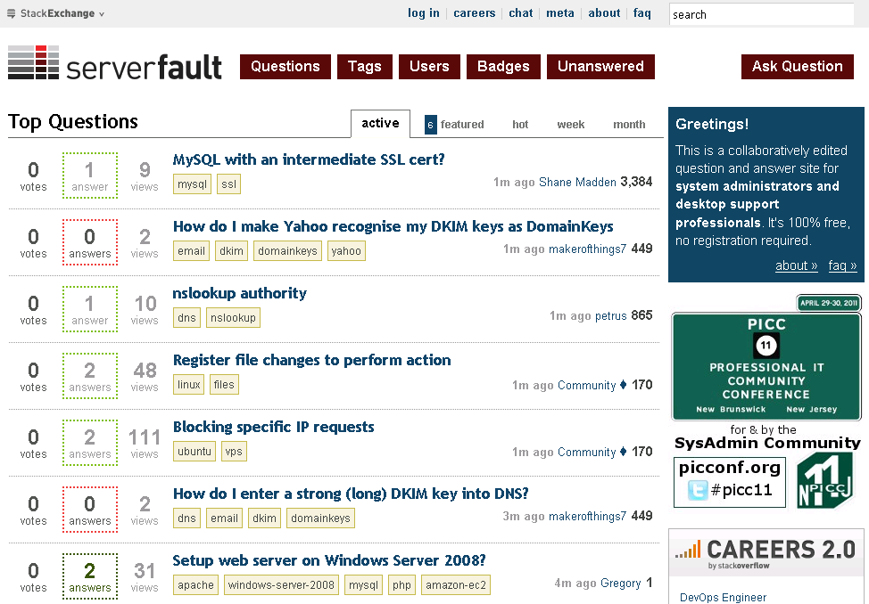

Slide 5
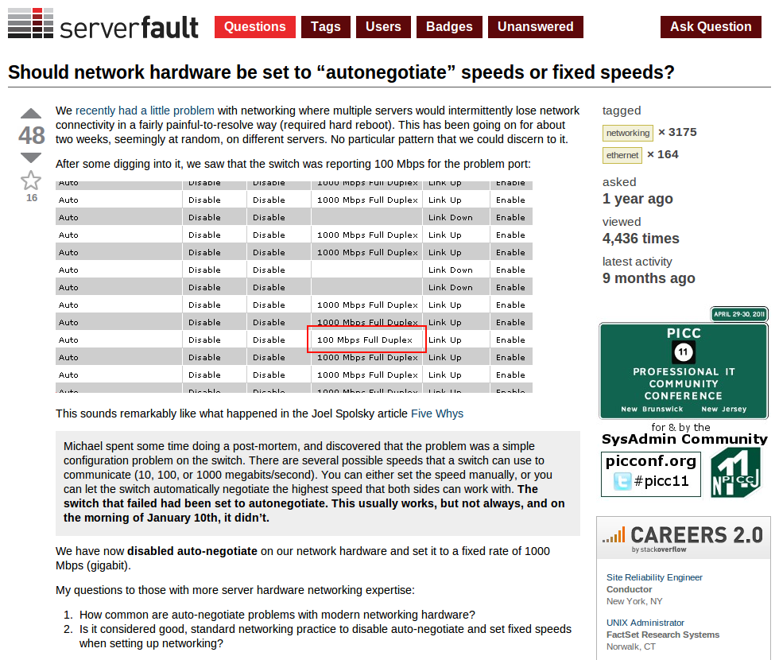

Slide 6
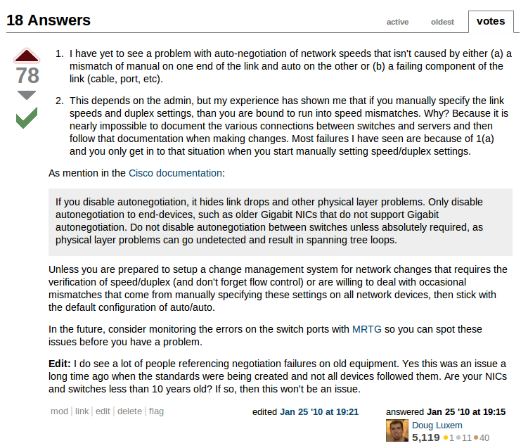

Slide 7
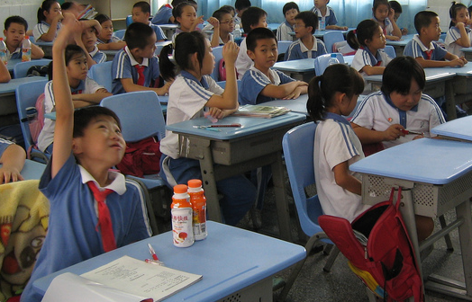
Why Participate online
The System Administration Community Needs you
Its good for you

Slide 8

We Want You
You probably know something almost nobody else does.
You have a unique view.

Slide 9
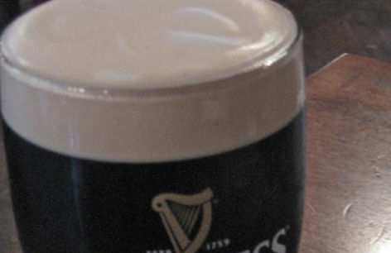
It is good for you
More fluency and facility
Interview Skills
You will become a better writer

Slide 10
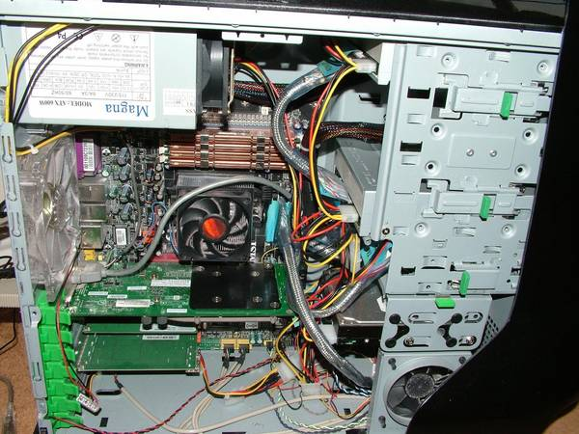
Why have Open IT Operations?
Betters decisions
Helps your field
Security by Obscurity

Slide 11
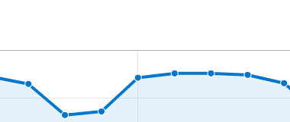
Stack Exchange Stats
120 million page views a month
Network number 250 in the US
800 HTTP requests a second
180 DNS requests a second
1.2 Million “visitors” a day for Stack Overflow a day and 100,000 for Server Fault

Slide 12
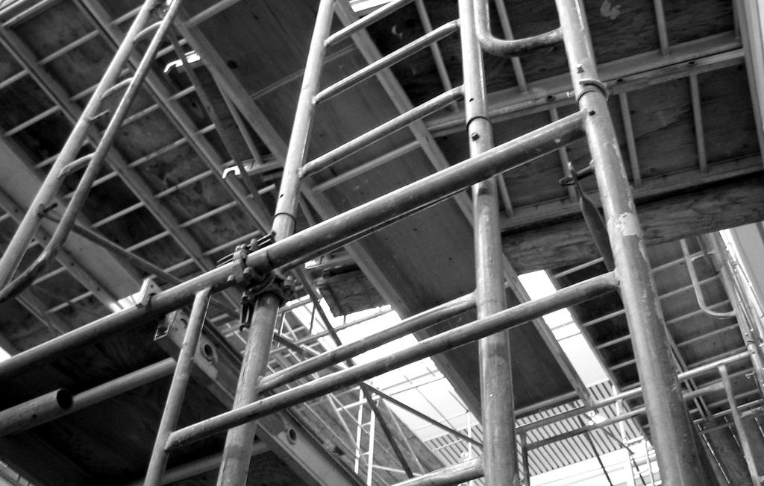
What is Stack Exchange’s Core Built On?
Largely a Microsoft stack using .NET MVC Razor, IIS, and SQL Server
Linux HAProxy and Redis
Awesome Programmers

Slide 13
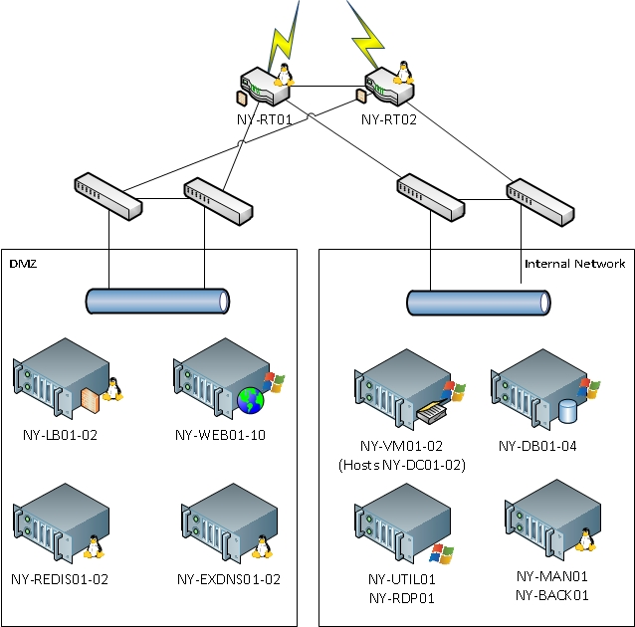
Network Diagram

Slide 14

This is a transition
And it goes on and on my friend

Slide 15
Performance Is A feature
“it is well known that speed correlates with activity, the faster you are, the more there is, and the SLOWER you are, the less there is … bottom line, performance is a feature. And a pretty important one.”
- Jeff Atwood

Slide 16
Common Bottlenecks
Disk
CPU
Network

Slide 17
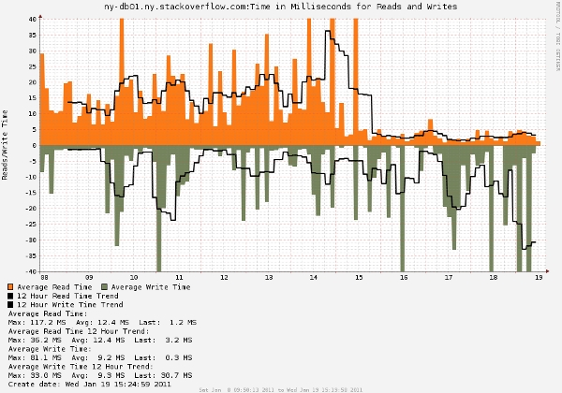
NOT good performance

Slide 18
Disk Performance
For DB servers, this is key
Evaluated Options
SAN
Disk Enclosure
SSD
SSD on PCI (i.e. FusionIO)

Slide 19
DAS Enclosure
Drive Enclosure, Directly Connected
Pro
Large Number of Spindles
Relatively Low cost
Con
Limited Flexibility
Still .. Kind of expensive for what you get

Slide 20
SANs
Pro
Very Flexible
Generally Expandable
Con
BOHICA Expensive
If you don’t have the infrastructure, you need to build it
Highly Specialized Configuration

Slide 21
PCI Flash Drives
Fusion IO Type Drives
Pro
Oh my, that’s fast
Price tolerable
Con
New Tech
No good SPoF Protection

Slide 22
SSDs
Normal, SATA SSDs, well almost
Pro
Fast, we are talking flash here
Flexible
“Cheap”
Con
If you by from your vendor, it’s not worth it
If you don’t buy from your vendor, they aren’t under warranty.

Slide 23
SSD vs Fusion IO
Random Reads — 2 threads, 8 outstanding requests, 64k blocks
 | Fusion IO | Intel X25-E
MB/s | 1424 | 1064
IOPS | 22788 | 17023
Random Writes — 2 threads, 1 outstanding request, 64k blocks
 | Fusion IO | Intel X25-E
MB/s | 632 | 584
IOPS | 10114 | 9337

Slide 24
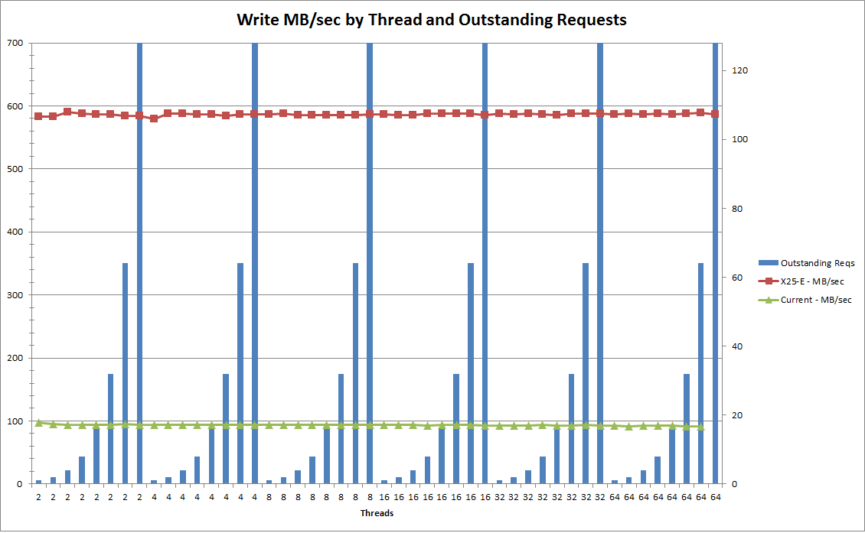
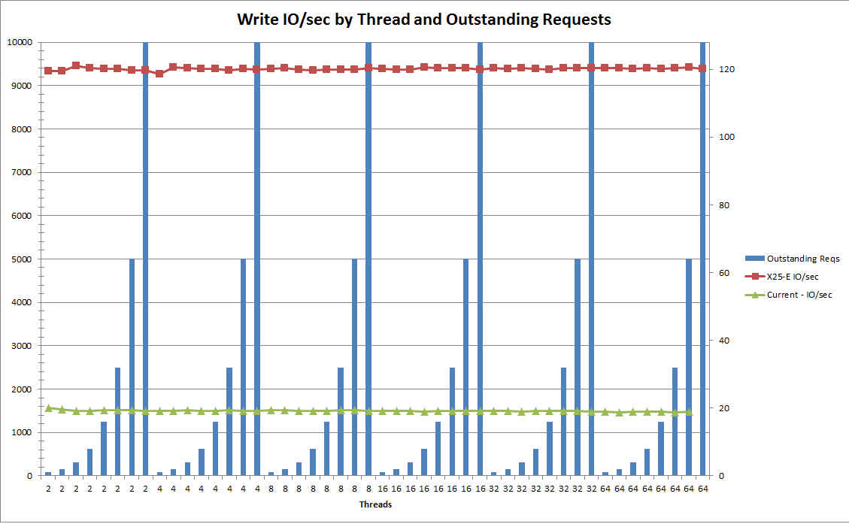
SSDs Win

Slide 25
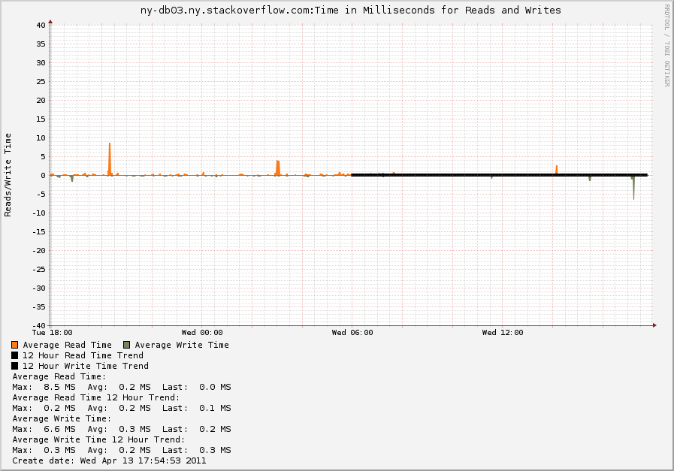
GOOD performance

Slide 26
SSDs Everywhere
Vendor Prices Suck
We have decided that taking on the risk of non-warranty covered disks is ok
Everywhere we can get some performance out of a better disk system, we will put in SSDs
Intel rocks the house
The new 3rd Gen technology from Intel gives you more storage, and better performance in the MLC format

Slide 27
Network Performance
Weird Network Behavior
LOTS of 0 length TCP windows
Random failures
Could not instrument our switches
If your network is slow, it doesn’t matter how fast your machines are

Slide 28
You get what you pay for
Pay the name brand premium
We chose cisco because we know the equipment and IOS
Dell switches are cheap, but you get cheap equipment
No instrumentation
Not true wire-speed gig-E (on all ports)
NO INSTRUMENTATION

Slide 29
Intel I/OAT
Intel® QuickData Technology — enables data copy by the chipset instead of the CPU, to move data more efficiently through the server and provide fast, scalable, and reliable throughput.
Direct Cache Access (DCA) — allows a capable I/O device, such as a network controller, to place data directly into CPU cache, reducing cache misses and improving application response times.

Slide 30
Intel I/OAT (cont)
Extended Message Signaled Interrupts (MSI-X) – distributes I/O interrupts to multiple CPUs and cores, for higher efficiency, better CPU utilization, and higher application performance.
Receive Side Coalescing (RSC) — aggregates packets from the same TCP/IP flow into one larger packet, reducing per-packet processing costs for faster TCP/IP processing.
Low Latency Interrupts — tune interrupt interval times depending on the latency sensitivity of the data, using criteria such as port number or packet size, for higher processing efficiency.

Slide 31

Lessons Learned

Slide 32

Oops, Naming is Hard
I picked the wrong Active Directory Name Twice:
stackoverflow.com – Don’t use an actual domain
ny.stackoverflow.com – To Concrete

Slide 33

Don’t Forget about Power
Overload on Failure
Solution, 2/3rds capacity at power loss for web servers:
Web01: Two Power Supplies in both A and B feeds
Web02: Feed A only
Web03: Feed B only
etc…

Slide 34
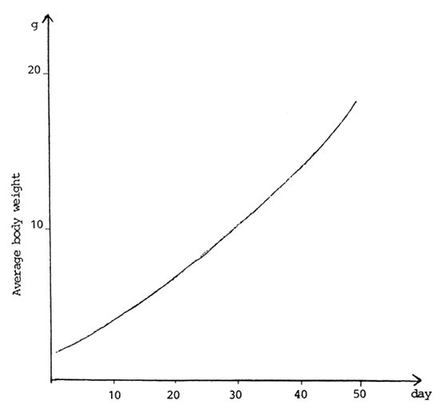
Stay Ahead of the Curve
Over provision your hardware
“Over Provision” your ability to manage your environment.
Make Predictions and Trend

Slide 35
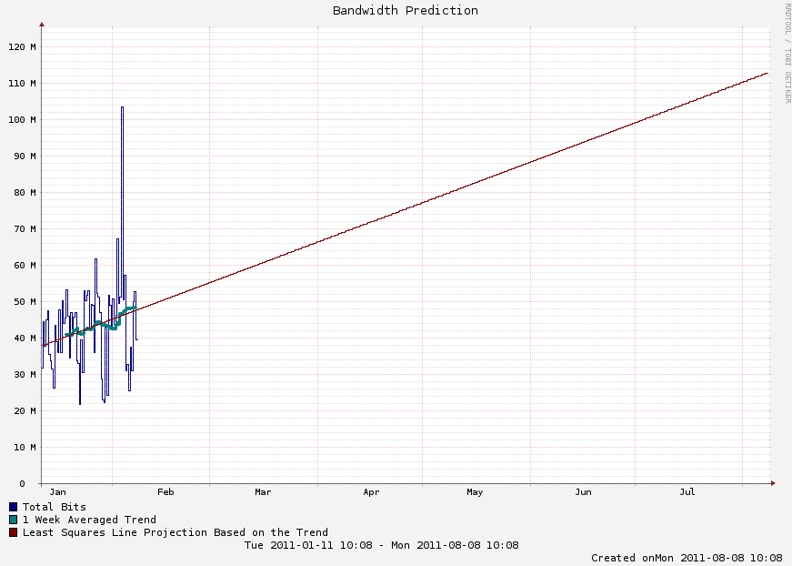
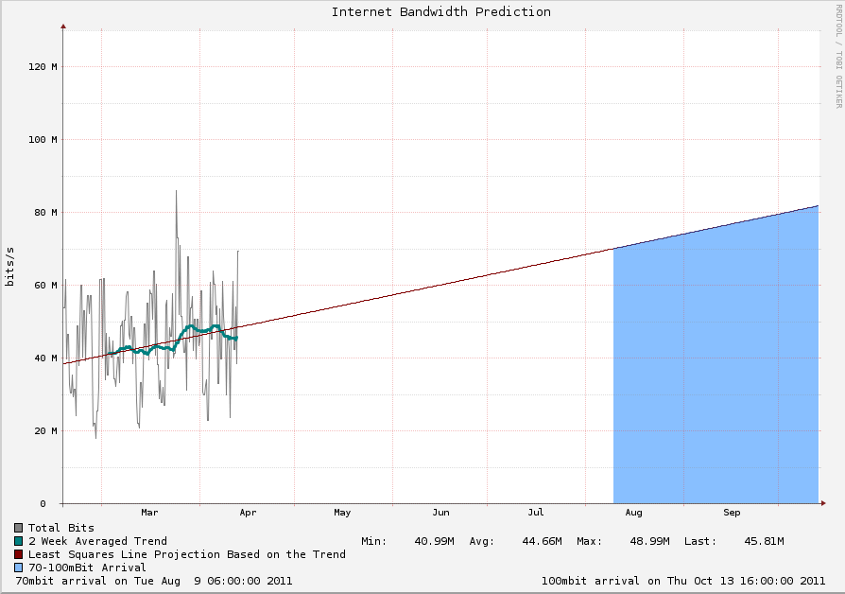
Bandwidth Predictions

Slide 36

Don’t Save
Starting small will end up costing you.

Slide 37

More Data is More Awesome
Collect what you can as soon as possible
When you have data, you can stop guessing
Know what you are looking at., i.e. Max vs Avg

Slide 38
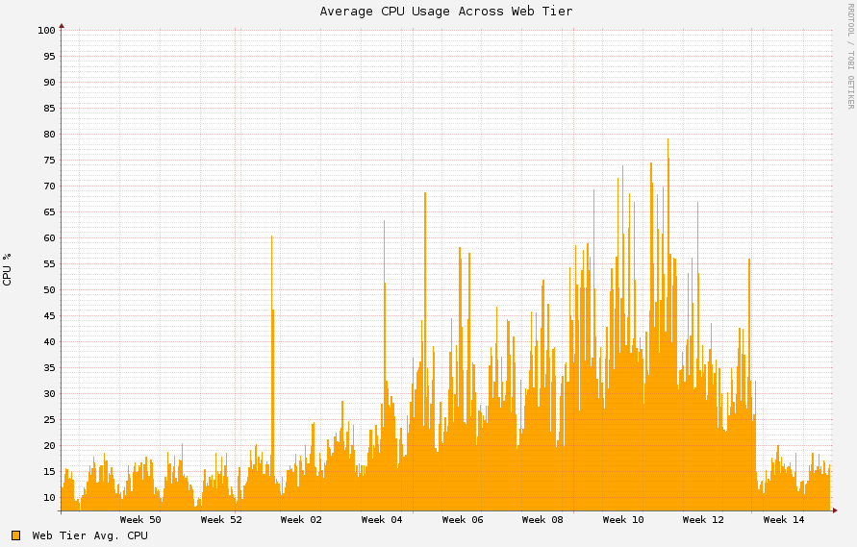
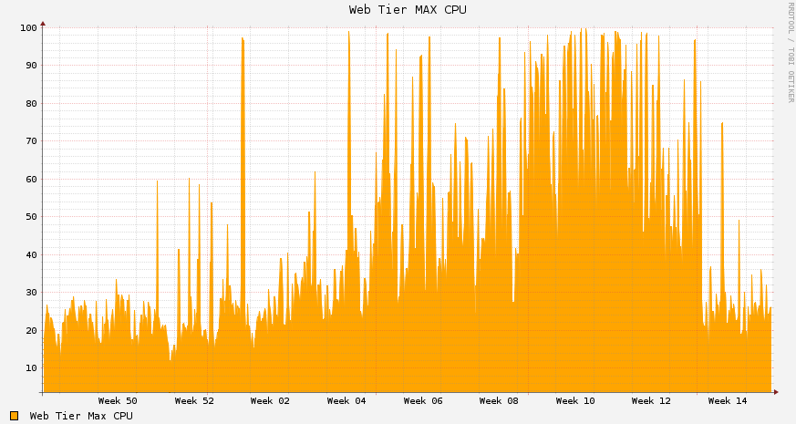
Max Vs. Average
Average CPU: 5 minutes samples of 1 minute average of All servers from web tier
Max CPU: MAX of all 1 minute averages from all servers in the web tier. This reflected when we actually started to see issues

Slide 39
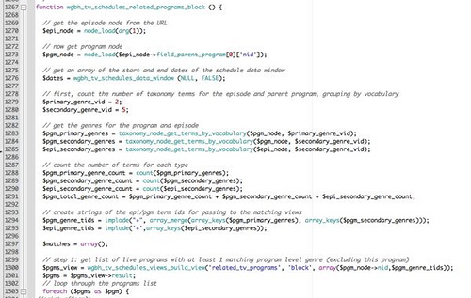
Coding is Not Optional
Communicate better with your developers
There isn’t always the tools that you need
It will hold you back

Slide 40
QUESTIONS?
AMA

Slide 41
Additional information
http://serverfault.com
http://stackexchange.com/about
http://blog.serverfault.com
http://www.intel.com/go/ioat

