Slide 1
Scaling the Windows Stack
George Beech @GABeech
PICC ‘12

Slide 2
Agenda
What is Stack Exchange?
Growth this Year
Our Technology Stack
How we scale
Dealing with Windows stack scaling pain

Slide 3
Stack Exchange
Stack Exchange is a fast-growing network of 87 question and answer sites on diverse topics from software programming to cooking to photography and gaming. We build libraries of high-quality questions and answers, focused on the most important topics in each area of expertise. From our core of Q&A, to community blogs and real-time chat, we provide experts with the tools they need to make The Internet a better place.
stackexchange.com

Slide 4

Growth this Year
Quantcast rank: 250 (April 2011) -> 132 (May 2012)
Pageviews / month: 120M (April 2011) -> 271M (May 2012)
HTTP Requests/s: 800 (April 2011) -> 900 (May 2012)
“Visits”: 1.5M (April 2011) -> 2.9M (May 2012)
SSL: <1%% of requests (April 2011) -> ~3% of requests (May 2012)

Slide 5

Our Core Technology Stack
ASP.NET MVC 3 (RAZOR)
IIS 7.5
Windows Server 2008 R2
Microsoft SQL Server 2008 R2
C# (.net 4)

Slide 6
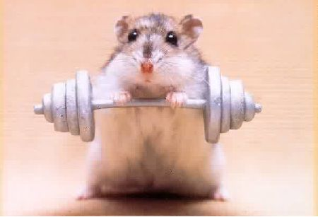
HAMPSTERS!
Reference: http://meta.stackoverflow.com/q/96354

Slide 7
Important Infrastructure
Load Balancing
Haproxy (currently 1.5dev6)
Network Caching
Redis (2.4.10)
Search
Lucene.NET
Monitoring
SolarWinds Orion
Custom Status Console (uses Orion data)

Slide 8
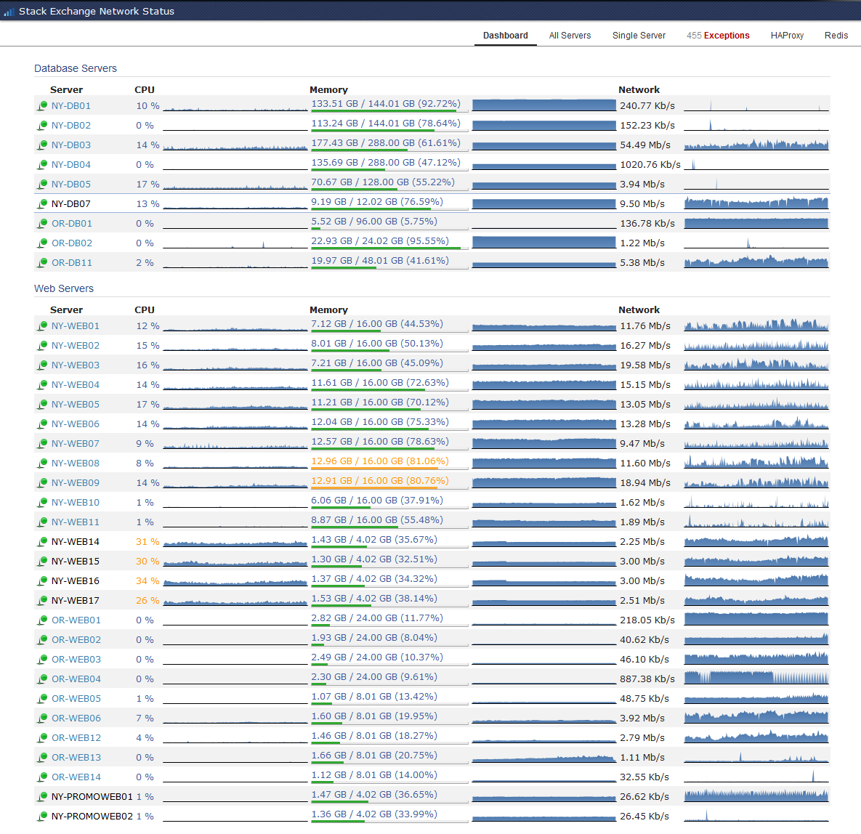

Slide 9
How have we Scaled?
AWESOME Devs
CACHE ALL THE THINGS!
Always be planning for the future
Vertical vs Horizontal
Right Tool, Right Job

Slide 10
Step Back
Last Year
9 Production, 1 Dev Web Server
2 DB (Hot/Warm Pair) - Stack Overflow Dedicated
This Year
9 Production, 2 Dev Web Server
2 DB (Hot/Warm Pair) - Stack Overflow Dedicated

Slide 11
Awesome Devs
SE 1.0 – equivalent to pre-optimized SE 2.0
Optimized SE 2.0

Slide 12
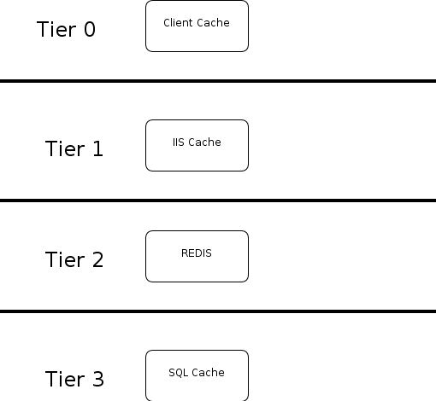
Caching, Caching, Caching

Slide 13
A little more on Caching
Not All Users are equal
90+% of our page views are anonymous
Much more aggressive Caching for anonymous users
Very few anonymous user requests hit the database

Slide 14
Future Planning, it’s IMPORTANT
Game plan what you expect your growth to look like
You’ll be wrong
Design for a reasonable amount of growth – avoid over engineering AND under engineering

Slide 15
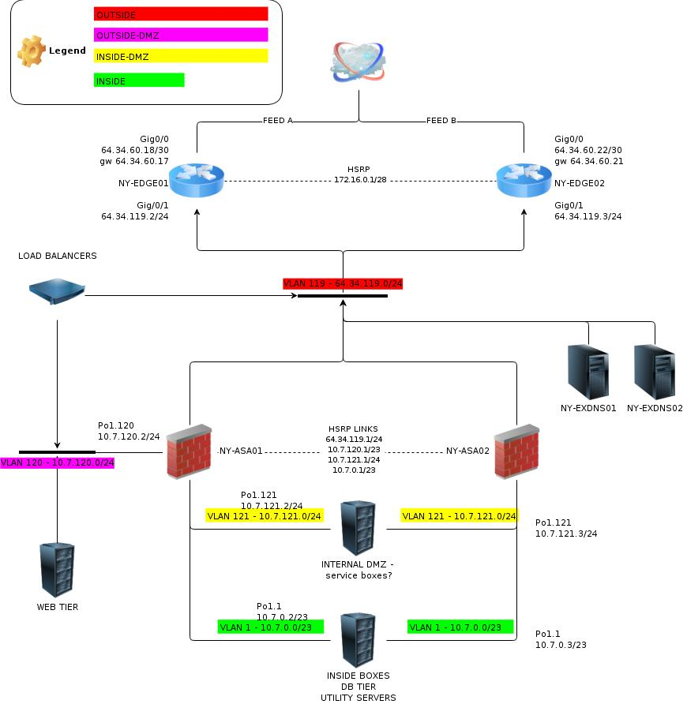

Slide 16
Vertical and Horizontal
They aren’t mutually exclusive
We grow primarily up, but also out when needed
We have scaled our SQL servers up
Added RAM ( Currently 144GB / 288 GB )
SSDs ( Moved to Intel 710 200GB SSDs )
If we needed we would scale our Web servers out

Slide 17

Always Use the right tool
Don’t Use Ports
Don’t try and force a piece of software to be everything
Use specific tools for specific jobs

Slide 18
Scaling Windows can be painful
2008 Does not respect GARP out of the box (there is a hotfix)
$$$$
Garbage Collection Pain
Deployment can be harder

Slide 19
Wait, no GARP?!
“First, a Windows Vista or Windows Server 2008 will not update the Neighbor cache if an ARP broadcast is received unless it is part of a broadcast ARP request for the receiver. What this means is that when a gratuitous ARP is sent on a network with Windows Vista and Widows Server 2008, these systems will not update their cache with incorrect information if there is an IP address conflict.”
http://blogs.technet.com/b/networking/archive/2009/03/30/tcp-ip-networking-from-the-wire-up.aspx

Slide 20

$$$

Slide 21
Garbage Collection
3 tiers
Gen-0
Gen-1
Gen-2
Under Certain situations this can kill you
For more information:
http://marcgravell.blogspot.com/2011/10/assault-by-gc.html

Slide 22
Deployment
Imaging … sucks
Scripted installs are MUCH better now (kickstart/preseed like installs)
Network configuration is still generally painful
WDS + GPO will get you 95% of the way there

Slide 23
Questions?

