Slide 1

When Disaster Strikes
How Stack Exchange Survived Hurricane Sandy

Slide 2

First, Lets Talk DR
DR is not just for Disasters
Design for degraded performance
  Unless you can’t
Plan, Document, Test, Repeat
Communication

Slide 3
Not Just for Disasters?
Maintenance
Upgrades
Human Failure
Physical Issues

Slide 4
Designing Your DR Plan
Most people don’t need 1-1 parity
List Human factors
Must Haves, Nice to Haves, Can do without

Slide 5
Design Your DR Site
Keep things the Same
  Network ID’s (Name & VLAN #)
Location, Location, Location

Slide 6
7 P’s
Proper
Previous
Planning
Prevents
Piss
Poor
Performance

Slide 7
Communication
One of the most important parts of DR
Have a communication Plan
  Who is in charge (information clearing house)
  Multiple Channels
    Phone, IM, IRC, Smoke Signals

Slide 8
Where We Started
Original SO Hardware
  Ok, maybe a few minor upgrades
Backup site was unloved
We couldn’t even Build in Oregon

Slide 9
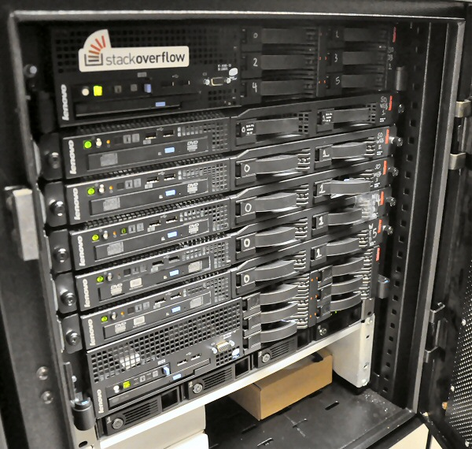
Ok, maybe a few more

Slide 10
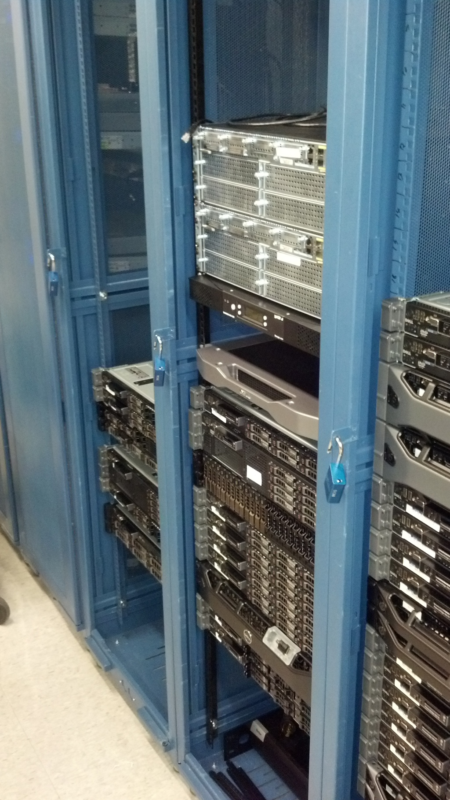
Primary DC

Slide 11
Our DR Plan Before Summer 2012
Pray

Slide 12
Building a DR Plan
Who needs to be involved?
What level of service
  Per service provided
Communication Plan

Slide 13
Challenges to Migrating SE Services
0 Downtime Migration
Syncing Data

Slide 14
Ok, I have a plan ... Now what?
Walk the plan
Break it up into testable units
Test those units
Test the whole plan

Slide 15
Expected vs. Unexpected
Unexpected
  Natural Disaster
  Fiber Cut
  UPS Catches Fire
Expected
  Upgrades
  Maintenance

Slide 16
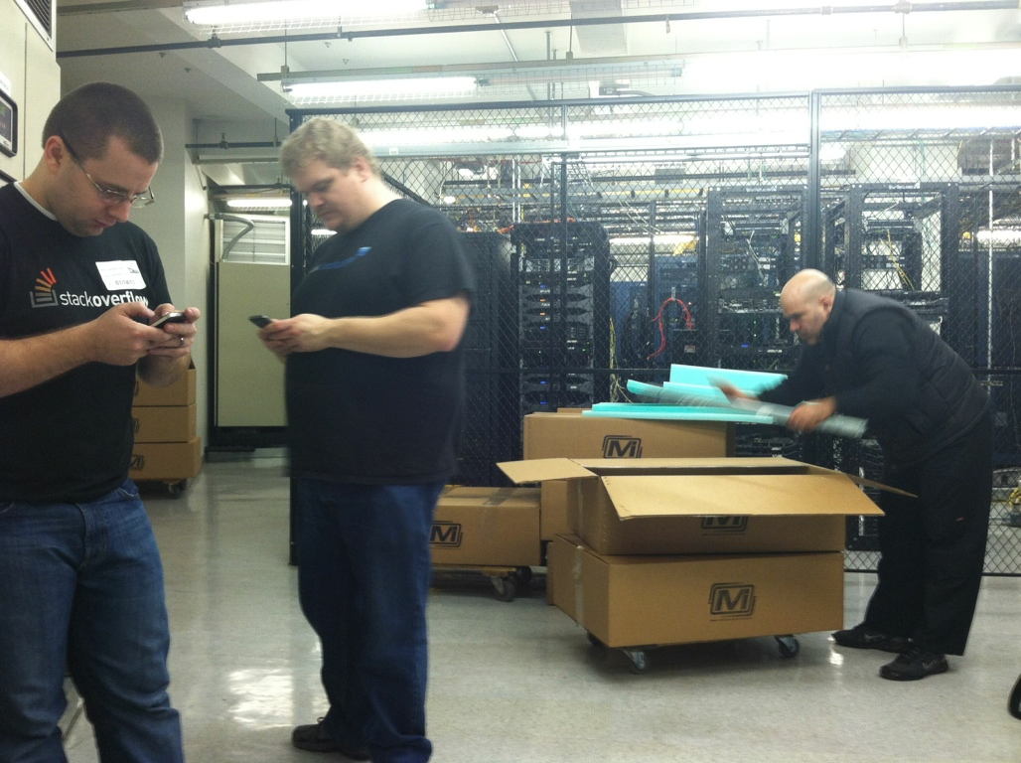
Expected: Datacenter Move

Slide 17
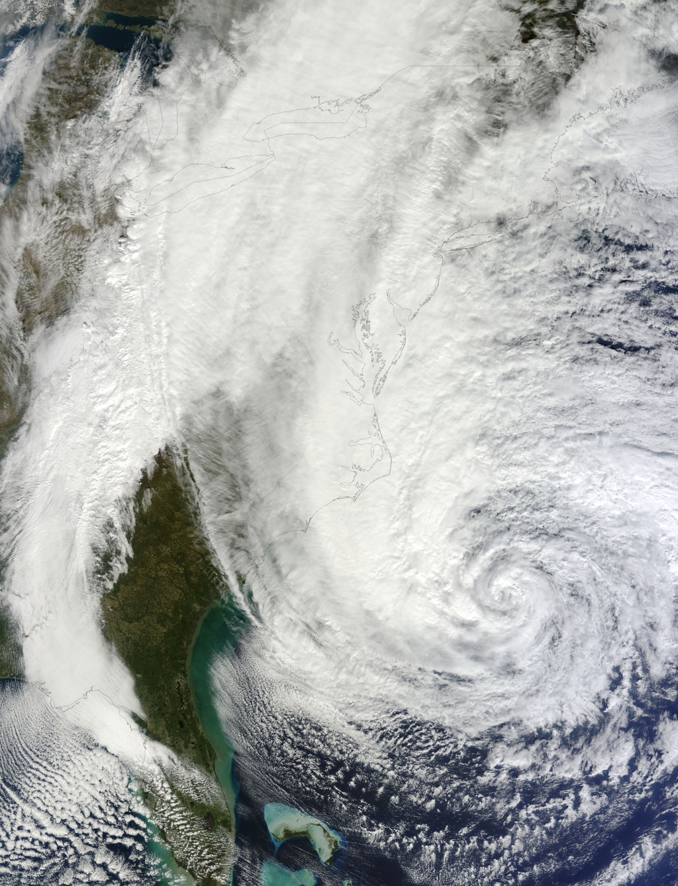
Unexpected: SANDY

Slide 18
What was Sandy
Hurricane Sandy was the deadliest and most destructive hurricane of the 2012 Atlantic hurricane season, as well as the second-costliest hurricane in United States history. Classified as the eighteenth named storm, tenth hurricane and second major hurricane of the year, Sandy was a Category 3 storm at its peak intensity when it made landfall in Cuba. While it was a Category 2 storm off the coast of the Northeastern United States, the storm became the largest Atlantic hurricane on record (as measured by diameter, with winds spanning 1,100 miles (1,800 km)). Preliminary estimates assess damage at nearly $75 billion (2012 USD), a total surpassed only by Hurricane Katrina. At least 285 people were killed along the path of the storm in seven countries. The severe and widespread damage the storm caused in the United States, as well as its unusual merge with a frontal system, resulted in the nicknaming of the hurricane by the media and several organizations of the U.S. government "Superstorm Sandy"
From Wikipedia (http://en.wikipedia.org/wiki/Hurricane_sandy)

Slide 19

Where Was I When it started?
Irene “Called Wolf”

Slide 20
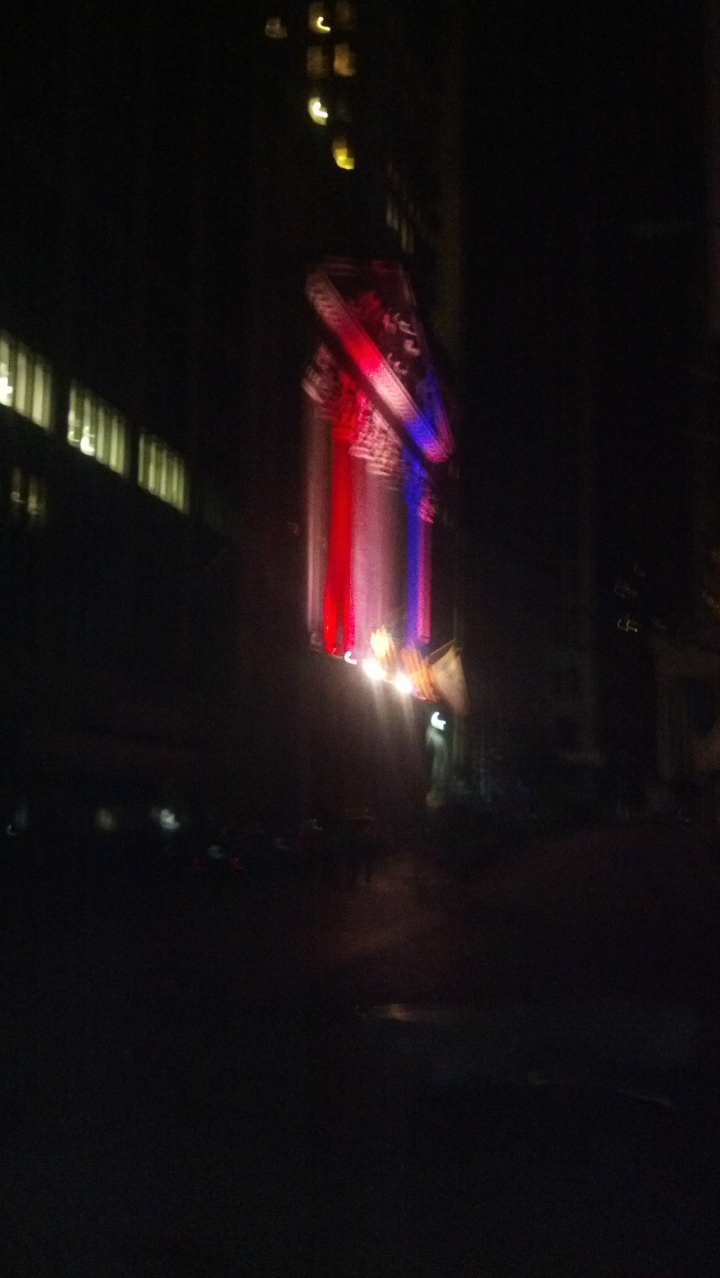
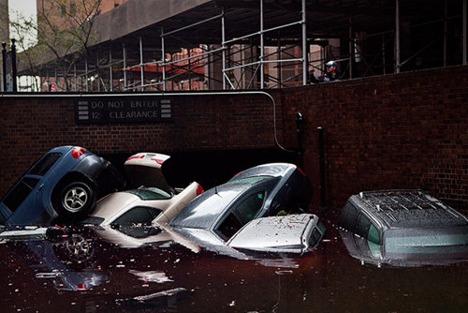
Lower Manhattan

Slide 21
75 Broad
Basement and Sub-basement flooded
20,000 Gallon Fuel tank ripped off moorings
Heroic effort by the staff of four companies

Slide 22
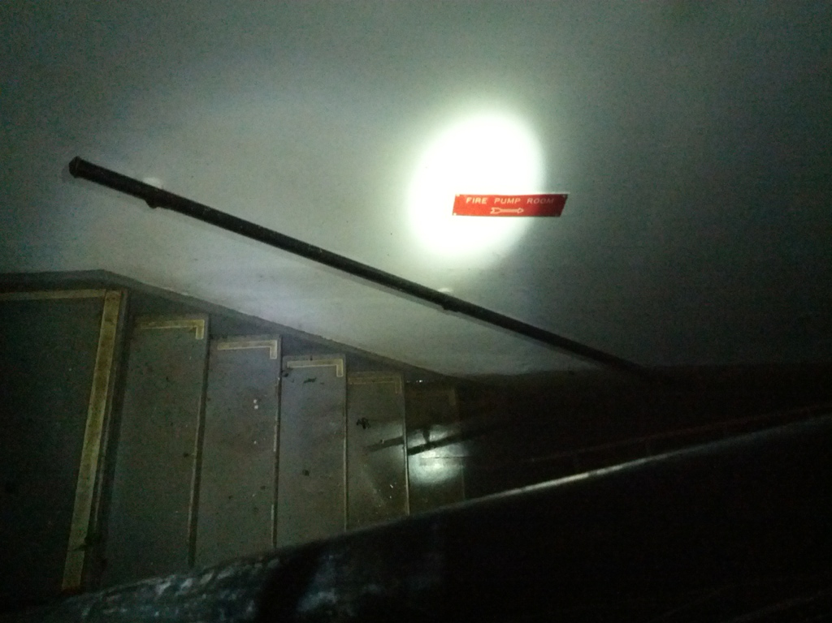
75 Broad Photos

Slide 23
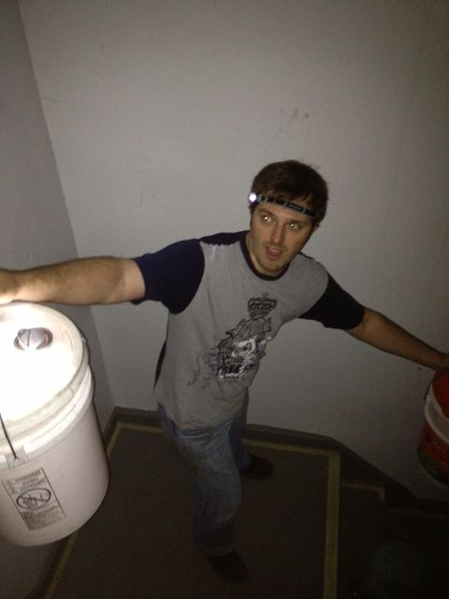
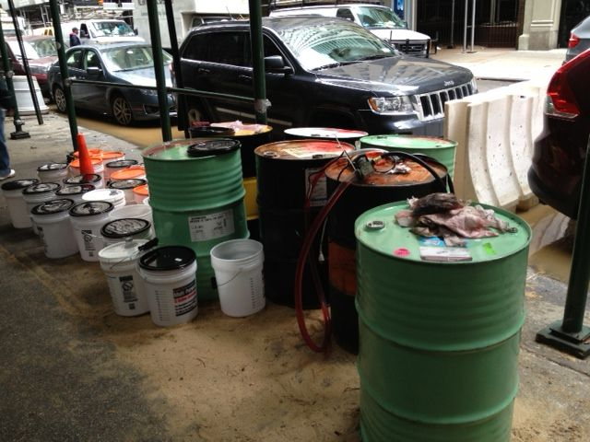
Bucket Brigade
Kept the 5000 Gallon Feeder tank full

Slide 24
So, What did we do?
First, we got really lucky
Heard from Internap (also in 75 Broad) the Generator was about to fail
Initiated DR Plan, moved all services to Oregon

Slide 25
What was Involved?
~10 people working together
First, Migrate SO, and SE stack
Move Careers, and blog network

Slide 26
Database
MSSQL Server
  “Always”-On (2012)
~400GB
~200 Databases

Slide 27
Web
IIS
  Web.config
HAProxy
HAProxy Logs
Builds

Slide 28
Support Services
Caching Tier
  Redis
Search
  Lucene/ElasticSearch
Monitoring

Slide 29
DNS Migration
Failover Strategy was to change DNS records
  TTLs
Many Domains and Hundreds of Records

Slide 30
AD DC’s
Long term shutdown
  What happens when a DC is shutdown for an extended period of time
FSMO Roles

Slide 31
Failures
Multiple Stop and Starts
Failures to communicate
Under estimation of severity of the issue
Manual Processes where still in place

Slide 32
Successes
All Critical Services did not experience downtime
  RO Mode for a few mins
100% Service restoration within 3 days (in OR)

Slide 33
Questions?

