Slide 1

SketchUp Getting Started Videos
These SketchUp video tutorials are provided by the makers of SketchUp, there are many more videos on their YouTube channel.
youtube.com/user/SketchUpVideo
If you are unfamiliar with the basics of SketchUp we highly recomend that you watch these videos before procceding.
→

Slide 2
Part 1 – Getting started Part 2 – Offset tool and follow me Part 3 - Inference, materials, 3D warehouse Part 4 – Groups and components

Slide 3


SketchUp2Room Basic Tutorial
→
Download the Sketchup2Room distribution here:
github.com/lisa-lionheart/sketchup2room
You can download SketchUp 2014 Here:
sketchup.com/download
SketchUp2Room project Structure:
bin: Where the executable is stored.
source: The C++ source code.
examples: Couple of example files for you to look at.
tutorial: This tutorial
workspace: A place for you to start creating your own rooms.
We highly recommend that you look around the examples and tutorial SketchUp files

Slide 4
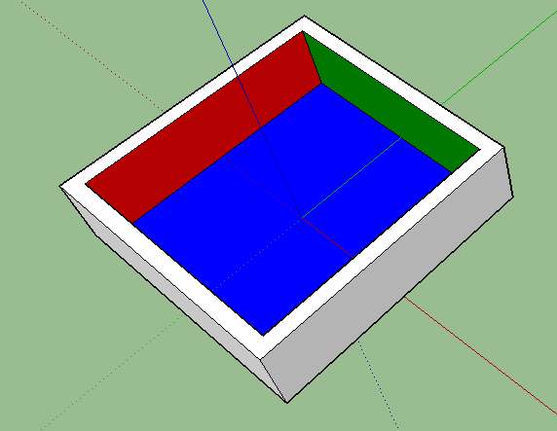
Tutorial 1: Basics of how to structure your SketchUp project
Once you can have SketchUp installed and the SketchUp2Room project downloaded. You can start creating JanusVR rooms. There are a lot of good tutorials on YouTube that explain how to use SketchUp so we won’t cover those here.
Creating a simple room with 4 walls and a ceiling will just work. The only caveat is that sketchup2room will ignore faces with the Default material. For a face to be exported you must use the paint bucket to set the faces material.
Now save your file, save it into the workspaces directory and then double click on the build command file. A terminal window should appear and a build directory will be created with the JanusVR html and associated assets.
Tut1_example1.skp →

Slide 5
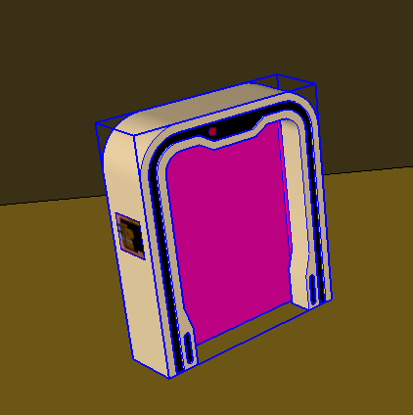
You can now add an entry to your JanusVR workspaces.txt to the html file in the build directory and visit the room in JanusVR. :D
The entrance portal will be placed at the origin (where the axis’s meet) and will be facing along the green (x axis).
This is fine but if we want to change where the entrance to this room is and make links to other JanusVR rooms. For that we need components.
For now we will use and existing component but later on we want to create our own.
From the file menu, choose File -> Import go to examples/models and select arch.skp. A holodeck arch based on TNG will be selected and you can position it wherever you like in the room.

Slide 6
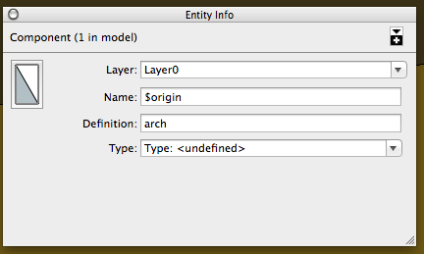
Once you have positioned the arch, make sure it is selected and right click and choose “Entity Info”. A toolbox will be displayed with information about this instance of the arch component.
The important parts here are “name” and “definition” name is unique to this copy (instance) of the arch where as arch is the name of the component all copies will have the same definition name. When sketchup2room encounters a component in a SketchUp file it will export the component as a separate OBJ file from the main room geometry.
By setting the name of an instance we can instruct sketchup2room to do different things. For now change the value of the name of the arch to $origin this will instruct SketchUp to set the origin to the location of the arch.

Slide 7
Save the file and run the build command. When you visit the room in VR now, the entrance should appear in the archway.
When you create your own components to be used with JanusVR its important to note that the the portal will be created on the components origin and will be facing along the components local x (green) axis. Sketchup2Room uses the green axis for setting all directions.
When you build large complex rooms it’s a very good idea to break your file into different components so that you can control how your level is loaded. Things that don’t need to be drawn immediately like furniture or statues should be in components but things like the floor and walls that need to give the player a sense that there is something there should not be components
Tut1_example2.skp →

Slide 8
Part 2: Adding some links
Now that we have a basic room setup with an entrance portal we should some links.
We start by creating a new instance of the arch, as we have already imported the arch component we do not import it again. Instead choose from the menu Window-> Components a dialog will appear and in that will be an icon for the arch component. In future you will use this dialog a lot to place your own pre made components into your rooms.
Click on the arch icon and then move your cursor back to the main window, the familiar arch should appear beneath the cursor. Click to place a new instance in the room and position where you want it with the move/rotate tools.
Now, to make this new instance of the arch component into a link we need to change the instance name, right click with the arch selected and choose Entity Info.
Set the name to the following: “$link|title=This is a link|http://www.vrsites.com”
Note the use of pipe character “|” to separate declarations, this character is used throughout sketchup2room to separate definitions
Tut1_example3.skp →

Slide 9
Advanced Links As you may have guessed, there are various options like the title field you can set on an link. The general for all skecthup2room commands is:
$<typename>|<options>|<value (url)>
Where the options and value section are optional and depend on the type.
Here are the complete list of options for the $link type:
Name | Value | Description
title | String | Sets the title of the link
noglow | None | Disables the glow effect
notext | None | Draws no text on the door
autoload | None | Automatically load the target room
col | RGB | Sets the colour of the glow effect
thumb | String | Path to the thumbnail image, will be copied to build directory
size | width height | Set the size of the portal. Default: 1.8 2.5

Slide 10


Part 3: Let there be light
So now we have a room, it has an entrance, several links to other rooms. But it feels drab because everything is 10% lit.
First import a new component, Choose File -> Import and select examples/models/placeholders/!sun.skp, place the sun icon anywhere you like. The “!” at in front of the name means this component is a “placeholder” it will not be visible in the room when compiled.
Set the name of the sun icon to “$ambient|0.5 0.5 0.5”, this will set the default light level for the room. Play around with the value to see what effects it has on the room.
Now import examples/models/placeholders/!lightbulb.skp Create a couple of instances of “!lightbulb” and position them in your scene set their names to:
$light|5 5 5
$light|0 5 0
$light|0 0 5
$light|0 0 5
Tut1_example4.skp →

Slide 11
Properties for $light entities
Like links there are various options you can set:
Name | Value | Default | Description
func | String | “pointlight” | Specifies a custom light function to use, currently the only supported values is “torchlight” which will create a flickering effect
range | Number | 20 | Maximum distance (meters) to apply the light, to increase performance set this to the minimum that does not cause graphical artifacts. Alternatively you can set this to a lower value to achieve some interesting effects
falloff | Number | 2 | Specifies the falloff power factor, where 1=1/x 2=1/x² 3=1/x³
cond | GLSL Expresion | “true” | Allows you to enable disable the light with some custom condition. Perhaps based on the proximity of the player enable the light?

Slide 12
Additional properties for $spotlight entities
As well as $light you can create directional spotlights which will emit light from the components green axis.
These support all the properties of the $light entity as well as these additional properties:
Name | Value | Default | Description
outerCone | Number | 40^{O} | The angle that light is emitted from the spot light
innerCone | Number | outerCone - 2^{O} | The angle, that within receives maximum intensity. The difference will have a gradual fall off to 0 when it reaches the outer cone
Tut_spotlight.skp →

