Slide 1
▸ GAI OBSERVE LLC · POC LEARNING LAB
Six control patterns for enterprise agentic AI
The Business Case — POCs 01–06
Scripted demonstrations on synthetic data. Every figure in this deck is ILLUSTRATIVE — drawn from runs recorded in the public repository, quoted with that label.
GAI-Engineering/poc-learning-lab · MIT (code) · CC BY 4.0 (content) · October 2026

Slide 2
THE MARKET — WHY CONTROL IS THE PRODUCT
$2.58B → $24.5B
Enterprise agentic AI market, 2024 → 2030 (Grand View Research) — 46.2% CAGR. The spend is arriving whether the controls are ready or not.
40% of enterprise apps
will feature task-specific AI agents by the end of 2026 (Gartner, August 2025) — up from less than 5% in 2025.
>40% cancelled
of agentic AI projects will be cancelled by the end of 2027 (Gartner, June 2025) — cost, unclear value, inadequate risk controls.
$1.5B → $41.8B
Contact-center AI spend, 2025 → 2032 (Omdia) — the buyer this lab designs for.
The gap
Growth and cancellation are the same market read twice. The six patterns in this lab are the controls that decide which side of it a deployment lands on.

Slide 3
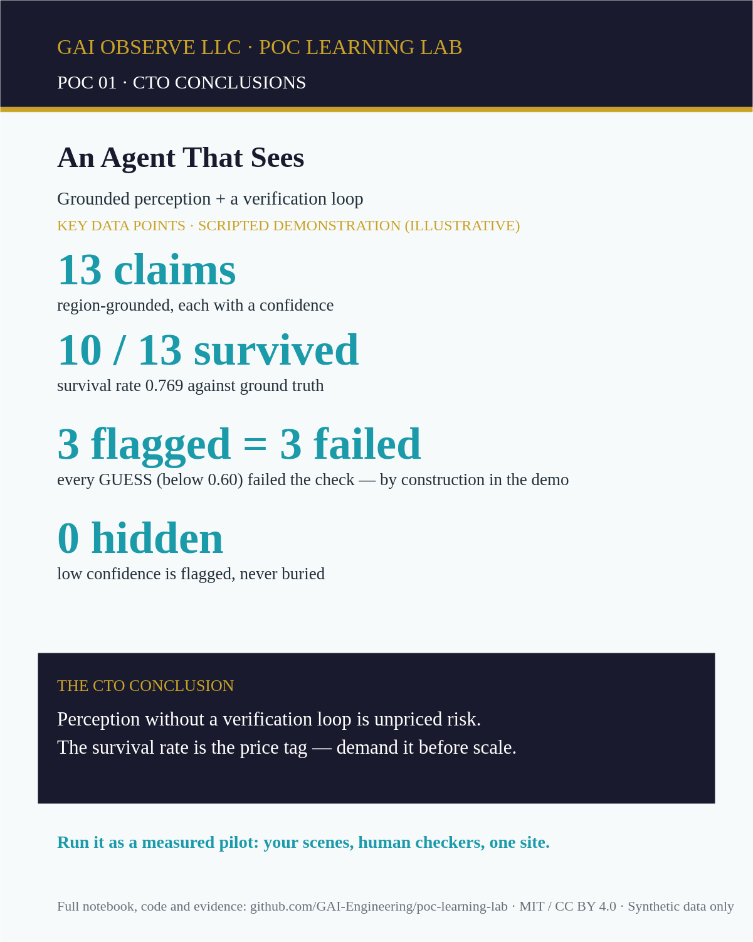
PATTERN 1 — GROUNDED PERCEPTION WITH A VERIFICATION LOOP (POC 01)
An agent that checks its own claims before anyone acts on them.
• 13 region claims · 10 survived verification · survival rate 0.769
• Flag rule: confidence < 0.60 = GUESS (flagged, not hidden)
• The 3 failed claims are exactly the 3 flagged (0.42 / 0.35 / 0.48) — in the demo this holds by construction; the lesson is the loop, not the rate
• Flip one verification outcome and the headline moves to 0.692 — try it live in the notebook (§ "Change one outcome")

Slide 4
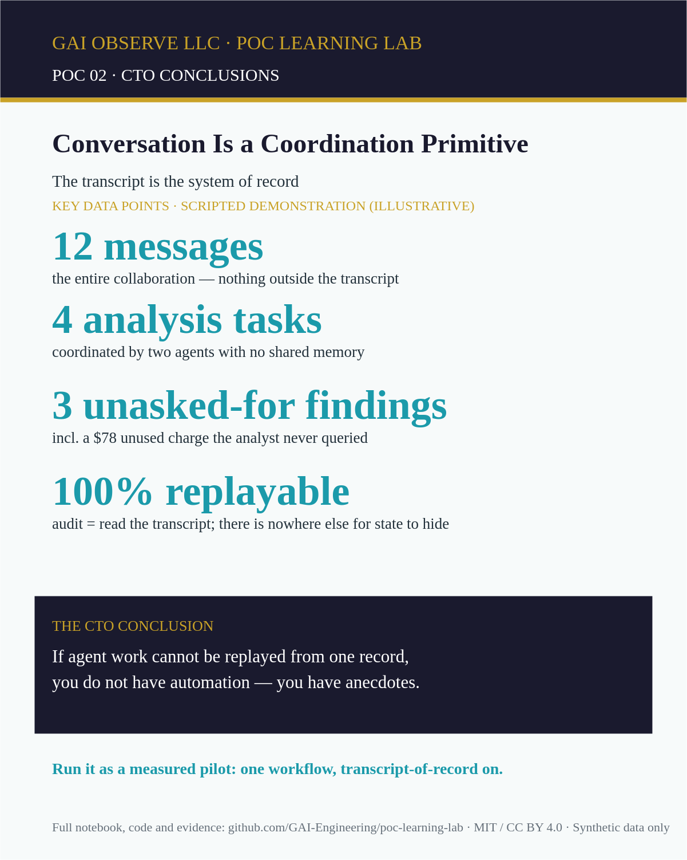
PATTERN 2 — THE TRANSCRIPT IS THE SYSTEM OF RECORD (POC 02)
The transcript is the system of record — coordination you can replay.
• 12 transcript messages · 4 tasks · 2 agents · 0 side channels
• 3 unasked-for findings: $78.00 unused gym charge (Feb–Mar) · coffee subscription billed 3x in March vs 2x · second streaming sub started March
• State = the transcript file; replay and audit read it alone

Slide 5
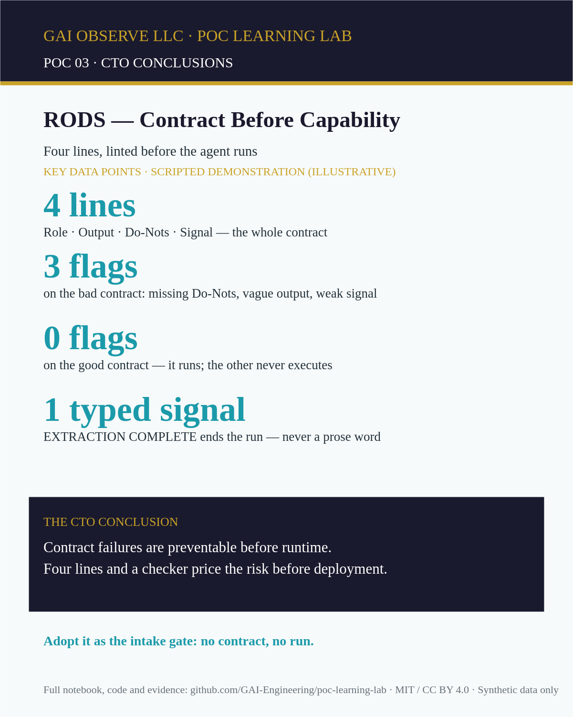
PATTERN 3 — CONTRACT BEFORE CAPABILITY (POC 03, RODS)
Four lines of contract, linted before the agent ever runs.
• Contract = 4 lines (Role · Output · Do-Nots · Signal)
• Good contract: lint CLEAN · Bad contract: 3 flags (MISSING Do-Nots, WEAK_SIGNAL, VAGUE_OUTPUT)
• Extraction: 4 obligations · termination on the typed signal EXTRACTION COMPLETE (check returned SIGNAL, never a prose word)

Slide 6
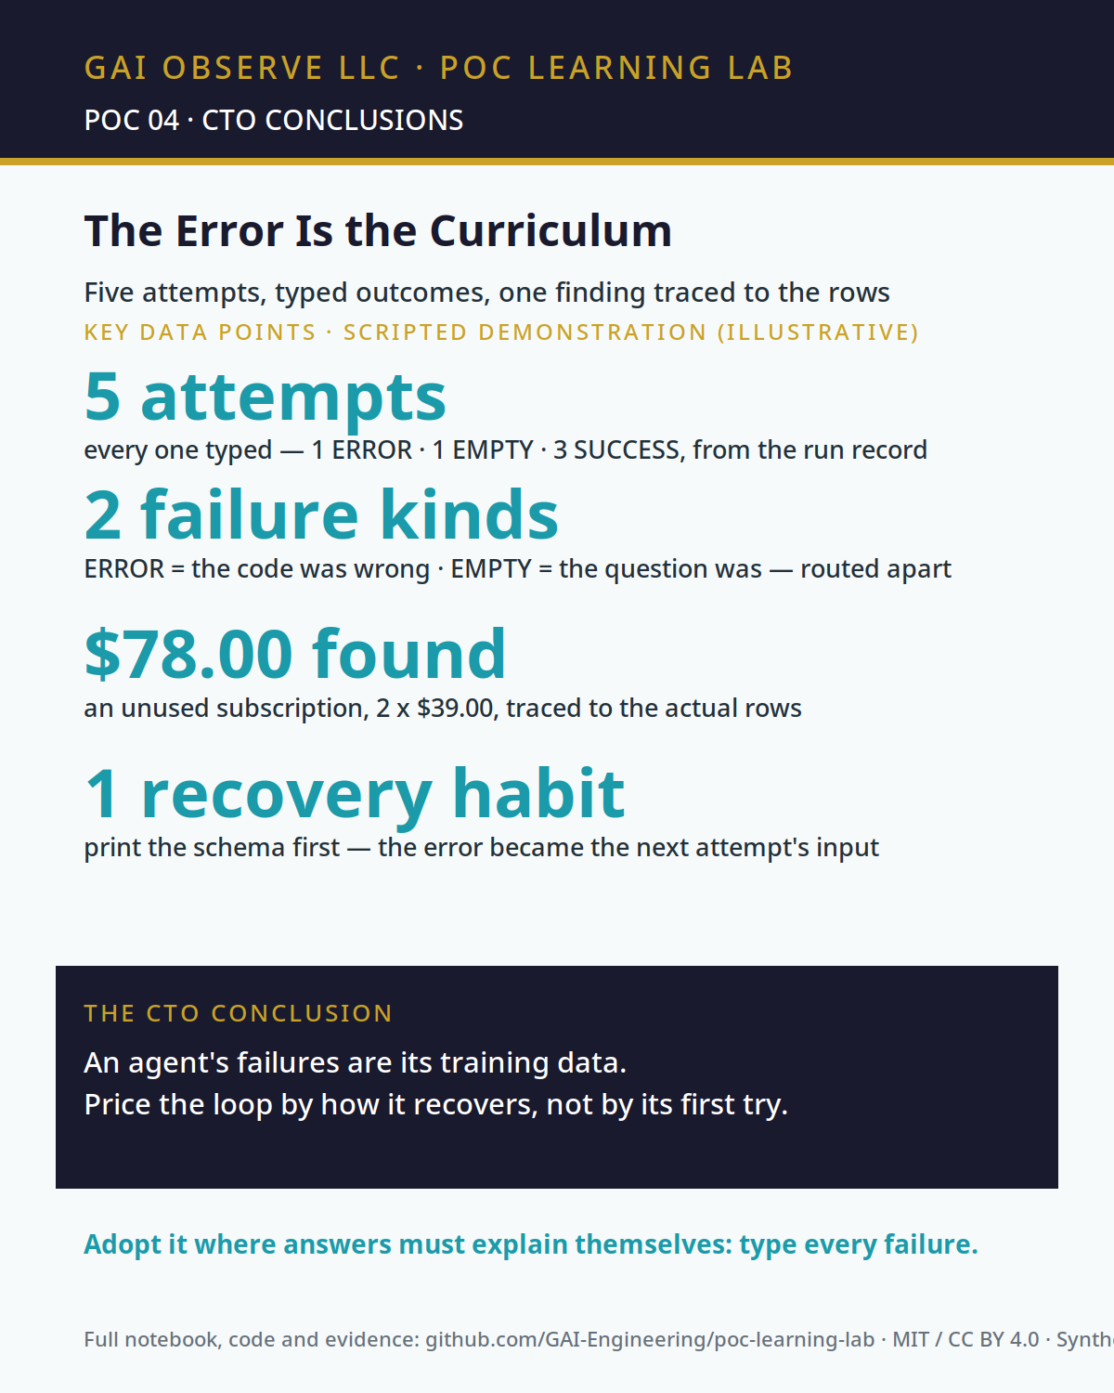
PATTERN 4 — THE ERROR IS THE CURRICULUM (POC 04)
Every outcome is labelled, and the label teaches the next attempt.
• 5 attempts · 1 ERROR · 1 EMPTY · 3 SUCCESS — outcomes computed from the run record (runs/attempts.csv), never typed into the summary
• The error was a wrong key ('amt'); the recovery habit — print the schema first — is attempt 2, and the revised query succeeds
• EMPTY means the question was wrong (category 'gym' matches no rows); the exact name from the totals ('gym-unused') succeeds
• Finding: gym-unused totals $78.00 (2 x $39.00, 2026-02 and 2026-03), traced to rows in data/transactions.csv (22 rows)
• Change a figure in the CSV and the finding moves — the perturbation test moves the gym amounts and watches $78.00 become $98.00 (tests/test_perturbation.py)

Slide 7
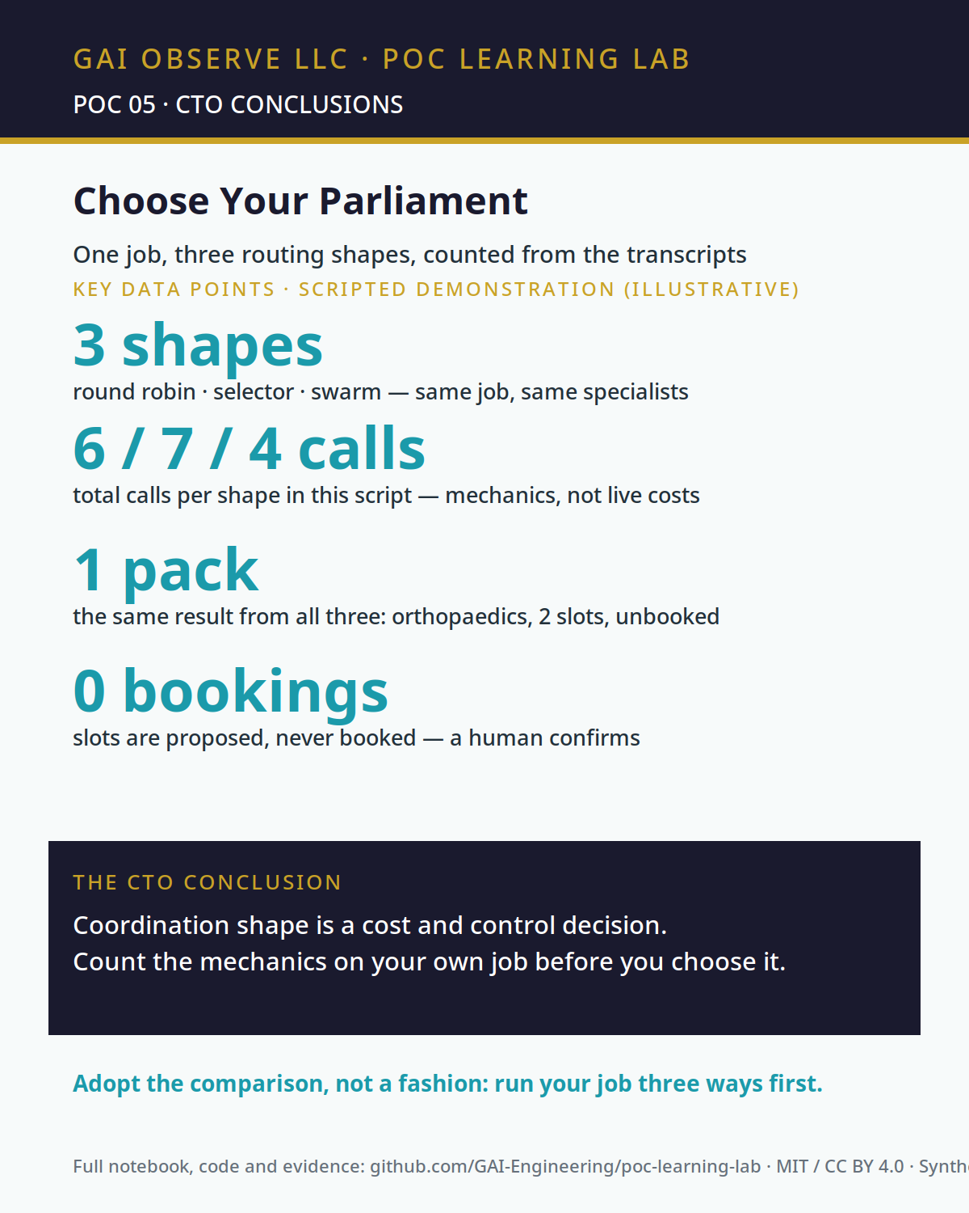
PATTERN 5 — CHOOSE YOUR PARLIAMENT (POC 05)
Who speaks next is a design decision — count what each shape costs in calls.
• Same job, three shapes, counted from runs/routing-comparison.csv: round robin 6 agent turns / 6 total calls · selector 3 agent turns + 4 routing calls / 7 total · swarm 4 agent turns + 3 hand-offs / 4 total
• All three modes prepared the same pack (specialty orthopaedics, 2 slots — Tue 09:30, Wed 14:10 — unbooked, awaiting human confirmation)
• These counts are the mechanics of this script — round robin runs its sequence twice by construction; the swarm takes a verification hand-back by construction. They are not live routing costs.
• A router that can never finish is capped and ends INCOMPLETE (tests/test_perturbation.py, failed-router case)

Slide 8
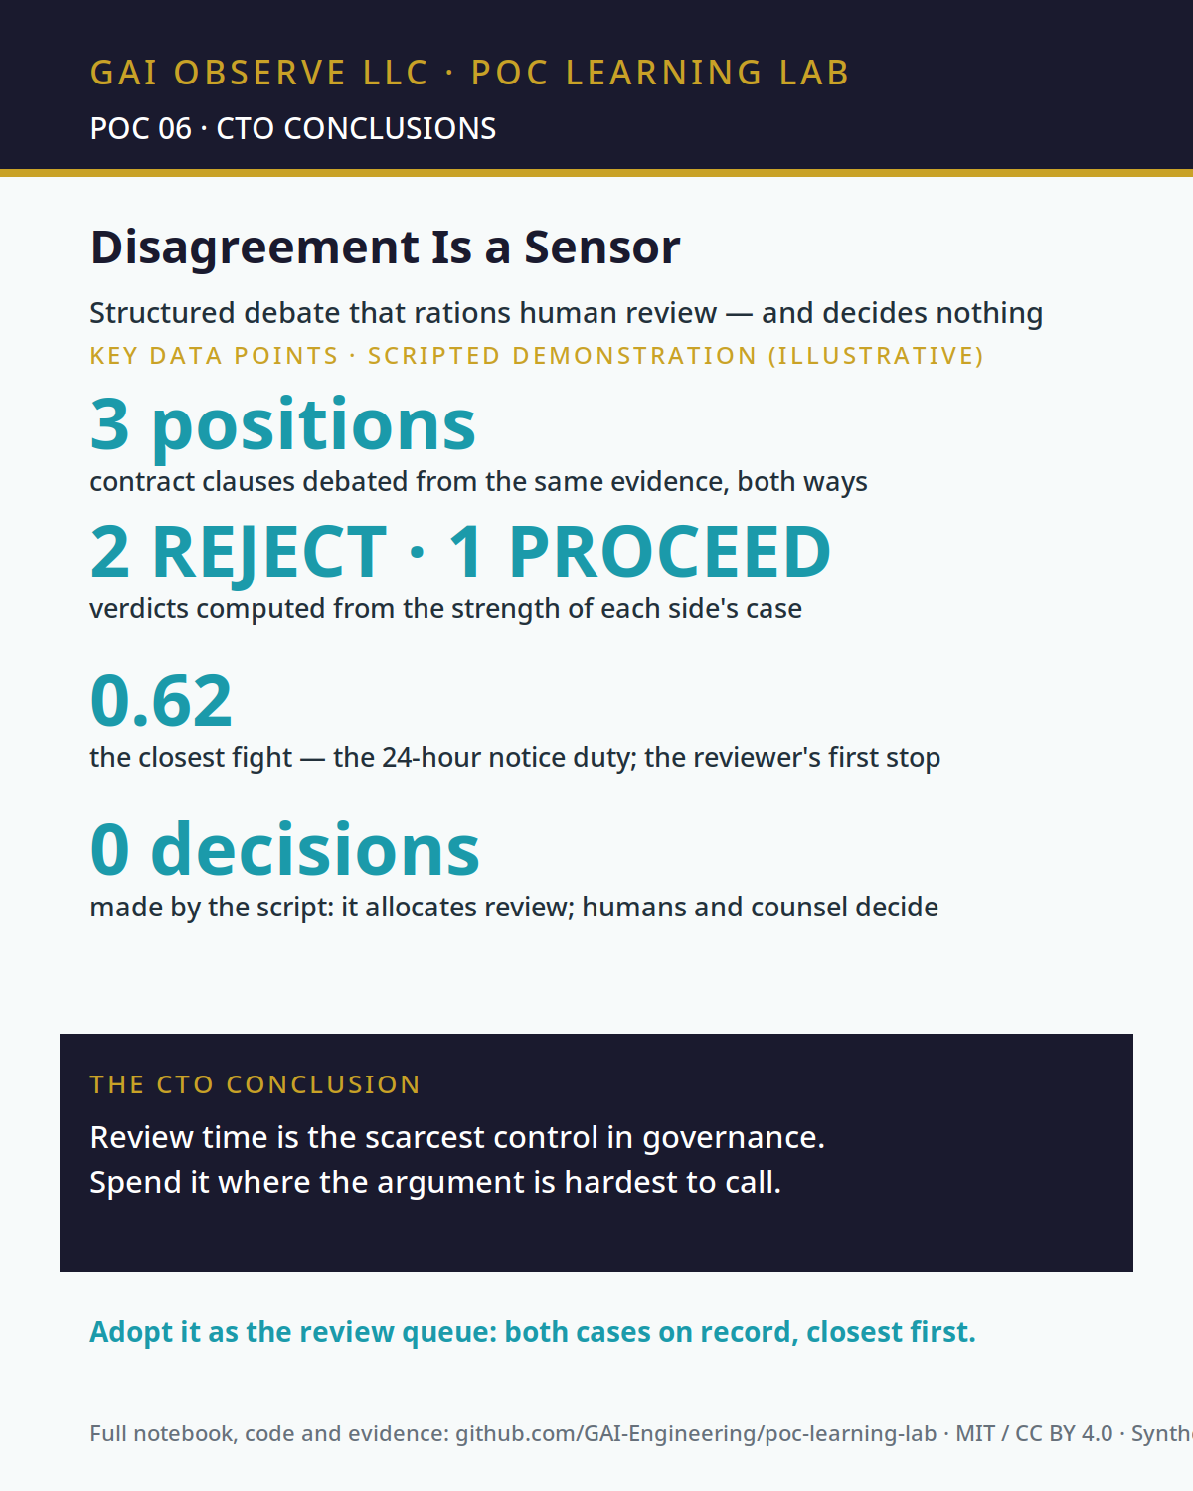
PATTERN 6 — DISAGREEMENT IS A SENSOR (POC 06)
Structured disagreement allocates scarce human review to the closest fights.
• 3 positions debated (runs/verdicts.csv): C1 auto-renewal at +8% — REJECT (strength 5 for / 11 against) · C2 24-hour incident-notice duty — PROCEED (8 / 5) · C3 uncapped liability — REJECT (2 / 14)
• Closest fight: C2, balance 0.62 — the most balanced argument in the script and the reviewer's first stop
• The balance map is an illustrative argument-balance prompt for human review: it locates no genuine uncertainty, is not a risk register, and a real position requires independent evidence and counsel review
• Adding a fourth position produces four verdicts — the counts are computed, not typed (tests/test_perturbation.py)

Slide 9
THE PORTFOLIO VIEW — WHERE THE NEXT EFFORT GOES
Invest first — POC 03 (RODS)
The contract pattern is the most transferable asset in the lab: four lines, a linter, a typed completion signal. It generalises to every agent the lab will ever ship.
Gated — POC 02 (transcripts)
The system-of-record pattern proceeds behind its durability gates: persistence, replay and failure recovery proven before any stronger claim.
Teaching demo — POC 01 (perception)
Held as a teaching artefact until a real perception adapter replaces the scripted scene. Its lesson — the verification loop — is already load-bearing in POC 04.
Day 2 (POCs 04–06)
The analyst–executor loop, group-chat routing shapes and structured debate extend the same discipline: labelled outcomes, counted calls, disagreement treated as a sensor.

Slide 10
METHOD — HOW THIS LAB EARNS TRUST
• Every result is computed from data files in the repo — change an input and the result moves; each notebook carries a perturbation test that proves it.
• Modes are printed on the face of the work: INTERIM notebooks are scripted demonstrations; a FINAL promotion requires a real recorded run, reproducible end to end, and passes the evaluator’s full QA.
• Releases are signed by an independent evaluator of record, with conditions recorded in RELEASES.md and closed only on evidence.
• Figures of record are the data-drawn SVG infographics in business/infographics/; generated images are checked figure-by-figure at full size before they are used.
• Corrections are made in public, in the commit history — including this deck’s predecessors.

