Slide 1
GIS + OLS Analysis
Rat Density and Wind Turbine Construction

Slide 2
Map the county-level distribution of wind turbine construction and rat density.
Test whether rat density is spatially clustered using General G and Moran's I.
Identify hot spots, cold spots, clusters, and local outliers.
Use OLS regression to examine the relationship between construction timing and rat density.
Interpret the model carefully

Slide 3
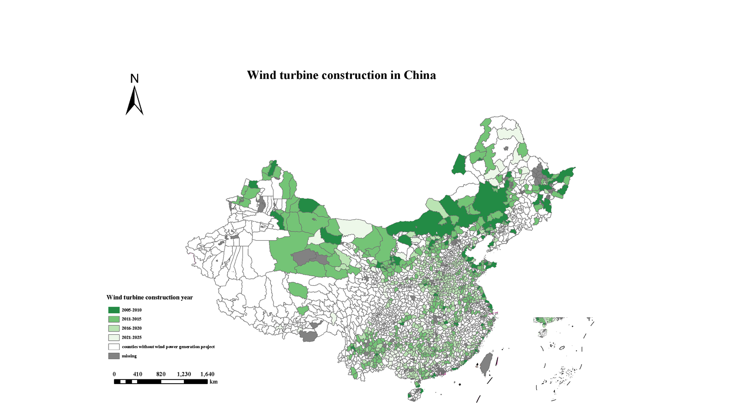
GIS source figure
Wind Turbine Construction in China
Brief explanation
This map shows when counties first had wind turbine construction projects.
Darker green areas represent earlier construction years, while lighter areas represent later development.
It provides the explanatory spatial variable used later in the regression model.
01

Slide 4
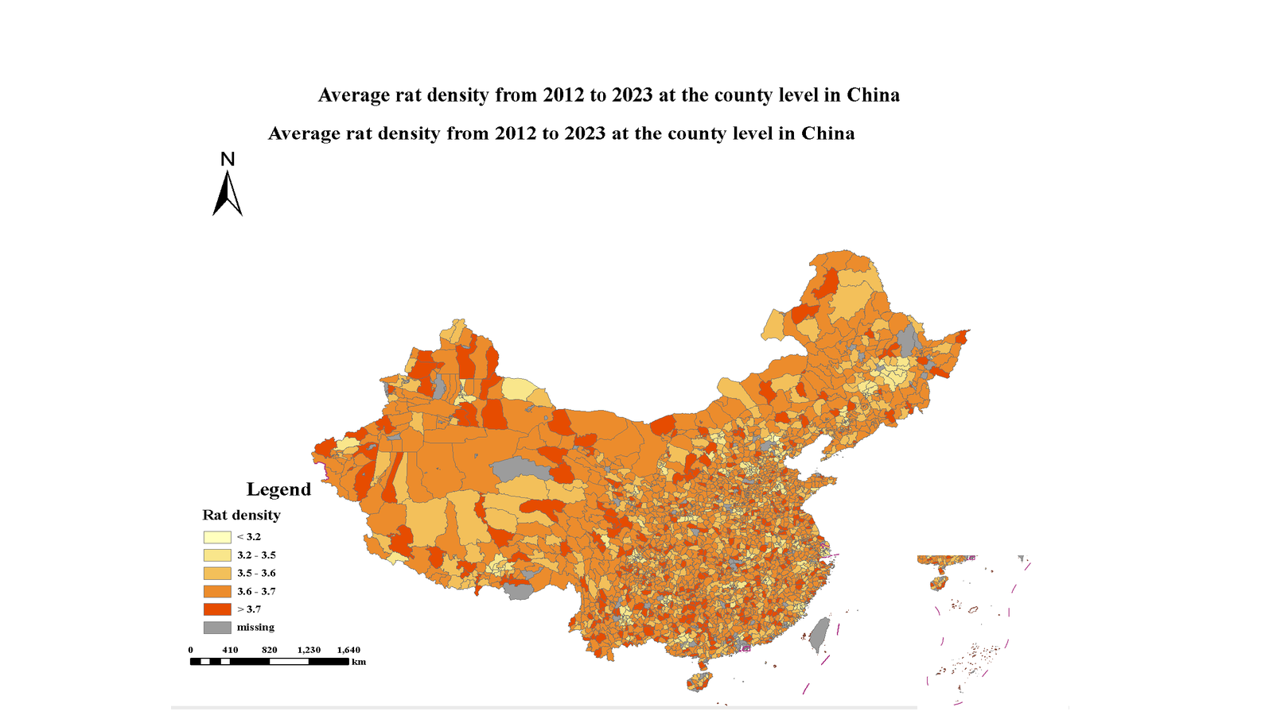
GIS source figure
Average Rat Density, 2012-2023
Brief explanation
Rat density is mapped at the county level across China.
The distribution is spatially uneven, with many counties in medium to high density classes.
This map establishes the dependent variable for the spatial and regression analysis.
02

Slide 5

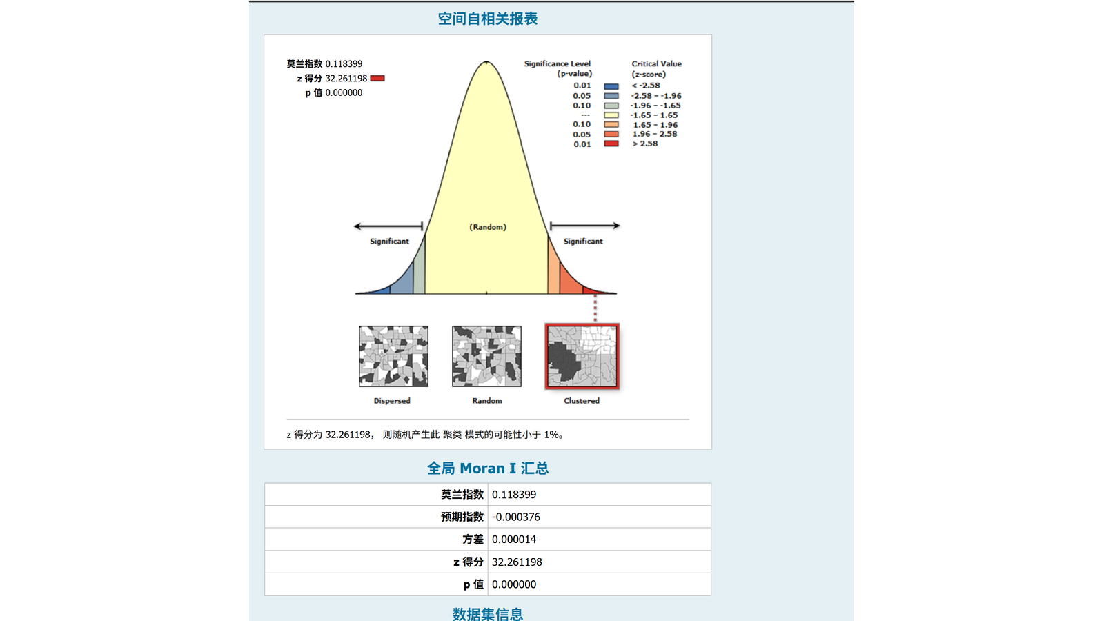
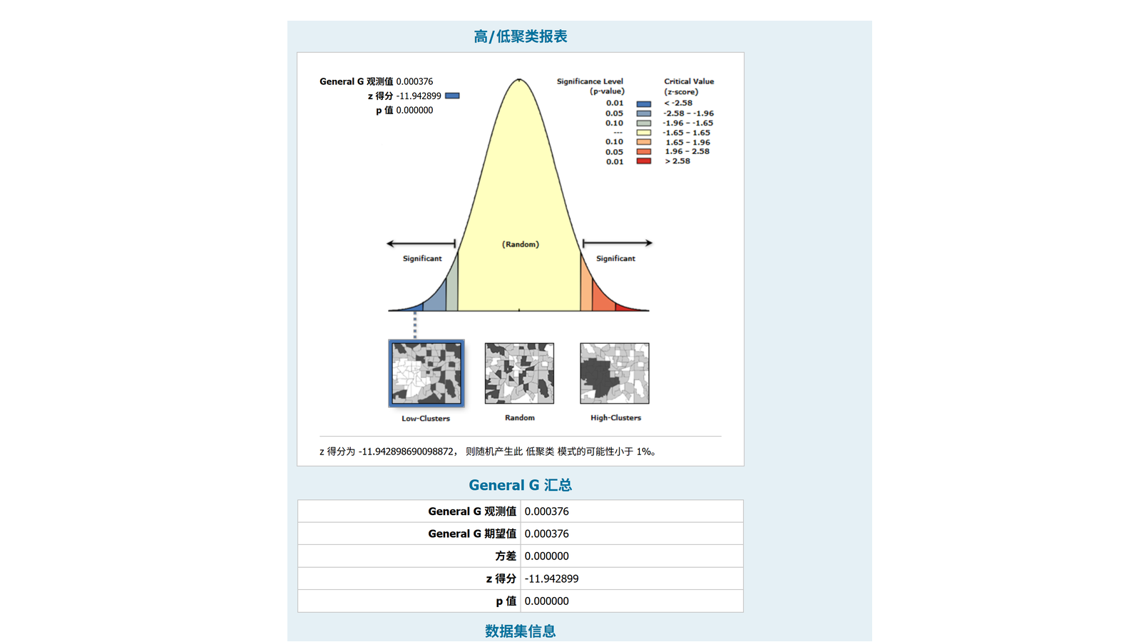
Spatial statistics result
Spatial Autocorrelation Report
Global Moran's I is 0.118399 with z = 32.261 and p = 0.000.
The positive Moran's I indicates clear spatial clustering of rat density.
Nearby counties tend to have more similar rat density values than expected by chance.
The General G statistic tests whether high or low values cluster spatially.
The z-score is -11.94 with p = 0.000, indicating statistically significant low-value clustering.
This means the observed pattern is unlikely to be random.
04

Slide 6
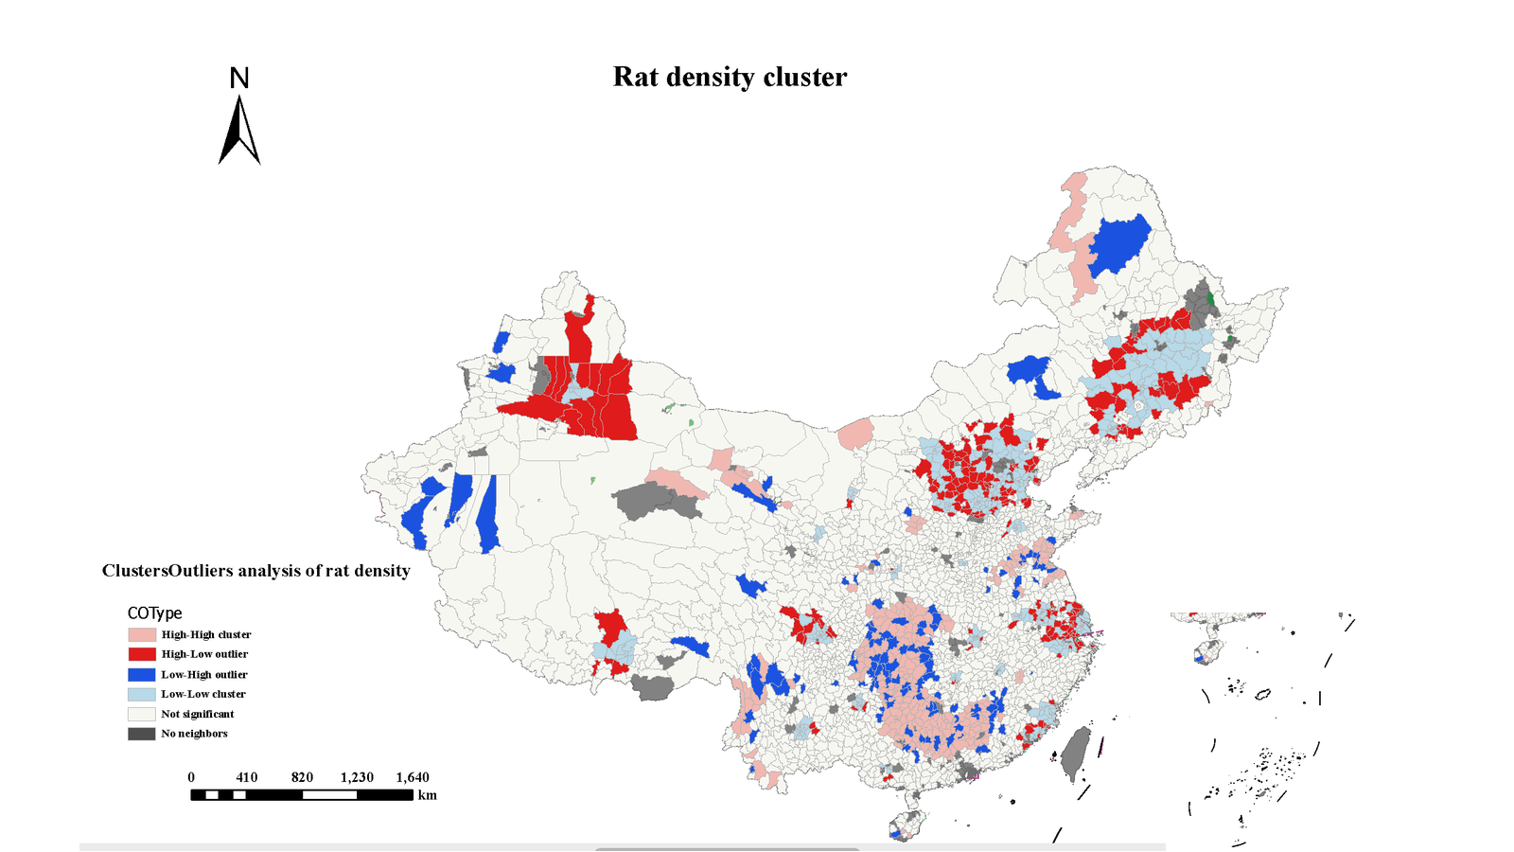
Local spatial association
Rat Density Clusters and Outliers
Brief explanation
The cluster-outlier map separates high-high, low-low, and local outlier counties.
High-high clusters indicate neighboring counties with similarly high rat density.
High-low and low-high outliers point to local exceptions that may deserve closer investigation.
05

Slide 7
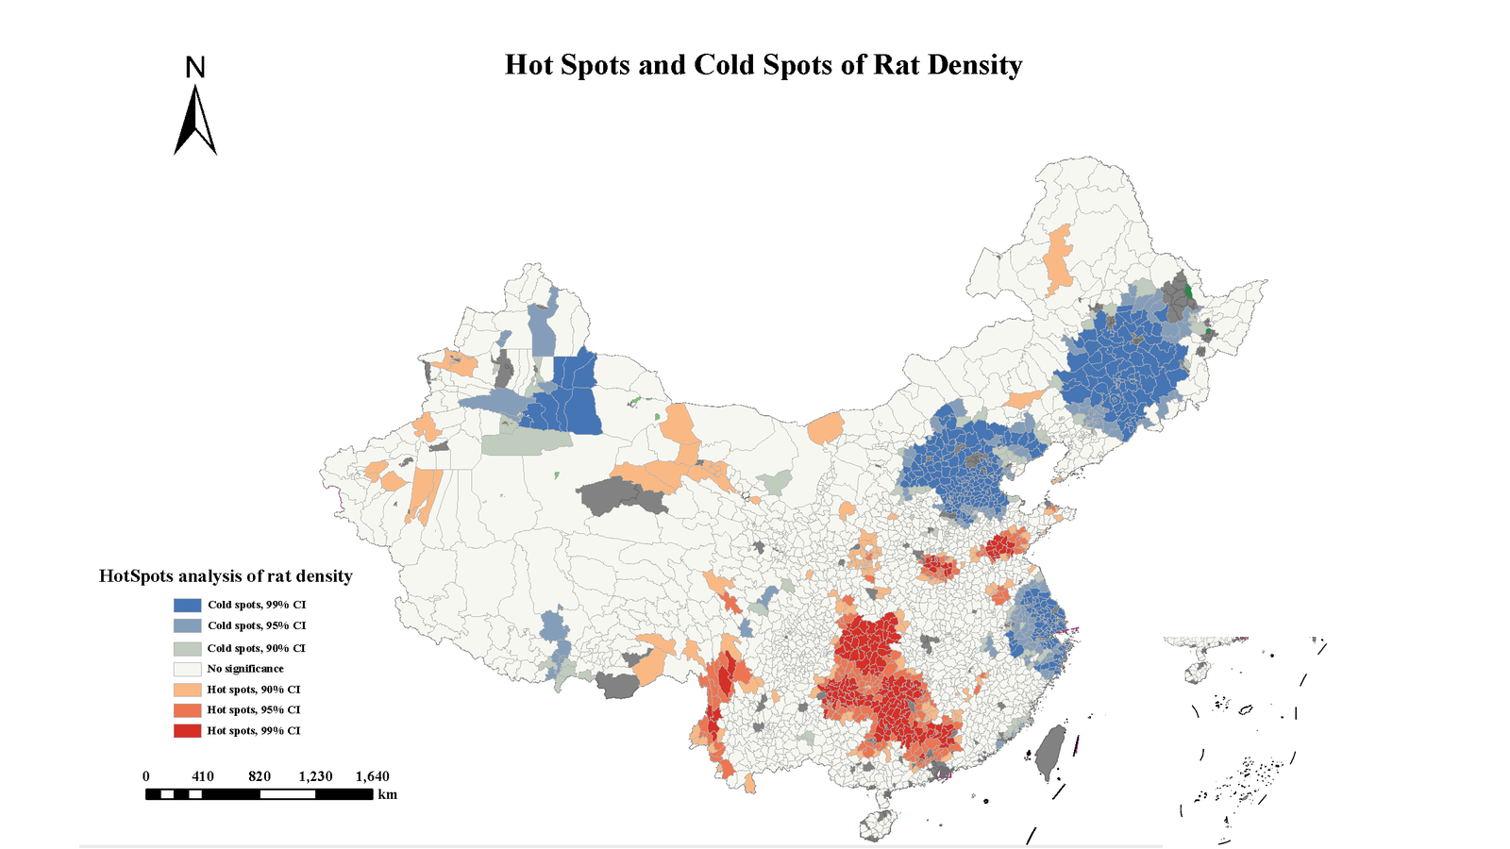
Hot spot analysis
Hot Spots and Cold Spots
Brief explanation
Red areas identify statistically significant hot spots of high rat density.
Blue areas identify statistically significant cold spots of low rat density.
Hot spots concentrate mainly in southern and southeastern regions, while cold spots appear in several northern and northeastern areas.
06

Slide 8
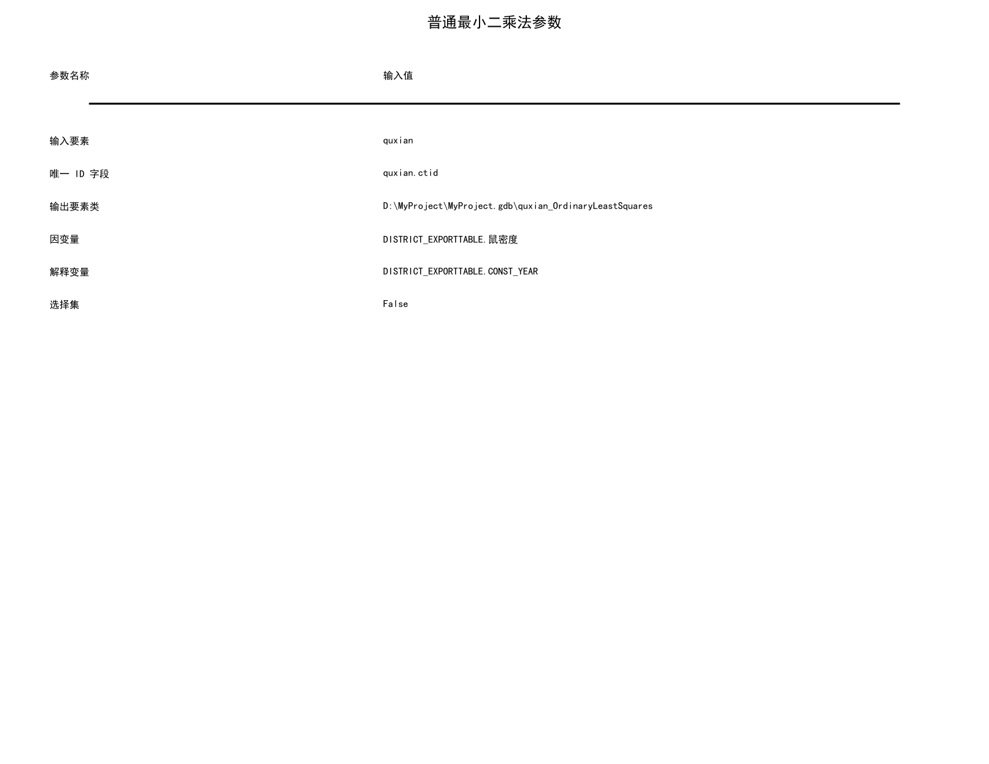
PDF page 6
OLS Parameter Settings
Brief explanation
This page records the OLS input settings and output location.
Input features are county-level records, with rat density as the dependent variable.
The explanatory variable is CONST_YEAR, representing wind turbine construction timing.
15

Slide 9

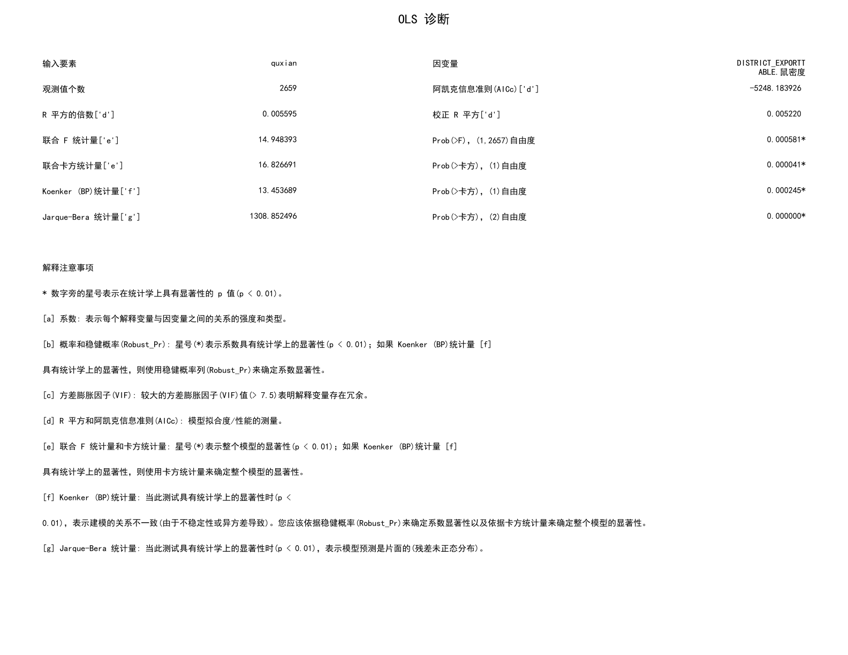
OLS Diagnostic Summary
Brief explanation
The model includes 2,659 observations.
R-squared is 0.005595 and adjusted R-squared is 0.005220, so explanatory power is very limited.
The model is statistically significant, but diagnostics suggest caution because residuals are not perfectly normal and heteroskedasticity is present.
11

Slide 10
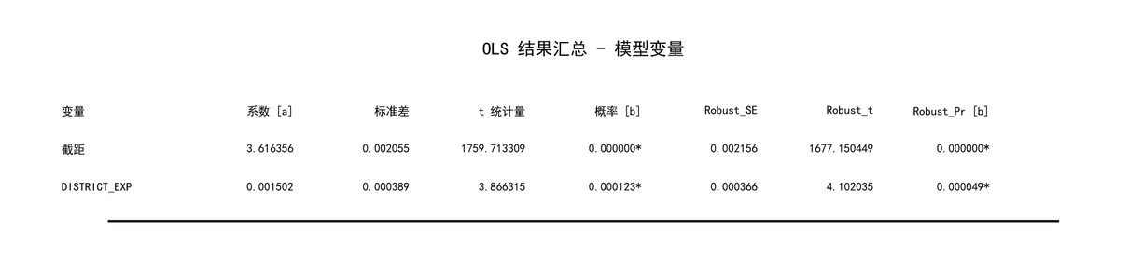
OLS result
OLS Coefficient Summary
Brief explanation
The OLS result shows a positive and statistically significant two-variable relationship.
This supports a preliminary association between wind turbine construction timing and rat density.
07

Slide 11
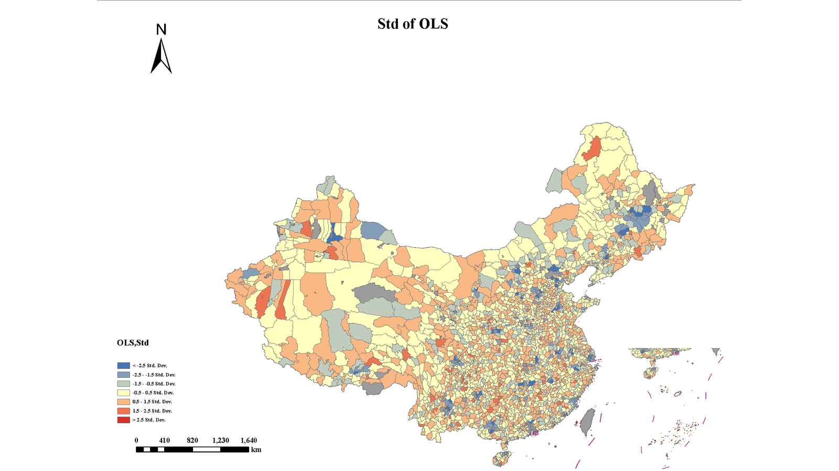
Regression map
Standardized OLS Values
Brief explanation
This map shows standardized OLS output values across counties.
Counties far from zero indicate places where the model result differs more strongly from the average pattern.
It helps locate areas where model behavior is unusually high or low.
08

Slide 12
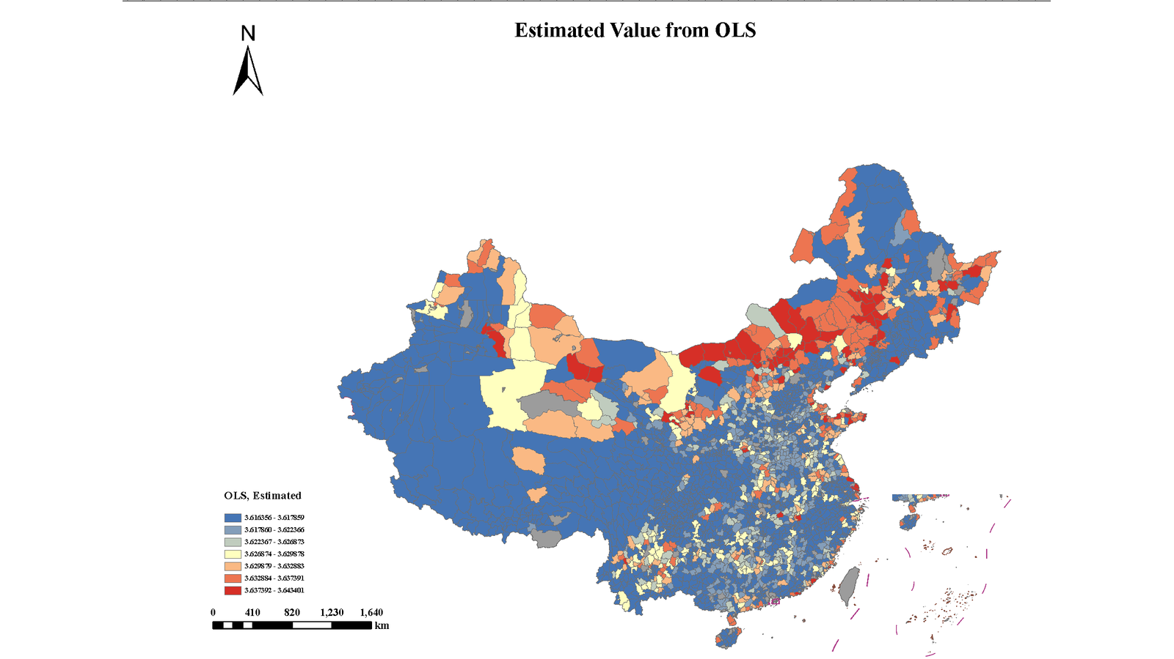
Regression map
Estimated Values from OLS
Brief explanation
The OLS estimated value map shows predicted rat density values by county.
The value range is narrow, suggesting that the simple model explains only limited variation.
Spatial differences remain, so further explanatory variables may be needed.
09

Slide 13
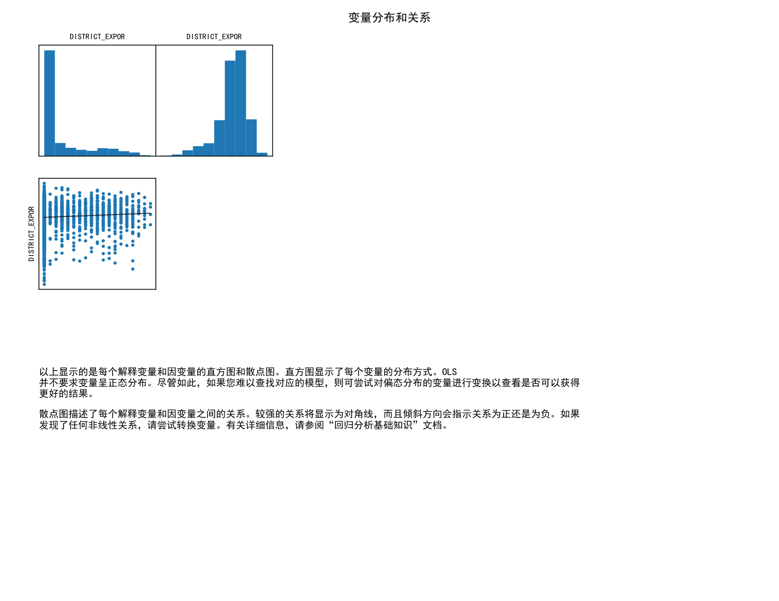
Variable Distributions and Relationship
Brief explanation
The histograms show the distributions of the dependent and explanatory variables.
The scatter plot shows only a weak linear relationship, even though the fitted line is slightly positive.
This helps explain why the coefficient is significant but the R-squared remains low.
12

Slide 14
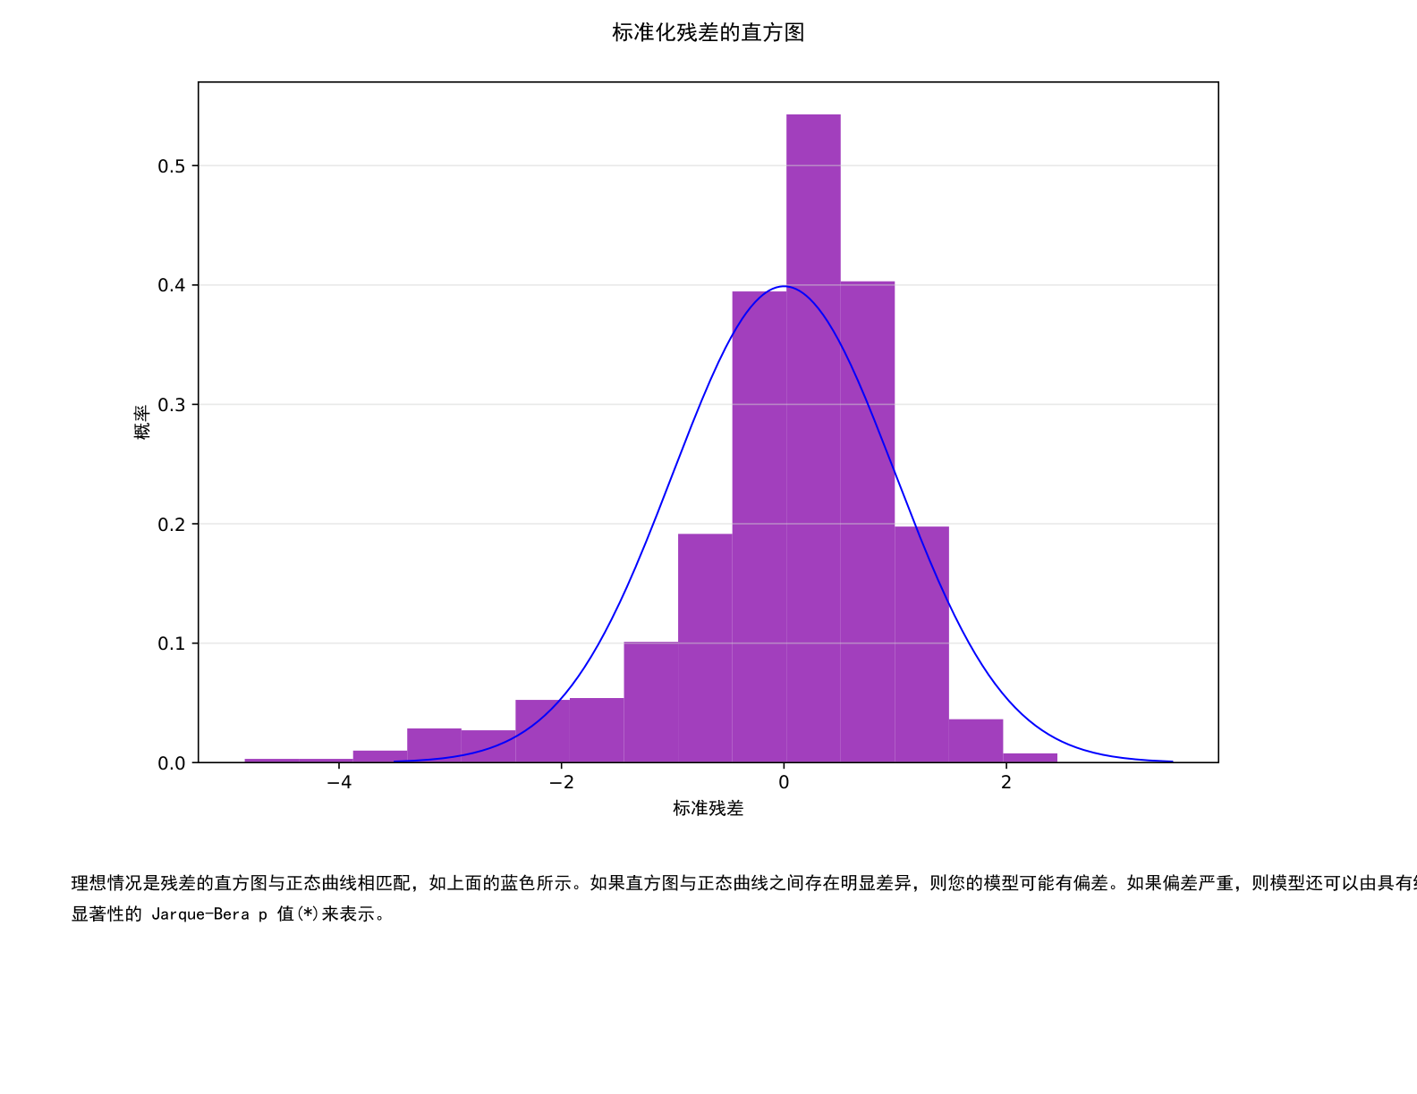
Standardized Residual Histogram
Brief explanation
The residual histogram is compared with a normal curve.
Most residuals are near zero, but the left tail is longer than ideal.
This supports the diagnostic warning that the residuals are not perfectly normally distributed.
13

Slide 15
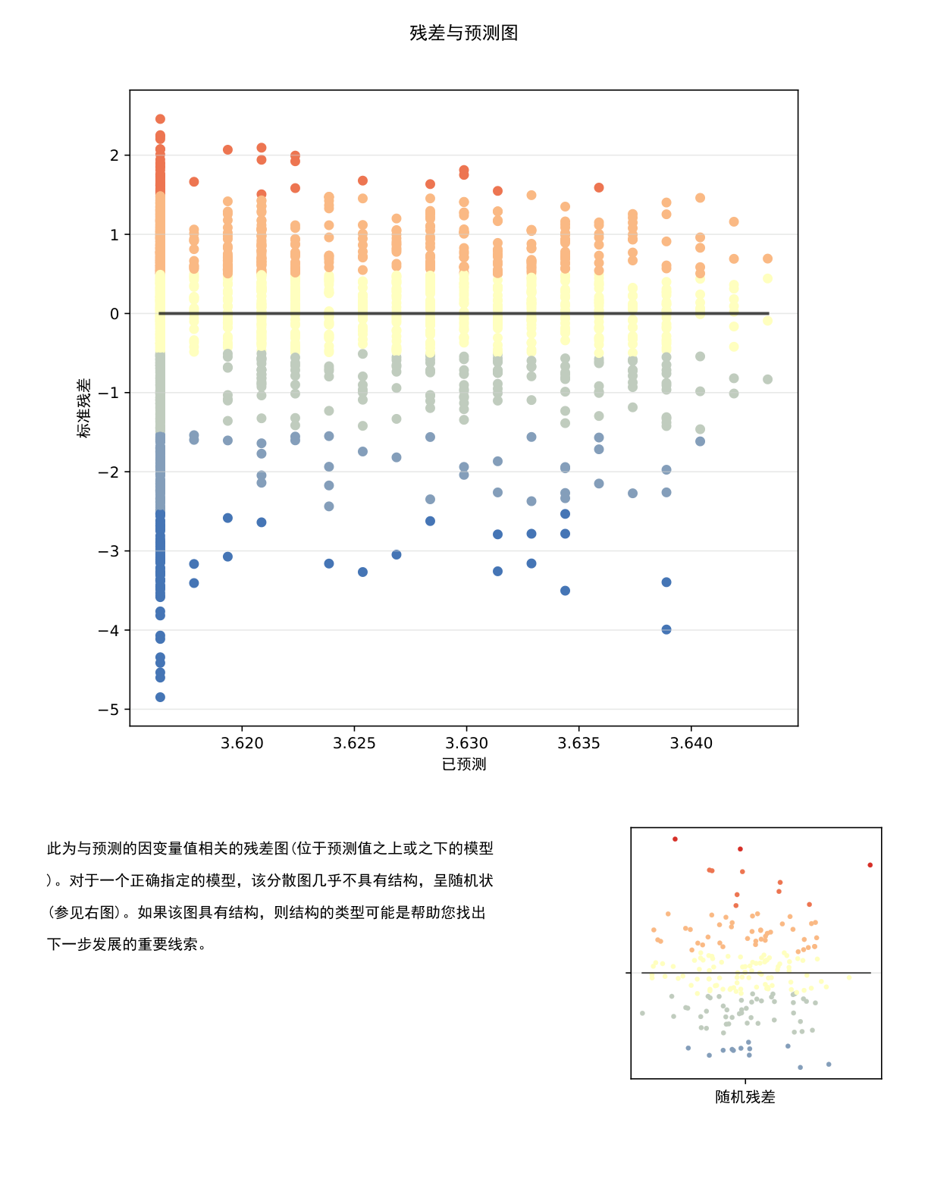
Residuals Versus Predicted Values
Brief explanation
This plot checks whether residuals are randomly distributed around zero.
The vertical bands and wide residual spread show that prediction errors remain substantial.
The model captures a statistically detectable trend, but it is not sufficient as a strong prediction model.
14

Slide 16
Main Conclusion
Rat density is not randomly distributed; it shows clear spatial clustering.
Hot spot and cluster maps identify priority areas for further investigation.
OLS shows a statistically significant positive relationship with wind turbine construction timing.
Because R-squared is very low, the result should be treated as preliminary evidence rather than a complete explanation.

