Slide 1
Value evaluation framework

Slide 2
Why Measure Generative AI Value?
Generative AI is a strategic enabler of knowledge-based work
Value emerges through changes in decisions, work, and experience
Executives need a shared language, not just technical metrics
Executive perspective requires outlook to whether decisions are better, or just faster ones
The extent of value realized across the organization – not only as pilots
AI utilized to strengthen human expertise instead of weakening it

Slide 3
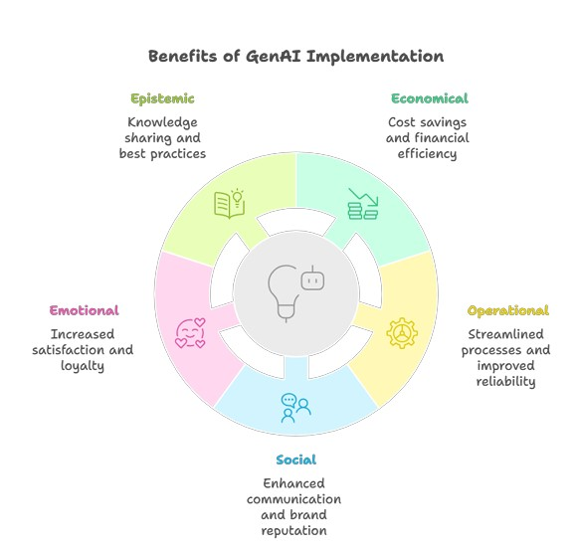
Value evaluation framework: Value dimensions
BETA version
Informational value – insight, understanding, decision quality
Economic value – time savings, productivity, ROI
Operational value – speed, flow, quality of work
Social value – sharing, collaboration, trust
Emotional value – agency, confidence, meaningful work
Informational

Slide 4
Value × Knowledge Processes Matrix
Each value dimension is assessed across the selected knowledge processes
The matrix highlights strengths, gaps, and bottlenecks
Color-coding (green / yellow / red) supports executive dialogue

Slide 5
Key Principles
We do not measure AI
We measure how work, decisions, and experience change

Slide 6
Value evaluation framework: metrics matrix
BETA version
Knowledge Process Value Dimension | Capture | Access/ Retrieval | Synthesis
Informational Value | New knowledge documented | Time to relevant answer | Diversity of sources in decisions
Economic Value | Automated documentation rate | Time saved (€) | ROI of AI-supported decisions
Operational Value | Process learning captured | Reduction of rework | Reduced lead times
Social Value | Captured tacit knowledge | Transparency of sources | Cross-unit shared insights
Emotional Value | Recognition of individual expertise | Reduced frustration | Trust in AI-generated synthesis

