Slide 1
Comparisons & Experiments
Used transcript evaluation Python library (jiwer)
Side-by-side comparison
Analysis of error types
Classification: transcript level, post-transcript level, eval level
Spelling mistake metric (Levenshtein distance)
Comparison of multiple Whisper models
OpenAI Whisper, gpt-4o-transcribe, WhisperX (v3, v2, large, medium, small, tiny)
Post transcript enhancement
Analysis of logprobs
2-pass LLM-based enhancement
Quick fixes

Slide 2
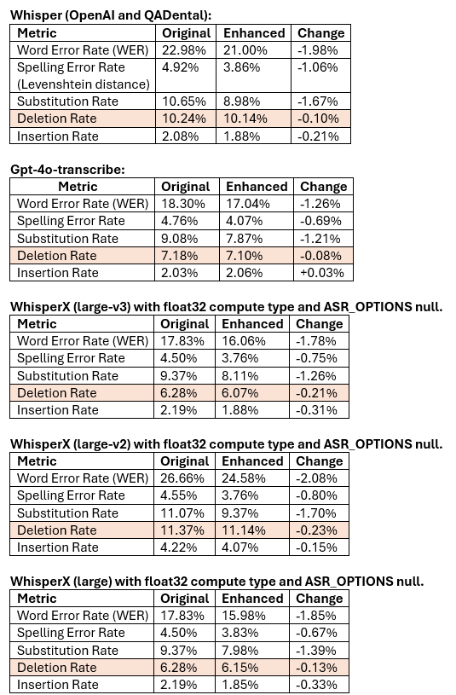
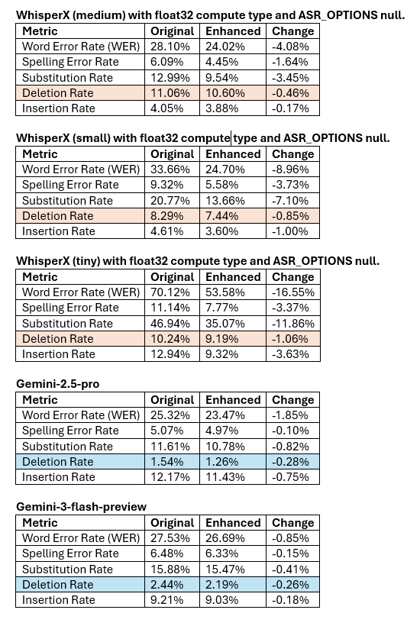

Slide 3
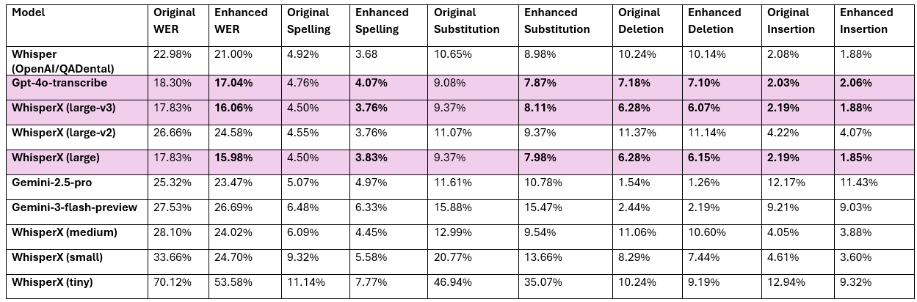

Slide 4
Error type | Description | Examples (from eval reports) | Fix vs live with (and fix stage)
Brands / proper nouns garbled | Brand/company names become phonetically similar nonsense tokens → high-impact substitutions | Straumann → Strauman, Dentsply Sirona → (split/garbled variants), Nobel Biocare → Nobel / Biocare distortions, Camlog Conelog → Camlog / Conelog variants, Implantona → implantoona/implanttoona (Ajokortti_eval.txt) | Fix (high priority): Post-transcription: entity normalization (standard brand list + fuzzy matching). If errors are extreme, a transcription-level prompt/glossary could help.
Names altered (identity drift) | Person names/surnames wrong (near-miss) → high user-visible errors | Martola/Martoon, Pallonen/Pallosen, Suojärvi/Suojärven (Ajokortti_eval.txt) | Fix: Post-transcription: spelling + dictionary-mapped variants only.
Digits vs Finnish number words | Reference uses words, but hypothesis uses digits (or vice versa) → full word errors | kahdenkymmenen → 20, yksitoista → 11 (Ari_Heiskanen_1_eval.txt); viisikymmentäkuusi → 56 (Ari_Heiskanen_2_eval.txt) | Fix: Post-transcription: normalize to one policy (digits or words).
Decimals / spoken math tokenization | “X ja puoli”, ranges, decimals become wrong single tokens or odd splits | ... ja puoli → 375 (likely intended 37.5) (Ari_Heiskanen_1_eval.txt); kolmeviisi ↔ kolme viiva viisi (Antti_Ulvio_Pohjustus_eval.txt) | Fix: Mostly post-transcription with a Finnish number/decimal normalizer.
Function-word deletions (glue words missing) | Short words dropped: hurts WER but meaning often survives | frequent [D:ja], [D:että], [D:se] patterns (Ajokortti_eval.txt, Atte_Lajunen_1080p_eval.txt) | Often live with it if the meaning is intact. A post-transcription insertion of a small whitelist (että/ja/niin/…).
Unhelpful insertions (extra fillers/words) | Extra small words inserted → slight WER increase | insertions like ... [I] around sentence starts and discourse words (Ajokortti_eval.txt, Antti_Ulvio_Pohjustus_eval.txt) | Usually live with unless the meaning changes. If needed: post-transcription filter repeated filler duplicates; avoid aggressive “helpful” rewriting.

Slide 5
Finnish morphology / case ending errors | Same lemma but wrong case/number/ending → substitutions | e.g., plural/singular or case changes like ...-llä ↔ ...-llä type drift (Aki_Linden_20210115_Final_1080p_eval.txt, Hannu_Heiska_eval.txt) | Fix: Post-transcription Finnish-aware correction (inflection only when very clear). Avoid meaning-changing edits.
Compound + hyphenation inconsistencies | Compounds split/merged; hyphenated clinical terms vary | peri-implantiitti ↔ periimplantiitti variants (Ajokortti_eval.txt); compound merging/splitting causing deletions (Finnendo_Pohjustus_eval.txt) | Fix: Post-transcription consistency normalization.
Loanword / English term distortion | English technical tokens misheard into unrelated Finnish words | lowdose → loudausohjelmia (Atte_Lajunen_1080p_eval.txt); minor loanword variants in endo/prosthetics context (Finnendo_Pohjustus_eval.txt) | Fix: Post-transcription bilingual domain lexicon + consistency.
Catastrophic omissions (chunk missing) | Large consecutive deletions → not recoverable safely from text | Atte Lajunen shows very high deletions; long [D:...] runs (Atte_Lajunen_1080p_eval.txt) | Must fix at the transcription level (fine-tuning). Should not be done at the post-transcript level
Evaluation artifacts (style vs content) | Changes that are “better text” but penalized by WER | hyphen/spacing differences (hands-on ↔ hands on) and similar tokenization shifts (Ajokortti_eval.txt) | Fix: Evaluation-level normalization (hyphen/number policy) + post-transcription consistent formatting.

Slide 6
Conclusions
Deletion rate is the most critical issue
Transcription-level enhancements
Fine-tuning, adjusting ASR parameters
Quick fixes: post-transcript enhancements (LLM-based)
Proper nouns, spellings, digits vs. numbers, decimals, Finnish morphology / case ending, compound + hyphenation inconsistencies, loanword / English term distortion
Decision between WhisperX (large) vs. gpt-4o-transcribe

