Slide 1
Successful adoption of GenAI from a knowledge management perspective
Veera Saastamoinen
Research Assistant, Information and Knowledge Management Unit
University of Tampere

Slide 2
About the study: successful adoption of GenAI from a knowledge management perspective
The canvas was made in thesis, which examined suddessfull GenAI adoption in SMEs from a knowledge management perspective
The study used Design Science Research (DSR), and created the canvas as an artifact. The canvas is based on literature, and was developed further with participating companies

Slide 3
Why use the canvas and how to use it
A practical tool for structuring and addressing GenAI adoption from a knowledge management perspective
Supports to identification of critical factors across different phases of implementation and understanding the whole adoption
Supports structured discussions (e.g. workshops) and shared understanding
Supports decision-making and aligns GenAI with organizational goals and strategy
Canvas can be used alone to structure adoption, or with support questions to assess the critical factors affecting
Identify the most relevant factors for your organization based on current priorities and context
Address the most relevant issues first, while ensuring all categories are considered over time
Support questions can be used to guide reflection and deepen understanding

Slide 4
How to use the canvas
Familiarize yourself with the canvas and identify which phase of implementation the organization is currently in
Processing the canvas can focus on the current phase or encompass all phases of implementation
Review the canvas and its critical factors systematically
Consider each critical factor, or focus on the critical factors most relevant to the organization
Consider how these critical factors are currently addressed in the organization
Each critical factor is associated with one or more support questions
Support questions can guide processing and deepen the understanding of adoption
All categories of the canvas should be processed to ensure a comprehensive approach to GenAI adoption

Slide 5
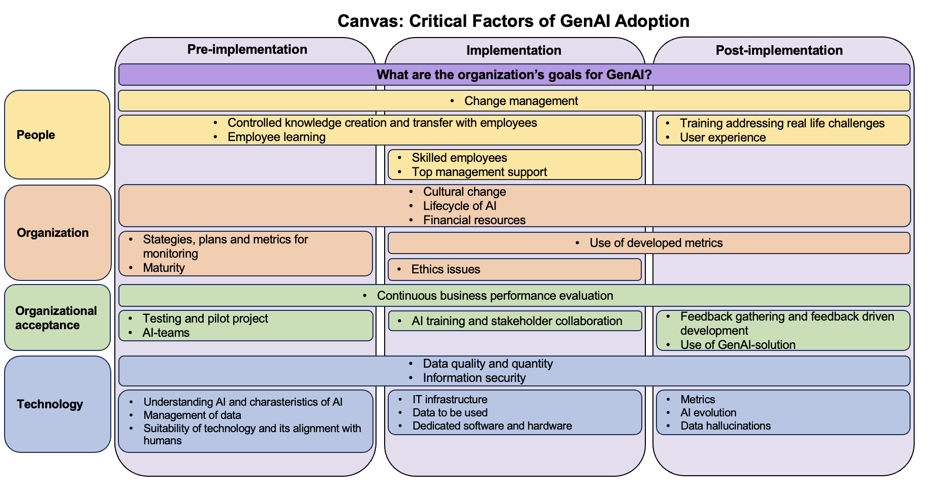

Slide 6
Pre-implementation support questions
What is the organization's goal for using GenAI? What is intended to be achieved with GenAI? Why is GenAI being implemented?
People
Change management
Has change management been planned and prepared for?
How are employees' fears and concerns managed/considered in change management?
Training
Are all employees trained in understanding, using and securing GenAI?
Communication
Is the change communicated openly to employees from the beginning?
Are enough time and resources allocated for communication?
Success story
Are there any success stories that can be used in change management?
Do employees share their own success stories?
Key users
Are there users maintaining change management and internally marketing the implementation?
Controlled knowledge creation and transfer with employees
How is the creation and transfer of knowledge with people ensured within the organization?
How to ensure that the information created and shared by GenAI is suitable?
Employee learning
How is employee learning and knowledge internalization supported during AI adoption?
Maturity
What is the organization’s current level of AI readiness and maturity?
What existing capabilities does the organization have?
Organizational acceptance
Continuous business performance evaluation
How is business performance evaluated during pre-implementation?
Testing and pilot project
How can the GenAI solution be tested?
Has a minimum valuable product or pilot project been or can it be done?
Is there enough time and other resources allocated for testing and piloting?
AI-teams
Are there teams responsible for AI, or can such be formed?
Technology
Data quality and quantity
Is there enough data available?
Is the data quality good?
Information security
What are the biggest risks in terms of information security?
How has information security been taken into account?
Understanding AI and charasteristics of AI
What kind of AI technology can be used to achieve the goals?
Does management understand the principles of GenAI and its key features?
Do employees understand the principles of GenAI and its key features?
Management of data
Where is the data collected from?
Is the data in the correct format/structured in the desired format?
What kind of data is transferred and shared with people?
Suitability of technology and its alignment with humans
What technologies are available?
Have the alternatives been studied and their suitability assessed?
Is the chosen technology compatible with other technologies?
How easy is the technology to learn and adopt for users in the organization?
How well does the technology fit with the users' current working methods and skill level?
Organization
Cultural change
What is the organizational culture like?
What is the organizational culture's readiness for change?
How is cultural change managed?
Lifecycle of AI
How can an organization prepare for the development of AI?
Financial resources
Are the organization's financial resources sufficient to support GenAI-solutions?
Strategies, plans and metrics for monitoring succes
Is there a plan or strategy for risk management?
How are risks identified and addressed?
Is there an AI strategy, is it included as part of another strategy, or have guidelines been developed for the use of AI?
How will the use of GenAI and its success be monitored and measured at different stages of implementation?

Slide 7
Implementation support questions
What is the organization's goal for using GenAI? What is intended to be achieved with GenAI? Why is GenAI being implemented?
People
Change management
Has change management been planned and prepared for?
How are employees' fears and concerns managed/considered in change management?
Training
Are all employees trained in understanding, using and securing GenAI?
Communication
Is the change communicated openly to employees from the beginning?
Are enough time and resources allocated for communication?
Success story
Are there any success stories that can be used in change management?
Do employees share their own success stories?
Key users
Are there users maintaining change management and internally marketing the implementation?
Controlled knowledge creation and transfer with employees
How is the creation and transfer of knowledge between people ensured within the organization?
Employee learning
How is employee learning and knowledge internalization supported during AI adoption (e.g. addressing knowledge internalization)
Skilled employees
Are there enough trained employees?
Does management have enough skills and knowledge?
Top management support
Is there support from management for the implementation?
Organizational
Cultural change
What is the organizational culture like?
What is the organizational culture's readiness for change?
How is cultural change managed?
Lifecycle of AI
How is the lifecycle of AI taken into account when implementing it?
Financial resources
Are the organization's financial resources sufficient to support GenAI-solutions?
Ethics issues
What ethical risks could arise from the use of this GenAI-solution?
Use of developed metrics
What developed metrics can be used now and how?
Organizational acceptance
Continuous business performance evaluation
How is business performance evaluated during implementation?
AI training and stakeholder collaboration
Will stakeholders be trained on GenAI?
Will cooperation with stakeholders change with implementation?
Technology
Data quality and quantity
Is there enough data available?
Is the data quality good?
Information security
What are the biggest risks in terms of information security?
How has information security been taken into account?
IT infrastructure
Is your IT infrastructure ready to support AI solutions?
Is the current infrastructure sufficient, or are upgrades required?
Data to be used
What and what kind of data can be used?
Need for dedicated software and hardware
Does the solution require dedicated tools or systems?

Slide 8
Post-implementation support questions
What is the organization's goal for using GenAI? What is intended to be achieved with GenAI? Why is GenAI being implemented?
People
Change management
Has change management been planned and prepared for?
How are employees' fears and concerns managed/considered in change management?
Training
Are all employees trained in understanding, using and securing GenAI?
Communication
Is the change communicated openly to employees from the beginning?
Are enough time and resources allocated for communication?
Success story
Are there any success stories that can be used in change management?
Do employees share their own success stories?
Key users
Are there users maintaining change management and internally marketing the implementation?
Controlled knowledge creation and transfer with employees
How is the creation and transfer of knowledge between people ensured within the organization?
Training need to address real life challenges
Does the training address to real life challenges (e.g. cross checking information)
User experience
What are the users' experiences with the GenAI solution?
How has the solution affected the users' work?
Organizational
Cultural change
What is the organizational culture like?
What is the organizational culture's readiness for change?
How is cultural change managed?
Lifecycle of AI
Is the organization prepared for the entire lifecycle of AI?
Can GenAI solution be further developed without restarting the work?
Financial resources
Are the organization's financial resources sufficient to support GenAI-solutions?
Use of developed metrics
What metrics are used to evaluate the success of the GenAI solution?
How are the impacts of using GenAI monitored and controlled?
Organizational acceptance
Continuous business performance evaluation
How is business performance evaluated during post-implementation?
Feedback gathering and feedback driven development
Will feedback be collected from users to support the development of GenAI?
Use of GenAI-solution
Is the GenAI solution used?
Technology
Data quality and quantity
Is there enough data available?
Is the data quality good?
Information security
What are the biggest risks in terms of information security?
How has information security been taken into account?
Metrics
How is the use of technology and its success measured?
AI evolution
How the technology of the solution can develop?
Data hallucinations
Can GenAI produce data hallucinations?
How can employees recognize hallucinations?

