Slide 1
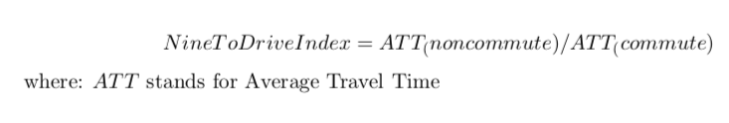
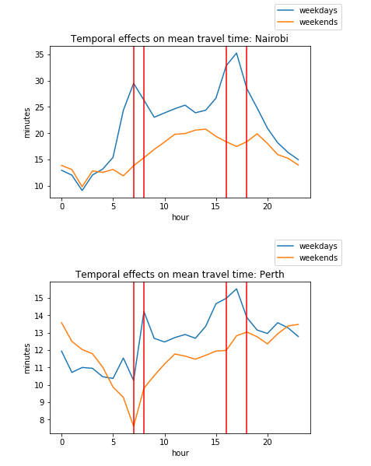

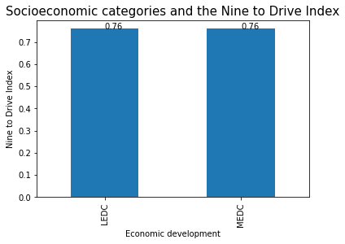
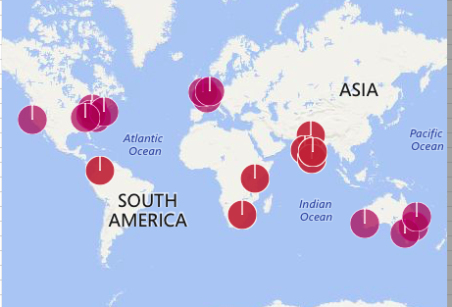
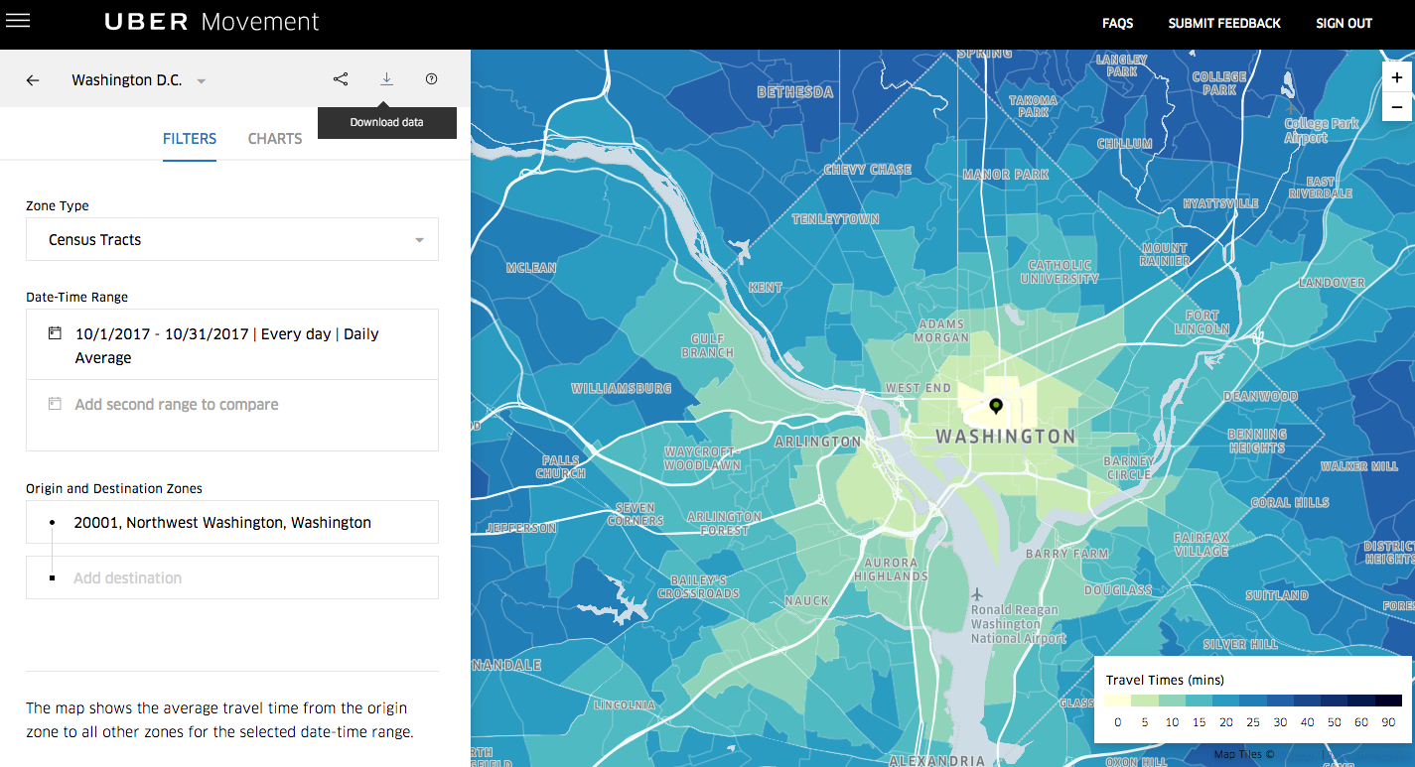
”Working Nine to Drive” :
Socioeconomic Status and Commuter Traffic
Laurence Warner: lpwarner@uchicago.edu, codingforpeoplepeople.wordpress.com
MA Computational Social Science, University of Chicago
Background
Methods
Example time series
Conclusion
The ‘9 to 5’ is a Western capitalist convention of working hours. Conventional wisdom states that it heavily influences traffic patterns.
Hypothesis: traffic in generally non-western LEDCs is not as heavily dictated by commuting hours.
For each city, consider the Average Travel Time (ATT) of all rides.
How does the ATT change depending on temporal factors? I propose a novel index to measure this:
Interpretation: Index takes on values 0-1. 1: no commuter effect. The lower the index, the more significant a ‘Nine to Drive’ commuter effect.
In my analysis, I defined weekday commute hours as those which were the maximum for some city:
Weekday AM; 7, 8
Weekday PM: 16, 17, 18
Nairobi has the most significant Nine To Drive Index: 0.614, whereas Perth has the least significant: 0.871.
Nine To Drive hours are bounded by the red lines.
A Nine to Drive effect exists. Adds approx. 1/3 to travel times (1/2 in the case of Nairobi).
However, there is strong prima facie evidence that the country’s socioeconomic status is not a predictor of a Nine to Drive effect, and that the hypothesis is incorrect.
Data
Limitations
Key Result
Data: only 7 LEDC cities (4 Indian).
Method: Aggregates spatial information
Uber Movement: anonymized data on over 2 billion trips to help urban planners.
In April 2018, Uber expanded its program to 20 cities, 7 of which are from Less Economically Developed Countries (LEDCs), giving unique insight into traffic patterns in those countries.
Large CSVs of all rides from 2016Q1 downloaded systematically and dealt with Pandas.
Future Research
I’ll be picking up a new passenger for my MA thesis: problematic smartphone usage (as part of my #firstweekflipphone project).
Suggestions for building upon this work:
Make use of spatial data: can we identify census tracts which are commuter hubs to validate the link between time & working hours.
Validate with traditional data sources

