Slide 1
Water Utility
AIM:
Comparative Analysis of Water Usage by Purpose
Track the loss of water

Slide 2
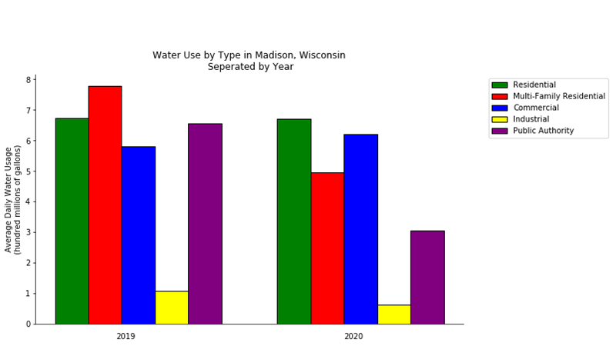

Slide 3
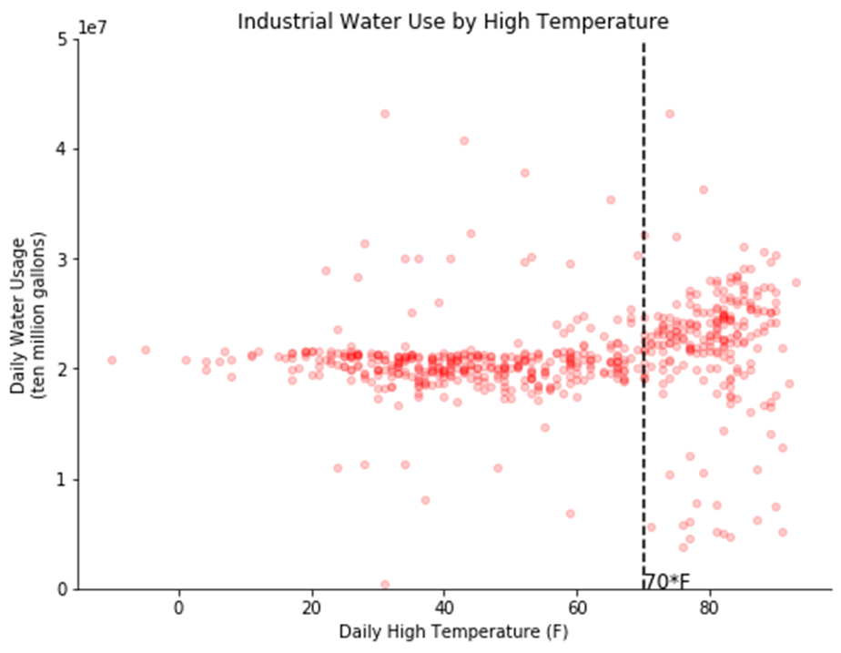

Slide 4
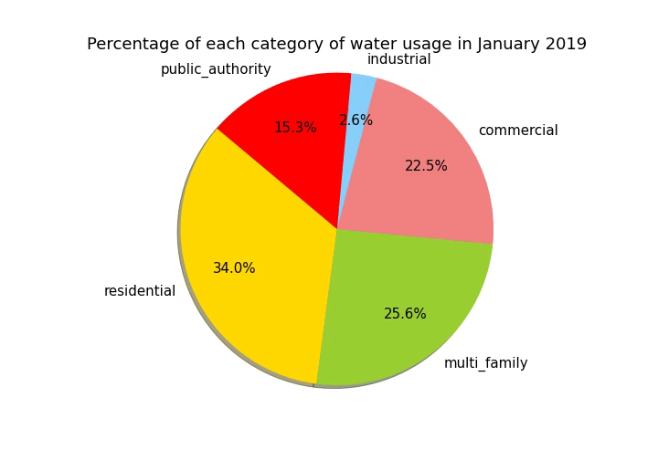
Sudden irregularities in water usage
Might be related to crucial events

Slide 5
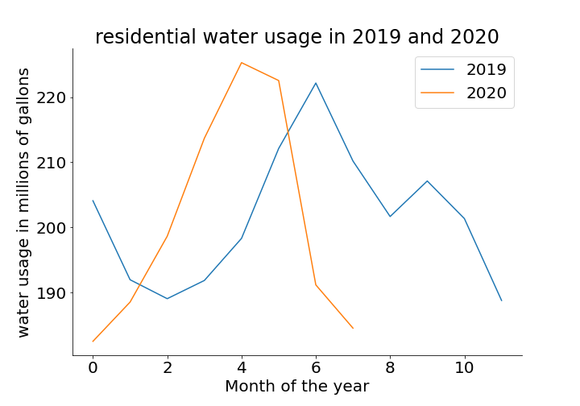

Slide 6
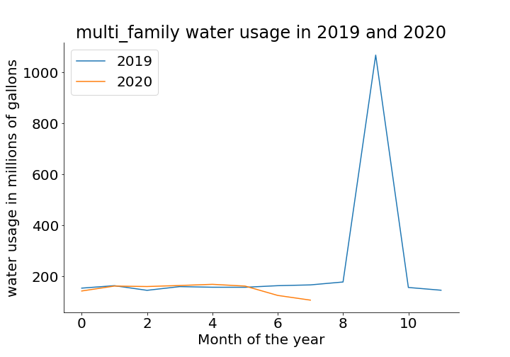

Slide 7
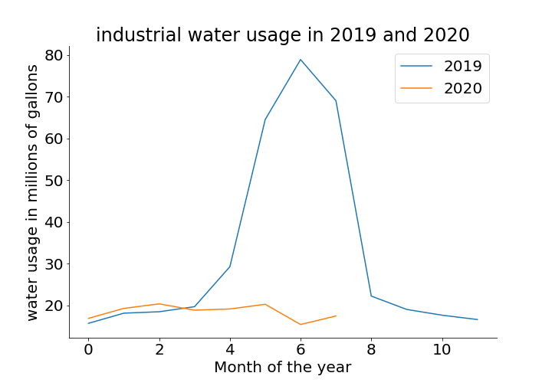

Slide 8
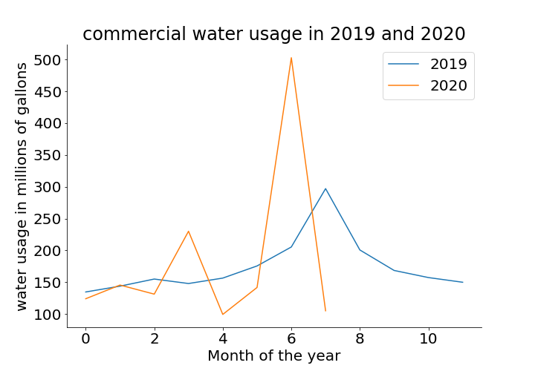

Slide 9
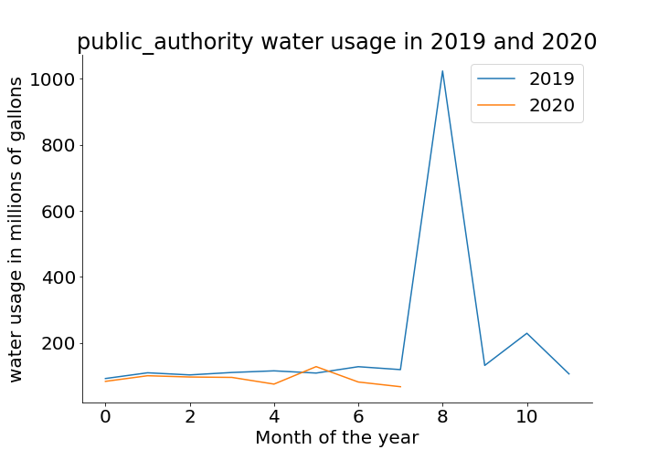

Slide 10


