Slide 1
misfitai
Wear what you already own.
Your closet, calendar, and style instincts. Finally in sync.
Leave-behind · Startup Studio · Spring 2026

Slide 2
THE CHANGE
Closets used to be private.
Phones changed that.
AI just made them queryable.
We're the first product treating a wardrobe as a structured database — built once from a 90-second video, then queried daily by your calendar and the weather.
misfitai
02 / 19

Slide 3
PROBLEM
Closets are full. People feel like they have nothing to wear.
~150
20%
10min
items in the average closet
of those are worn regularly
spent deciding what to wear, daily
Capsule Wardrobe Data July 2020
California Closets via WSJ, reported by The Cut
GQ India
The pain isn't owning too little — it's not being able to see, recall, or recombine what you own. Today's tools (notes apps, photo albums, memory) all break at scale, especially when context like weather or what's on Tuesday's calendar matters.
misfitai
03 / 19

Slide 4



WHY NOW
Three independent shifts just made closet AI buildable for the first time.
People already photograph their clothes.
OOTD posts, flat lays, haul photos, and #shopmycloset content have normalized the exact capture motion our onboarding requires — pointing a phone at clothing.
Context is one click away.
Apple/Google calendar, weather, and location are one OAuth click away. The wardrobe can finally know what tomorrow looks like.
Vision models commoditized.
Gemini 2.5 Flash extracts 10+ structured attributes per garment from a casual photo in a single API call.
The "can this actually work at consumer scale?" question has been answered.
misfitai
04 / 19

Slide 5
SOLUTION
Photograph your closet once. Get the right outfit, every day.
1
Capture
2
Digitize
3
Recommend
>
>
Upload a few photos — a flat lay, a mirror photo, or individual items. No special setup required.
AI extracts each garment and catalogs it. Your wardrobe becomes a queryable database.
Each morning, the app reads your calendar & weather
then picks best outfit for each event.
misfitai
05 / 19

Slide 6

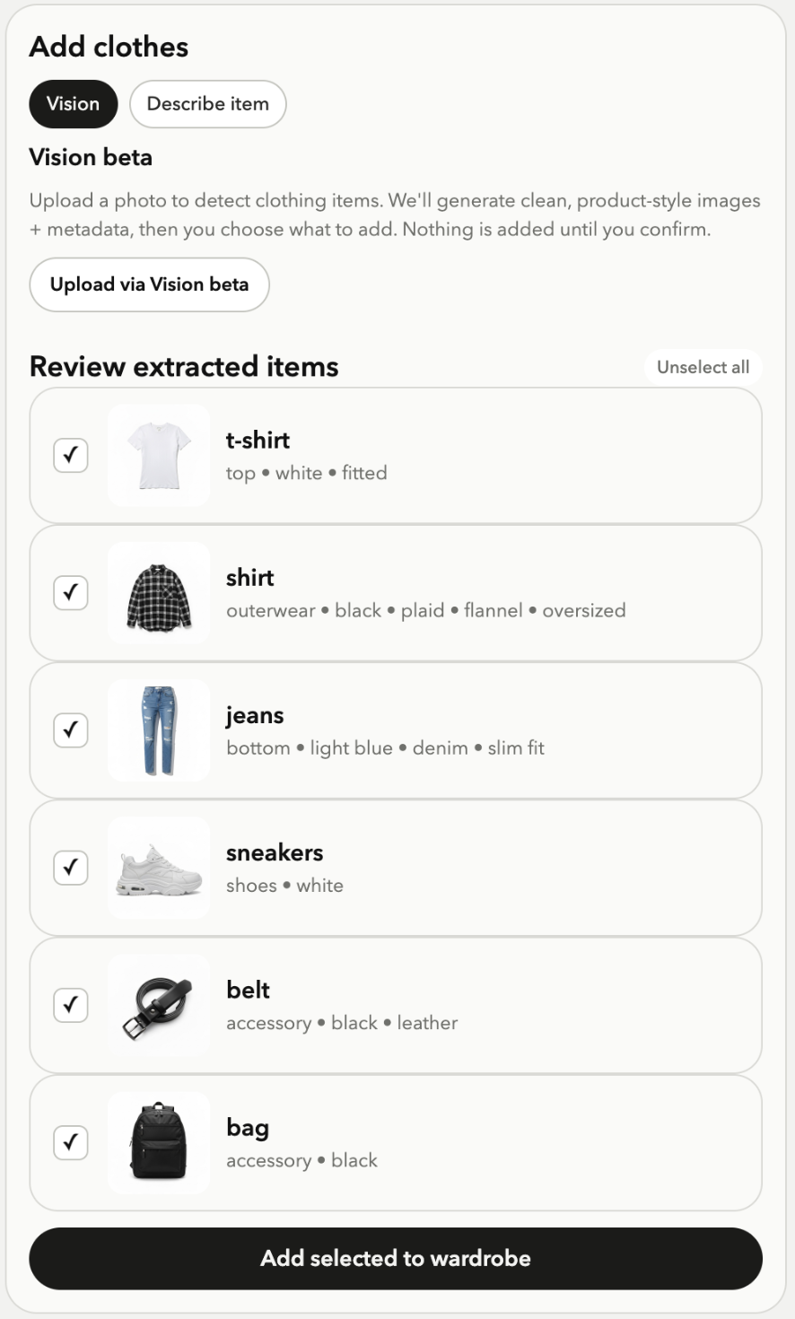
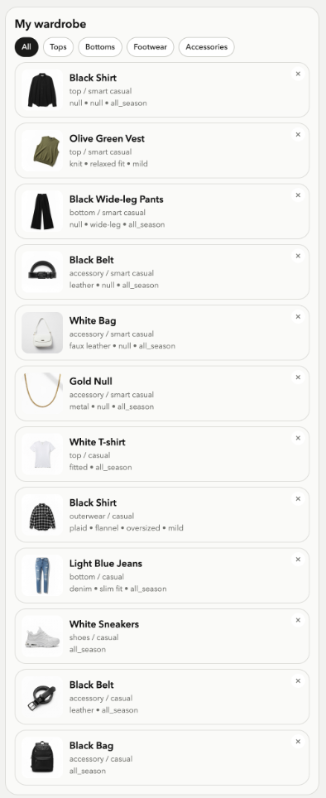
PRODUCT · THE AHA MOMENT
A pile of photos becomes a structured wardrobe in minutes!
>
>
Your OOTD photo
Extract items
Added to wardrobe
06 / 19

Slide 7
ONBOARDING · THE WEDGE
The lowest-friction onboarding any closet app has ever shipped.
Flow A · Quick start
1–2 min
Upload 5–15 photos — a flat lay, individual items, or an outfit shot. The background pipeline extracts garments, deduplicates, and tags each one. Items appear live in a grid as they're processed.
Flow B · Guided capture
2–5 min
Optional, post-onboarding. Power users add high-value or missed items by category with an on-rails, step-by-step flow.
Flow C · Manual cleanup
Always-on
Edit, merge, or delete. Fast corrections — at most 1–2 taps to fix a misdetection.
Design principle: Low friction always leads. Guided and manual are safety nets, never gates.
misfitai
07 / 19

Slide 8
TECH · MOAT
A working vision pipeline built on foundation models
Extract
Render
Store
Recommend
Vertex Gemini
>
Vertex Imagen
>
Supabase
>
Rules + Vertex Gemini
Structured JSON per garment
Clean synthetic product image per item
Each garment as a queryable image
Outfit per event
with explanation
Unit economics: Marginal cost per closet today: ~ $0.50 - $0.80. Target: < $0.10
The moat: Most competitors without a vision pipeline force manual entry. Competitors who built bespoke pipelines own infra debt we don't. We're riding the foundation model cost curve, not fighting it.
misfitai
08 / 19

Slide 9
RECOMMENDATION ENGINE
Rules-based selection + LLM-generated explanation. Fast, debuggable, accurate.
How it works
Tuesday · Work meeting · 62°F
1. Read calendar + weather for the week.
Navy blazer + white oxford
+ slim charcoal trousers + brown loafers
2. For each event, run a formality fallback chain (e.g. work_meeting → formal → smart_casual).
3. Filter wardrobe by event-specific exclusion rules (no tank tops at meetings).
Why:
4. Score by freshness, recency, and color compatibility.
Business-formal for the meeting. Brown loafers soften the look without dropping it to casual. You haven't worn the oxford in 11 days.
5. Generate a one-line explanation with an LLM ("why this works").
misfitai
09 / 19

Slide 10
COMPETITION
Existing tools force manual entry. Status quo is your memory.
 | Manual entry | Calendar / weather aware | Recommends outfits | Onboarding time
Status quo (memory + closet) | — | ✗ | ✗ | Daily, manual
Stylebook | Required | ✗ | Non | 5+ hrs
Whering, Save Your Wardrobe | Required | ✗ | Manual | Hours
Cladwell | Required | ✗ | Generic | 3+ hrs
misfitai | Auto | ✓ | Per event | ≈7 mins
Wedge: every other product asks the user to enter items by hand. We replace that with a 90-second video. Onboarding cost goes from hours to minutes — and that's the gate everyone else fails at.
misfitai
10 / 19

Slide 11
TRACTION
Live since 15th April. Growth is early-stage but compounding.
30
133
signups
garments digitized
live API: misfitai-2026.web.app
across all users
misfitai
11 / 19

Slide 12
BUSINESS MODEL
Freemium subscription, with affiliate revenue on gap-filling recommendations.
Pricing
Revenue layers
Free
$0
Now
Pro subscription — ARPU target $50 /yr.
Up to 50 items. Manual outfit picks.
Pro
$9.99 / mo
+6mo
Affiliate revenue on gap-filling buys ("you don't own black trousers").
Unlimited wardrobe. Calendar + weather. Daily picks.
Pro Annual
$79 / yr
+18mo
B2B: white-label closet for retailers / resale platforms.
Same as Pro · best ARPU.
misfitai
12 / 19

Slide 13
MARKET — BOTTOM-UP
A Bottom-Up Path to $1.6B ARR in the US Consumer Market
US smartphone users age 18–45
[ 110M ]
Reachable: care about style and shop for apparel
[ 32M ]
Serviceable: open to trying a closet-planning app
[ 8M ]
4% paid conversion · $50 annual ARPU
[ $1.6B ARR ]
misfitai
13 / 19

Slide 14
UNIT ECONOMICS — PLACEHOLDER
Margin gets healthier as inference cost drops and LTV extends.
 | Today | After Q4'26 fine-tune | Notes
ARPU (annual) | $50 | $60 | Affiliate layer adds ~$10
COGS — vision (per closet) | $0.18 | $0.05 | Batched + fine-tuned YOLO
COGS — recurring (LLM, infra) | $3 / yr | $2 / yr | Cached explanations
Gross margin | ~94% | ~97% | Software-like
CAC (target, paid) | $15 | $12 | Creator-led GTM
LTV (24mo retention) | $80 | $110 | Calendar lock-in
LTV : CAC | 5.3x | 9.2x | Healthy
misfitai
14 / 19

Slide 15
OUR ROADMAP
Ship iOS, then unlock the affiliate layer. B2B follows traction!
Now
Q3 '26
Q4 '26
2027
Web app live (misfitai-2026.web.app)
iOS build on Expo, internal TestFlight
Vision pipeline v1 in production
App Store launch
Calendar + weather integration GA
First 1K Pro subs
Affiliate links on gap recommendations
Fine-tuned YOLO on DeepFashion2
$10K MRR target
B2B pilot with one retailer
Resale-marketplace tie-in (Depop / Vestiaire?)
$1M ARR
misfitai
15 / 19

Slide 16
RISKS & MITIGATIONS
Three ways this could fail — and what we're doing about each.
1
Vision quality breaks trust.
Ship with confidence thresholds, a 2-tap correction UI, and guided capture as a fallback. Every edit becomes labeled training data for detection, dedupe, and tagging.
2
Outfit help may start as episodic, not daily.
Start with high-intent moments: interviews, work meetings, dinners, travel, bad-weather days, and “what do I wear Tuesday?” prompts. Each use captures feedback and context, turning event-based outfit help into a weekly, then daily habit.
3
Big platforms ship a built-in version.
Vision pipeline + recommendation rules are commoditizing — the moat is the ingest behaviour and the cross-app graph (calendar × weather × wardrobe). Move fast on pilots.
misfitai
16 / 20
Notes:
- If the first closet scan misses items, duplicates garments, or tags clothes incorrectly, users may not trust the recommendations.
Risk 2: Users may not want daily outfit automation
Some users may not need a full outfit every morning, especially if their schedule is repetitive.
Start with high-intent moments: interviews, work meetings, dinners, travel, bad-weather days, and “what do I wear Tuesday?” prompts. Daily picks are the long-term behavior; event-based outfit help is the wedge.
Our advantage is the full wardrobe graph: video ingest + real closet inventory + calendar + weather + wear history + feedback. The faster we activate closets, the better the recommendations become.

Slide 17





TEAM
Engineers who've shipped.
[photo]
[photo]
[photo]
Gautam Agarwal
CEO
ML@Columbia
Google
Shrey Arora
CAIO
CS@Columbia
Ex-Amazon
Shivangi Kumar
CTO
MSCS@Columbia
Ex-Goldman Sachs
[photo]
[photo]
Rushin Bhatt
COO
ML @ Columbia
Ex Fynd (Fashion AI)
Meona Khetrapal
CPO
MSCS@Columbia
Ex-NVIDIA
misfitai
17 / 20

Slide 18
THE ASK
Raising $500K pre-seed to prove closet activation and paid conversion.
12-15 month runway to: 10K sign ups · 2K activated closets · 1K Pro subscribers
[35%]
Growth & Activation
Influencer seeding, campus/style communities, referral loops, and onboarding experiments to drive closet uploads.
[30%]
Mobile Product
First mobile-native designer, TestFlight → App Store launch, QA, closet capture/correction flows, outfit feedback loops.
[20%]
Data & Monetization
One part-time data engineer, wardrobe tagging quality, behavior analytics, affiliate integrations, retail/resale partnerships, and gap-filling recommendations.
[15%]
Infrastructure & Operations
Hosting, inference, analytics tooling, support, compliance, and basic operating costs.
misfitai
18 / 20
Notes:
[40%] Vision pipeline
Improve closet scan quality and reduce processing cost.
Fine-tune YOLO on DeepFashion2, improve dedupe/tagging accuracy, and cut inference cost to <$0.05 per closet.
[35%] Growth
Launch iOS and acquire the first 10K users.
Run 2 creator pilots, launch on TestFlight → App Store, and build campus/style-community growth loops.
[25%] Team
Add the design and ML support needed to ship fast.
Hire a mobile-native designer and part-time ML/data engineer to improve onboarding, wardrobe review, and recommendation quality.

Slide 19
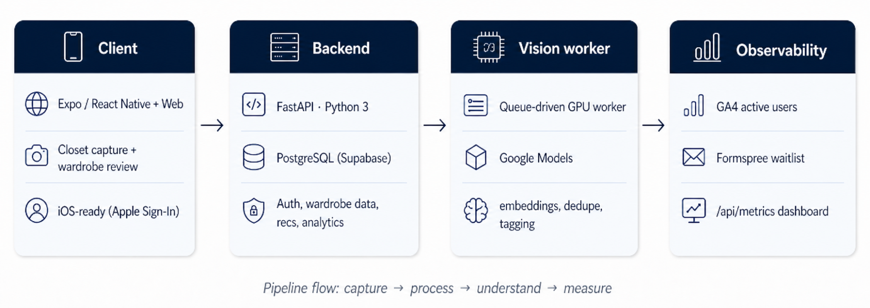
APPENDIX · ARCHITECTURE
Simple, modular infrastructure built for scalable closet digitization.
FastAPI + PostgreSQL + a GPU vision worker - reliable, debuggable, and ready to scale.
Client
Expo / React Native · Web (Firebase Hosting) · iOS-ready (Apple Sign-in)
Backend
FastAPI · Python 3 · PostgreSQL (Supabase) · Auth + analytics + recs
Vision worker
YOLOv8s + EfficientSAM · open_clip ViT-B/32 · Single T4/L4 GPU, queue-driven
Observability
GA4 active users · Formspree waitlist · /api/metrics dashboard
misfitai
19 / 20

Slide 20
misfitai
Wear what you already own. Let AI make it effortless.
Thank you.
20 / 20

