Slide 1
Team Tatooine
Chemistry & Biology project

Slide 2
Table of contents
01
02
03
04
Our team
Our Idea
Stages of realization
Used technologies

Slide 3
01
Our Team

Slide 4
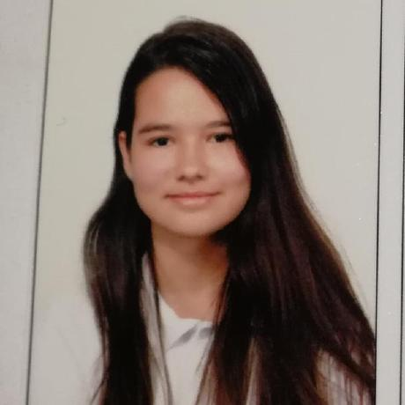
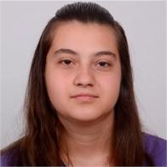
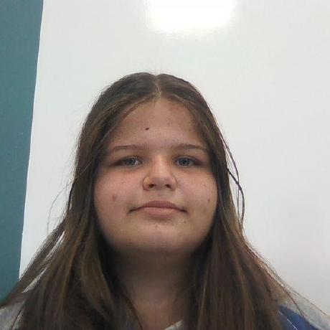
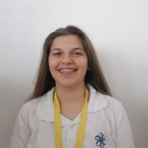
Galya Ivanova
Zhasmina Mihaleva
Petya Stoyanova
Aleksandra Petrova
Scrum trainer
Backend Developer
Backend Developer
Designer

Slide 5
02
Our idea

Slide 6
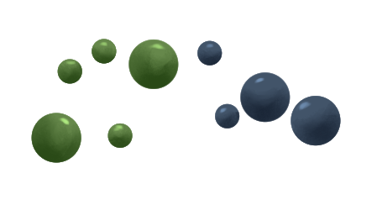


Our task was to create educational application connected with biology or chemistry

Slide 7
03
Stages of realization

Slide 8
01
02
03
04
Idea & organization
Realization
Test
Present

Slide 9
04
Used technologies

Slide 10











Slide 11
Let’s go to our game

Slide 12
Thanks for your attention!

