Slide 1
Welcome The Python Project
Calculter and speed test game

Slide 2
on script that performs various tasks such as user authentication, presenting options to the user,
presenting options to the user, and offering functionalities like a calculator and a speed test game.
1. User Authentication:
It prompts the user to enter their name and checks if it matches 'shubham'. If it does, it prints
'Hello'; otherwise, it prints 'Sorry, wrong name
It prompts the user to enter a password and checks if it matches 'python'. If it does, it prints a
welcome message; otherwise, it prints 'Wrong password

Slide 3
2. Project Selection:
It presents the user with two project options: 'Calculator' and 'Speed Test
Based on the user's selection, it executes the corresponding functionality.

Slide 4
3. Calculator Functionality:
If the user selects 'Calculator', it presents arithmetic operations (addition, subtraction,
multiplication, and division) and performs the chosen operation on two numbers entered by the user

Slide 5
4. Speed Test Functionality:
If the user selects 'Speed Test', it prompts the user to answer a certain number of arithmetic
questions within a specified time limit
The user's performance (number of correct answers and time taken) is displayed at the end

Slide 6
5. Additional Functions:
It includes functions to generate arithmetic questions and to play the speed test game

Slide 7
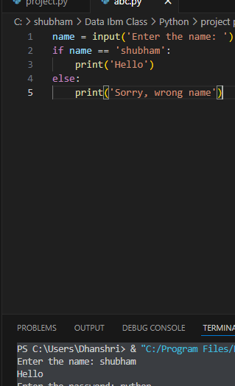
Project start 1 st step user input value
Step 1 it prompts the user to input their name and checks if the name entered is ‘shubham’ if it is it
Prints ‘hello’ otherwise it prints ‘sorry , wrong name’

Slide 8
.
2. User Input:
The script prompts the user to enter a password using the input() function and stores the input in the variable password
2. Password Verification:
It then checks if the entered password matches the string 'python' using an if statement
If the password matches, it prints a welcome message enclosed in asterisks
If the password doesn't match, it prints 'Wrong password

Slide 9
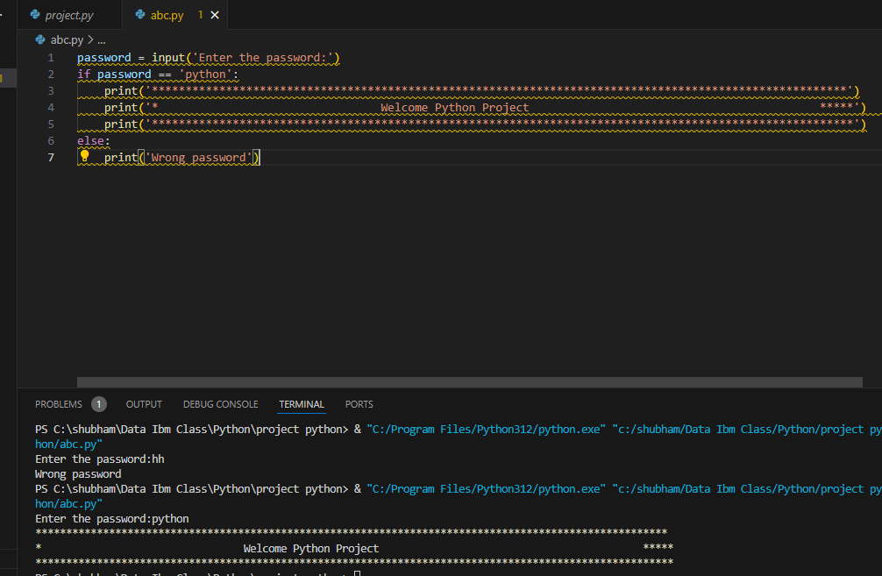

Slide 10
Start
If statment
false
Condition
Body of Else
True
Body of if
End

Slide 11
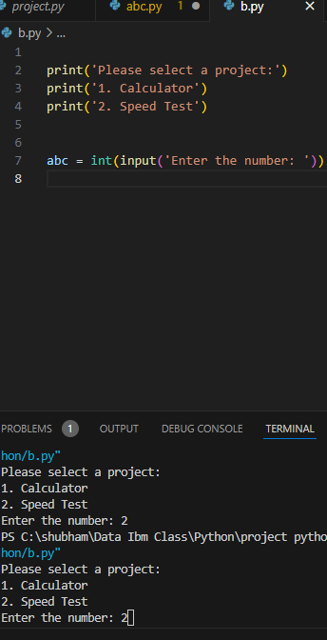
3 rd part start this project select the project option
It seems like you're starting a Python project where the user selects an option from a menu. You've got
the menu printed out nicely, and you're prompting the user to enter a number to select an option

Slide 12
Select The Calculter programe
1. If the user selects option 1 (Calculator), the program enters into the block where various arithmetic
operations can be performed
2. Inside the "Calculator" block, the program displays another menu with four arithmetic operations
addition, subtraction, multiplication, and division
3. After displaying the menu, the program prompts the user to enter a choice (a number from 1 to 4)
corresponding to the arithmetic operation they want to perform
4. Depending on the user's choice, the program executes the corresponding block of code. For
example, if the user chooses addition (entering 1), the program prompts the user to enter two numbers
adds them together, and prints the result. Similarly, the program handles subtraction, multiplication
and division based on the user's choice

Slide 13
Each arithmetic operation is contained within its own if statement, ensuring that only the code corresponding to the user's choice is executed.
The program uses input() functions to accept user input, int() to convert the input to integers since arithmetic operations are expected, and then performs the calculations accordingly
Overall, this code provides a simple calculator program where users can perform basic arithmetic operations by selecting from a menu

Slide 14
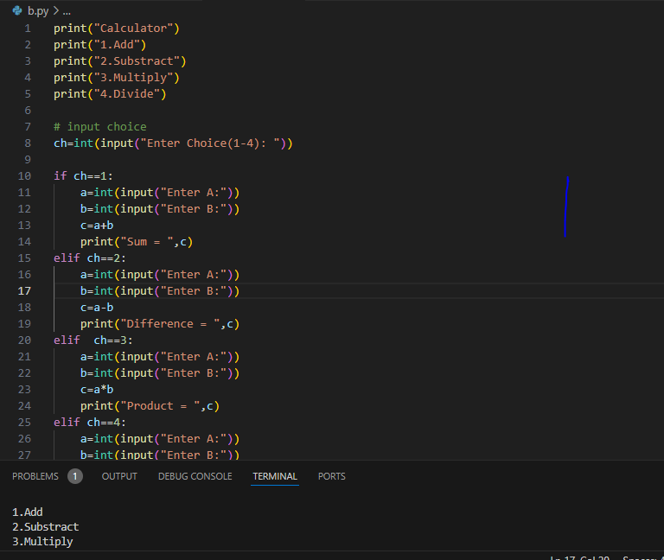

Slide 15
1.generate_question() function :This function generates a random arithmetic questionit randomly selects two operands
(‘op1’ and ‘op2’) between 1 and 11 and a random aritmatic oprator (‘operand’) from the set [‘+’,-’,*’,’/’] it then calculates the
Correct answer based on the selected oprator and returns both and question and the answer as a tuple
2.play_game() function this function is the main game loop it first asks the plyear to enter their name if the name entered it is
Shubham it prints name correct otherwise it prints wrong name but don’t worery continue study. It then asks the plyear to
How many question they want to answer .it initializes a varible ‘correct’ to keep track of the number of correct
Answersand start_time to record the start time of quiz it then iterates through a loop for the specified number of
Questions generating a question using the ‘generate_question()’ function asking the player to input their answer and
Checking if the answer is correct.it increment the’correct’ varible if the answer is correct_after the loop ends it calcu
Ter the total timestaken for the quiz (end_time to start_time) and prints the number of corre answer and time taken
3.Play game() function call finally the scripts calls the play_game() function to start the quiz

Slide 16
