Slide 1
Distributed tasks with aws sqs

Slide 2
What is sqs
Amazon Simple Queue Service (Amazon SQS) offers a reliable, highly-scalable managed hosted queue for inter communication between applications or microservices. SQS moves data between distributed application components and helps you decouple

Slide 3
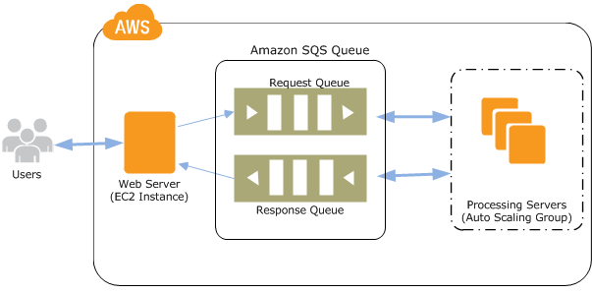
Typical sqs architecture

Slide 4

Queue types

Slide 5
1.
Standard queue

Slide 6
2.
FIFo queue

Slide 7
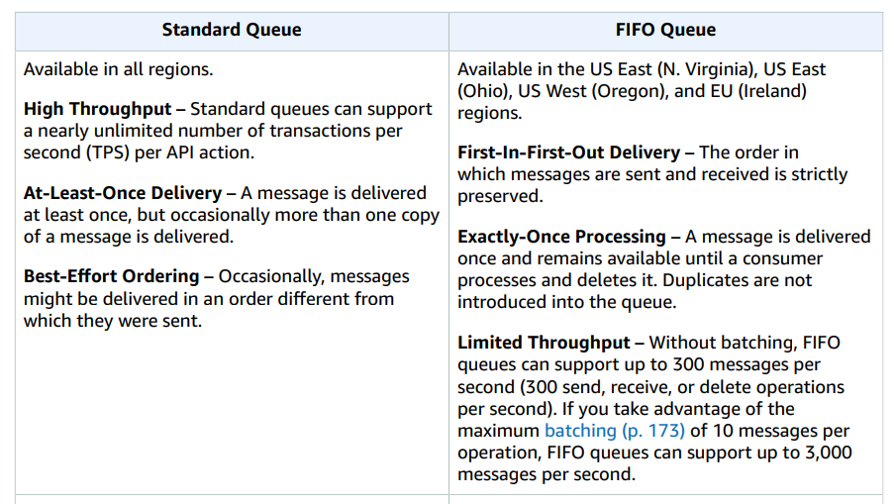

Slide 8
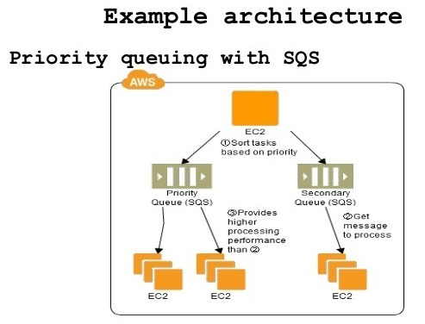
Priority queue

Slide 9
THANKS!
Any questions?
Do not hesitate to reachout in the forums!

