Slide 1
COMPACT SAFETY DEVICE
TEAM-24
PROTOTYPING AND TESTING PROJECT

Slide 2
TEAM MEMBERS
K SAI DINESH (CS20B1122)
G KAVYA SRI (CS20B1126)
K SATHWIKA (EC20B1011)
SAHITHI PATTEM (EC20B1116)
S SAKET REDDY (ME20B1054)

Slide 3
MOTIVATION
Safety is becoming a major concern in India, especially for women and children. Also, the crime rate is on a spike in India. With increasing exposure of women in different fields, the amount of violence has also increased many a fold due to this. When it comes to children, kidnapping cases are on a rise in India with over 101 thousand kidnapping and abduction cases in year 2021 alone. So our objective is to:
Provide a compact device which can make calls and share our location with the emergency contacts.
Should protect the bearer against the assaulters though some self-defence mechanism.

Slide 4
LITERATURE SURVEY
Personal Safety Device Using GPS and GSM(2014)
This paper proposed a wearable device that sends an alert message to the user’s emergency contacts and a central monitoring system when the user presses a panic button. The device uses GPS and GSM technologies to provide the user’s location.
Wearable Panic Button with GPS Location (2018)
This study developed a small wearable device that sends a panic signal to a mobile app and emergency contacts. The device is equipped with GPS technology to provide the user's location information.
Compact Safety Device with GPS and Bluetooth (2019)
This research proposed a compact safety device that uses GPS and Bluetooth to send location information and alert messages to emergency contacts. The device is small enough to be attached to a keychain or worn as a pendant.

Slide 5
ROADMAP- TIMELINE
Week: 1-4
(6th - 27th January, 2023)
Searching and defining the problem statement for the project. Doing a market research for pinpointing the target audience and understanding what is really needed.
Week: 5-9
(3rd February - 3rd March, 2023)
Performing the literature survey by searching for any existing products/technologies in use & devising a viable solution. 3D Modelling & iteration. Idea validation through hackathon.
Week: 9-15
(17th March - 14th April, 2023)
Ordered the necessary components from Amazon. Started assembling the product and coding the working process of the device. Gaining insights for improvement in 2nd hackathon

Slide 6
ROLES & RESPONSIBILITIES
K SAI DINESH:
Wrote the code for the working of Arduino & did some literature survey.
KAVYA SRI:
Defined the problem statement, did literature survey and ordered the components.
SATHWIKA & SAHITHI:
Selected the right components & were responsible for designing & assembly of the circuits.
SAKET REDDY:
Designed the 3D CAD model for our product & made improvements over it based on professor’s feedback.

Slide 7
METHODOLOGY
This product is put to use when the assaulter tries to attack the user. The following actions take place:
Make a call
(SIM800L)
Button Pressed
Person receives call & message
Send Msg. with GPS coordinates
(NEO-6M GPS)
Self-defence Mech.
Pepper Spray

Slide 8
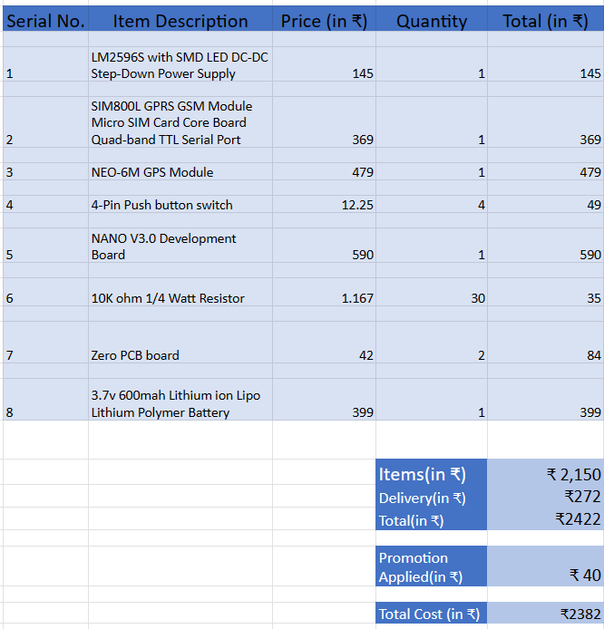
BILL OF MATERIALS

Slide 9
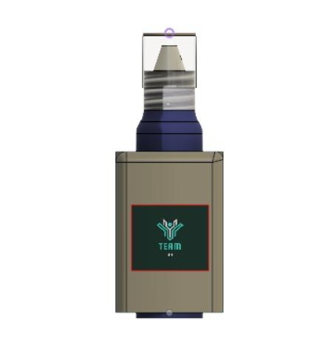
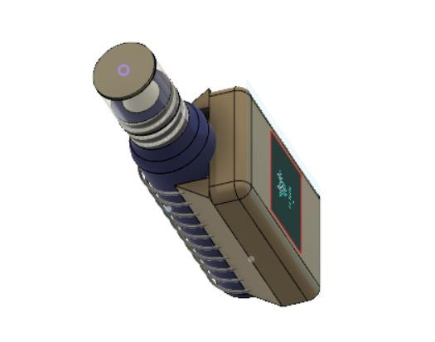
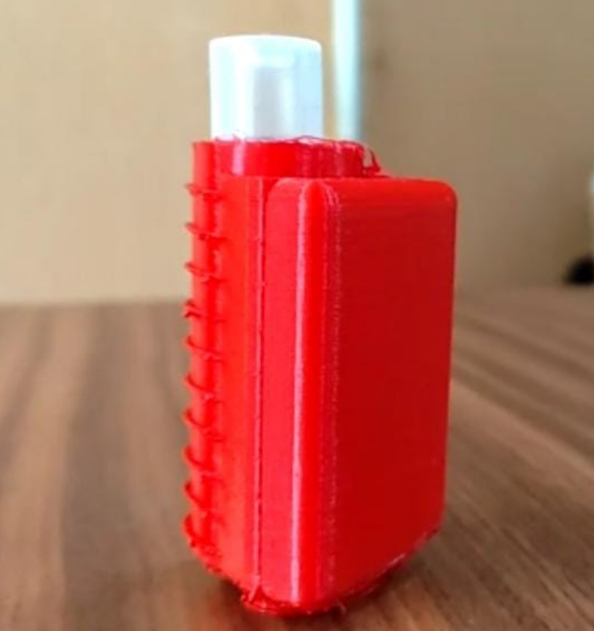
THE PRODUCT

Slide 10
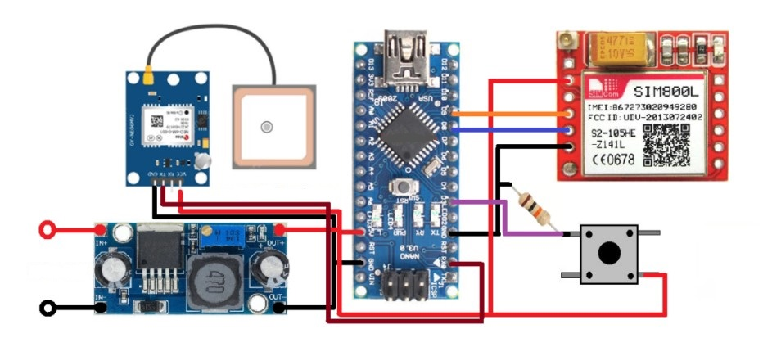
CIRCUIT DIAGRAM

Slide 11
SCOPE
IN Features:
Sends notifications with GPS location to emergency contacts in case of an emergency
Can make emergency calls using a SIM module, even if the user's phone is not nearby or not working
OUT Features:
College student: Expects the device to provide a sense of security when walking home alone at night.
Senior citizen: Expects the device to be easy to use and understand, and to have a GPS location feature that can help emergency responders find them quickly in case of a medical emergency.
Parent: Expects the device to help keep their child safe when walking to and from school or other activities, and to provide a way to call for help or alert them in case of an emergency situation.
User: Expects the device to be affordable and accessible for all users.
CONSTRAINTS
Presence of network.
Accessibility of the device.
Working of GPS.
Strength of the user.

Slide 12
KEY TAKEAWAYS
Learning/Benefits
Compact safety devices with multiple functionalities are effective for personal safety.
Alert message, GPS address, and call functionalities can provide quick and reliable notifications.
Shock generation, piezoelectricity,hidden camera,activation of alarm and pepper spray can increase the device's effectiveness as a deterrent.
Prioritizing safety in the workplace, minimizing loss costs, and ensuring the device takes up less space can improve its overall usability and accessibility
Specific Takeaways
Alert message feature
GPS tracking system
Call feature
Shock generation feature
Piezoelectricity
Pepper spray integration.
Minimize loss cost
Less space (easy to carry)

Slide 13
FUTURE SCOPE
The following aspects can brought into the product in the near future:
Integrate the device with a app which connects to the nearest police station helpline to contact for help.
Make the device’s working network independent.
Using VPS (Visual Positioning System) instead of GPS.
Integrate a piezoelectric shockwave generator with the device, which gives an electric shock when the assaulter tries to dispossess the user of the device.
Inbuilt memory storage of camera recording

Slide 14
CONCLUSION
Finally, we conclude our project by saying that this product can make a positive impact in contributing to the safety of women and children in general use cases. This device can help the women and children to feel more safe when they step outside of the house and give themselves a better chance of defending themselves against the assaulters. With improvements in technology, we can integrate stronger self-defense gadgets to this device and make it go network-less, to increase its effectiveness and thus perform better in these kinds of situations.
REFERENCES
WOMEN SAFETY DEVICE BASED ON GPS & GSM (2020)
E-defense-for-women-safety

