Slide 1

MobileNet
Name : G.KAVYASRI
Roll No: CS20B1126

Slide 2
CORE CONCEPT
MobileNetV1 -tdepth-wise separable convolutions
MobileNetV2 - Adds inverted residual blocks and linear bottlenecks.
MobileNetV3
Introduced multiple versions: MobileNetV3-Large and MobileNetV3-Small.
Included squeeze-and-excitation blocks for channel-wise dependencies.

Slide 3
Introduction
Introduced by Google in 2017.
MobileNet is a popular convolutional neural network (CNN) architecture designed for efficient and lightweight deep learning inference on mobile and embedded devices.
Uses depth-wise separable convolutions
Main focus: Achieving high accuracy with low computational and memory requirements.

Slide 4
Proposal
An efficient network architecture and a set of two hyper-params in order to build very small, low latency models that can be easily matched to design requirements for mobile and embedded vision application.
Small Network
Compressing - Product quantization , Hashing , Pruning ,Vector quantization , Huffman coding
Shrinking - Width multiplier , Resolution multiplier
Factorizing - to speed up pretrained networks
Distillation - uses a larger network to teach a small network - Face Attributes.
Low bit network

Slide 5
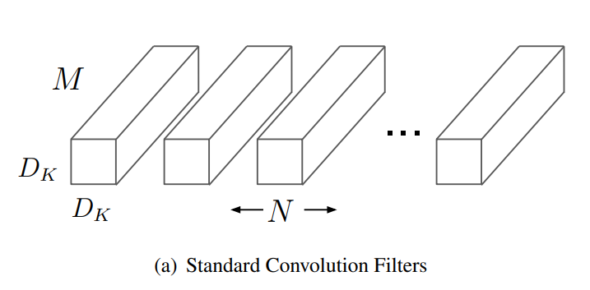
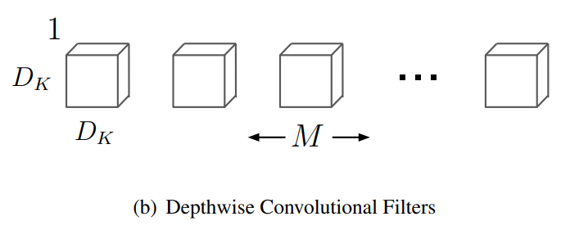
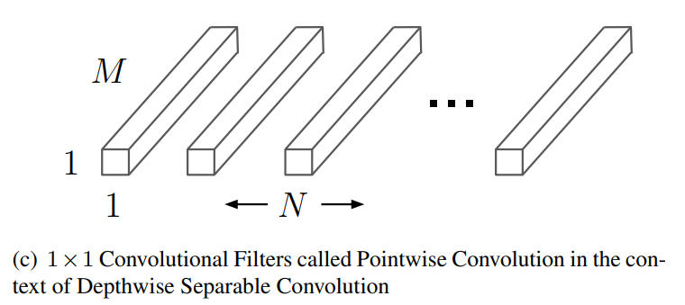
Depth-wise separable convolution
Depth-wise Separable Convolution = Depth-wise convolution + pointwise convolution
The standard convolutional filters in (a) are replaced by two layers: depth-wise convolution in (b) and pointwise convolution in (c) to build a depthwise- separable convolution.

Slide 6
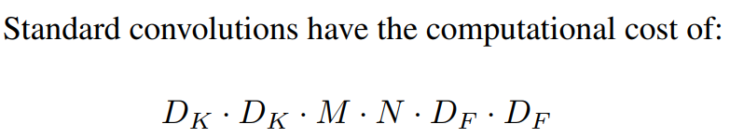

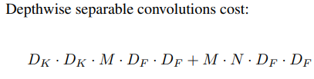
Computational cost
computational cost = (#of elements per kernel) * (# of kernels) * (# of positions taken per kernel)
Depth-wise separable convolutions to break the interaction between “the number of output channels” (N) and “size of the kernel” (D_{K})
Where
D_{K}: Kernel size
M : # channels (depth) of input feature map
N: # filters (output channel/depth)
D_{F}: Input feature map size

Slide 7
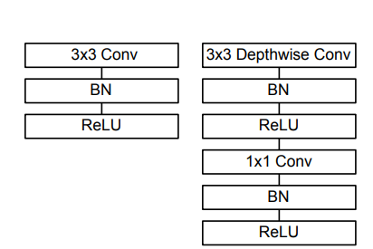
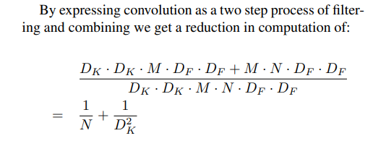
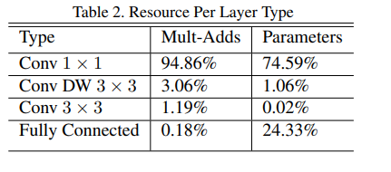
Reduced Computation
Depth-wise separable convolution Layer
By expressing convolution as a two step process of filtering and combining we get a reduction in computation of:
Standard Conv Layer
MobileNet uses 3 × 3 depth-wise separable convolutions which uses between 8 to 9 times less computation than standard convolutions.

Slide 8

Two Hyper-Parameters
Width Multiplier (α)
Thinner model (reduce channels)
Computational cost
Where α ∈ (0, 1] with typical settings of 1, 0.75, 0.5 and 0.25.
α = 1 is the baseline MobileNet
α < 1 are reduced MobileNets.
The number of parameters quadratically by roughly α ^2 .
Resolution multiplier (ρ)
Reduced Representation (reduce width & height)
where ρ ∈ (0, 1] with input resolution of the network is 224, 192, 160 or 128.
ρ = 1 is the baseline MobileNet
ρ < 1 are reduced computation MobileNets.
Resolution multiplier has the effect of reducing computational cost by ρ^2 .

Slide 9
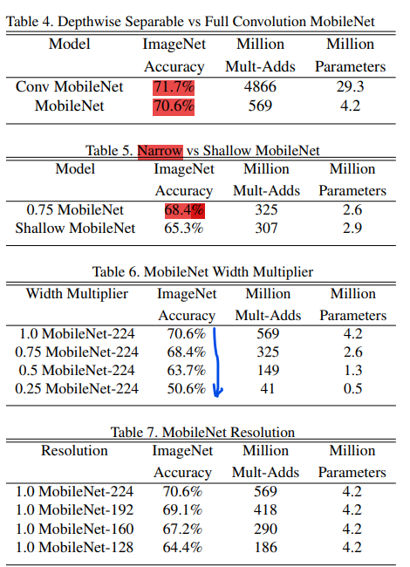
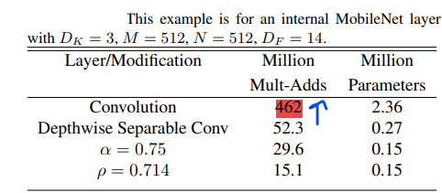
Experiment Results:

Slide 10
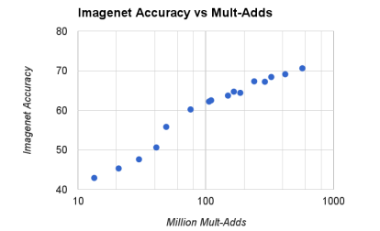
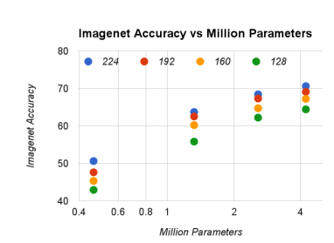
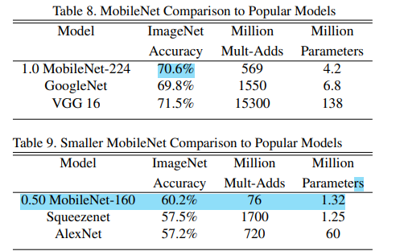
Testing on 16 models made from the cross product of width multiplier α ∈ {1, 0.75, 0.5, 0.25} and resolutions {224, 192, 160, 128} using ImageNet benchmark.
Results are log linear with a jump when models get very small at α = 0.25
The colors encode input resolutions.
The number of parameters do not vary based on the input resolution.
Applications:
Fine Grained Recognition –fine tuning
Large Scale Geolocalization - PlaNet
Face Attributes – Distillation
Object Detection
Face Embeddings – Train by min squared diff of output of FaceNet and MobileNet

Slide 11
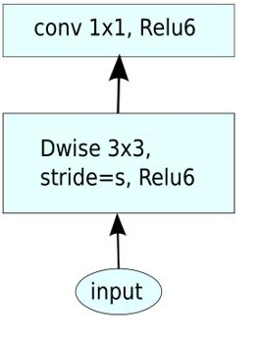
MobileNet V1
Introduced by Google in 2017.
Key idea: Depth-wise separable convolutions to reduce computation.
Architecture overview:
Regular convolution followed by depth-wise convolution and pointwise convolution.
Depth-wise convolution performs channel-wise convolutions followed by 1x1 pointwise convolutions
Benefits:
Low model size and computational complexity.
Suitable for image classification tasks on resource-constrained devices.

Slide 12
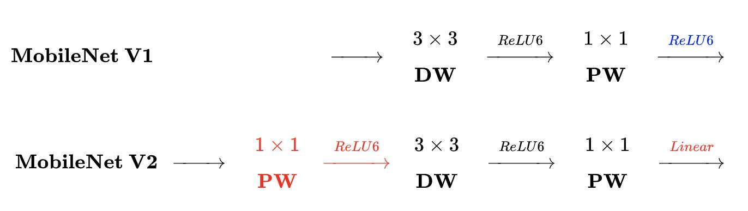
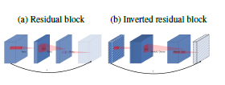
MobileNet V2
Introduced in 2018 as an improvement over MobileNet V1.
Key Idea: Inverted residual blocks with linear bottlenecks.
Main focus: Improve performance and efficiency.
Architecture features:
Inverted residual blocks: Efficient architecture with skip connections for gradient flow.
Linear bottlenecks: Pointwise convolutions to reduce dimensionality.
Introduces skip connections for better gradient flow.
Benefits:
Higher accuracy with comparable computational requirements.
Well-suited for object detection, semantic segmentation, and computer vision tasks.

Slide 13
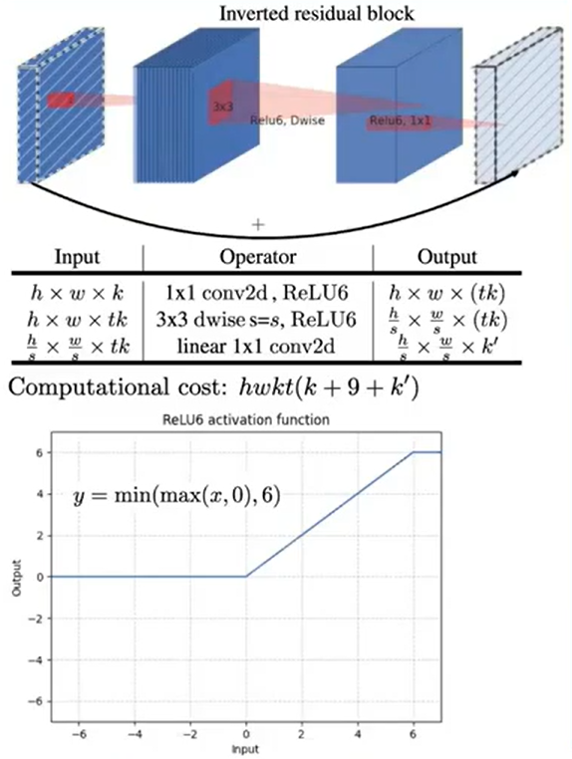
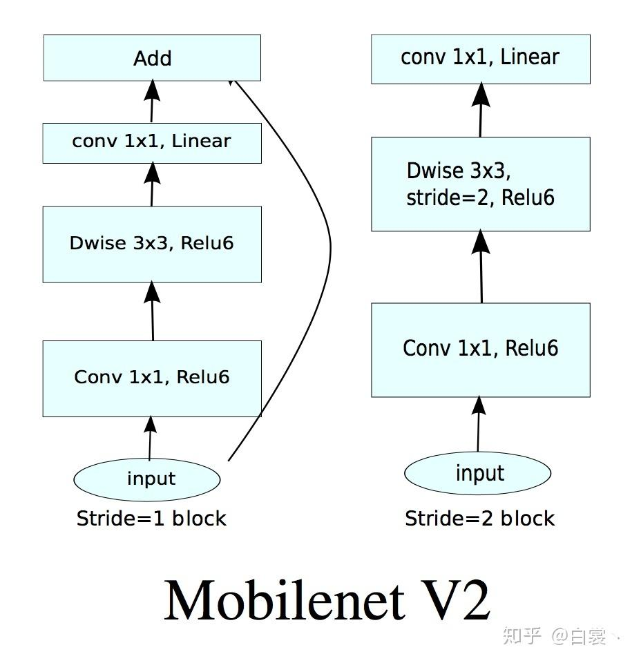
Inverted Residual block

Slide 14

Information loss
Higher dim activation increases => No. of channels increases => Higher chances to recover lost info about MoI (Intuititve Justification)
ReLU causes information loss when applied on low dim activations (channels) => Transformation process
MoI (Manifold of Interest) can be encoded on low-dimensional activations

Slide 15
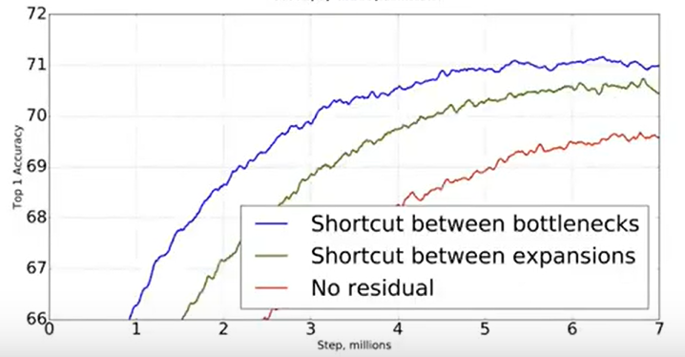
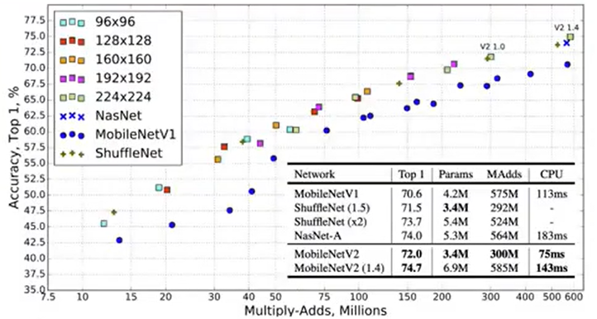
Experiment Results

Slide 16
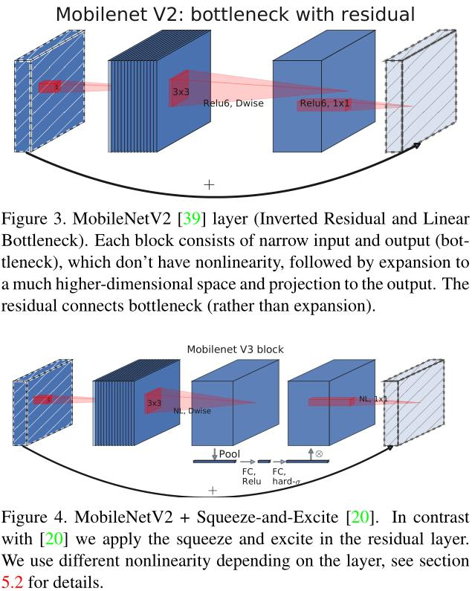
MobileNet V3
Introduced in 2019, further optimizing MobileNet models.
Key Idea: Squeeze-and-excitation (SE) blocks and Hard-swish activation function
Main focus: Pushing the performance limits with advanced techniques.
Architecture enhancements:
Introduces squeeze-and-excitation (SE) blocks for channel-wise attention.
Uses the hard-swish activation function for reduced computational cost.
Benefits:
Improved accuracy and efficiency for real-time image classification, object detection, and semantic segmentation.

Slide 17
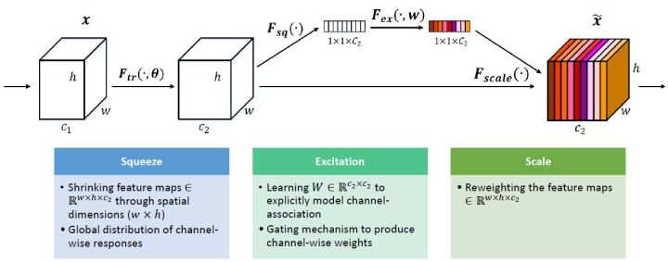
Squeeze and Excitation Blocks

Slide 18
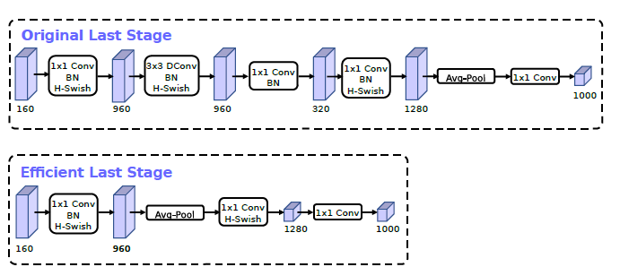
Redesigning Expensive Layers
Able to reduce the number of filters to 16 while maintaining the same accuracy as 32 filters using either ReLU or swish. This saves an additional 2 milliseconds and 10 million MAdds
This more efficient last stage is able to drop three expensive layers at the end of the network at no loss of accuracy.

Slide 19

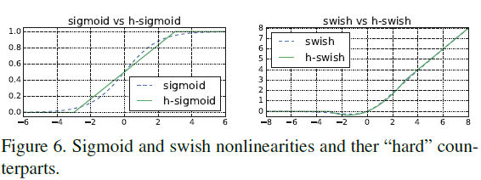
Hard-swish activation function
replace sigmoid function with its piece-wise linear hard analog.

Slide 20
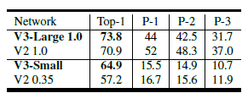
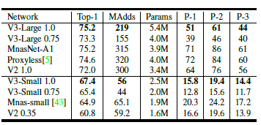
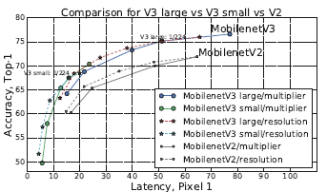
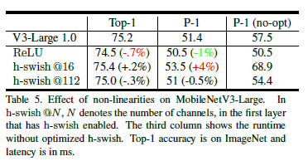
Comparison Results
All our convolutional layers use BN layers with average decay of 0.99

Slide 21
Summary of Differences
MobileNet V1 | MobileNet V2 | MobileNet V3
Introduces depth-wise separable convolutions | Adds inverted residual blocks and linear bottlenecks. | Introduced multiple versions: MobileNetV3-Large and MobileNetV3-Small.
Used standard convolutional layers and point-wise convolutions.. | Used linear bottlenecks for efficient information flow and Employed depth-wise separable convolutions like MobileNetV1... | Included squeeze-and-excitation blocks for channel-wise dependencies.
Did not include residual connections. | Include residual connections | Focused on improving efficiency and performance trade-offs.
Applied 3x3 convolutions in most layers | Applied a combination of 3x3 convolutions in some layers and added 1x1 point-wise convolutions for channel expansion and reduction | Applied a combination of 3x3 and 5x5 depth-wise convolutions, as well as 1x1 convolutions for expansion and reduction.
Efficiently reduced the number of parameters and computations. | Achieved better accuracy compared to MobileNetV1. | Achieved higher accuracy with reduced computational cost.
Used standard activation functions. | Used linear bottlenecks with ReLU6 activations. | Utilized the hard-swish activation function for non-linearity

Slide 22
Use cases
MobileNet V1: Efficient feature extraction for image classification.
MobileNet V2: Object detection, semantic segmentation, and computer vision tasks.
MobileNet V3: Real-time image classification, object detection, and semantic segmentation.

Slide 23
Research Papers
Efficient Convolutional Neural Networks for Mobile Vision Applications [Link]
MobileNetV2: Inverted Residuals and Linear Bottlenecks [Link]
Squeeze-and-Excitation Networks [Link]
Searching for MobileNetV3 [Link]

Slide 24


