Slide 1
CAPGEMINI | SPRINT EVALUATION
Asset Lifecycle
Management System
A role-based application for managing assets, maintenance requests, and operational visibility.
SAP CAP • SAP Fiori • OData services • SAP BTP deployment

Slide 2
Project Overview
01
What the system does
User
Admin
Provides a central application to track company assets and coordinate maintenance work across different user roles.
View assigned assets and raise maintenance requests.
Maintain master data and review maintenance requests.
Core idea
The right user sees the right functions, while asset and maintenance information is managed through backend services.
Manager
Monitor maintenance activity and review reports.
ASSET LIFECYCLE MANAGEMENT | PROJECT OVERVIEW
02

Slide 3
Problem Statement & Objectives
02
Challenges addressed
Project objectives
• Asset details can be spread across multiple records
• Maintenance requests need a clear workflow
• Different teams need role-appropriate views
• Managers need a quick overview of asset operations
• Organize asset information in one application
• Enable users to submit maintenance requests
• Support admin review and approval decisions
• Give managers visibility into maintenance status and reports
ASSET LIFECYCLE MANAGEMENT | PROJECT OVERVIEW
03

Slide 4
Maintenance Request Workflow
04
01
02
03
04
05
Submit
Review
Decision
Track
Close
User creates a maintenance request for an asset.
Admin checks the request and its details.
Admin approves or rejects the request.
Manager monitors progress and status.
Request is updated when work is completed.
ASSET LIFECYCLE MANAGEMENT | PROJECT OVERVIEW
05

Slide 5
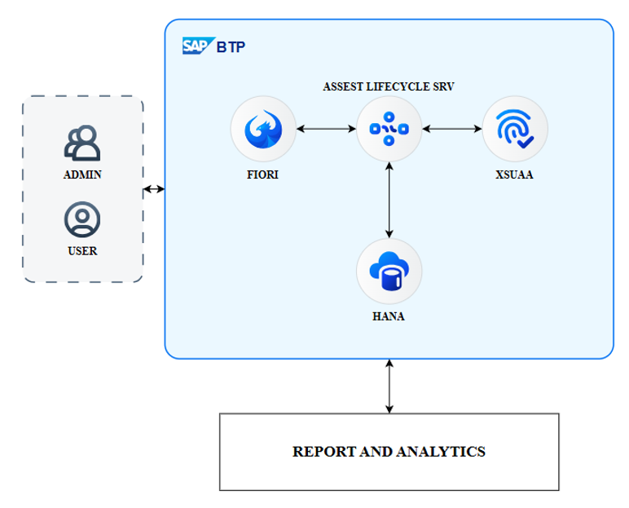
System Architecture
05
1. Presentation layer
2. Service layer
3. Data layer
Fiori-style web pages
User Dashboard
Admin pages
Manager Dashboard
SAP CAP services
CDS service definitions
OData V4 endpoints
Role-based authorization
Database persistence
Asset records
Employee/user mapping
Maintenance requests
Deployment target: SAP Business Technology Platform (BTP), using Cloud Foundry and the configured application services.
ASSET LIFECYCLE MANAGEMENT | PROJECT OVERVIEW
06

Slide 6
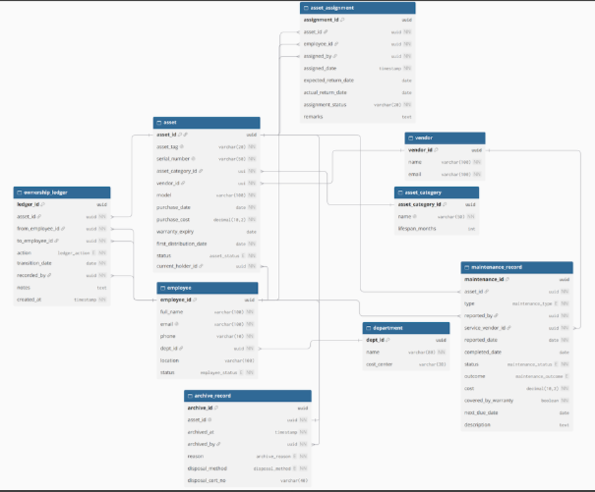
Entity Relationship Diagram
06
SAP CAP
CDS
Backend application framework
Data models and service definitions
OData V4
Fiori-style UI
API access for UI and service operations
Role-specific web interface
SAP BTP / Cloud Foundry
HANA / configured database
Cloud deployment environment
Persistent application data
ASSET LIFECYCLE MANAGEMENT | PROJECT OVERVIEW
07

Slide 7
User Roles & Responsibilities
03
USER
ADMIN
MANAGER
View assigned assets
Raise maintenance requests
Track request status
Manage asset/master data
Approve or reject requests
Maintain data quality
Monitor maintenance work
Review operational reports
Follow request progress
ASSET LIFECYCLE MANAGEMENT | PROJECT OVERVIEW
04

Slide 8
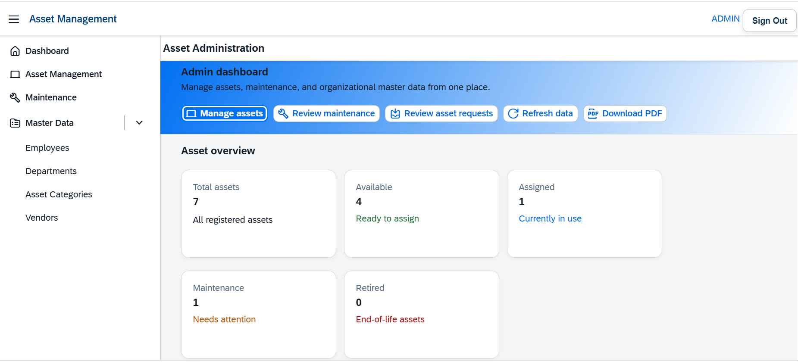
Output Screens
07
ASSET LIFECYCLE MANAGEMENT | PROJECT OVERVIEW
08

Slide 9
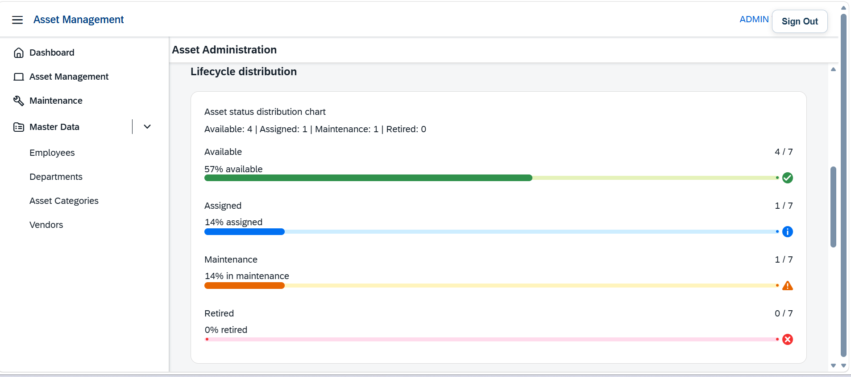

Slide 10
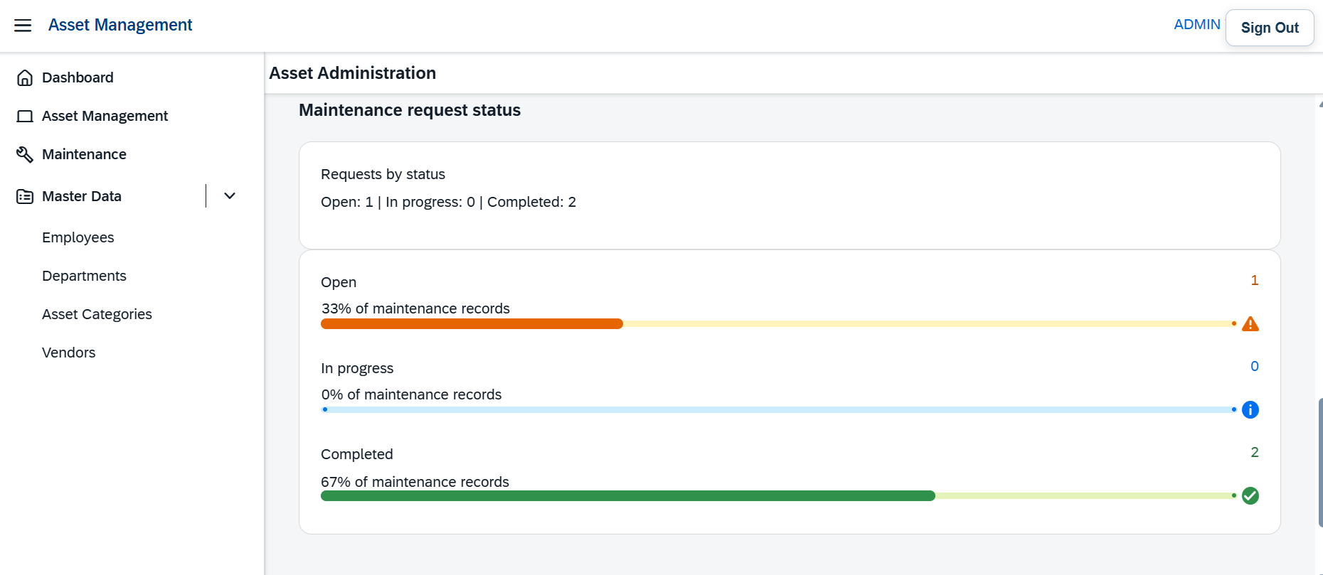

Slide 11
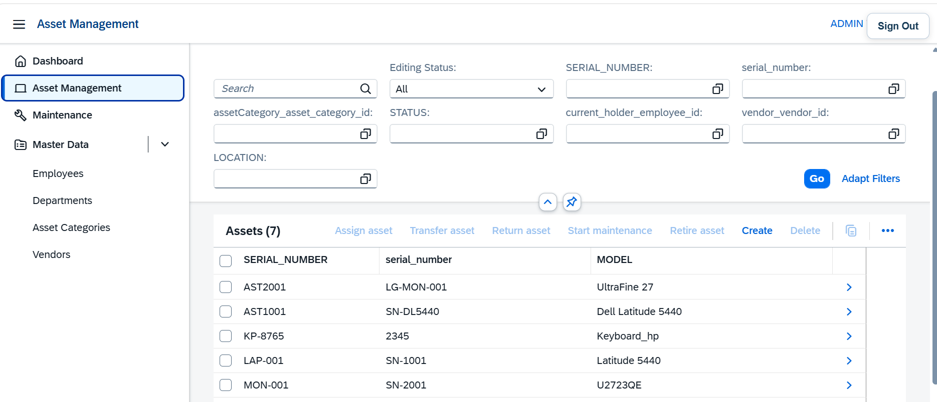

Slide 12
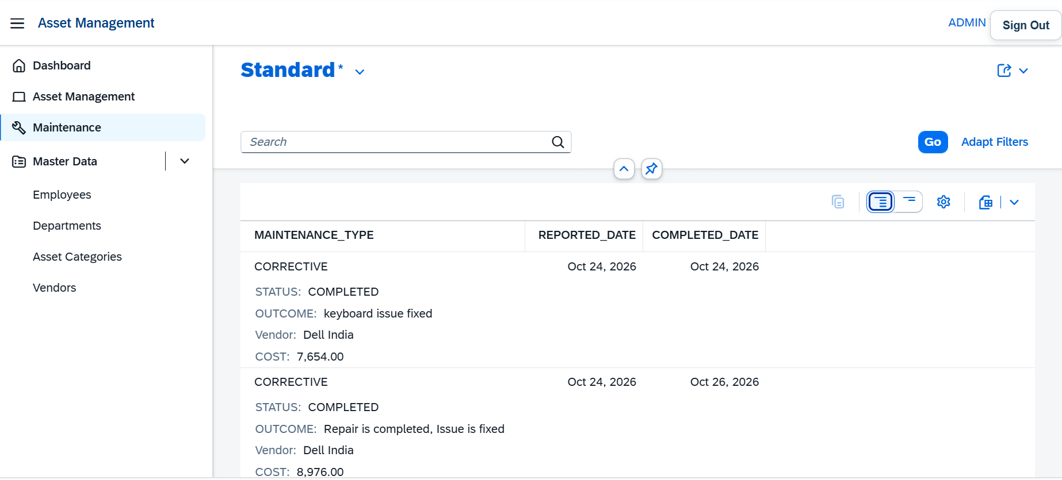

Slide 13
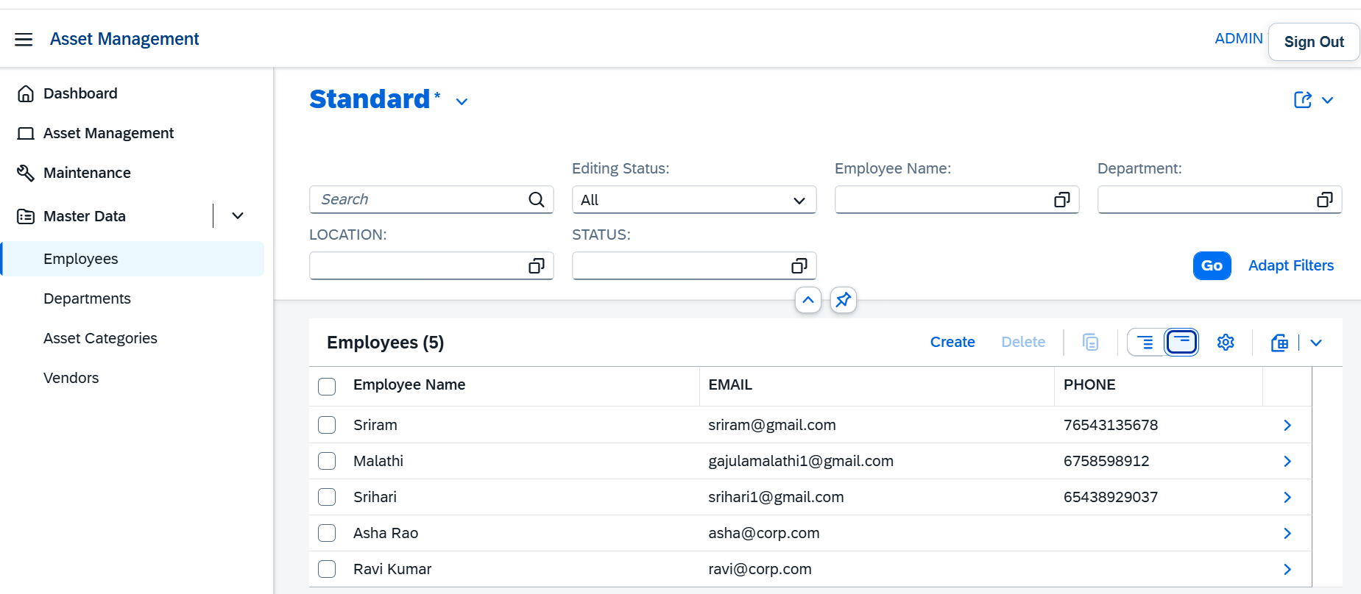

Slide 14
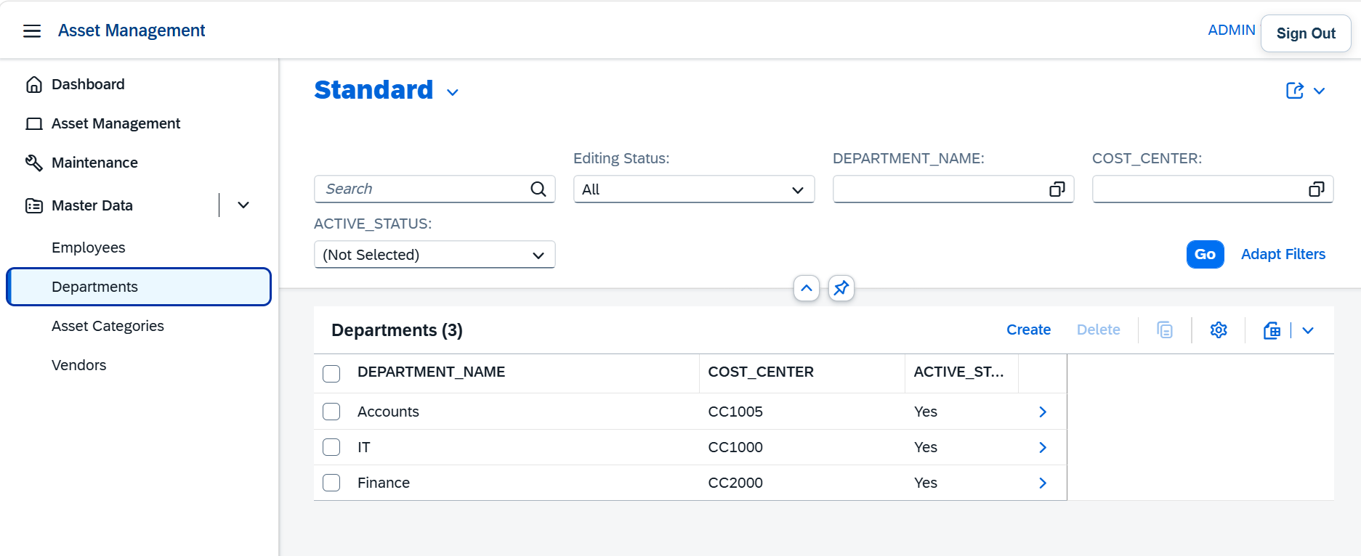

Slide 15
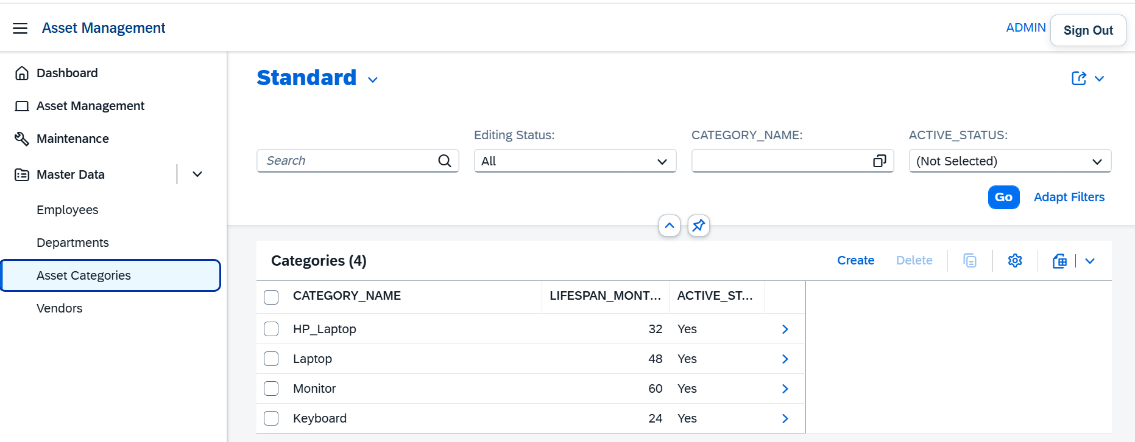

Slide 16
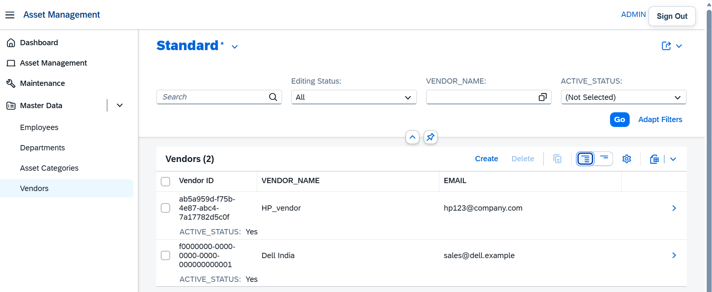

Slide 17
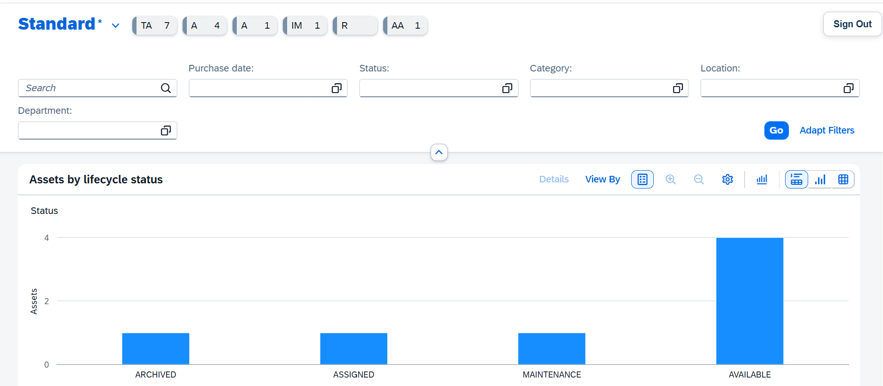
Manager Dashboard:

Slide 18
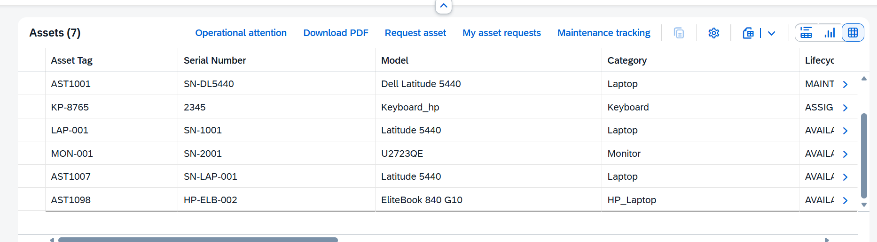

Slide 19
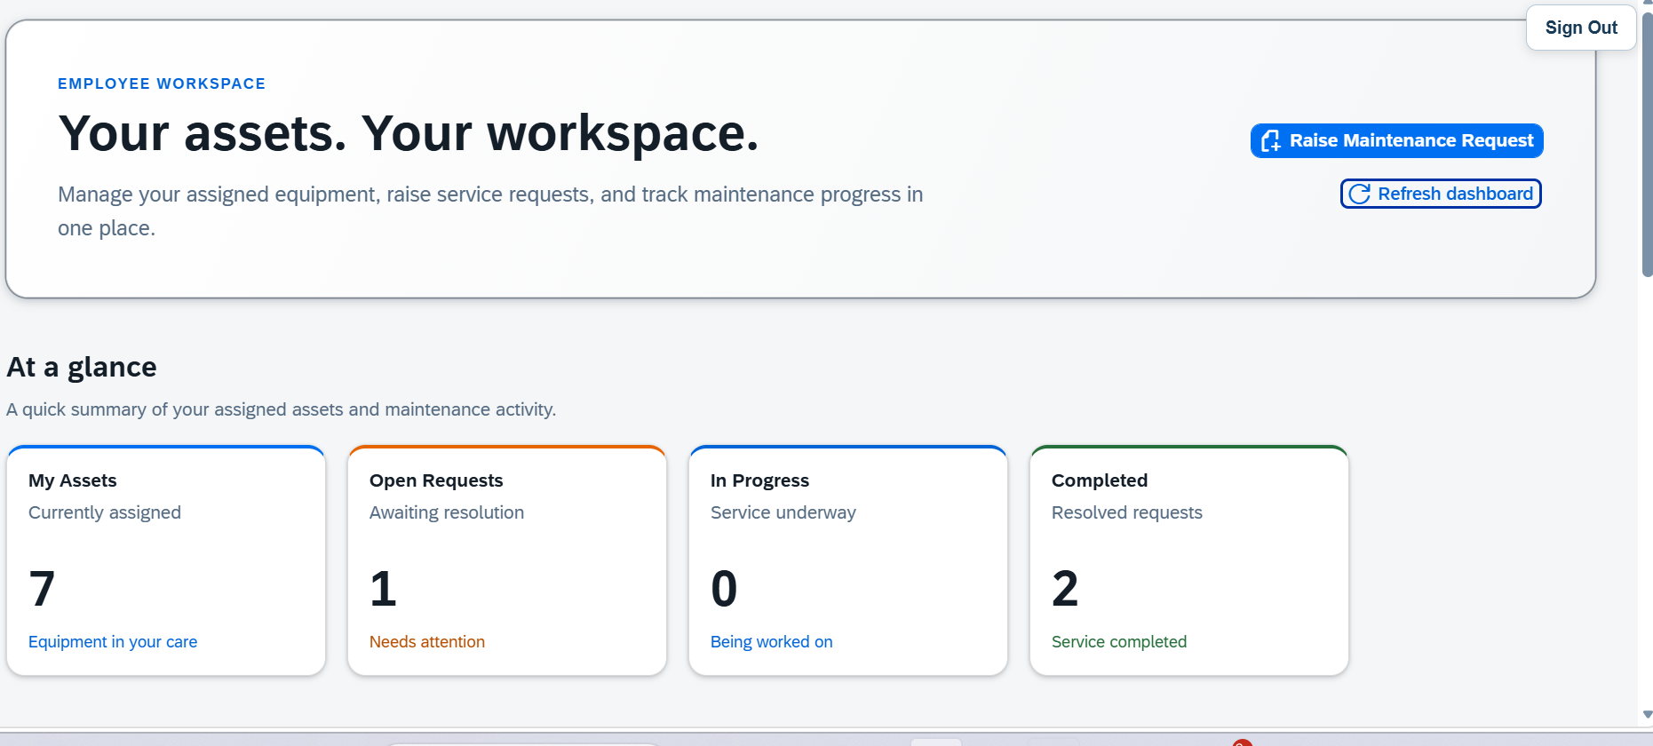
User Dashboard:

Slide 20
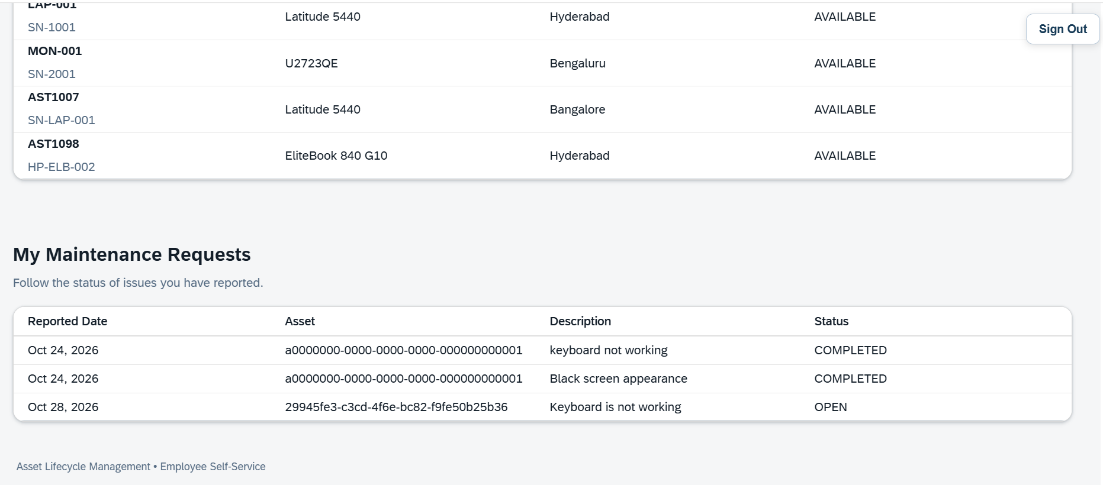

Slide 21
Key Benefits
08
Better visibility
Clear ownership
Asset and maintenance information is easier to review.
Each role has defined responsibilities.
Structured workflow
Faster monitoring
Requests move through review, decision, and tracking.
Manager views can support operational follow-up.
Expected outcome: a more organized and transparent asset maintenance process.
ASSET LIFECYCLE MANAGEMENT | PROJECT OVERVIEW
09

