Slide 1
Software Engineering
Wei-Min Wu（吴为民）
School of Petroleum
China University of Petroleum - Beijing at Karamay
Fall, 2025

Slide 2
Course Introduction
《软件工程》（双语）是一门什么样的课程？
* 是软件工程专业的一门重要的必修课程。
* 软件工程作为一门工程学科，所研究的是软件设计、开发、测试、维护以及管理的方法学。因此，本课程是学生们在至少学习了一门编程语言后，在软件设计理念上进一步加以提升的课程。
* 为此，课程内容将全面涵盖软件工程领域的基本主题，包括：软件工程概述、软件过程、敏捷软件开发、需求工程、系统建模、体系结构设计、设计和实现、软件测试、软件演化。此外，作为扩展，还加进了可依赖系统、软件复用、及项目管理三个高级主题。
* 只有掌握了这些知识，才能进一步研习软件工程的更高级的主题，如安全工程、分布式系统、服务系统等等。所以，本课程无疑具有承上启下的作用。
* 本课程是双语课程，旨在提高学生的英文阅读理解能力，鼓励学生通过阅读原文来更准确地理解教材和文献的内容。

Slide 3
课程介绍
先导课程
* 一门面向对象编程语言（C++或Java）。
* 大学计算机基础。
联系方式
（1）微信群：将在校区企业微信群中建立课程班级的微信群。
（2）课程网站：作业在雨课堂上布置和提交。

Slide 4
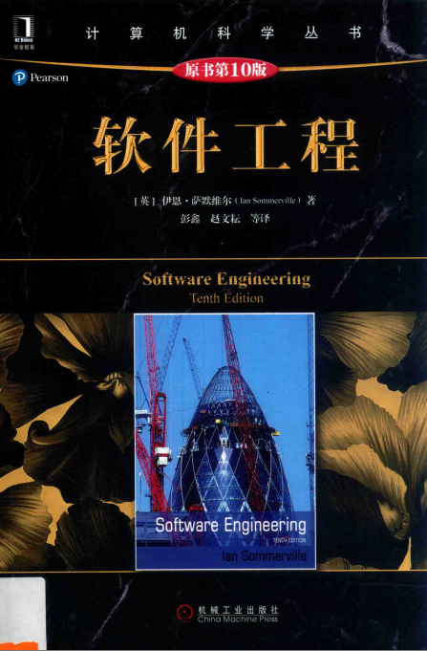

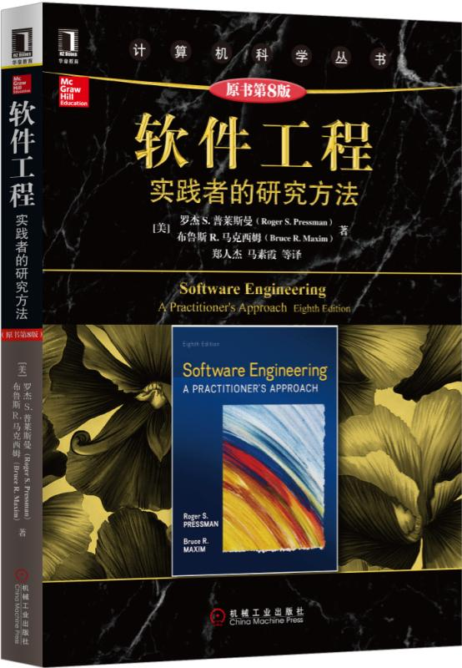
课程介绍
Textbook
1. 《软件工程》（原著第10版），伊恩.萨默维尔，彭鑫，赵文耘译，机械工业出版社，2018.2。
References
1. Software Engineering, 10th Edition, Ian Sommerville, Pearson Education Limited, 2016.
2. 《软件工程：实践者的研究方法》（原著第8版），罗杰 S. 普莱斯曼，郑人杰译，机械工业出版社，2016.11。

Slide 5
课程介绍
学时分配
共48学时（24次课），全部采取课堂讲授方式教学。
考核方式
* 总评成绩 = 平时成绩×40% + 结课考试成绩×60%
注意！ 若结课考试成绩低于40分，其课程总评成绩评定为不合格，总评成绩按结课考试成绩记。
* 平时成绩 = 考勤/提问×20%+平时作业×80%
* 结课考试：笔试（闭卷），英文试卷。

Slide 6
课程介绍
Contents
Chap. 1 Introduction 导论
Chap. 2 Software processes 软件过程
Chap. 3 Agile software development 敏捷软件开发
Chap. 4 Requirements engineering 需求工程
Chap. 5 System modeling 系统建模
Chap. 6 Architectural design 体系结构设计
Chap. 7 Design and implementation 设计和实现
Chap. 8 Software testing 软件测试
Chap. 9 Software evolution 软件进化
Chap. 10 Dependable systems 可依赖系统
Chap. 15 Software reuse 软件复用
Chap. 22 Project management 项目管理

Slide 7
Chap. 1 Introduction
Topics covered
Professional software development 专业软件开发
What is meant by software engineering.
Software engineering ethics 道德
A brief introduction to ethical issues that affect software engineering.
Case studies 案例
An introduction to four examples that are used in later chapters in the book.

Slide 8
Chap. 1 Introduction
Software engineering SE
The economies of ALL developed nations are dependent on software.
More and more systems are software controlled.
Software engineering is concerned with theories, methods and tools for professional software development. 软件工程：关注的是用于专业软件开发的理论、工具及工具
Expenditure on software represents a significant fraction of GNP in all developed countries.

Slide 9
Chap. 1 Introduction
Software engineering methods needed
There are no universal notations, methods, or techniques for software engineering because different types of software require different approaches. 没有统一的表示法、方法或技术
- Developing an organizational information system is completely different from developing a controller for a scientific instrument. Neither of these systems has much in common with a graphics-intensive computer game.
All of these applications need software engineering; they do not all need the same software engineering methods and techniques. 都需要，但不需要相同的

Slide 10
Chap. 1 Introduction
Software costs 成本
Software costs often dominate computer system costs. The costs of software on a PC are often greater than the hardware cost. 软件成本 >> 硬件成本
Software costs more to maintain than it does to develop. For systems with a long life, maintenance costs may be several times development costs.
维护成本 >> 开发成本
Software engineering is concerned with cost-effective software development. 软件工程：关注的是高成本效益的软件开发

Slide 11
Chap. 1 Introduction
Software project failure 项目失败
Increasing system complexity 日益复杂
Systems have to be built and delivered more quickly;
larger, even more complex systems are required;
systems have to have new capabilities that were previously thought to be impossible.
Failure to use software engineering methods 不得法
Many companies have drifted into software development as their products and services have evolved. They do not use software engineering methods in their everyday work. Consequently, their software is often more expensive and less reliable than it should be.

Slide 12

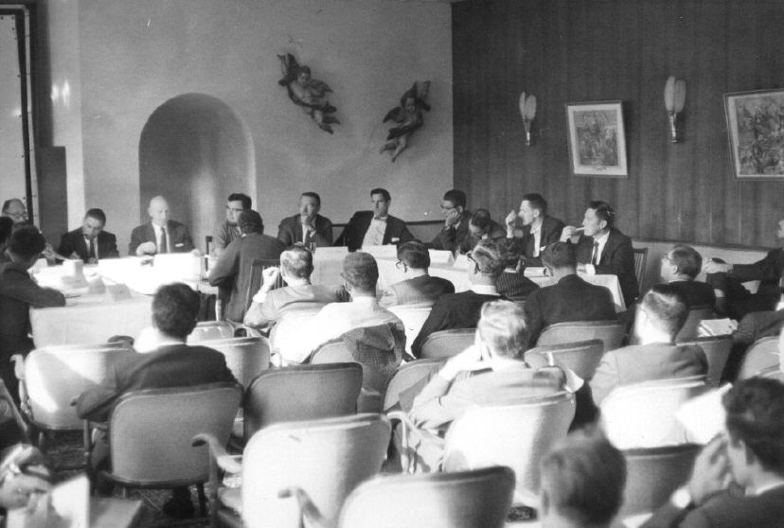
Chap. 1 Introduction
知识链接
会议在在原西德加密斯（Garmish）召开，名为：北大西洋公约组织（NATO）科学委员会会议。会议上首次提出了软件危机的概念，通过该概念试图建立并使用正确的软件工程方法，开发出低成本、高可靠性的软件，从而解决或缓解软件危机。

Slide 13
Chap. 1 Introduction
Software development: individual vs professional
个人开发 vs 专业开发
The key distinctions:
- Professional software is intended for use by someone apart from its developer and that teams rather than individuals usually develop the software. 用户使用，团队开发
- It is maintained and changed throughout its life.
Software engineering is intended to support professional software development rather than individual programming.
- It includes techniques that support program specification, design, and evolution, none of which are normally relevant for personal software development.
软件工程用于专业开发而非个人开发

Slide 14
Chap. 1 Introduction
Professional software development
Frequently asked questions about software engineering
Question | Answer
What is software? 软件概念 | Computer programs and associated documentation. Software products may be developed for a particular customer or may be developed for a general market.
What are the attributes of good software? 好的属性？ | Good software should deliver the required functionality and performance to the user and should be maintainable, dependable and usable.
What is software engineering? SE概念 | Software engineering is an engineering discipline that is concerned with all aspects of software production.
What are the fundamental software engineering activities? | Software specification, software development, software validation and software evolution. SE活动： 软件规格说明、软件开发、软件确认与软件演进

Slide 15
Chap. 1 Introduction
Professional software development
Frequently asked questions about software engineering
Question | Answer
What is the difference between software engineering and computer science? | Computer science focuses on theory and fundamentals; software engineering is concerned with the practicalities of developing and delivering useful software. 软件工程 vs 计算机科学
What is the difference between software engineering and system engineering? | System engineering is concerned with all aspects of computer-based systems development including hardware, software and process engineering. Software engineering is part of this more general process. 软件工程 vs 系统工程
What are the key challenges facing software engineering? | Coping with increasing diversity, demands for reduced delivery times and developing trustworthy software. 面临的挑战
What are the costs of software engineering? | Roughly 60% of software costs are development costs, 40% are testing costs. For custom software, evolution costs often exceed development costs. 成本

Slide 16
Chap. 1 Introduction
Professional software development
Frequently asked questions about software engineering
Question | Answer
What are the best software engineering techniques and methods? 最佳技术/方法 | Different techniques are appropriate for different types of system. For example, games should always be developed using a series of prototypes whereas safety critical control systems require a complete and analyzable specification to be developed. You can’t, therefore, say that one method is better than another. 不同技术适合于不同类型的系统
What differences has the web made to software engineering? | The web has led to the availability of software services and the possibility of developing highly distributed service-based systems. Web-based systems development has led to important advances in programming languages and software reuse. Web带来改变

Slide 17
Chap. 1 Introduction
About software
Software is not just the programs themselves but also all associated documentation, libraries, support websites, and configuration data that are needed to make these programs useful. 软件不只是程序
A professionally developed software system is often more than a single program. A system may consist of several separate programs and configuration files that are used to set up these programs. It may include system documentation, which describes the structure of the system, user documentation, which explains how to use the system, and websites for users to download recent product information.
This is one of the important differences between professional and amateur software development.

Slide 18
Chap. 1 Introduction
Software products 软件产品
Generic products 通用产品
Stand-alone systems that are marketed and sold to any customer who wishes to buy them.
Examples – PC software such as graphics programs, project management tools; CAD software; software for specific markets such as appointments systems for dentists. 例子
Customized products 定制化产品
Software that is commissioned by a specific customer to meet their own needs.
Examples – embedded control systems, air traffic control software, traffic monitoring systems.

Slide 19
Chap. 1 Introduction
Product specification 产品规格
Generic products 取决于软件开发者
The specification of what the software should do is owned by the software developer and decisions on software change are made by the developer.
Customized products 取决于客户
The specification of what the software should do is owned by the customer and they make decisions on software changes that are required.
However, the distinction between these system product types is becoming increasingly blurred. More and more systems are now being built with a generic product as a base, which is then adapted to suit the requirements of a customer. 真实情况

Slide 20
Chap. 1 Introduction
Quality/Software attributes 质量/产品属性
Quality is not just concerned with what the software does, it has to include the software’s behavior while it is executing and the structure of the system programs and associated documentation. 质量含义
This is reflected in the non-functional attributes. Examples: the software’s response time to a user query and the understandability of the program code. 非功能属性
The specific set of attributes that you might expect from a software system obviously depends on its application. An aircraft control system must be safe, an interactive game must be responsive, and so on. 需要什么属性，取决于应用

Slide 21
Chap. 1 Introduction
Essential attributes of good software
Product characteristic | Description
Acceptability 可接受性 | Software must be acceptable to the type of users for which it is designed. This means that it must be understandable, usable and compatible with other systems that they use.
Dependability and security 可依赖性和安全 | Software dependability includes a range of characteristics including reliability, security and safety. Dependable software should not cause physical or economic damage in the event of system failure. Malicious users should not be able to access or damage the system.
Efficiency 高效性 | Software should not make wasteful use of system resources such as memory and processor cycles. Efficiency therefore includes responsiveness, processing time, memory utilisation, etc.
Maintainability 可维护性 | Software should be written in such a way so that it can evolve to meet the changing needs of customers. This is a critical attribute because software change is an inevitable requirement of a changing business environment.

Slide 22
Chap. 1 Introduction
Software engineering 软件工程
Software engineering is an engineering discipline that is concerned with all aspects of software production from the early stages of system specification through to maintaining the system after it has gone into use.
Engineering discipline 是工程学科
Using appropriate theories and methods to solve problems bearing in mind organizational and financial constraints.
All aspects of software production 涉及软件产品的所有方面
Not just technical process of development. Also project management and the development of tools, methods etc. to support software production.

Slide 23
Chap. 1 Introduction
Importance of software engineering SE重要性
More and more, individuals and society rely on advanced software systems. We need to be able to produce reliable and trustworthy systems economically and quickly. 越来越需要
It is usually cheaper, in the long run, to use software engineering methods and techniques for software systems rather than just write the programs as if it was a personal programming project. For most types of system, the majority of costs are the costs of changing the software after it has gone into use. 从长远看，更便宜

Slide 24
Chap. 1 Introduction
Software process activities 软件过程活动
Software specification, where customers and engineers define the software to be produced and the constraints on its operation. 规格说明
Software development, where the software is designed and programmed. 开发
Software validation, where the software is checked to ensure that it is what the customer requires. 确认
Software evolution, where the software is modified to reflect changing customer and market requirements. 演化

Slide 25
Chap. 1 Introduction
General issues that affect software
影响软件的一般问题
Heterogeneity 异构性
Increasingly, systems are required to operate as distributed systems across networks that include different types of computer and mobile devices.
Business and social change 商业和社会变化
Business and society are changing incredibly quickly as emerging economies develop and new technologies become available. They need to be able to change their existing software and to rapidly develop new software.

Slide 26
Chap. 1 Introduction
General issues that affect software cont’d
影响软件的一般问题
Security and trust 安全和信任
As software is intertwined with all aspects of our lives, it is essential that we can trust that software.
Scale 规模
Software has to be developed across a very wide range of scales, from very small embedded systems in portable or wearable devices through to Internet-scale, cloud-based systems that serve a global community.

Slide 27
Chap. 1 Introduction
Software engineering diversity SE多样性
There are many different types of software system, no universal set of software techniques that is applicable to all of these. 没有通用的技术
The software engineering methods and tools used depend on: the type of application being developed, the requirements of the customer and the background of the development team. 影响因素
Perhaps the most significant factor in determining which software engineering methods and techniques are most important is the type of application being developed. 最重要因素：应用的类型

Slide 28
Chap. 1 Introduction
Application types 应用类型
Stand-alone applications 独立应用
These are application systems that run on a local computer, such as a PC. They include all necessary functionality and do not need to be connected to a network.
Interactive transaction-based applications 基于事务的交互式应用
These are applications that execute on a remote computer and that are accessed by users from their own computers, phones, or tablets.
Embedded control systems 嵌入式控制系统
These are software control systems that control and manage hardware devices. Numerically, there are probably more embedded systems than any other type of system.

Slide 29
Chap. 1 Introduction
Application types cont’d
Batch processing systems 批处理系统
These are business systems that are designed to process data in large batches. They process large numbers of individual inputs to create corresponding outputs.
Entertainment systems 娱乐系统
These are systems that are primarily for personal use and which are intended to entertain the user.
Systems for modeling and simulation 用于建模和模拟的系统
These are systems that are developed by scientists and engineers to model physical processes or situations, which include many, separate, interacting objects.

Slide 30
Chap. 1 Introduction
Application types cont’d
Data collection systems 数据收集系统
These are systems that collect data from their environment using a set of sensors and send that data to other systems for processing.
Systems of systems 系统之系统
These are systems that are composed of a number of other software systems.

Slide 31
Chap. 1 Introduction
About application types
Of course, the boundaries between these system types are blurred. 边界是模糊的
Each type of system requires specialized software engineering techniques because the software has different characteristics. 各有专门的SE技术
Nevertheless, there are software engineering fundamentals that apply to all types of software systems. 但仍有普适的SE基本原理

Slide 32
Chap. 1 Introduction
Software engineering fundamentals 基本原理
Systems should be developed using a managed and understood development process. Of course, different processes are used for different types of software. 采用被管理和理解的开发过程
Dependability and performance are important for all types of system. 可依赖性和性能：重要
Understanding and managing the software specification and requirements (what the software should do) are important. 理解和管理软件规格说明和需求：重要
Where appropriate, you should reuse software that has already been developed rather than write new software. 软件重用

Slide 33
Chap. 1 Introduction
Internet software engineering 互联网软件工程
The Web is now a platform for running application and organizations are increasingly developing web-based systems rather than local systems.
Web services allow application functionality to be accessed over the web.
Cloud computing is an approach to the provision of computer services where applications run remotely on the ‘cloud’. 云计算
Users do not buy software but pay according to how much the software is used, or are given free access in return for watching adverts displayed on their screen.

Slide 34
Chap. 1 Introduction
Web-based software engineering 基于Web的软件工程
The fundamental ideas of software engineering, discussed in the previous section, apply to web-based software, as they do to other types of software. 以前原理仍适用于基于Web的软件
Web-based systems are getting larger and larger, so software engineering techniques that deal with scale and complexity are relevant for these systems. 应付规模和复杂性的技术更为相关

Slide 35
Chap. 1 Introduction
Web software engineering Web软件工程
Software reuse 软件复用
Software reuse is the dominant approach for constructing web-based systems. When building these systems, you think about how you can assemble them from pre-existing software components and systems.
Incremental and agile development 增量式和敏捷开发
Web-based systems should be developed and delivered incrementally. It is now generally recognized that it is impractical to specify all the requirements for such systems in advance.

Slide 36
Chap. 1 Introduction
Web software engineering cont’d
Service-oriented systems 面向服务的系统
Software may be implemented using service-oriented software engineering, where the software components are stand-alone web services.
Rich interfaces 丰富的界面
Interface development technologies such as AJAX and HTML5 have emerged that support the creation of rich interfaces within a web browser.
AJAX: Asynchronous Javascript And XML
HTML: Hyper Text Mark-up Language
XML: Extensible Markup Language

Slide 37
Chap. 1 Introduction
Software engineering ethics SE道德准则
Software engineering involves wider responsibilities than simply the application of technical skills. 更广泛的责任
Software engineers must behave in an honest and ethically responsible way if they are to be respected as professionals. 诚实、道德
Ethical behaviour is more than simply upholding the law but involves following a set of principles that are morally correct. 不止守法，还要遵守道德

Slide 38
Chap. 1 Introduction
Issues of professional responsibility 职业责任
Confidentiality 保密
Engineers should normally respect the confidentiality of their employers or clients irrespective of whether or not a formal confidentiality agreement has been signed.
Competence 能力
Engineers should not misrepresent their level of competence. They should not knowingly accept work which is outwith their competence.

Slide 39
Chap. 1 Introduction
Issues of professional responsibility cont’d
Intellectual property rights 知识产权
Engineers should be aware of local laws governing the use of intellectual property such as patents, copyright, etc. They should be careful to ensure that the intellectual property of employers and clients is protected.
Computer misuse 计算机滥用
Software engineers should not use their technical skills to misuse other people’s computers. Computer misuse ranges from relatively trivial (game playing on an employer’s machine, say) to extremely serious (dissemination of viruses).

Slide 40
Chap. 1 Introduction
ACM/IEEE Code of Ethics ACM/IEEE道德准则
The professional societies in the US have cooperated to produce a code of ethical practice.
Members of these organisations sign up to the code of practice when they join.
The Code contains eight Principles related to the behaviour of and decisions made by professional software engineers, including practitioners, educators, managers, supervisors and policy makers, as well as trainees and students of the profession.

Slide 41
Chap. 1 Introduction
Rationale for the code of ethics 出发点
Computers have a central and growing role in commerce, industry, government, medicine, education, entertainment and society at large. Software engineers are those who contribute by direct participation or by teaching, to the analysis, specification, design, development, certification, maintenance and testing of software systems.
Because of their roles in developing software systems, software engineers have significant opportunities to do good or cause harm, to enable others to do good or cause harm, or to influence others to do good or cause harm. To ensure, as much as possible, that their efforts will be used for good, software engineers must commit themselves to making software engineering a beneficial and respected profession.

Slide 42
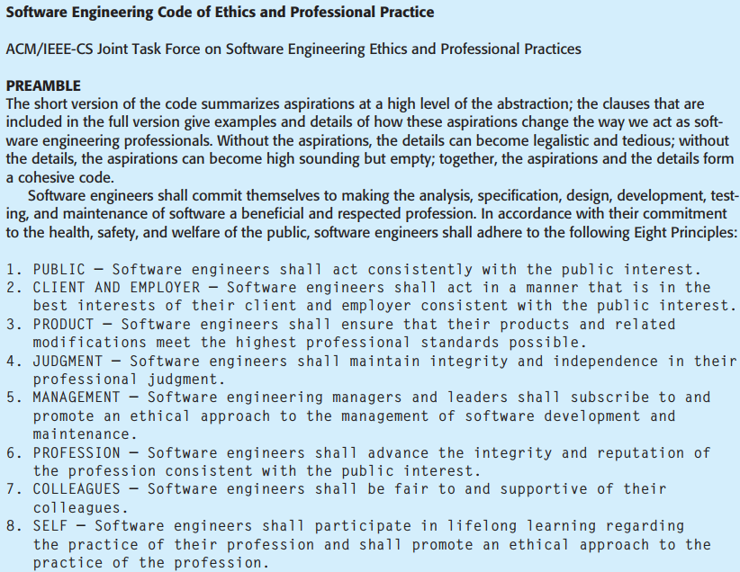

Slide 43
Chap. 1 Introduction
Ethical dilemmas 道德困境
Disagreement in principle with the policies of senior management. 与高级管理层的政策有分歧
Your employer acts in an unethical way and releases a safety-critical system without finishing the testing of the system. 雇主行为不道德
Participation in the development of military weapons systems or nuclear systems. 参与军事武器或核系统开发

Slide 44
Chap. 1 Introduction
Case studies 案例研究
To illustrate software engineering concepts, the book uses examples from four different types of system. 来自四种不同类型的系统
One of the key messages in this book is that software engineering practice depends on the type of systems being produced.
The book therefore chooses an appropriate example when discussing concepts such as safety and dependability, system modeling, reuse, etc.
讨论不同概念时，选择适当的系统

Slide 45
Chap. 1 Introduction
Case studies cont’d
A personal insulin pump 胰岛素泵
An embedded system in an insulin pump used by diabetics to maintain blood glucose control.
A mental health case patient management system 心理健康病例病人管理系统
A information system used to maintain records of people receiving care for mental health problems.
A wilderness weather station 野外气象站
A sensor-based data collection system that collects data about weather conditions in remote areas.
A digital learning environment 数字化学习环境
A support environment to learning in schools.

Slide 46
Chap. 1 Introduction
Insulin pump control system 胰岛素泵控制系统
Collects data from a blood sugar sensor and calculates the amount of insulin required to be injected.
Calculation based on the rate of change of blood sugar levels.
Sends signals to a micro-pump to deliver the correct dose of insulin.
Safety-critical system : as low blood sugars can lead to brain malfunctioning, coma and death; high-blood sugar levels have long-term consequences such as eye and kidney damage.

Slide 47
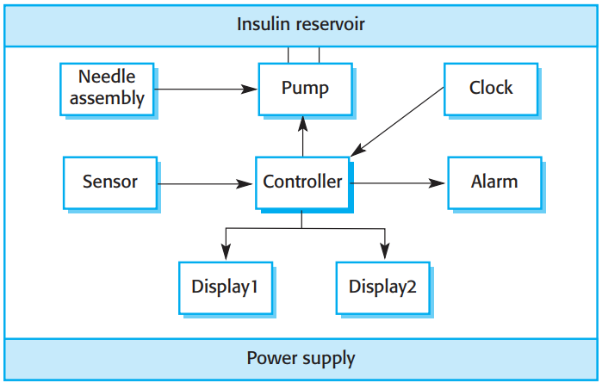
Chap. 1 Introduction
Insulin pump hardware architecture

Slide 48
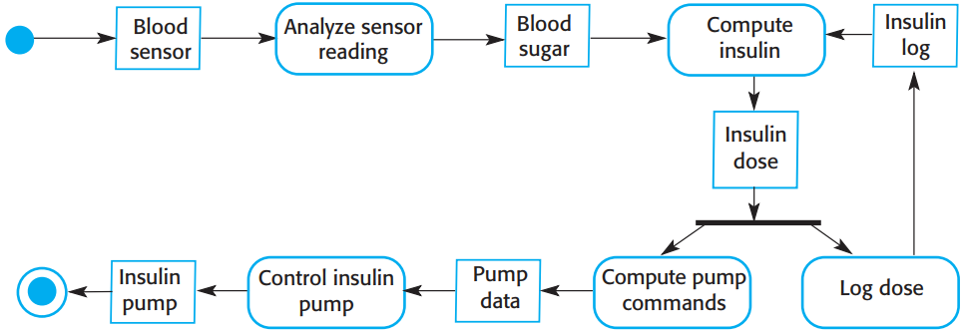
Chap. 1 Introduction
Activity model of the insulin pump UML模型

Slide 49
Chap. 1 Introduction
Essential high-level requirements 需求
The system shall be available to deliver insulin when required. 可用
The system shall perform reliably and deliver the correct amount of insulin to counteract the current level of blood sugar. 可靠
The system must therefore be designed and implemented to ensure that the system always meets these requirements.

Slide 50
Chap. 1 Introduction
Mentcare: A patient information system for mental health care 心理健康护理患者信息系统
It is a medical information system that maintains information about patients suffering from mental health problems and the treatments that they have received. 是一个医疗信息系统
Most mental health patients do not require dedicated hospital treatment but need to attend specialist clinics regularly where they meet a doctor who has detailed knowledge of their problems. 无需住院,定期诊所就诊
To make it easier for patients to attend, these clinics are not just run in hospitals. They may also be held in local medical practices or community centres.

Slide 51
Chap. 1 Introduction
Mentcare
Mentcare is an information system that is intended for use in clinics. 是在诊所中使用的信息系统
It makes use of a centralized database of patient information but has also been designed to run on a PC, so that it may be accessed and used from sites that do not have secure network connectivity. 中心化数据库
When the local systems have secure network access, they use patient information in the database but they can download and use local copies of patient records when they are disconnected. 可访问、下载

Slide 52
Chap. 1 Introduction
Mentcare goals 目标
To generate management information that allows health service managers to assess performance against local and government targets. 可供评估
To provide medical staff with timely information to support the treatment of patients. 提供及时信息，支持患者治疗

Slide 53
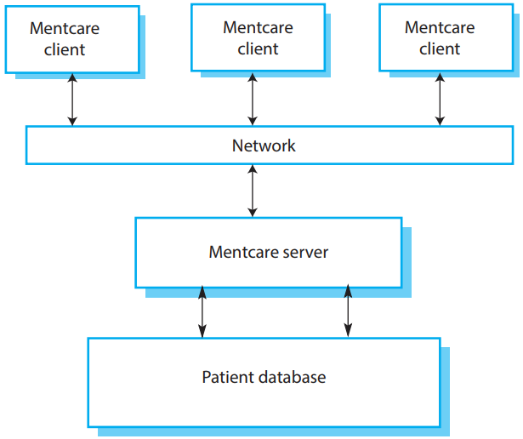
Chap. 1 Introduction
The organization of the Mentcare system

Slide 54
Chap. 1 Introduction
Key features of the Mentcare system 关键特性
Individual care management 个人化护理管理
Clinicians can create records for patients, edit the information in the system, view patient history, etc. The system supports data summaries so that doctors can quickly learn about the key problems and treatments that have been prescribed.
Patient monitoring 患者监护
The system monitors the records of patients that are involved in treatment and issues warnings if possible problems are detected.
Administrative reporting 管理报告
The system generates monthly management reports showing the number of patients treated at each clinic, the number of patients who have entered and left the care system, number of patients sectioned, the drugs prescribed and their costs, etc.

Slide 55
Chap. 1 Introduction
Mentcare system concerns 关心点
Privacy 隐私
It is essential that patient information is confidential and is never disclosed to anyone apart from authorised medical staff and the patient themselves.
Safety 安全
Some mental illnesses cause patients to become suicidal or a danger to other people. Wherever possible, the system should warn medical staff about potentially suicidal or dangerous patients.
The system must be available when needed otherwise safety may be compromised and it may be impossible to prescribe the correct medication to patients.

Slide 56
Chap. 1 Introduction
Wilderness weather station 野外气象站
The government of a country with large areas of wilderness decides to deploy several hundred weather stations in remote areas.
Weather stations collect data from a set of instruments that measure temperature and pressure, sunshine, rainfall, wind speed and wind direction.
The weather station includes a number of instruments that measure weather parameters such as the wind speed and direction, the ground and air temperatures, the barometric pressure and the rainfall over a 24-hour period. Each of these instruments is controlled by a software system that takes parameter readings periodically and manages the data collected from the instruments.

Slide 57
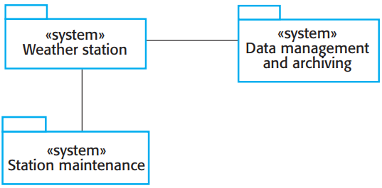
Chap. 1 Introduction
The weather station’s environment 所处环境
* The figure has used the UML package symbol to indicate that each system is
a collection of components and the separate systems are identified using the UML stereotype «system».
* The associations between the packages indicate there is an exchange of information but, at this stage, there is no need to define them in any more detail.
三个组成部分

Slide 58
Chap. 1 Introduction
Weather information system 气象信息系统
The weather station system
This is responsible for collecting weather data, carrying out some initial data processing and transmitting it to the data management system.
The data management and archiving system
This system collects the data from all of the wilderness weather stations, carries out data processing and analysis and archives the data.
The station maintenance system
This system can communicate by satellite with all wilderness weather stations to monitor the health of these systems and provide reports of problems.

Slide 59
Chap. 1 Introduction
Additional software functionality 附加功能
Monitor the instruments, power and communication hardware and report faults to the management system.
Manage the system power, ensuring that batteries are charged whenever the environmental conditions permit but also that generators are shut down in potentially damaging weather conditions, such as high wind.
Support dynamic reconfiguration where parts of the software are replaced with new versions and where backup instruments are switched into the system in the event of system failure.

Slide 60
Chap. 1 Introduction
iLearn: A digital learning environment 数字化学习环境
It is a framework in which a set of general-purpose and specially designed tools for learning may be embedded, plus a set of applications that are geared to the needs of the learners. 框架 = 工具+应用
The tools included in each version of the environment are chosen by teachers and learners to suit their specific needs. 满足特定需求
These can be general applications such as spreadsheets, learning management applications such as a Virtual Learning Environment (VLE) to manage homework submission and assessment, games and simulations.

Slide 61
Chap. 1 Introduction
Service-oriented systems 面向服务的系统
The system is a service-oriented system with all system components considered to be a replaceable service. 组件是可替换服务
This allows the system to be updated incrementally as new services become available
增量式更新
It also makes it possible to rapidly configure the system to create versions of the environment for different groups such as very young children who cannot read, senior students, etc. 为不群体快速配置

Slide 62
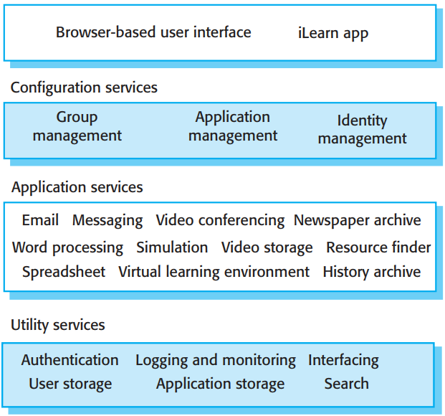
Chap. 1 Introduction
iLearn architecture 架构
* It was designed for use in schools for students from 3 to 18 years of age.
* This is a distributed system in which all components of the environment are services that can be accessed from anywhere on the
Internet. There is no requirement that all of the learning tools are gathered together
in one place.
配置服务
应用服务
公共服务

Slide 63
Chap. 1 Introduction
iLearn services 三种服务
Utility services that provide basic application-independent functionality and which may be used by other services in the system. 公共服务
Application services that provide specific applications such as email, conferencing, photo sharing etc. and access to specific educational content such as scientific films or historical resources. 应用服务
Configuration services that are used to adapt the environment with a specific set of application services and to define how services are shared between students, teachers and their parents. 配置服务

Slide 64
Chap. 1 Introduction
iLearn service integration 服务集成
Integrated services are services which offer an API (application programming interface) and which can be accessed by other services through that API. Direct service-to-service communication is therefore possible. 集成服务
Independent services are services which are simply accessed through a browser interface and which operate independently of other services. Information can only be shared with other services through explicit user actions such as copy and paste; 独立服务
If an independent service becomes widely used, then integrate it to become an integrated service.

Slide 65
Chap. 1 Introduction
Key points 本章要点
Software engineering is an engineering discipline that is concerned with all aspects of software production.
Essential software product attributes are maintainability, dependability and security, efficiency and acceptability.
The high-level activities of specification, development, validation and evolution are part of all software processes.

Slide 66
Chap. 1 Introduction
Key points cont’d
There are many different types of system and each requires appropriate software engineering tools and techniques for their development.
The fundamental ideas of software engineering are applicable to all types of software system.
Software engineers have responsibilities to the engineering profession and society. They should not simply be concerned with technical issues.
Professional societies publish codes of conduct which set out the standards of behaviour expected of their members.

