Slide 1
3.17(1)
作业08
补充题 试求：在1和300之间能够被2、3、5中任意一个整除，但不能被7整除的整数的个数。

Slide 2
作业08参考解答
3.17 判断以下命题是否恒真。如果不是，举一反例。
(1) (A⊂B ∧ C⊂D) ⇒ (A∩C)⊂(B∩D)
解: A=C=Ø
B={1}
D={2}
A∩C=Ø
B∩D=Ø=A∩C
显然， A⊂B，C⊂D，
但 B∩D中不存在A∩C中没有的元素，
故(A∩C)⊂(B∩D)不成立。

Slide 3
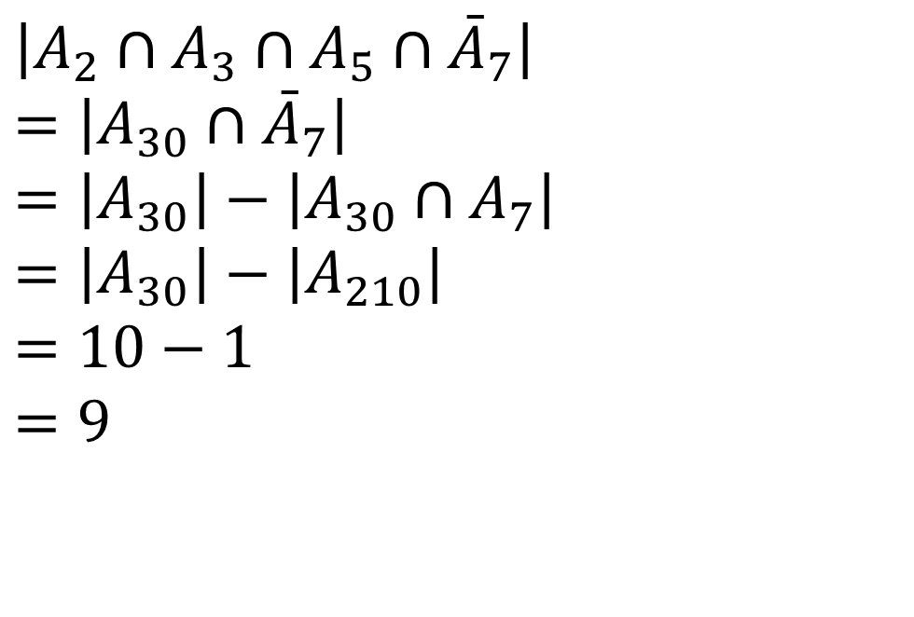
补充题 试求：在1和300之间能够被2、3、5中任意一个整除，但不能被7整除的整数的个数。
解:
$$\left|A_{2}∩A_{3}∩A_{5}∩{\bar{A}}_{7}\right| \\ =\left|A_{30}∩{\bar{A}}_{7}\right|$$
$$=\left|A_{30}\right|−\left|A_{30}∩A_{7}\right|$$
$$=\left|A_{30}\right|−\left|A_{210}\right| \\ =10−1$$
$$=9$$

Slide 4
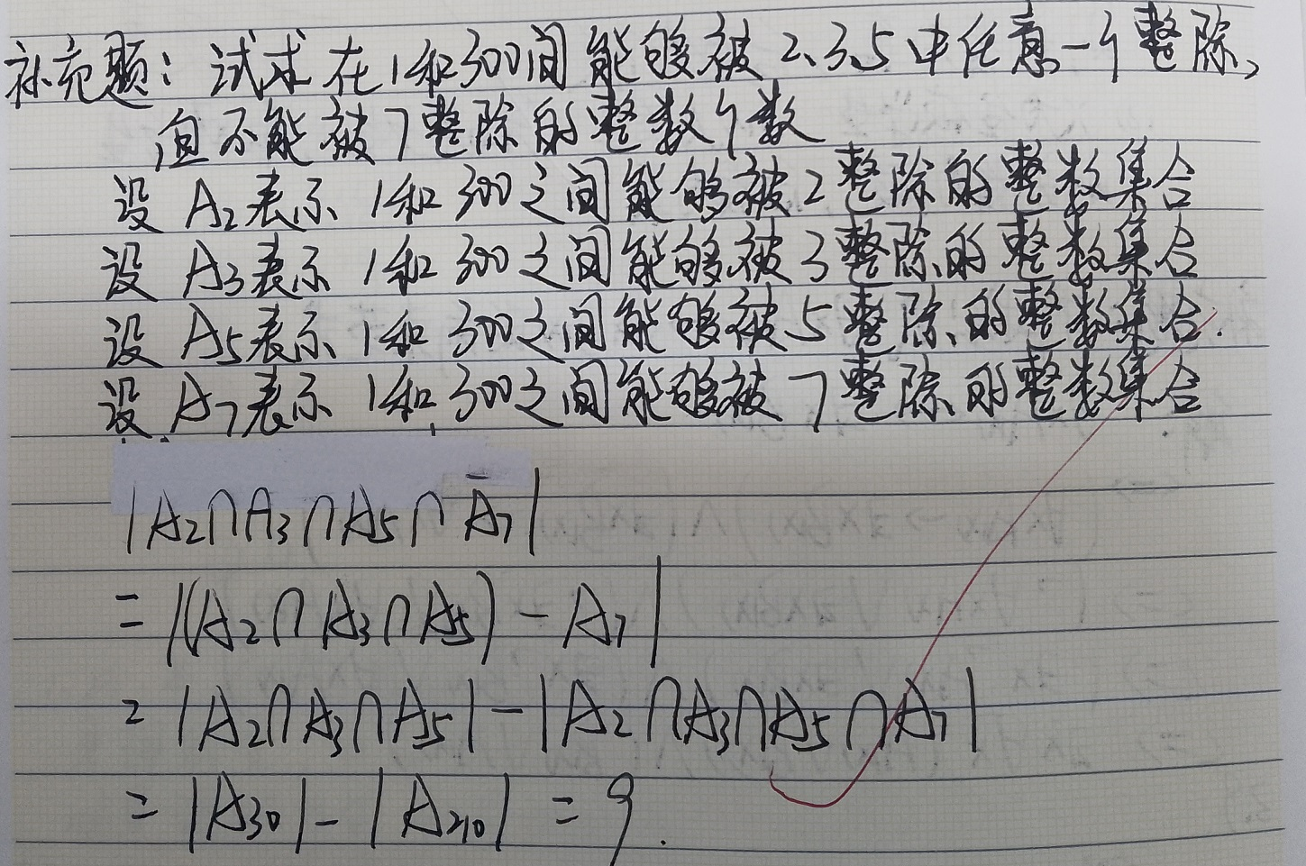

Slide 5
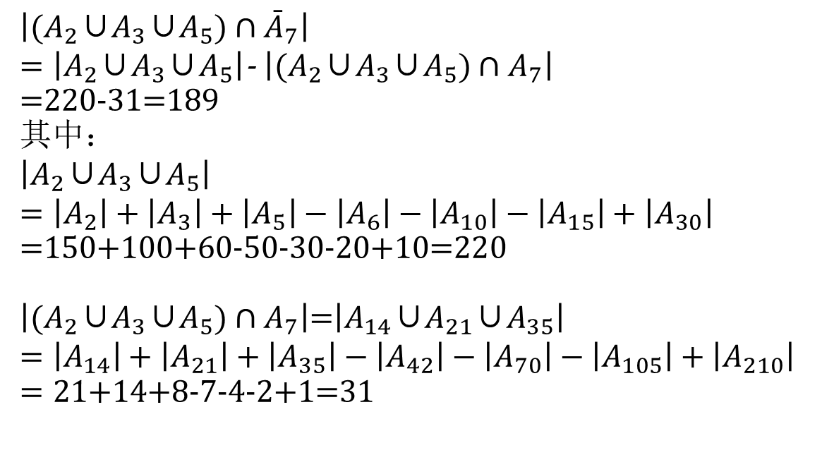
补充题 试求：在1和300之间能够被2、3、5中至少一个整除，但不能被7整除的整数的个数。
解:
$$\left|{(A}_{2}\text{∪}A_{3}\text{∪}A_{5})∩{\bar{A}}_{7}\right|$$ $=\left|A_{2}\text{∪}A_{3}\text{∪}A_{5}\right|$- $\left|{(A}_{2}\text{∪}A_{3}\text{∪}A_{5})∩A_{7}\right|$
=220-31=189 其中：
$$\left|A_{2}\text{∪}A_{3}\text{∪}A_{5}\right|$$
$$=\left|A_{2}\right|+\left|A_{3}\right|+\left|A_{5}\right|−\left|A_{6}\right|−\left|A_{10}\right|−\left|A_{15}\right|+\left|A_{30}\right|$$
$=$150+100+60-50-30-20+10=220
$\left|{(A}_{2}\text{∪}A_{3}\text{∪}A_{5})∩A_{7}\right|$=$\left|A_{14}\text{∪}A_{21}\text{∪}A_{35}\right|$
$$=\left|A_{14}\right|+\left|A_{21}\right|+\left|A_{35}\right|−\left|A_{42}\right|−\left|A_{70}\right|−\left|A_{105}\right|+\left|A_{210}\right|$$
$=21$+14+8-7-4-2+1=31

Slide 6
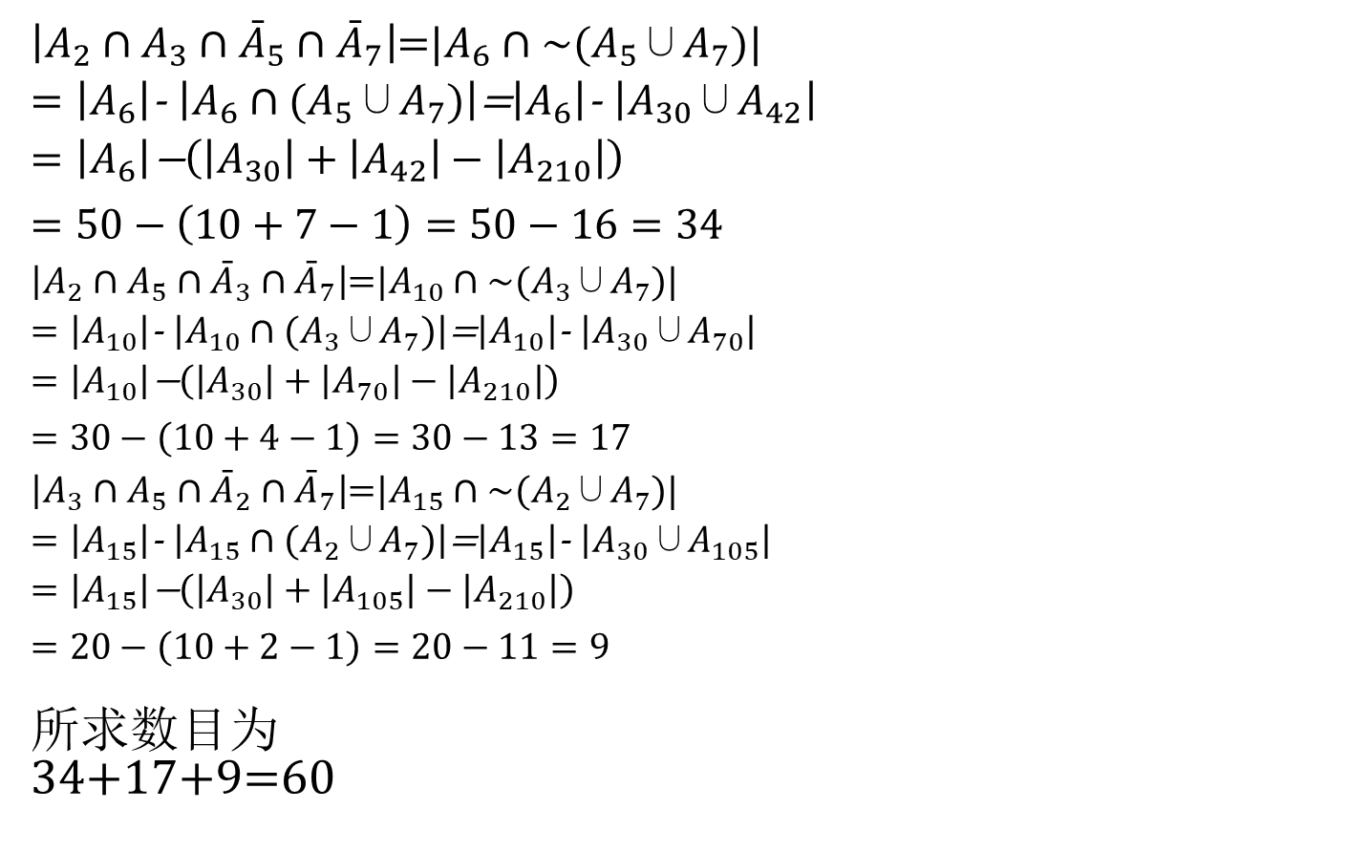
补充题 试求：在1和300之间能够被2、3、5中恰好两个整除，但不能被7整除的整数的个数。
解:
$\left|A_{2}∩A_{3}∩{\bar{A}}_{5}∩{\bar{A}}_{7}\right|$=${|A}_{6}∩\sim (A_{5}\text{∪}A_{7})|$ $=\left|A_{6}\right|$- $\left|A_{6}∩(A_{5}\text{∪}A_{7})\right|$=$\left|A_{6}\right|$- $\left|A_{30}\text{∪}A_{42}\right|$
= $\left|A_{6}\right|\text{−}\left(\left|A_{30}\right|+\left|A_{42}\right|−\left|A_{210}\right|\right)$
$$=50−\left(10+7−1\right)=50−16=34$$
$\left|A_{2}∩A_{5}∩{\bar{A}}_{3}∩{\bar{A}}_{7}\right|$=${|A}_{10}∩\sim (A_{3}\text{∪}A_{7})|$ $=\left|A_{10}\right|$- $\left|A_{10}∩(A_{3}\text{∪}A_{7})\right|$=$\left|A_{10}\right|$- $\left|A_{30}\text{∪}A_{70}\right|$
= $\left|A_{10}\right|\text{−}\left(\left|A_{30}\right|+\left|A_{70}\right|−\left|A_{210}\right|\right)$
$$=30−\left(10+4−1\right)=30−13=17$$
$\left|A_{3}∩A_{5}∩{\bar{A}}_{2}∩{\bar{A}}_{7}\right|$=${|A}_{15}∩\sim (A_{2}\text{∪}A_{7})|$ $=\left|A_{15}\right|$- $\left|A_{15}∩(A_{2}\text{∪}A_{7})\right|$=$\left|A_{15}\right|$- $\left|A_{30}\text{∪}A_{105}\right|$
= $\left|A_{15}\right|\text{−}\left(\left|A_{30}\right|+\left|A_{105}\right|−\left|A_{210}\right|\right)$
$$=20−\left(10+2−1\right)=20−11=9$$
所求数目为
34+17+9=60

Slide 7
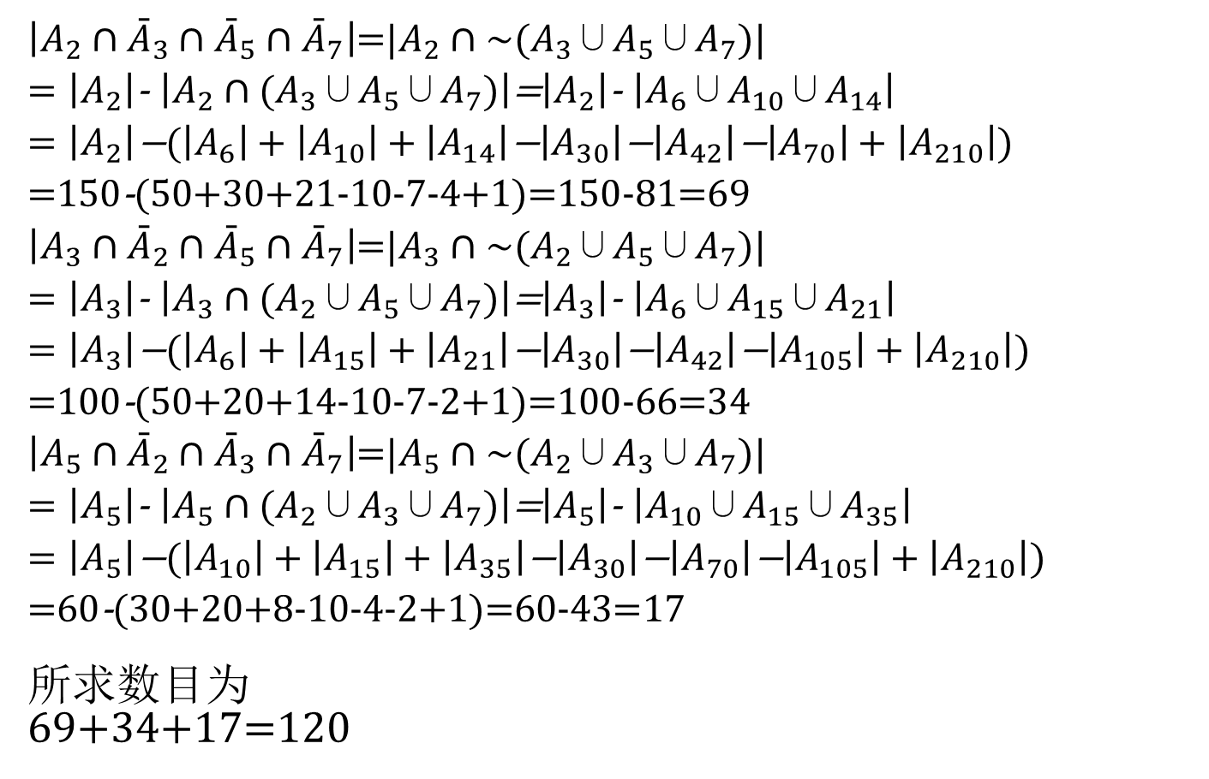
补充题 试求：在1和300之间能够被2、3、5中一个且仅一个整除，但不能被7整除的整数的个数。
解:
$\left|A_{2}∩{\bar{A}}_{3}∩{\bar{A}}_{5}∩{\bar{A}}_{7}\right|$=${|A}_{2}∩\sim {(A}_{3}\text{∪}A_{5}\text{∪}A_{7})|$ $=\left|A_{2}\right|$- $\left|A_{2}∩{(A}_{3}\text{∪}A_{5}\text{∪}A_{7})\right|$=$\left|A_{2}\right|$- $\left|A_{6}\text{∪}A_{10}\text{∪}A_{14}\right|$
= $\left|A_{2}\right|\text{−}(\left|A_{6}\right|+\left|A_{10}\right|+\left|A_{14}\right|\text{−}\left|A_{30}\right|\text{−}\left|A_{42}\right|\text{−}\left|A_{70}\right|+\left|A_{210}\right|)$
=150-(50+30+21-10-7-4+1)=150-81=69
$\left|A_{3}∩{\bar{A}}_{2}∩{\bar{A}}_{5}∩{\bar{A}}_{7}\right|$=${|A}_{3}∩\sim {(A}_{2}\text{∪}A_{5}\text{∪}A_{7})|$ $=\left|A_{3}\right|$- $\left|A_{3}∩{(A}_{2}\text{∪}A_{5}\text{∪}A_{7})\right|$=$\left|A_{3}\right|$- $\left|A_{6}\text{∪}A_{15}\text{∪}A_{21}\right|$
= $\left|A_{3}\right|\text{−}(\left|A_{6}\right|+\left|A_{15}\right|+\left|A_{21}\right|\text{−}\left|A_{30}\right|\text{−}\left|A_{42}\right|\text{−}\left|A_{105}\right|+\left|A_{210}\right|)$
=100-(50+20+14-10-7-2+1)=100-66=34
$\left|A_{5}∩{\bar{A}}_{2}∩{\bar{A}}_{3}∩{\bar{A}}_{7}\right|$=${|A}_{5}∩\sim {(A}_{2}\text{∪}A_{3}\text{∪}A_{7})|$ $=\left|A_{5}\right|$- $\left|A_{5}∩{(A}_{2}\text{∪}A_{3}\text{∪}A_{7})\right|$=$\left|A_{5}\right|$- $\left|A_{10}\text{∪}A_{15}\text{∪}A_{35}\right|$
= $\left|A_{5}\right|\text{−}(\left|A_{10}\right|+\left|A_{15}\right|+\left|A_{35}\right|\text{−}\left|A_{30}\right|\text{−}\left|A_{70}\right|\text{−}\left|A_{105}\right|+\left|A_{210}\right|)$
=60-(30+20+8-10-4-2+1)=60-43=17
所求数目为
69+34+17=120

Slide 8
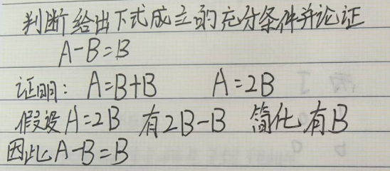
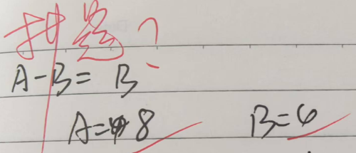
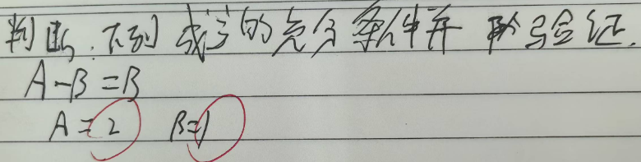
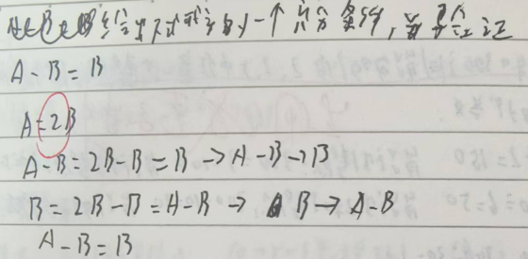
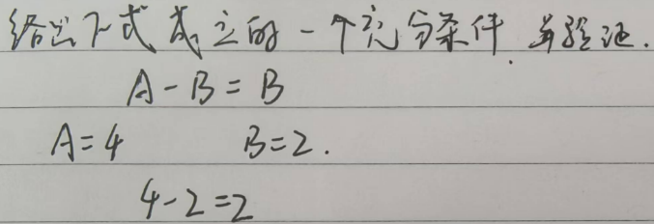

Slide 9
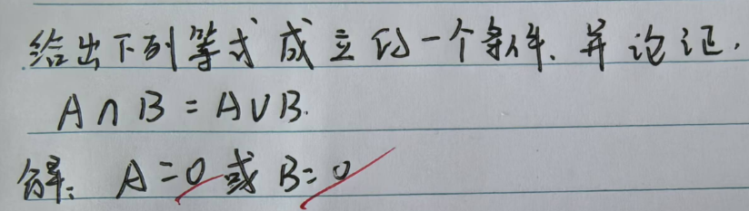
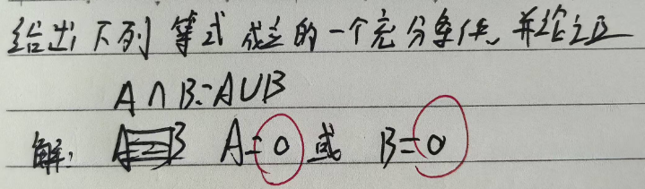
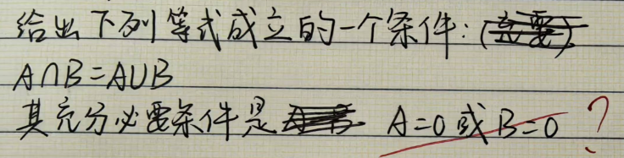

Slide 10
