Slide 1
CAR GAME IN C++

Slide 2
NAME OF THE STUDENT
ANIK SARKAR(123210903207)
ARPAN GHOSH(123210903212)
MANOJ SARKAR(123210903226)
SANGRAMJIT DAS(123210903240)

Slide 3
INTRODUCTION
Racing games are video games genre in which a player participates in a racing competition. We have created a racing game in c++ which can be enjoyable for kids, that the kids can enjoy passing time.

Slide 4
CONCEPT
We have created a car game in c++, in which the car goes on a direct path. In that direct path there are many obstacles that coming in the car’s path. A player has to tackle the obstacles to defend the car to go in it’s way. By tackling the obstacles a player can also earn points. When the obstacle is crashed with the car, then the GAME IS OVER.
INFORMATION
We use the A and D key to control the left and right movement of player’s car. We will keep track of the position of the car. When A or D key is pressed, we move the position of the car to the left or right lane and draw the car based on the position.

Slide 5
APPLICATION USED
DEV C++

Slide 6
HEADER FILES USED
<iostream>
<conio.h>
<dos.h>
<time.h>
<windows.h>

Slide 7
FUNCTIONS USED
PREDEFINED FUNCTION
Setcursor
Gotoxy
USER-DEFINED FUNCTION
drawBorder
genEnemy
drawEnemy
eraseEnemy
drawCar
eraseCar
gameover

Slide 8
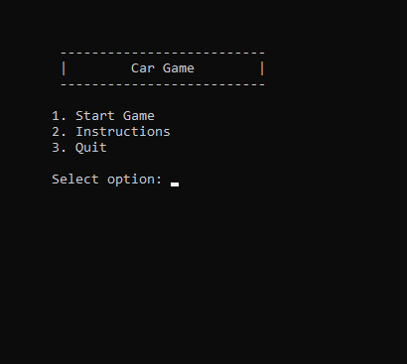
OUTPUT

Slide 9
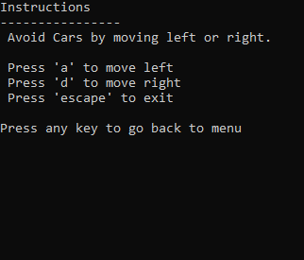

Slide 10
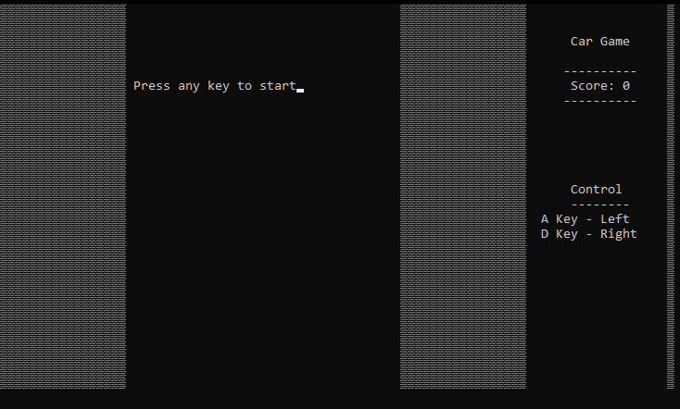

Slide 11
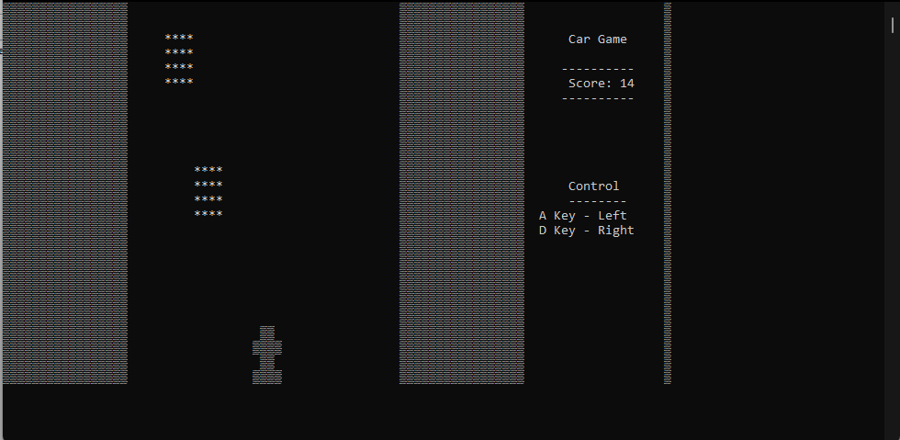

Slide 12
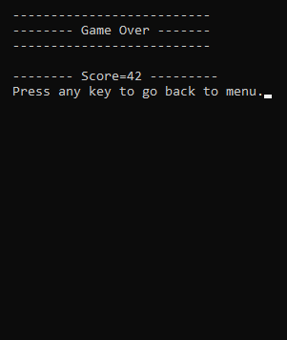

Slide 13
THANK YOU

