Slide 1
WLFW Grassland Bird Outcomes Assessment
Preliminary Design. Open to Input.

Slide 2
WLFW Monitoring Objectives
Estimate effects of EQIP practices on NOBO and other grassland birds
1
Estimate influence of landscape context on practice efficacy
2
Estimate practice implementation quality
3

Slide 3
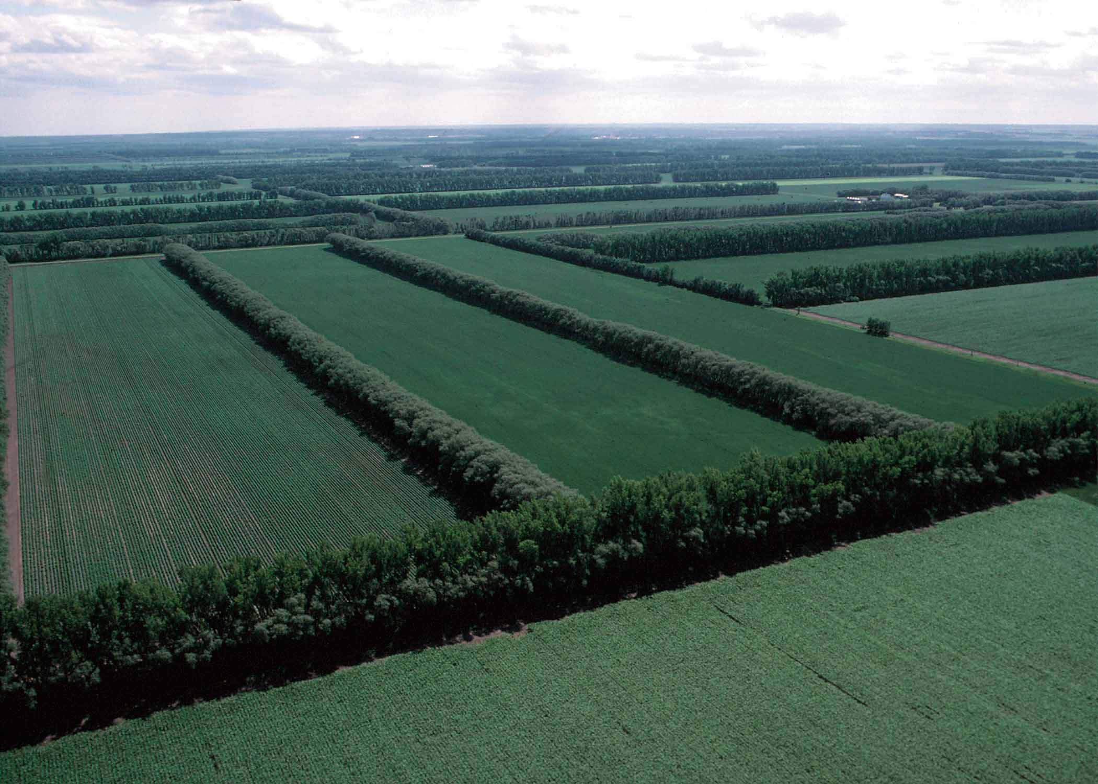
States involved
Forest Management Cluster– GA, FL, SC, AL, VA, and AR
Grassland Cluster – MO, oH, TN, TX, and IA
Shrub Planting Cluster– IN, DE, and MD

Slide 4
Key points
WLFW
Focused
Certified
Non-focused
Program
Context
Chronosequence
Planned
Planned
Certified
Prescribed fire
Forest stand improvement
Practice
Focused contracts occur within 8 km of a NBCI or State Focus Area or Landscape (see next slide)
Certified contracts should be contracts that have been completed in the last 3 years
Each practice should be represented in each level of the Chronosequence level

Slide 5
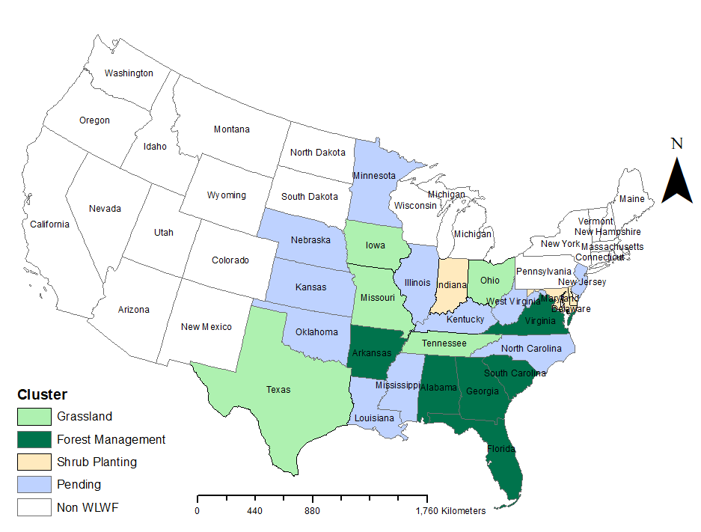
Spatial Frame

Slide 6

Forest Management Cluster
WLFW
Focused
Certified
Non-focused
Program
Context
Chronosequence
Planned
Planned
Certified
Prescribed fire
Forest stand improvement
Practice
Prescribed fire
Forest stand improvement
Prescribed fire
Forest stand improvement
Prescribed fire
Forest stand improvement

Slide 7

Grassland Cluster
WLFW
Focused
Certified
Non-focused
Program
Context
Chronosequence
Planned
Planned
Certified
Prescribed grazing
Forage planting
Practice
Prescribed grazing
Forage planting
Prescribed grazing
Forage planting
Prescribed grazing
Forage planting
Brush Management
Brush management
Brush management
Brush management

Slide 8
WLFW
Focused
Certified
Non-focused
Program
Context
Chronosequence
Planned
Planned
Certified
Hedgerow planting
Practice
Hedgerow planting
Hedgerow planting
Hedgerow planting
Shrub Planting Cluster

Slide 9
Bobwhite Focus Area
< 8 km
WLFW-like practice
> 8 km
WLFW contract

Slide 10
Forest Management (GA, FL, SC, AL, VA, and AR)
 | Planned |  | Certified
Practice | Focused | Non-focused | Focused | Non-focused | Total
Prescribed fire (338) | 30 | 30 | 30 | 30 | 120
Forest stand improvement (666) | 30 | 30 | 30 | 30 | 120
Total | 60 | 60 | 60 | 60 | 240
40 contracts per state

Slide 11
Grassland Cluster (OH, TX, MO, and TN)
 | Planned |  | Certified
Practice | Focused | Non-focused | Focused | Non-focused | Total
Brush management (314) | 30 | 30 | 30 | 30 | 120
Prescribed grazing (528) | 30 | 30 | 30 | 30 | 120
Forage planting (512) | 30 | 30 | 30 | 30 | 120
Total | 90 | 90 | 90 | 90 | 360
90 contracts per state

Slide 12
Shrub Planting Cluster (MD, DE, IA and IN)
 | Planned |  | Certified
Practice | Focused | Non-focused | Focused | Non-focused | Total
Hedgerow planting (422) | 30 | 30 | 30 | 30 | 120
Total | 30 | 30 | 30 | 30 | 120
30 contracts per state

Slide 13
Species List
Henslow's Sparrow
Loggerhead Shrike
Grasshopper Sparrow
Northern Bobwhite
Bachman's Sparrow
Dickcissel
Western Meadowlark
Eastern Meadowlark
Field Sparrow

Slide 14


ARU and human point count in center of contract field/stand

Slide 15

Vegetation Sampling and Photo Points

Slide 16
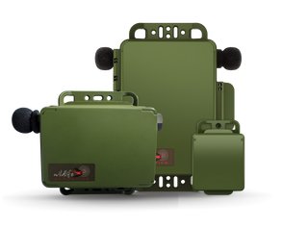
ARU Availability
50 Audiomoth ARUs ordered with WLFW funds
124 Wildlife Acoustic Minis ordered with WLFW funds
11 Wildlife Acoustic SM4s from SC
10 WA Minis ordered by Red Hill Quail Forever
~12 SM3s

Slide 17
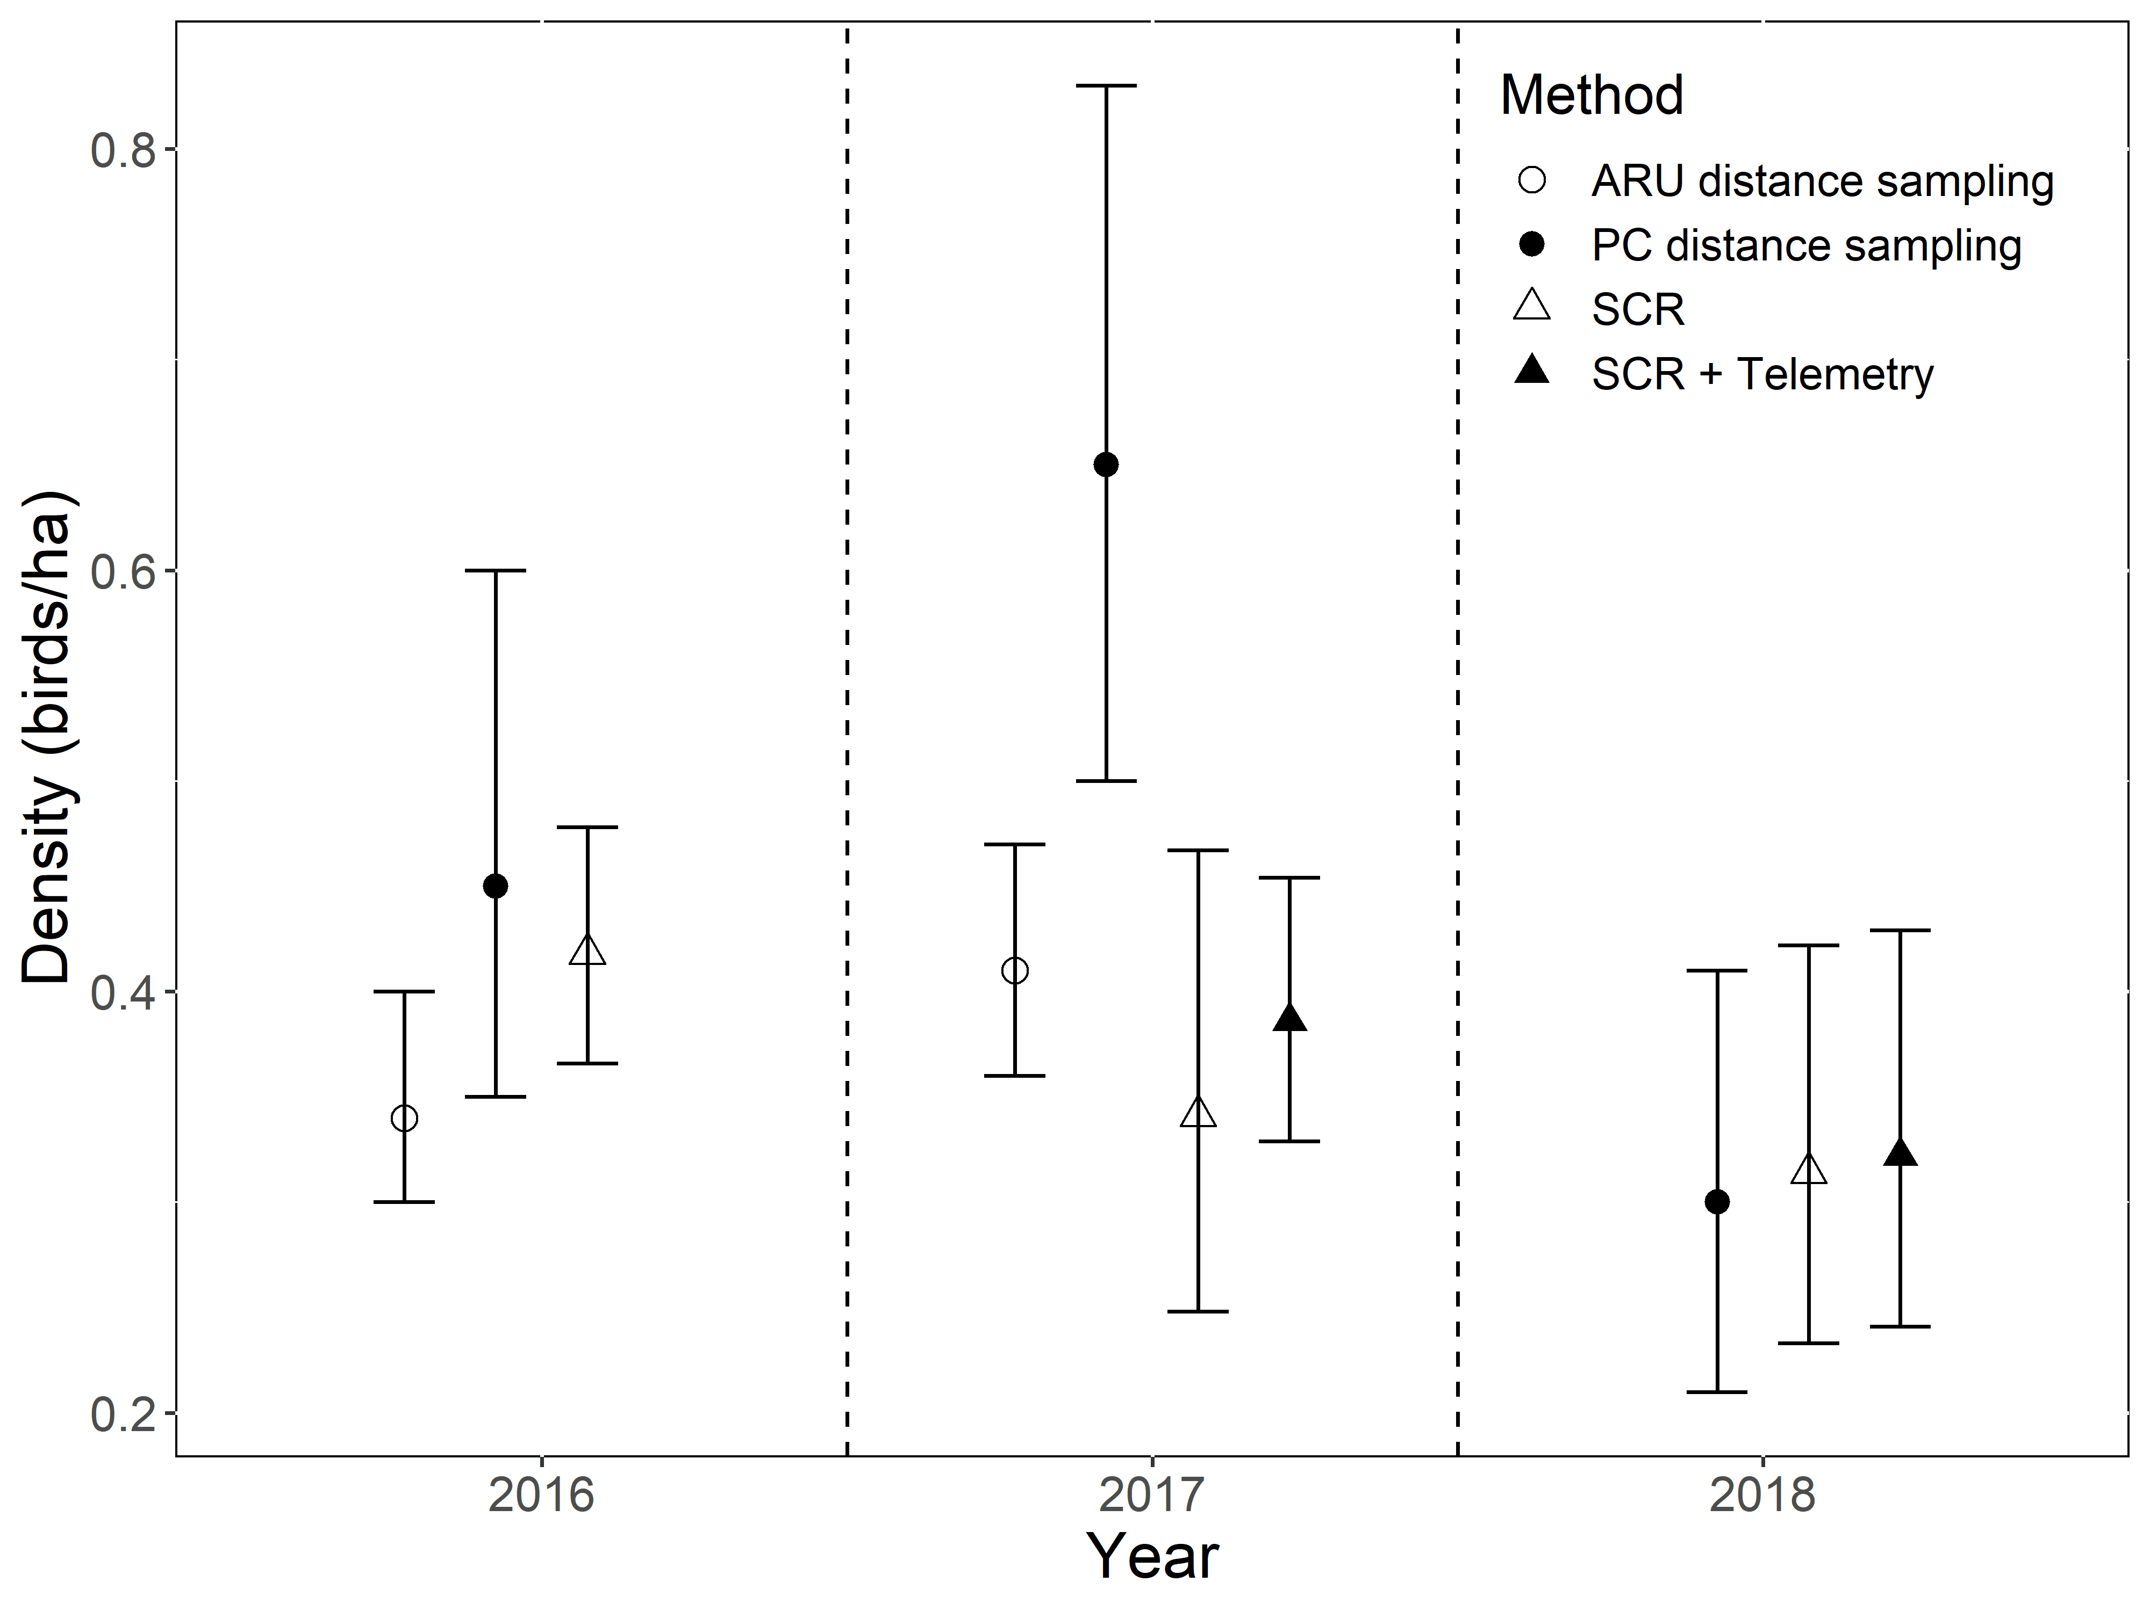
Efficacy of ARUs

Slide 18
Basic methodology
ARUs and human-based point counts at contracts during breeding season
Subset during fall
QF Bios conduct field sampling including deploying ARUs, point counts, and veg sampling (~20% of their job duties; ~ 52 days a year)
UGA manages data and conducts analyses

Slide 19
Biologist’s Contract List
List provided to UGA
ID | Name | Practice | Acres
10001 | John Smith | Prescribed Fire | 4
10002 | Jane Doe | Prescribed Fire | 88
10003 | Bobby Gentry | Prescribed Fire | 87
10004 | Jack Hasson | Prescribed Fire | 30
10005 | Pete Maravich | Prescribed Fire | 6
10006 | Stevie Nicks | Prescribed Grazing | 16
10007 | Axil Rose | Prescribed Grazing | 37
10008 | Joni Mitchell | Prescribed Grazing | 19
10009 | Ray Charles | Prescribed Grazing | 35
10010 | Ann Margaret | Prescribed Grazing | 59
10011 | Maralyn Monroe | Prescribed Grazing | 74
ID |  | Practice | Acres
10001 |  | Prescribed Fire | 14
10002 |  | Prescribed Fire | 88
10003 |  | Prescribed Fire | 72
10004 |  | Prescribed Fire | 0
10005 |  | Prescribed Fire | 45
10006 |  | Prescribed Grazing | 51
10007 |  | Prescribed Grazing | 91
10008 |  | Prescribed Grazing | 56
10009 |  | Prescribed Grazing | 19
10010 |  | Prescribed Grazing | 85
10011 |  | Prescribed Grazing | 98
Certain landowners agree to monitoring and being part of study
UGA prioritizes the order to contact landowners (i.e. call according to rank)
ID |  | Practice | Acres | Rank
10001 |  | Prescribed Fire | 84 | 2
10002 |  | Prescribed Fire | 62 | 3
10003 |  | Prescribed Fire | 57 | 5
10004 |  | Prescribed Fire | 43 | 1
10005 |  | Prescribed Fire | 62 | 4
10006 |  | Prescribed Grazing | 56 | 6
10007 |  | Prescribed Grazing | 65 | 4
10008 |  | Prescribed Grazing | 72 | 1
10009 |  | Prescribed Grazing | 32 | 2
10010 |  | Prescribed Grazing | 62 | 3
10011 |  | Prescribed Grazing | 98 | 5
ID |  | Practice | Acres | Rank
10001 |  | Prescribed Fire | 84 | 2
10002 |  | Prescribed Fire | 62 | 3
10003 |  | Prescribed Fire | 57 | 5
10004 |  | Prescribed Fire | 43 | 1
10005 |  | Prescribed Fire | 62 | 4
10006 |  | Prescribed Grazing | 56 | 6
10007 |  | Prescribed Grazing | 65 | 4
10008 |  | Prescribed Grazing | 72 | 1
10009 |  | Prescribed Grazing | 32 | 2
10010 |  | Prescribed Grazing | 62 | 3
10011 |  | Prescribed Grazing | 98 | 5
Bio conducts monitoring on those contracts

