Slide 1
Scheduling Suggestions:
Example Schedule:
Plan ahead.
Start surveys early in the season to allow yourself wiggle room in the event of unexpected scheduling / weather conflicts.
You should be grouping points by proximity, so you are able to complete multiple point counts in a morning.
When possible, conduct point count surveys on the ARU retrieval date to reduce the number of needed site visits.
Each “group” represents a cluster of points in close proximity. If many of your contracts are relatively close, you may need as few as 2 groups to cover 10-12 points with 6 ARUs. This example assumes you deploy 3 ARUs per group (i.e., 3 points are in each group).
This schedule does not account for weather or scheduling conflicts. However, it provides a little over 2-weeks worth of wiggle room.
It’s unlikely that you will be able to follow this schedule exactly. This is meant to serve as an example, but it is up to you to find a rotation that works for your schedule and site specifics.

Slide 2
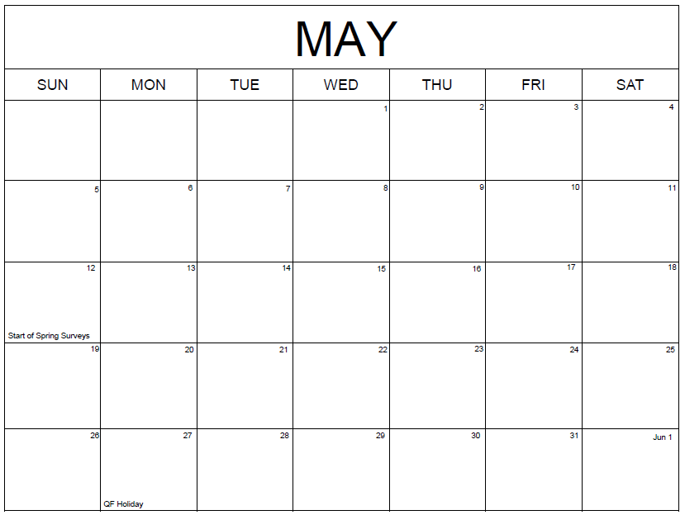
Deploy @ Group A
(delayed start)
Group A Recording Period (Replicate 1)
Deploy @ Group C
Group C Recording
Deploy @ Group B
Group B Recording Period (Replicate 1)
Period (Replicate 1)
Deploy @ Group D
Group D Recording Period (Replicate 1)
Deploy @ Group A
Group A Recording
Deploy @ Group B
Group B Recording Period (Replicate 2)
Period (Replicate 2)
Deploy @ Group C

Slide 3
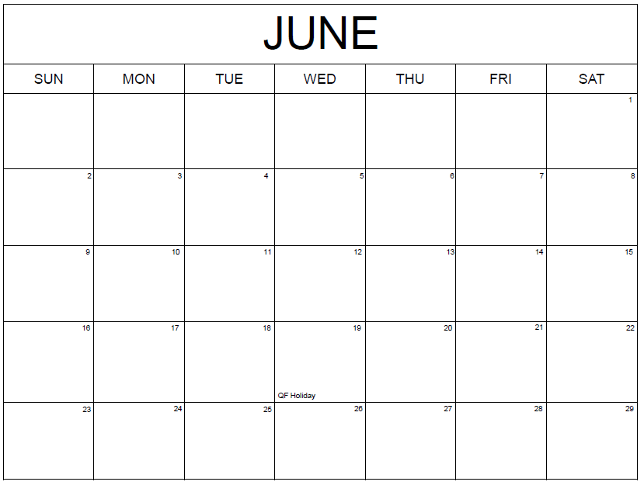
Group B Recording
Group C Recording
Period (Replicate 2) (cont.)
Deploy @ Group D
Group D Recording Period (Replicate 2)
Period (Replicate 2)
Deploy @ Group A
Group A Recording
Deploy @ Group B
Group B Recording Period (Replicate 3)
Period (Replicate 3)
Deploy @ Group C
(delayed start)
Deploy @ Group D
Group D Recording
Group C Recording Period (Replicate 3)
Period (Replicate 3)

Slide 4
