Slide 1
GDXRRW:
Exchanging Data Between
GAMS and R
Steve Dirkse sdirkse@gams.com
GAMS Development Corporation
www.gams.com
ISMP Berlin 20 August 2012
Notes:
Welcome, thank audience.

Slide 2
Welcome/Agenda
Background: why & what
readgdx: overview and examples
writegdx: overview and examples
Joint work with Michael Ferris & Renger van Nieuwkoop

Slide 3
GAMS Philosophy 101
Layered architecture with separation of:
Model and data
Model and user interface
Open architecture and interfaces to other systems
GDX (Gams Data eXchange) – data hugely important
GDX tools (from GAMS and 3rd parties)
GDX API to exchange data with other apps

Slide 4
GDX Advantages
Platform independent
Fully precise – data are stored in a binary format
Efficient: careful coding, sparsity, compression
Supported by freely available utilities
Standards-based: format is documented, tested, supported, and used in many applications
Language independent: published interfaces for many languages, e.g. C/C++, C#, Java, VB, Python, Delphi
Validated data
no syntax errors on read
consistent: no duplicates, contradictions, etc.

Slide 5
Why R?
R is a powerful, feature-packed software
Statistics
Data analysis, manipulation, and visualization
Programming – prototyping and development
Application-specific packages – thousands available
More statistics
Finance
Computation biology / bioinformatics (Bioconductor)
R is easy to install, update, and augment
R is fun to use

Slide 6
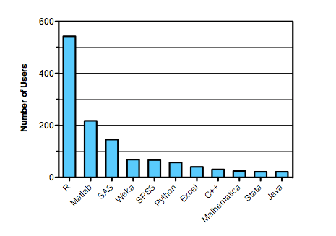
Why R?
Software used in data analysis competitions in 2011
Source: http://r4stats.com/articles/popularity

Slide 7
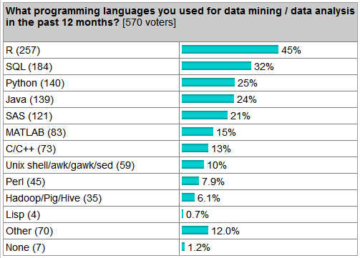
Why R?
Language use survey
Source: http://r4stats.com/articles/popularity

Slide 8
The GAMS Data Format
GAMS & GDX use a relational data model
Parameters and sets are indexed by labels, not integers
The union of labels used forms an ordered universe
Data is stored in sparse form
Set data – a collection of labels is a set
One-dimensional sets make the foundation
N-dimensional tuples build (sub)sets from this
Parameter data – numeric
Behave like N-dim sets, but with values
Special values – INF, eps, NA (missing)

Slide 9
GAMS Data - Example
SET people /
annika, elise, michelle, valerie
zoe, annie, emily, erica /;
SET friends(people,people) /
annika.zoe
elise.annie
michelle.emily
valerie.erica /;
Notes:
Illustrate that the data is indexed by labels, that sets can be indexed just like parameters, and that mappings can be viewed in different ways.

Slide 10
R Data Types and Formats
R has a wide variety of data types
GDXRRW uses:
numeric, character, logical
scalar, vector, matrix, array
List: collections of potentially unrelated objects
factors: efficient storage for names
dataframes: matrix with different modes per column
E.g. cols 1 & 2 strings, col 3 numeric
R borrows from Perl: TMTOWTDI
There’s more than one way to do it
e.g. accessing a list via order or by name
e.g. matrix indexed by both integers and strings

Slide 11
Design goals & issues
Simplicity: make the obvious choice
Convenience
Give the users what they want
Map GDX data to oft-used, similar R data structures
E.g. factors, data frames
Efficiency
Force of habit to consider speed and memory
Sometimes conflicts with the R way
Data mapping
relational GDX data <-> multiple R possibilities
No single right way to do it

Slide 12
Background: why & what
Data mapping issues
writegdx: overview and examples

Slide 13
Example Data – data1
SET friends(*,*) /
annika.zoe
elise.annie
michelle.emily
valerie.erica
/;
execute_unload 'data1';
Notes:
Illustrate that the data is indexed by labels, that sets can be indexed just like parameters, and that mappings can be viewed in different ways.

Slide 14
rgdx: form=‘full’
r <- rgdx(‘data1’,
list(name=‘friends’,form=‘full’))
Each call reads a single set or parameter
Reading GDX this way is efficient and simple
Input list fields control what and how to return
name= ‘xxxxx’ – required, symbol name in GDX
form= ‘full’– return a full/dense result
Result fields include
val: a matrix of values (0/1 for sets)
uels: the GAMS labels mapped to each dimension
N.B.: r$val is dense and potentially big: each dimension has cardinality of the universe

Slide 15
rgdx: form=‘full’,compressed=TRUE
r <- rgdx(‘d1’,
list(name=‘friends’,form=‘full’,
compress=TRUE))
Note the compress=TRUE option
r$val is compressed by removing empty rows/cols
r$uels is also smaller
r$val is still dense and potentially big, but each dimension has minimal cardinality
N.B.: compress=TRUE can squeeze out more than we intended

Slide 16
rgdx: form=‘full’,uels=xxx
i1 <- c("annika","elise")
i2 <- c("annie","zoe")
o <- list(name='friends',
form='full',uels=list(i1,i2))
r <- rgdx('data1', o)
Note the uels=list(i1,i2) option
r$val is as large as the Cartesian product i1 x i2 and is still dense
r$uels is identical to the input uels
This mode filters and reorders data

Slide 17
Example Data – data2
SETS
d 'daughters' /
annika, elise, michelle, valerie /
p 'people we know' /
zoe, annie, emily, erica /
friends(d,p) /
annika.zoe
elise.annie
michelle.emily
valerie.erica
/;
execute_unload 'data2';
Notes:
Illustrate that the data is indexed by labels, that sets can be indexed just like parameters, and that mappings can be viewed in different ways.

Slide 18
rgdx: form=‘full’,uels=xxx
We can create a filter by reading from GDX
dd <- rgdx('data2',list(name='d',compress=TRUE))
pp <- rgdx('data2',list(name='p',compress=TRUE))
filt <- list(dd$uels[[1]],pp$uels[[1]])
o <- list(name='friends',
form='full',uels=filt)
r <- rgdx('data1', o)
Note that:
The above technique is very reliable
Filters can be defined manually or automatically
Current work to automate this more

Slide 19
rgdx: form=‘sparse’
r <- rgdx(‘data1’,
list(name=‘friends’,form=‘sparse’))
The same options (compressed, uels) can be used
The same fields in the result r will be returned, except
r$val will be a sparse representation of the r$val from the full case
(i,j,val) or (i1,i2,i3,i4,…,iN,val) for parameters
(i,j) or (i1,i2,i3,i4,…,iN) for sets
N.B.: r$val has one row per element of data

Slide 20
rgdx.set: dataframe output
Convenience wrappers handle special cases
Implemented in R source
Allows for customization, documentation
r <- rgdx.set(‘data1’,’friends’)
An R session with print(r) and str(r) helps now
Possible options include compression, filtering.

Slide 21
Background: why & what
readgdx: overview and examples
writegdx: overview and examples

Slide 22
Readgdx – basic syntax
r = rgdx(‘filename.gdx’,o), where
r is a structure containing the result, i.e. output data
o is a structure of options controlling the read
Each call reads a single set or parameter
Reading GDX this way is efficient and simple
Option fields include
name= ‘xxxxx’ – required, symbol name in GDX
form= ‘full’ or ‘sparse’ – default sparse
compress= ‘true’ or ‘false’ – default false
uels: optional filter/mapping for each dimension
Result fields include
val: the Matlab matrix, in full or sparse form
uels: the GAMS labels mapped to each dimension

Slide 23
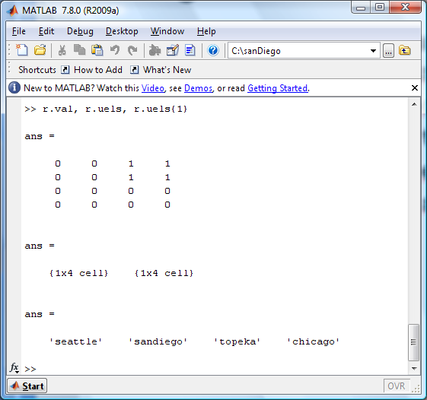
Readgdx – r.val and r.uels
The interesting results are the values and UELs
Set i / seattle, sandiego /
j / topeka, chicago /;
Set link(i,j) ‘set to read’ /
seattle.topeka, seattle.chicago,
sandiego.topeka, sandiego.chicago /;

Slide 24
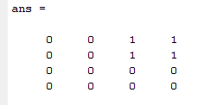
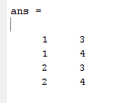
Readgdx – full vs. sparse
link(i,j) ‘set to read’ /
seattle.topeka, seattle.chicago,
sandiego.topeka, sandiego.chicago /;
Full (i.e dense) result
Sparse result

Slide 25
Readgdx – filtered reads
A filter is a list of labels - values whose labels are outside of this list are ignored.
Filters are specified using the uels field of the options
Each dimension has its own filter
To filter nothing out, use the universe as a filter
The result uels field duplicates the input options
Filters provide additional flexibility
E.g. compressed reads remove all zero rows/cols
Filters can reorder data as well as filter it

Slide 26
Readgdx – filtered reads
The Matlab code below does a filtered read on our example data, returning an empty set.
o.name = 'link';
dom = cell(1,2);
dom{1} = { 'chicago','topeka' };
dom{2} = { 'seattle','sandiego' };
o.uels = dom;
r = rgdx('rgdx.gdx',o);

Slide 27
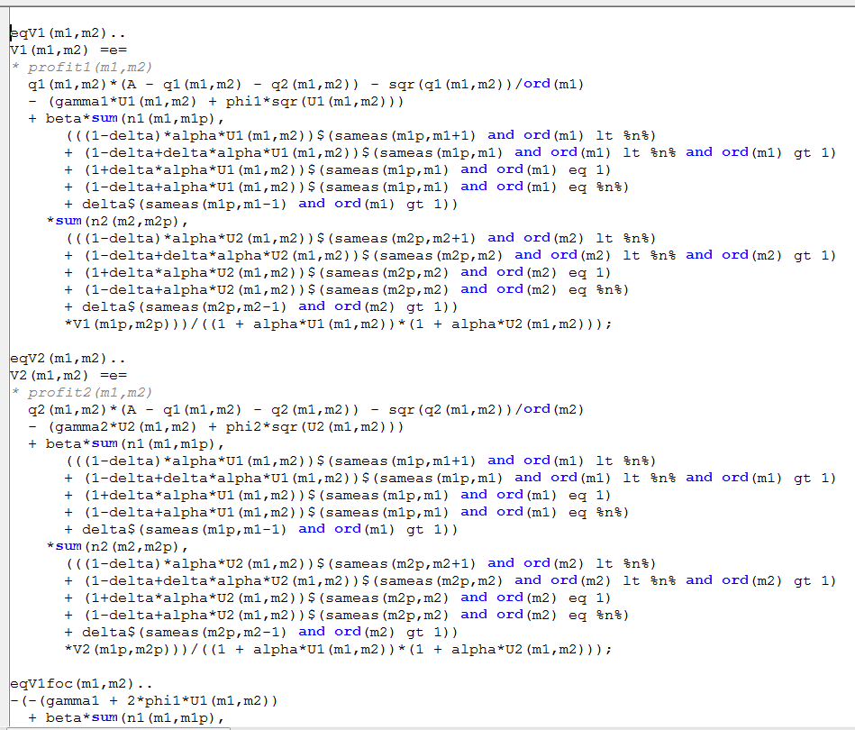
A Difficult Model

Slide 28
Readgdx - Visualizing the Jacobian
Use CONVERT to dump the Jacobian to GDX
A few Matlab lines give us an interesting picture
u = readgdx('dyngame.gdx'); universe = u.uels;
rFlags.name = 'I';
i = readgdx('dyngame.gdx',rFlags);
rFlags.name = 'J';
j = readgdx('dyngame.gdx',rFlags);
Adom{1} = {universe{i.val}};
Adom{2} = {universe{j.val}};
rFlags.name = 'A';
rFlags.uels = Adom;
rFlags.form = 'full';
A = readgdx('dyngame.gdx',rFlags);
% spy(A.val)

Slide 29
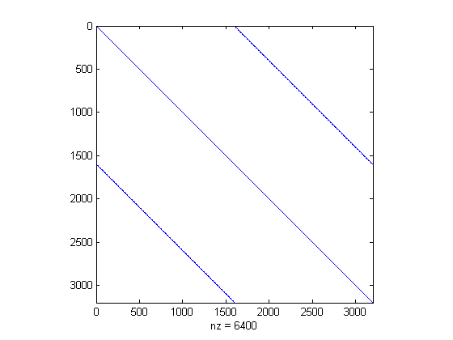
The Jacobian Revealed

Slide 30
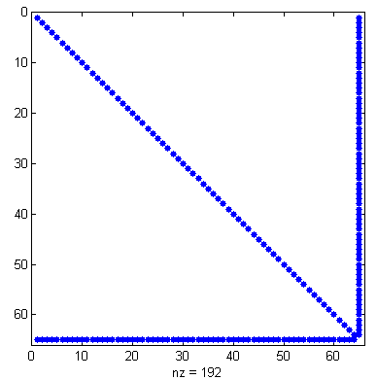
Another Model, Another Jacobian
o.name = 'A';
o.form = 'full';
o.compress='true';
A = rgdx(‘jac’,o);
spy(A.val);

Slide 31
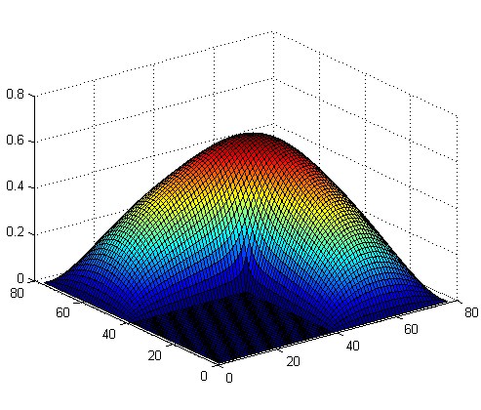
Visualizing a surface
fname = 'bratu';
u = rgdx(fname);
uni = u.uels;
o.name = 'I';
i = rgdx(fname,o);
o.name = ‘J';
j = rgdx(fname,o);
o.name = 'vsol';
o.form = 'full';
d{1} = {uni{i.val}};
d{2} = {uni{j.val}};
o.uels = dom;
v = rgdx(fname,o);
surf(v.val)

Slide 32
Background: why & what
readgdx: overview and examples
Example use cases

Slide 33
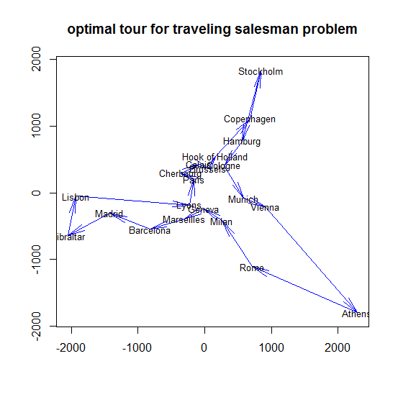
Visualizing a TSP on R’s eurodist data
Distance data native to R
To GDX via GDXRRW
Solve TSP in GAMS
Dump tour to GDX
Read tour into R
Plot cities and tour

Slide 34
Visualizing parking data on a grid
Data in GDX: nodes, arcs, coords, results
Read into R via GDXRRW
Adjust format, labels, etc.
Plot network and bar charts

Slide 35
Concluding Remarks
Additional enhancements are in progress
Reading/writing equations and variables
Make use of domain information where available
Suggestions welcome!!
We invite & encourage you to use these tools
For more information:
http://support.gams.com/doku.php?id=gdxrrw:interfacing_gams_and_r (GDXRRW Wiki, downloads, FAQ, etc)
http://www.gams.com/download/ (free GAMS downloads)
http://blog.modelworks.ch/ (Renger’s blog)
Notes:
Thank you!

