Slide 1
GDXRRW:
Exchanging Data Between
GAMS and R
Steve Dirkse sdirkse@gams.com
GAMS Development Corporation
www.gams.com
ISMP Berlin 20 August 2012
Notes:
Welcome, thank audience.

Slide 2
Welcome/Agenda
Background: why & what
Data mapping issues
Example use cases
Joint work with Michael Ferris & Renger van Nieuwkoop

Slide 3
GAMS Philosophy 101
Layered architecture with separation of:
Model and data
Model and user interface
Open architecture and interfaces to other systems
GDX (Gams Data eXchange) – data hugely important
GDX tools (from GAMS and 3rd parties)
GDX API to exchange data with other apps

Slide 4
GDX Advantages
Platform independent
Fully precise – data are stored in a binary format
Efficient: careful coding, sparsity, compression
Supported by freely available utilities
Standards-based: format is documented, tested, supported, and used in many applications
Language independent: published interfaces for many languages, e.g. C/C++, C#, Java, VB, Python, Delphi
Validated data
no syntax errors on read
consistent: no duplicates, contradictions, etc.

Slide 5
Why R?
R is a powerful, feature-packed software
Statistics
Data analysis, manipulation, and visualization
Programming – prototyping and development
Application-specific packages – thousands available
More statistics
Finance
Computation biology / bioinformatics (Bioconductor)
R is easy to install, update, and augment
R is fun to use

Slide 6
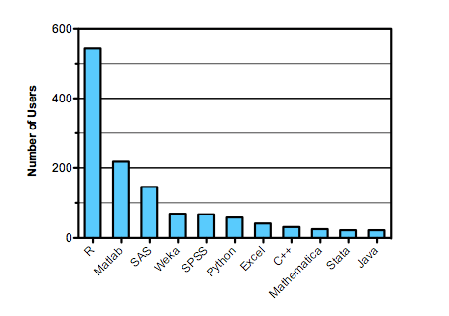
Why R?
Software used in data analysis competitions in 2011
Source: http://r4stats.com/articles/popularity

Slide 7
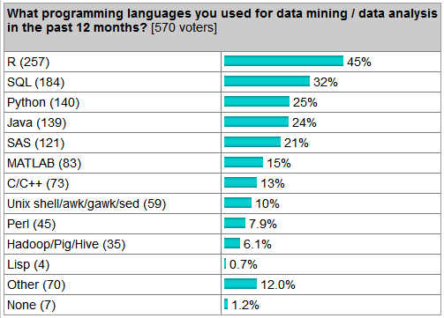
Why R?
Language use survey
Source: http://r4stats.com/articles/popularity

Slide 8
The GAMS Data Format
GAMS & GDX use a relational data model
Parameters and sets are indexed by labels, not integers
The union of labels used forms an ordered universe
Data is stored in sparse form
Set data – a collection of labels is a set
One-dimensional sets make the foundation
N-dimensional tuples build (sub)sets from this
Parameter data – numeric
Behave like N-dim sets, but with values
Special values – INF, eps, NA (missing)

Slide 9
GAMS Data - Example
SET people /
annika, elise, michelle, valerie
zoe, annie, emily, erica /;
SET friends(people,people) /
annika.zoe
elise.annie
michelle.emily
valerie.erica /;
Notes:
Illustrate that the data is indexed by labels, that sets can be indexed just like parameters, and that mappings can be viewed in different ways.

Slide 10
R Data Types and Formats
R has a wide variety of data types
GDXRRW uses:
numeric, character, logical
scalar, vector, matrix, array
List: collections of potentially dissimilar objects
factors: efficient storage for names
dataframes: matrix with different modes per column
E.g. cols 1 & 2 strings, col 3 numeric
R borrows from Perl: TMTOWTDI
There’s more than one way to do it
e.g. accessing a list via index position or name
e.g. matrix indexed by both integers and strings

Slide 11
Design goals & issues
Simplicity: make the obvious choice
Convenience
Give the users what they want
Map GDX data to oft-used, similar R data structures
E.g. factors, data frames
Efficiency
Force of habit to consider speed and memory
Sometimes conflicts with the R way
Data mapping
relational GDX data <-> multiple R possibilities
No single right way to do it

Slide 12
Background: why & what
Data mapping issues
Example use cases

Slide 13
Example Data – data1
SET friends(*,*) /
annika.zoe
elise.annie
michelle.emily
valerie.erica
/;
execute_unload 'data1';
Notes:
Illustrate that the data is indexed by labels, that sets can be indexed just like parameters, and that mappings can be viewed in different ways.

Slide 14
rgdx: form=‘full’
r <- rgdx(‘data1’,
list(name=‘friends’,form=‘full’))
Each call reads a single set or parameter
Reading GDX this way is efficient and simple
Input list fields control what and how to return
name= ‘xxxxx’ – required, symbol name in GDX
form= ‘full’– return a full/dense result
Result fields include
val: a matrix of values (0/1 for sets)
uels: the GAMS labels mapped to each dimension
N.B.: r$val is dense and potentially big: each dimension has cardinality of the universe

Slide 15
rgdx: form=‘full’,compress=TRUE
r <- rgdx(‘d1’,
list(name=‘friends’,form=‘full’,
compress=TRUE))
Note the compress=TRUE option
r$val is compressed by removing empty rows/cols
r$uels is also smaller
r$val is still dense and potentially big, but each dimension has minimal cardinality
N.B.: compress=TRUE can squeeze out more than we intended

Slide 16
rgdx: form=‘full’,uels=xxx
i1 <- c("annika","elise")
i2 <- c(“zoe",“annie")
o <- list(name='friends',
form='full',uels=list(i1,i2))
r <- rgdx('data1', o)
Note the uels=list(i1,i2) option
Each dimension has its own filter
r$val is as large as the Cartesian product i1 x i2 and is still dense
r$uels is identical to the input uels
This mode filters and reorders data

Slide 17
Example Data – data2
SETS
d 'daughters' /
annika, elise, michelle, valerie /
p 'people we know' /
zoe, annie, emily, erica /
friends(d,p) /
annika.zoe
elise.annie
michelle.emily
valerie.erica
/;
execute_unload 'data2';
Notes:
Illustrate that the data is indexed by labels, that sets can be indexed just like parameters, and that mappings can be viewed in different ways.

Slide 18
rgdx: form=‘full’,uels=xxx
We can create a filter by reading from GDX
dd <- rgdx('data2',list(name='d',compress=TRUE))
pp <- rgdx('data2',list(name='p',compress=TRUE))
filt <- list(dd$uels[[1]],pp$uels[[1]])
o <- list(name='friends',
form='full',uels=filt)
r <- rgdx('data1', o)
Note that:
The above technique is very reliable
The universe can be used: no filtering or reordering
Filters can be defined manually or automatically
Current work to automate this more

Slide 19
rgdx: form=‘sparse’
r <- rgdx(‘data1’,
list(name=‘friends’,form=‘sparse’))
The same options (compressed, uels) can be used
The same fields in the result r will be returned, except
r$val will be a sparse representation of the r$val from the full case
(i,j,val) or (i1,i2,i3,i4,…,iN,val) for parameters
(i,j) or (i1,i2,i3,i4,…,iN) for sets
N.B.: r$val has one row per element of data

Slide 20
rgdx.set: dataframe output
Convenience wrappers handle special cases
Implemented in R source
Allows for customization, documentation
r <- rgdx.set(‘data1’,’friends’)
An R session with print(r) and str(r) helps now
Possible options include compression.

Slide 21
Background: why & what
Data mapping issues
Example use cases

Slide 22
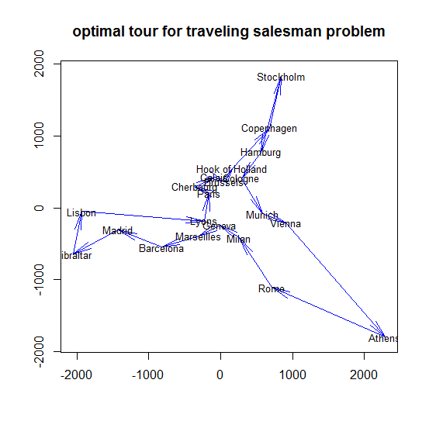
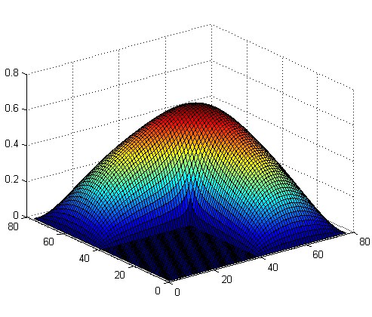
Visualizing a TSP on R’s eurodist data
Distance data native to R
To GDX via GDXRRW
Solve TSP in GAMS
Dump tour to GDX
Read tour into R
Plot cities and tour

Slide 23
Visualizing parking data on a grid
Data in GDX: nodes, arcs, coords, results
Read into R via GDXRRW
Adjust format, labels, etc.
Plot network and bar charts

Slide 24
Integrating model results with maps
Data in GDX: state subset and data
Read into R via GDXRRW
library(maps)
plots subset of states
Has centers of states
Use centers to position pie charts

Slide 25
Concluding Remarks
Additional enhancements are in progress
Reading/writing equations and variables
Make use of domain information where available
Suggestions welcome!!
We invite & encourage you to use these tools
For more information:
http://support.gams.com/doku.php?id=gdxrrw:interfacing_gams_and_r (Wiki, downloads, FAQ, etc)
http://www.gams.com/download/ (free GAMS downloads)
http://blog.modelworks.ch/ (Renger’s blog)
Notes:
Thank you!

