Slide 1
GDXRRW:
Exchanging Data Between
GAMS and R
Steve Dirkse sdirkse@gams.com
GAMS Development Corporation
www.gams.com
ISMP Berlin 20 August 2012
Notes:
Welcome, thank audience.

Slide 2
Welcome/Agenda
Background: why & what
readgdx: overview and examples
writegdx: overview and examples
Joint work with Michael Ferris & Renger van Nieuwkoop

Slide 3
GAMS Philosophy 101
Layered architecture with separation of:
Model and data
Model and user interface
Open architecture and interfaces to other systems
GDX (Gams Data eXchange) – data hugely important
GDX tools (from GAMS and 3rd parties)
GDX API to exchange data with other apps

Slide 4
GDX Advantages
Platform independent
Fully precise – data are stored in a binary format
Efficient: careful coding, sparsity, compression
Supported by freely available utilities
Standards-based: format is documented, tested, supported, and used in many applications
Language independent: published interfaces for many languages, e.g. C/C++, C#, Java, VB, Python, Delphi
Validated data
no syntax errors on read
consistent: no duplicates, contradictions, etc.

Slide 5
Why R?
R is a powerful, feature-packed software
Statistics
Data analysis, manipulation, and visualization
Programming – prototyping and development
Application-specific packages – thousands available
More statistics
Finance
Computation biology / bioinformatics (Bioconductor)
R is easy to install, update, and augment
R is fun to use

Slide 6
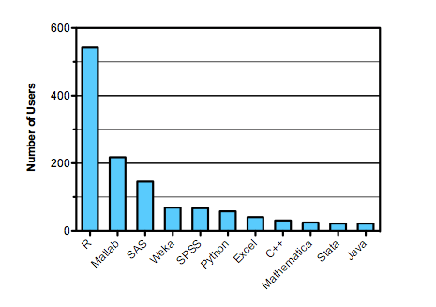
Why R?
Software used in data analysis competitions in 2011
Source: http://r4stats.com/articles/popularity

Slide 7
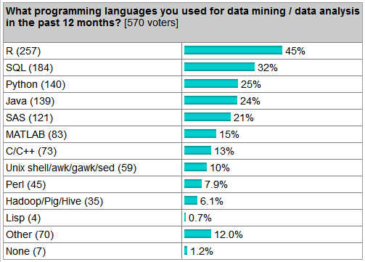
Why R?
Language use survey
Source: http://r4stats.com/articles/popularity

Slide 8
The GAMS Data Format
GAMS & GDX use a relational data model
Parameters and sets are indexed by labels, not integers
The union of labels used forms an ordered universe
Data is stored in sparse form
Set data – a collection of labels is a set
One-dimensional sets make the foundation
N-dimensional tuples build (sub)sets from this
Parameter data – numeric
Behave like N-dim sets, but with values
Special values – INF, eps, NA (missing)

Slide 9
GAMS Data - Example
SET people /
annika, elise, michelle, valerie
zoe, annie, emily, erica /;
SET friends(people,people) /
annika.zoe
elise.annie
michelle.emily
valerie.erica /;
Notes:
Illustrate that the data is indexed by labels, that sets can be indexed just like parameters, and that mappings can be viewed in different ways.

Slide 10
R Data Types and Formats
R has a wide variety of data types
GDXRRW uses:
numeric, character, logical
scalar, vector, matrix, array
List: collections of potentially unrelated objects
factors: efficient storage for names
dataframes: matrix with different modes per column
E.g. cols 1 & 2 strings, col 3 numeric
R borrows from Perl: TMTOWTDI
There’s more than one way to do it
e.g. accessing a list via order or by name
e.g. matrix indexed by both integers and strings

Slide 11
Design goals & issues
Simplicity: make the obvious choice
Convenience
Give the users what they want
Map GDX data to oft-used, similar R data structures
E.g. factors, data frames
Efficiency
Force of habit to consider speed and memory
Sometimes conflicts with the R way
Data mapping
relational GDX data <-> multiple R possibilities
No single right way to do it

Slide 12
Background: why & what
Data mapping issues
writegdx: overview and examples

Slide 13
Rgdx: form=‘full’
r <- rgdx(‘d1’,
list(name=‘friends’,form=‘full’))
Each call reads a single set or parameter
Reading GDX this way is efficient and simple
Input list fields control what and how to return
name= ‘xxxxx’ – required, symbol name in GDX
form= ‘full’– return a full/dense result
Result fields include
val: a matrix of values (0/1 for sets)
uels: the GAMS labels mapped to each dimension
N.B.: r$val is dense and potentially big: each dimension has cardinality of the universe

Slide 14
rgdx: form=‘full’,compressed=TRUE
r <- rgdx(‘d1’,
list(name=‘friends’,form=‘full’,
compress=TRUE))
Note the compress=TRUE option
r$val is compressed by removing empty rows/cols
r$uels is also smaller
r$val is still dense and potentially big, but each dimension has minimal cardinality
N.B.: compress=TRUE can squeeze out more than we intended

Slide 15
rgdx: form=‘full’,filter=xxx
r <- rgdx(‘d1’,
list(name=‘friends’,form=‘full’,
compress=TRUE))
Note the compress=TRUE option
r$val is compressed by removing empty rows/cols
r$uels is also smaller
r$val is still dense and potentially big, but each dimension has minimal cardinality
N.B.: compress=TRUE can squeeze out more than we intended

Slide 16
Background: why & what
readgdx: overview and examples
writegdx: overview and examples

Slide 17
Readgdx – basic syntax
r = rgdx(‘filename.gdx’,o), where
r is a structure containing the result, i.e. output data
o is a structure of options controlling the read
Each call reads a single set or parameter
Reading GDX this way is efficient and simple
Option fields include
name= ‘xxxxx’ – required, symbol name in GDX
form= ‘full’ or ‘sparse’ – default sparse
compress= ‘true’ or ‘false’ – default false
uels: optional filter/mapping for each dimension
Result fields include
val: the Matlab matrix, in full or sparse form
uels: the GAMS labels mapped to each dimension

Slide 18
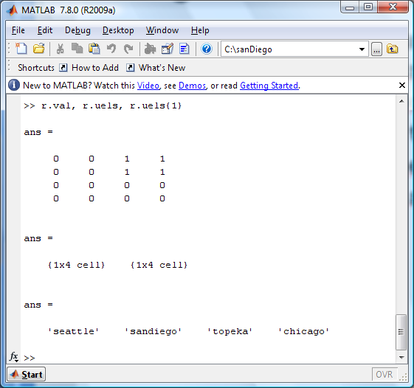
Readgdx – r.val and r.uels
The interesting results are the values and UELs
Set i / seattle, sandiego /
j / topeka, chicago /;
Set link(i,j) ‘set to read’ /
seattle.topeka, seattle.chicago,
sandiego.topeka, sandiego.chicago /;

Slide 19
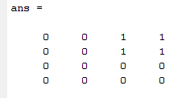
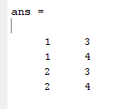
Readgdx – full vs. sparse
link(i,j) ‘set to read’ /
seattle.topeka, seattle.chicago,
sandiego.topeka, sandiego.chicago /;
Full (i.e dense) result
Sparse result

Slide 20
Readgdx – compressed reads
A compressed read removes empty rows/cols from the result
This saves significant space
The UELs corresponding to the remaining indices are returned in r.uels
The result may be more convenient also
Our example from the previous slides returns:
a 2x2 dense matrix of ones as r.val
r.uels{1} = ‘seattle’,’sandiego’ - the sources
r.uels{2} – ‘topeka’,’chicago’ – the sinks

Slide 21
Readgdx – filtered reads
A filter is a list of labels - values whose labels are outside of this list are ignored.
Filters are specified using the uels field of the options
Each dimension has its own filter
To filter nothing out, use the universe as a filter
The result uels field duplicates the input options
Filters provide additional flexibility
E.g. compressed reads remove all zero rows/cols
Filters can reorder data as well as filter it

Slide 22
Readgdx – filtered reads
The Matlab code below does a filtered read on our example data, returning an empty set.
o.name = 'link';
dom = cell(1,2);
dom{1} = { 'chicago','topeka' };
dom{2} = { 'seattle','sandiego' };
o.uels = dom;
r = rgdx('rgdx.gdx',o);

Slide 23
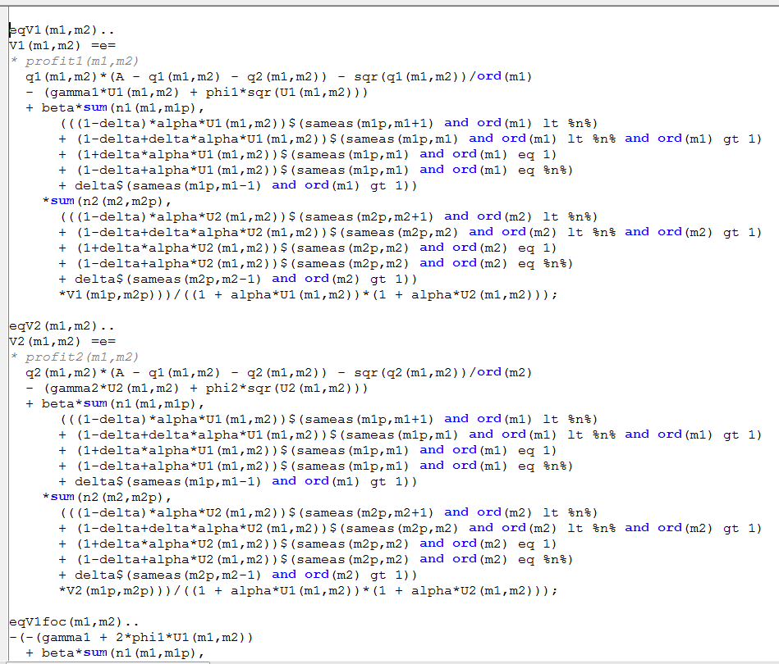
A Difficult Model

Slide 24
Readgdx - Visualizing the Jacobian
Use CONVERT to dump the Jacobian to GDX
A few Matlab lines give us an interesting picture
u = readgdx('dyngame.gdx'); universe = u.uels;
rFlags.name = 'I';
i = readgdx('dyngame.gdx',rFlags);
rFlags.name = 'J';
j = readgdx('dyngame.gdx',rFlags);
Adom{1} = {universe{i.val}};
Adom{2} = {universe{j.val}};
rFlags.name = 'A';
rFlags.uels = Adom;
rFlags.form = 'full';
A = readgdx('dyngame.gdx',rFlags);
% spy(A.val)

Slide 25
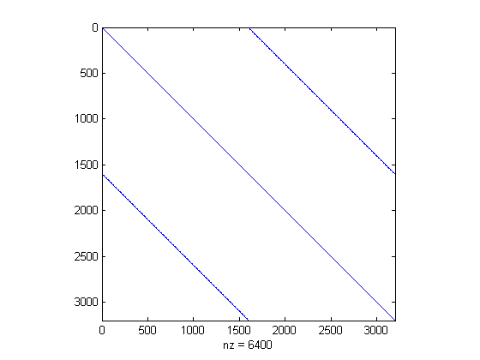
The Jacobian Revealed

Slide 26
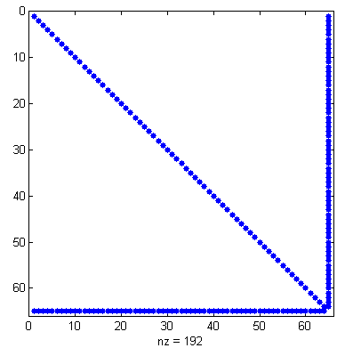
Another Model, Another Jacobian
o.name = 'A';
o.form = 'full';
o.compress='true';
A = rgdx(‘jac’,o);
spy(A.val);

Slide 27
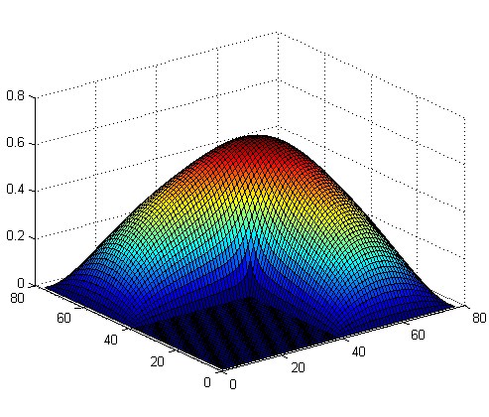
Visualizing a surface
fname = 'bratu';
u = rgdx(fname);
uni = u.uels;
o.name = 'I';
i = rgdx(fname,o);
o.name = ‘J';
j = rgdx(fname,o);
o.name = 'vsol';
o.form = 'full';
d{1} = {uni{i.val}};
d{2} = {uni{j.val}};
o.uels = dom;
v = rgdx(fname,o);
surf(v.val)

Slide 28
Background: why & what
readgdx: overview and examples
writegdx: overview and examples

Slide 29
Writegdx – basic syntax
wgdx(‘filename.gdx’,d1,d2,…,dn), where
di is a structure containing a symbol to write
One call writes the entire GDX file
Data fields include
name= ‘xxxx’ – required, symbol name in GDX
type= ‘set’ or ‘parameter’ – required
form= ‘full’ or ‘sparse’ – default sparse
val: the Matlab matrix, in full or sparse form
uels: optional mapping for each dimension

Slide 30
Writegdx – d.val and d.uels
The interesting inputs are the values and UELs
For example, how can we write a GDX equivalent to the data below:
Set i / seattle, sandiego /
j / topeka, chicago /;
Set link(i,j) /
seattle.topeka, seattle.chicago,
sandiego.topeka, sandiego.chicago /;

Slide 31
Writegdx – Simple Example
i.val = [1:2]';
i.uels = { 'seattle', 'sandiego' };
j.val = [1:2]';
j.uels = { 'topeka', 'chicago' };
link.val = [1 1 ; 1 2 ; 2 1 ; 2 2];
link.uels{1} = i.uels;
link.uels{2} = j.uels;
wgdx('wgdx', i, j, link);

Slide 32
Writegdx – Alternate Example
i.val = [1:2]';
i.uels = { 'seattle', 'sandiego' };
j.val = [4:5]';
j.uels = { ‘ignore’, ‘this’, ‘unused’, 'topeka', 'chicago' };
link.val = [1 4 ; 1 5 ; 2 4 ; 2 5];
link.uels{1} = i.uels;
link.uels{2} = j.uels;
wgdx('wgdx', i, j, link);

Slide 33
Genetics Example – Old
[s,metabs,rxns,output]=SIMPHENY2GAMS('Sim12');
% remove possible strings that are duplicate
[uels,I,J] = unique( lower({ metabs{:} rxns{:} })', 'first' );
s1 = length(metabs); s2 = length(rxns);
% array J: mapping between origin numbers and UEL list
m1 = J(1:s1); m2 = J(s1+1:s1+s2);
[r,c,v] = find(s); smat = [J(r) J(c+s1) v];
writegdx('data.gdx','set','metabs',m1,'set','rxns',m2,'par','s',smat,uels);

Slide 34
Genetics Example – New
[s,metabs,rxns,output]=SIMPHENY2GAMS('Sim12');
s1 = length(metabs); s2 = length(rxns);
d1.name = 'metabs'; d1.type = 'set';
d1.val = [1:s1]';
d1.uels = metabs';
d2.name = 'rxns'; d2.type = 'set';
d2.val = [1:s2]';
d2.uels = rxns';
d3.name = 's'; d3.type = 'parameter';
d3.val = s;
d3.uels = { metabs' rxns' };
wgdx('newData', d1, d2, d3);

Slide 35
Concluding Remarks
Additional enhancements are in progress
Reading/writing equations and variables
Make use of domain information where available
Suggestions welcome!!
We invite & encourage you to use these tools
For more information:
http://support.gams.com/doku.php?id=gdxrrw:interfacing_gams_and_r (GDXRRW Wiki, downloads, FAQ, etc)
http://www.gams.com/download/ (free GAMS downloads)
http://blog.modelworks.ch/ (Renger’s blog)
Notes:
Thank you!

