Slide 1
Firearm Store
Project by the students of
Vocational School for
Computer Programming and innovation

Slide 2
9A
9V
Aleksandra Laleva
Georgi Mihov
9B
9G
Boris Milev
Emily Kehayova

Slide 3
Steps of the making
1
2
3
4
Break the project into tasks for everyone
Combining them into a big program
Brainstorming
Making small parts of the code

Slide 4




The apps we used in the making of the project
Visual Studio Code
GitHub
Visual Studio 2019
Teams
Used in the beginning of the program
Used later on for the program

Slide 5
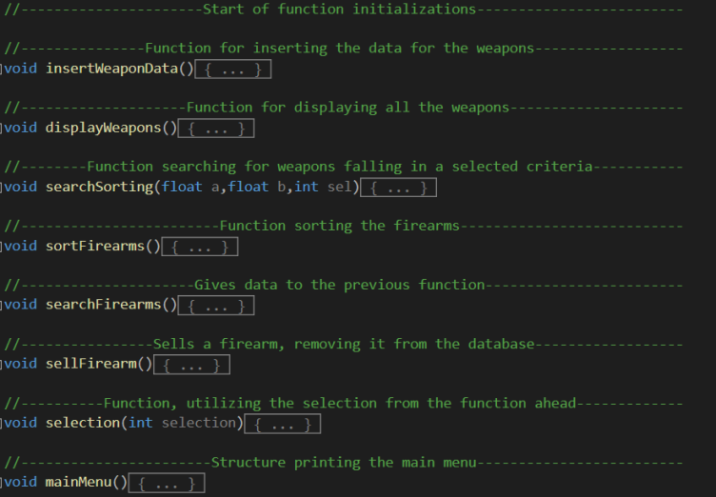
Some of our Functions:

Slide 6
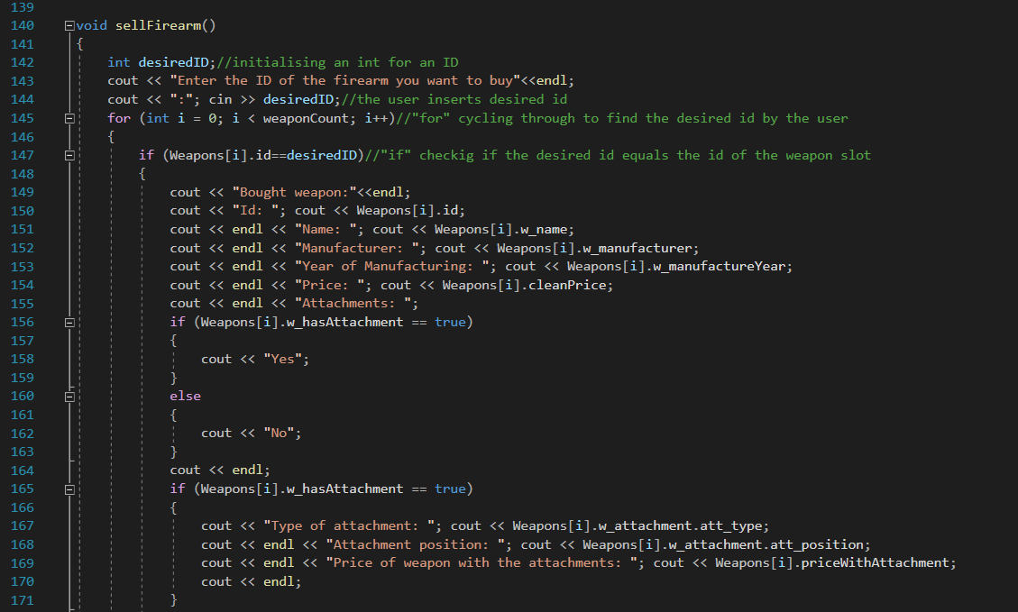
And now it’s time for our code

