Slide 1
Nigeria Power Outage Analysis – June 2025
By
IBRAHIM, Abdullahi Abdulmalik
Team BDC: July – September (2025) Submitted to: DataLab Analytics

Slide 2
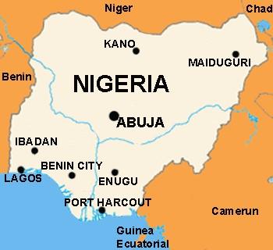
Power Outage Analysis Report
Comprehensive Assessment of Power Infrastructure Performance
(June 2025)
Cities: Abuja, Enugu, Kano, Lagos, Port Harcourt
Data: 250 Monitoring Stations

Slide 3
EXECUTIVE SUMMARY
This report presents a comprehensive analysis of power outage patterns across five Nigerian cities (Abuja, Enugu, Kano, Lagos, and Port Harcourt) during June 2025. The analysis reveals critical infrastructure vulnerabilities with significant variations in outage frequency and duration across geographic locations. Key findings indicate that Enugu and Lagos experience the highest outage rates at approximately 27%, while Kano demonstrates the most reliable service with an outage rate of 18%. The predictive model achieved a Brier score of 0.001, indicating high accuracy in forecasting outage occurrences.
Critical Finding: The rolling 3-hour outage rate reaches 39.26%, with lag2_status showing 28.76% correlation, suggesting cascading failure patterns that require immediate attention.

Slide 4
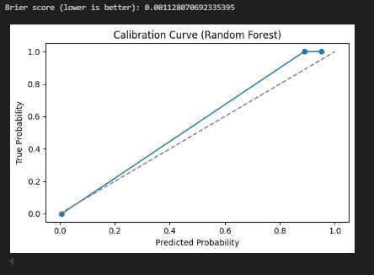
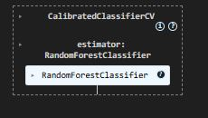
METHODOLOGY
The analysis employed advanced machine learning techniques using a Random Forest Classifier with the following approach:
Data collected from 250 stations (June 2025)
Random Forest Classifier used for prediction
Key predictors: Rolling outage rate, Lag1 & Lag2 status
Excellent calibration performance (Brier: 0.001)

Slide 5
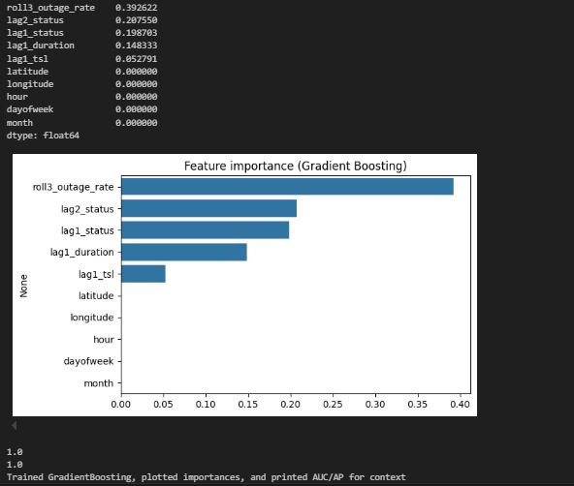
TEMPORAL ANALYSIS
Findings:
Outage rate: 23.2% in June 2025
Average duration: 4.56 mins per outage
Avg. time between outages: 3.71 hrs
High continuity (39.26% rolling outage rate)

Slide 6
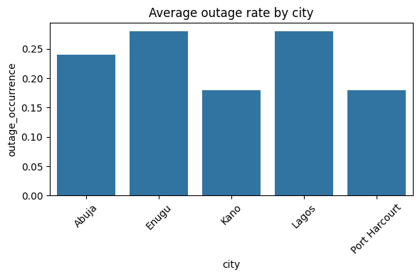
GEOGRAPHIC INSIGHTS
City Performance Overview:
Enugu & Lagos: 27% outage rate (Critical)
Abuja: 24% (Moderate reliability)
Port Harcourt & Kano: 18% (Better performance)

Slide 7
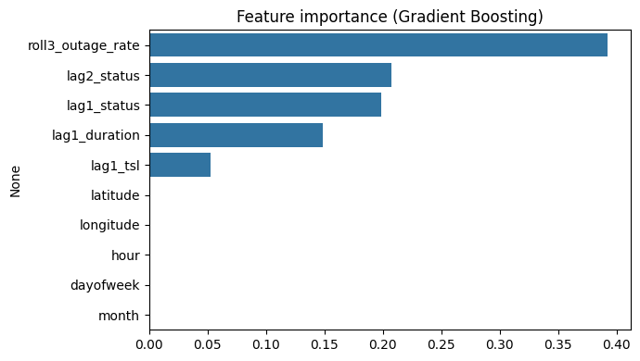
KEY PATTERNS & PREDICTORS
Critical Findings:
Rolling 3-hour outage rate = Strongest predictor (39.26%)
Lag features (Lag1 & Lag2) = 48.5% predictive power
Outages are infrastructure-driven, not demand-based

Slide 8
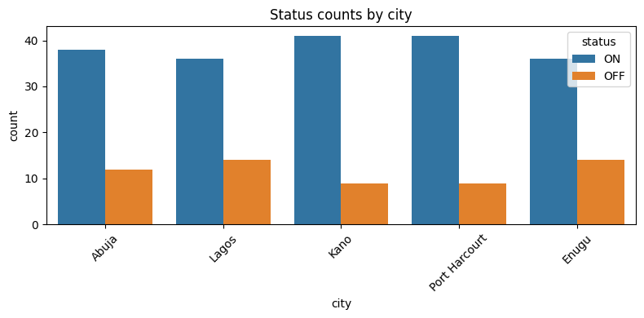
CITIES REQUIRING URGENT ATTENTION
Priority Cities:
Priority 1: Enugu (27%) – Infrastructure undersized
Priority 2: Lagos (27%) – Economic hub at risk
Priority 3: Abuja (24%) – Moderate reliability concern

Slide 9
STRATEGIC RECOMMENDATIONS
Immediate (0–3 Months):
Grid audit,
Predictive maintenance,
Load management
Medium-Term (3–12 Months):
Infrastructure upgrades,
Redundancy,
Distributed energy

Slide 10
LONG-TERM & POLICY OUTLOOK
System-Wide Transformation:
1–3 Year Plan:
AI-driven smart grid rollout,
Expand monitoring to 500+ stations
Achieve 10% outage rate nationwide
Policy Actions:
50% investment to Enugu & Lagos,
Enforce ≤10% outage standard

Slide 11
EXPECTED OUTCOMES & CONCLUSION
If implemented:
Year 1: Reduce outage in Enugu/Lagos from 27% to 18%
Year 3: Achieve national 10% outage rate
GDP boost: +1–2%
90% reliability achievable
Note:
This report provides actionable intelligence for infrastructure planning and investment decisions. Immediate action on Priority 1 cities (Enugu and Lagos) is strongly recommended.
Key Takeaway:
Nigeria’s power grid is predictable; the challenge is infrastructure, not randomness.

Slide 12
Thank You For Your Time.
Streamlit Prediction Web App (https://dp-abdul-machinelearning.streamlit.app/)

