Slide 1

Analyze promotions and provide Tangible insights to the sales director
RESUME CHALLENGE PROJECT
Unlocking Insights for Informed Decisions

Slide 2


ATLIQ Mart Analysis: Store Performance, Promotions, and Product Insights
PROJECT : ATLIQ MART PROMOTIONAL ANALYSIS
Unlocking Insights for Informed Decisions

Slide 3


Introductions
Problem Statement
Stake holders
Interests and expectations
Dashboard Overview
Findings and Recommendations

Slide 4

Problem Statement
ATLIQ Mart, a retail giant with 50 supermarkets in the southern region of India, needs to analyze the effectiveness of their Diwali 2023 and Sankranti 2024 promotions on AtliQ branded products. The Sales Director, Bruce Haryali, requires immediate insights to make informed decisions for the next promotional period.

Slide 5

Stakeholders
Primary Stakeholder: ATLIQ MART
Sales Director :BRUCE HARYALI

Slide 6

Key Interests:
Revenue growth
Incremental unit sales
Promotion effectiveness

Slide 7

Expectations:
Timely insights
Actionable recommendations
Strategies for future promotions

Slide 8
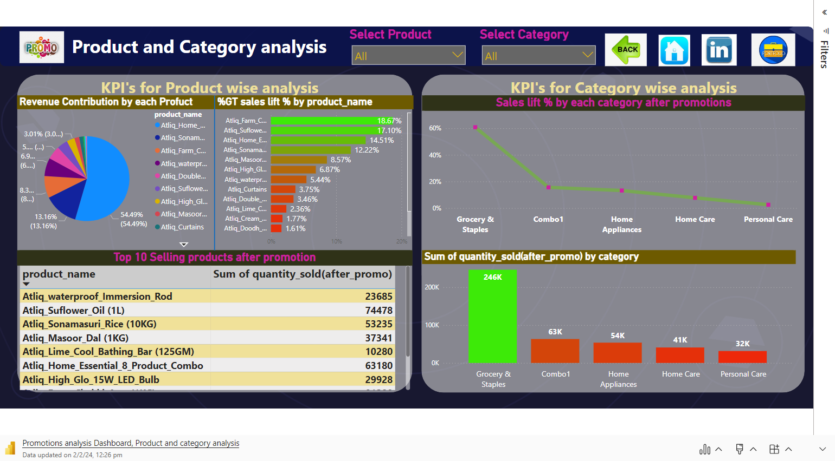
Data updated on 2/2/24, 12:26 pm

Slide 9

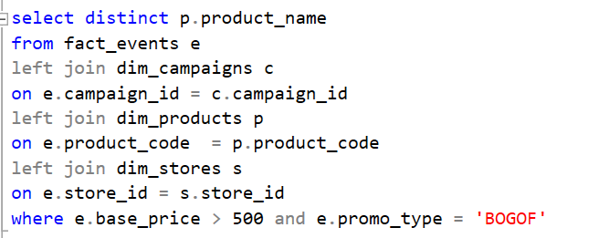

1. List of products that are price greater than 500 and featured in promo type of BOGOF (buy one get one free) ?
SQL query for the question
Result for the question

Slide 10
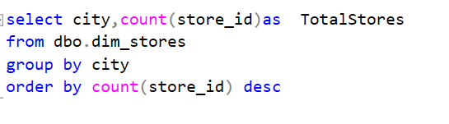
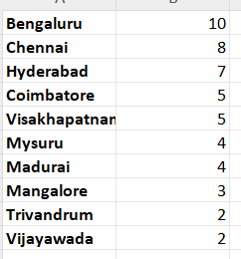
2. Create a report that provides number of stores in each city ?
SQL query for the question
Result for the question

Slide 11
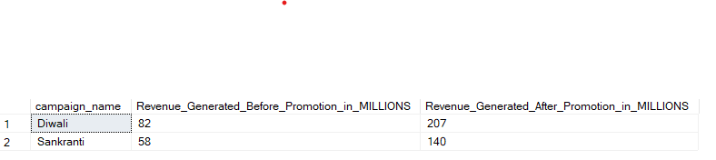
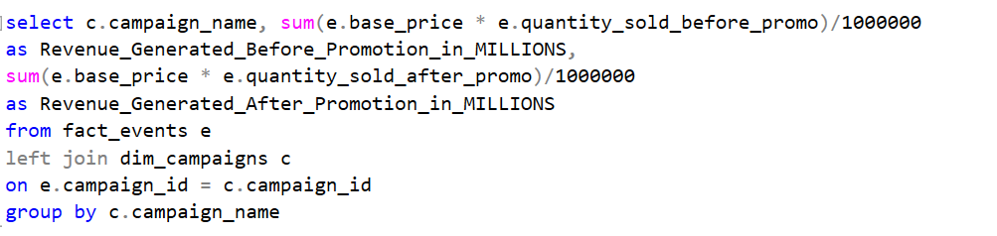
3. Create a report that generates each campaign along with total revenue generated before and after promotions?
SQL query for the question
Result for the question

Slide 12
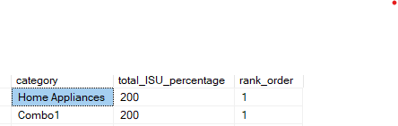
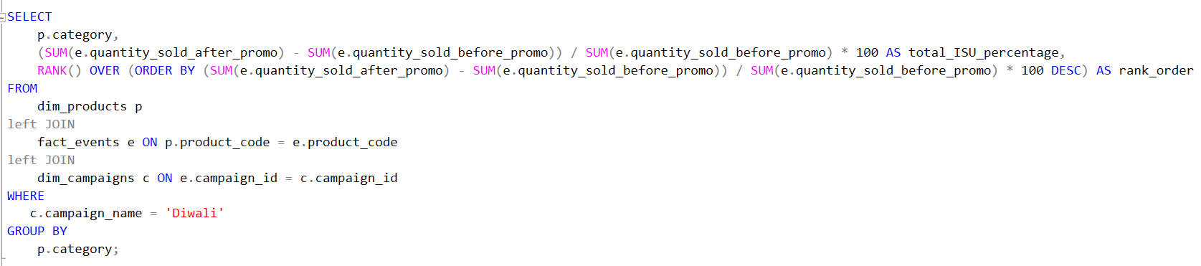
4.Incremental sold units percentage (ISU%) for each category during Diwali campaign and their rankings?
SQL query for the question
Result for the question

Slide 13
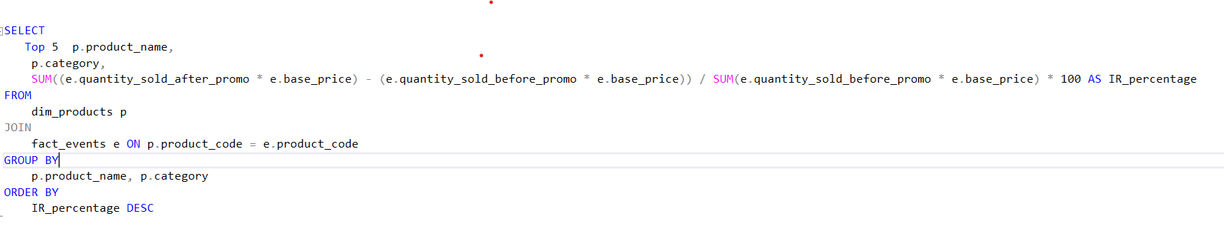
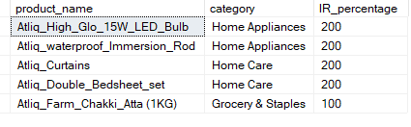
5.Top 5 products ranked by incremental revenue (IR%) for each category across all campaigns?
SQL query for the question
Result for the question

Slide 14
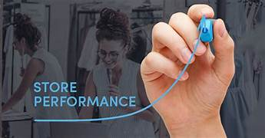
Store Performance Analysis
Metrics:
Incremental Revenue (IR)
Incremental Units Sold (IUS)
Findings:
Store with Highest Incremental Revenue: STRMYS-1 (Mysore) - 6.4 million
Store with Lowest Incremental Units Sold: STRMLR-0 (Mangalore) - 2 thousand

Slide 15

Recommendations:
For STRMYS-1:
Implement Customer Loyalty Program:
Reward frequent shoppers in Mysore with exclusive discounts or points-based rewards.
Encourage repeat business and create a positive shopping experience.
For STRMLR-0:
Localized Marketing Campaigns:
Understand the local preferences and cultural aspects in Mangalore.
Launch targeted marketing campaigns addressing specific needs or preferences of the Mangalore market.

Slide 16

Promotional Type Analysis
Metrics:
Incremental Revenue by Promotion Type
Contribution of BOGOF Promotion Type
Findings:
Incremental Revenue for Category 500 Cash Back: 123 million
BOGOF Promotion Type contributes approximately 80% to overall Incremental Revenue

Slide 17

Recommendations:
For Category 500 Cash Back:
Extended Duration with Tiered Rewards:
Extend the duration of the promotion with tiered rewards for higher spending.
Encourage customers to spend more to unlock additional cashback or exclusive discounts.
For BOGOF Promotion Type:
Bundle Deals Across Categories:
Expand BOGOF promotions to include cross-category bundle deals.
For example, buy a specific electronic item and get a related accessory for free.

Slide 18
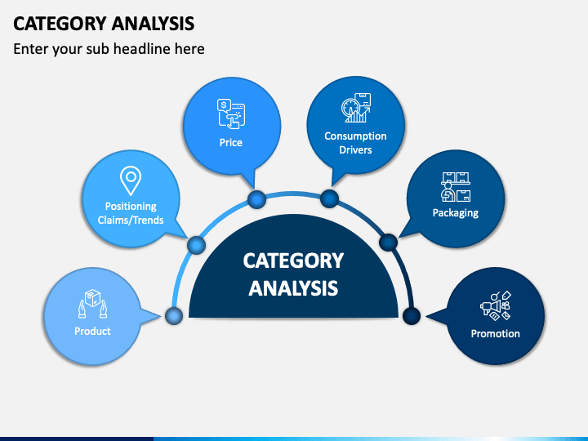
Product and Category Analysis
Metrics:
Revenue Contribution for a Product
Top Selling Product
Sales Lift Percentage by Category
Findings:
AtliQ_Home_Essential_8_Product_Como contributes 55% to overall revenue.
Top Selling Product: AtliQ_Waterproof_Immersion_Rod with 23,685 increment in quantity.
Sales Lift Percentage: 60% for Grocery and Staples category with 246 thousand quantity increase.

Slide 19

Recommendations:
For AtliQ_Home_Essential_8_Product_Como:
Bundle Promotion with Complementary Products:
Create a bundle promotion with complementary products, offering a discount when customers purchase both.
For AtliQ Water proof Immersion Rod:
Limited-Time Exclusive Offer:
Introduce a limited-time exclusive offer, such as a discount or gift, for customers purchasing AtliQ_Waterproof_Immersion_Rod.
For Grocery and Staples:
Subscription-Based Discounts:
Introduce subscription-based discounts for essential grocery items, encouraging customers to commit to regular purchases and enjoy ongoing discounts.

Slide 20


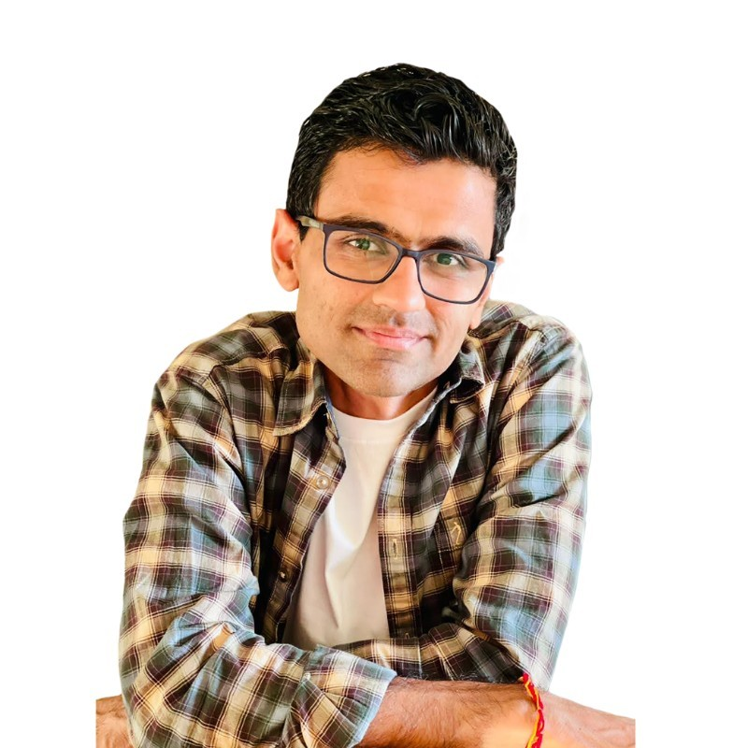
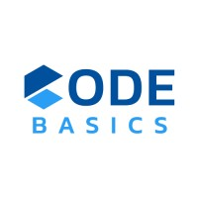



DHAVAL PATEL
HEMANAND VADIVEL

