Slide 1

LIFE EXPECTANCY PREDICTION
Presented By Batch:2
1. G. SnehaLatha(21481A0571) 2. J. Keerthi Lahari(21481A0584)
3. G. Thanmai Teja(21481A0570) 4. K. Yashwanth(21481A0596)
Under the Guidance of
Mrs.G.Bharathi
Sr.Scale.Gr.Asst.Professor,Mtech,(PHD)
DEPARTMENT OF COMPUTER SCIENCE AND ENGINEERING
SESHADRI RAO GUDLAVALLERU ENGINEERING COLLEGE
(An Autonomous Institute with Permanent Affiliation to JNTUK, Kakinada)
Seshadri Rao Knowledge Village GUDLAVALLERU – 521356 ANDHRA PRADESH

Slide 2
Outline of the Presentation:
1.Abstract​
2. Objectives​
3. Data Description​ and Visualization
4. Data Preprocessing​
5. Data Mining Techniques Used
6. Conclusion​

Slide 3
1. Abstract:
Data preprocessing cleans, transforms, reduces and prepares raw data for analysis, improving model accuracy.
This dataset covers life expectancy of all countries for data mining analysis.
It includes population, GDP, BMI, Status and other factors related to every country.
By applying data mining techniques, researchers can extract insights into life expectancy rate of a country and the factors contributing to it.

Slide 4
2.Objectives:
The main objectives of this project include:​
The analyzing of the Life Expectancy dataset.​
Doing Preprocessing on the dataset.
Data Visualization and applying Regression
models to the data​.
The goal of the project is to build a model that can predict the life expectancy of the country according to its features.​

Slide 5
3.Data Description:​
1. Data Source: Kaggle​
2. Data Size: 325 KB​
Features:​
Country, Year, Status, Life Expectancy, Population, Infant Mortality, Adult Mortality, Thinness (5-9 years), Thinness (10-19 years), Percentage Expenditure, BMI, GDP, Polio, etc.​

Slide 6
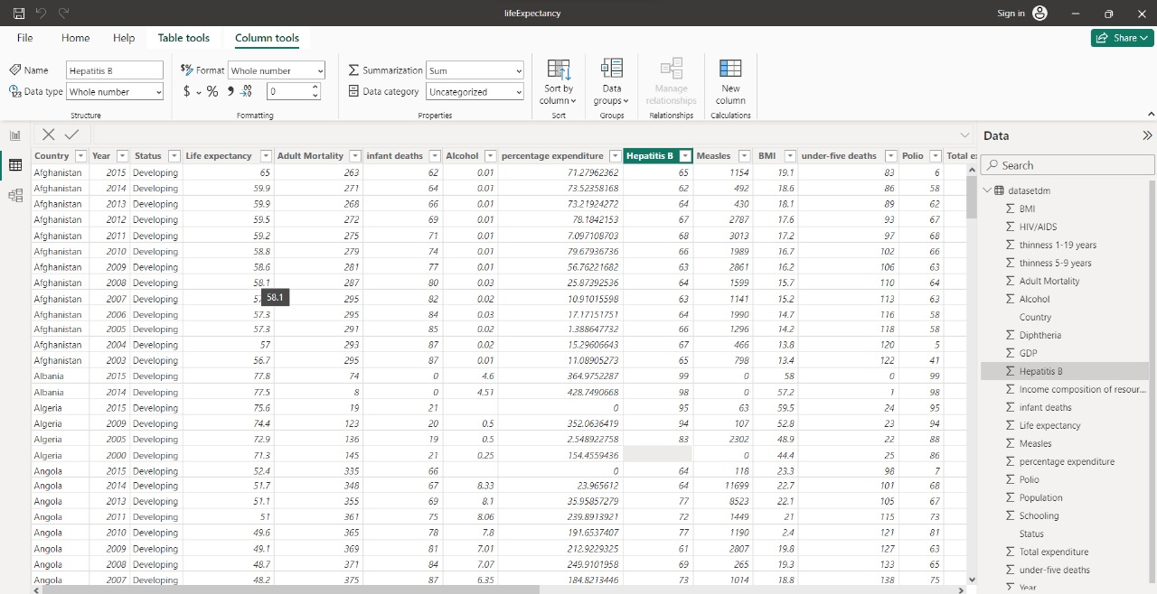
4.Data Preprocessing:
Data Cleaning:
Data Cleaning identifies and fixes errors, duplicates, and irrelevant data from a raw dataset.

Slide 7
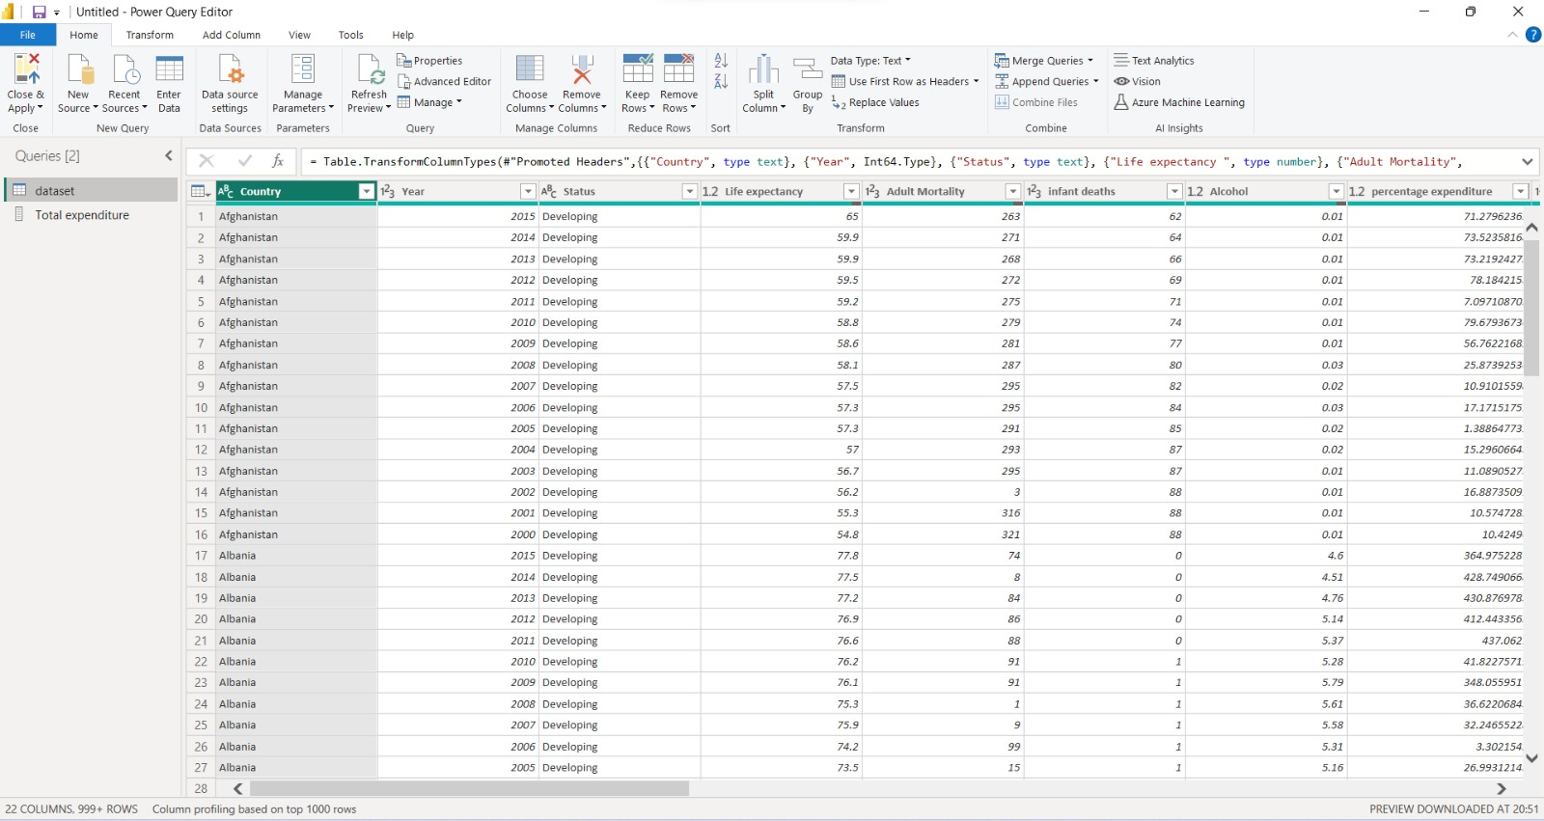
Data Transformation:
Data transformation is the process of converting, cleansing, and structuring data into a usable format that can be analyzed to support decision making processes, and to propel the growth of an organization.

Slide 8
Data Reduction:
Data reduction technique can be applied to obtain a reduced representation of the dataset that is much smaller in volume, yet closely maintains the integrity of the original data.
Dimensionality reduction is the process of reducing the number of random variables or attributes under consideration.

Slide 9
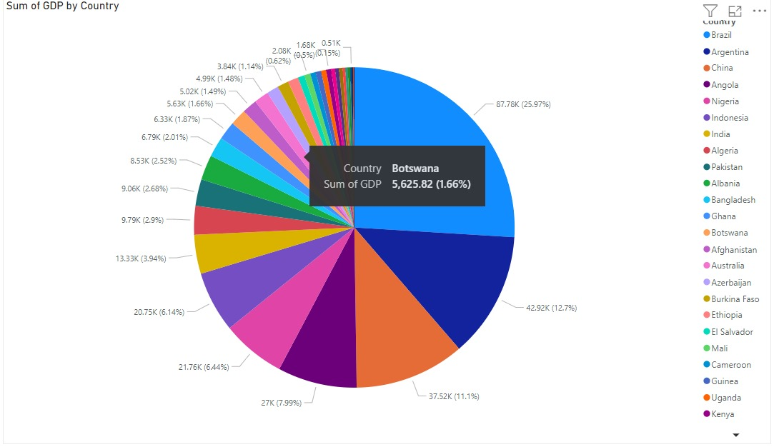
Data Visualization:
Data visualization is the representation of data through use of common graphics, such as charts, plots, infographics and even animations. The main goal of data visualization is to make it easier to identify patterns, trends and outliers in large data sets.

Slide 10
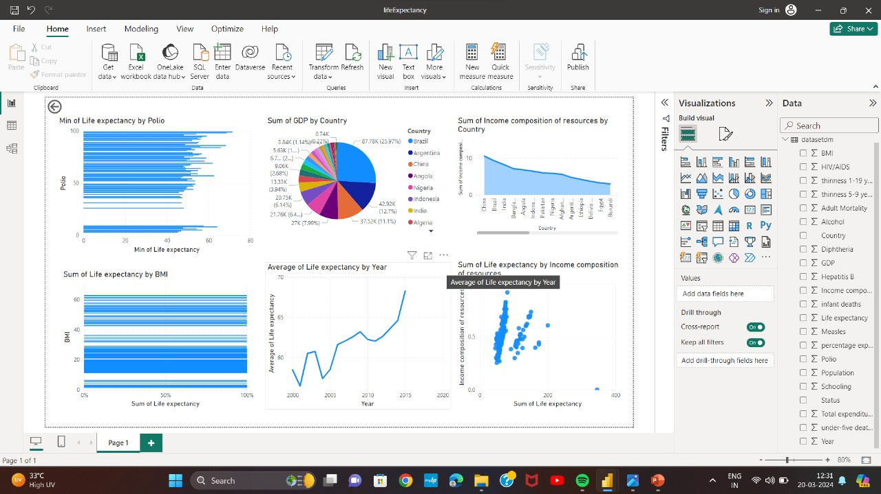

Slide 11
5.Data Mining Techniques Used:
Multiple linear regression refers to a statistical technique that uses two or more independent variables to predict the outcome of a dependent variable.
Multiple linear regression (MLR) is a statistical technique that analyzes the relationship between a dependent variable and two or more independent variables. It's also known as multiple regression.
Life expectancy can be modeled using regression analysis, typically multiple linear regression. Multiple factors such as country, GDP, BMI, status, healthcare access, and other factors can influence life expectancy, making it suitable for regression analysis where multiple predictors are considered.

Slide 12
6.Conclusion:
In this data mining project, we set out to explore the factors influencing life expectancy to estimate life expectancy rates. Through extensive data analysis and regression modeling, we gained valuable insights into the key determinants of life expectancy across different countries.
Data preprocessing is essential in life expectancy projects to clean, transform, and standardize datasets and ensuring accurate analysis of the data.
Data preprocessing is essential in a life expectancy project to clean, transform, and organize raw data, ensuring accuracy and reliability for predictive modeling and analysis. It helps in handling missing values, outliers, and normalization, enhancing the effectiveness of the model.

Slide 13


