Slide 1

CHATTERBOX – INSTANT CHATS, INSTANT BONDS
Department of Computer Science and Engineering
Seshadri Rao Gudlavalleru Engineering College, Gudlavalleru
By
G. Snehalatha (21481A0571)
J. Keerthi Lahari (21481A0584)
K. Devi Durga Bhavani (21481A0593)
G. Hemanth (21481A0573)
Under the guidance of
Dr. M. Babu Rao, M.Tech, Ph.D.
Professor, Department of CSE

Slide 2
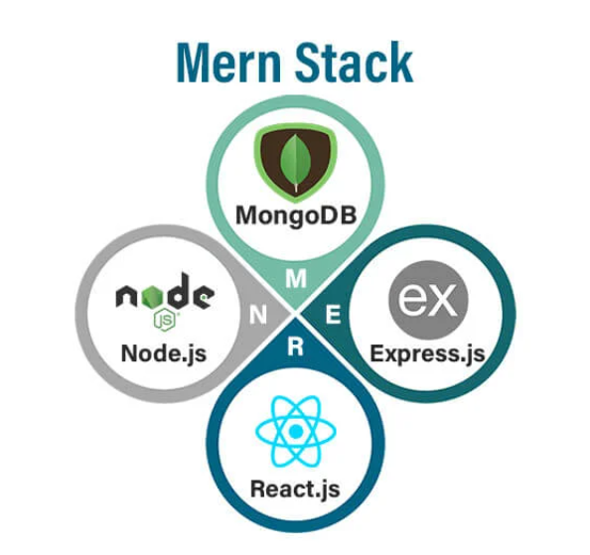
OUTLINE:
Abstract
Introduction
Requirements
Methodology
Implementation
Results
Conclusion

Slide 3
ABSTRACT:
Built a real-time chat application leveraging the MERN stack and Socket.IO to enable instant
communication between users.
Implemented features like user registration, secure login, profile management, and customizable
avatar selection.
Integrated Socket.IO for seamless real-time messaging, supported by a secure backend using REST APIs.
Designed a responsive React-based frontend to deliver a smooth and consistent user experience across
all devices.
Adopted a modular and scalable architecture to ensure easy maintenance and flexibility for future
enhancements.

Slide 4
INTRODUCTION
Developed a real-time chat application using the MERN stack (MongoDB, Express.js, React.js, Node.js) and Socket.IO for seamless, instantaneous communication.
Key features include user registration, secure login, profile management with avatar selection, and a responsive chat interface optimized for all devices.
Achieved real-time messaging through Socket.IO, allowing instant exchanges without page refreshes.
Backend securely handles user data, RESTful API requests, and WebSocket connections to facilitate reliable communication.
Frontend, built with React.js, delivers a dynamic and engaging user experience, ensuring responsiveness and usability.
Designed with scalability and modularity to support future enhancements such as group chats, multimedia sharing, and video calls for diverse communication needs.

Slide 5
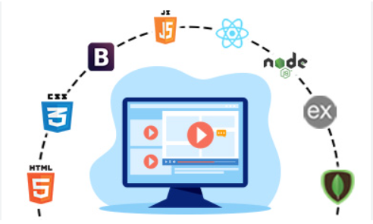
REQUIREMENTS:
Software Requirements
Operating System
Visual Studio Code
Backend Development Requirements
Node.js
Express.js
MongoDB
Socket io
Frontend Development Requirements
React.js
NPM Packages

Slide 6
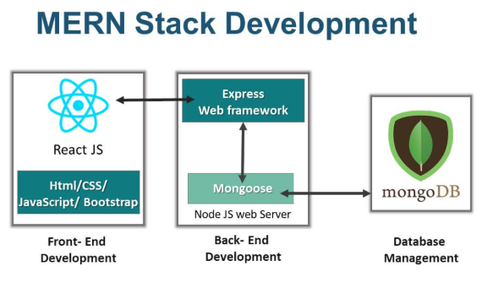
METHODOLOGY:

Slide 7
Design and Development:
Frontend: The user interface is built using React.js, HTML, CSS, and JavaScript to provide a responsive and user-friendly design.
Backend: The server-side logic is managed using Node.js and Express.js to process requests, manage user data, and interact with the database.
Database: MongoDB stores user data (e.g., login credentials, profile details) and chat messages.
Key Features:
User Authentication: Secure login and registration using JWT
Real-Time Messaging: Instant message exchange using Socket.IO without page refresh, real-time communication.

Slide 8
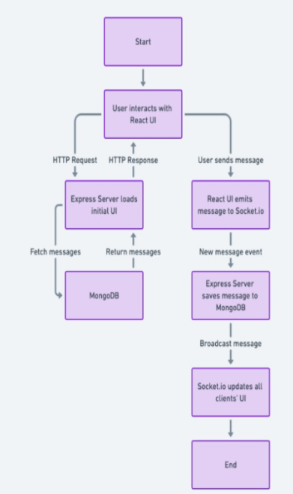
ARCHITECTURE OF REALTIME CHAT APPICATION:

Slide 9
IMPLEMENTATION:
The implementation of the Chatter Box for real time messaging platform involves several stages, from designing the user interface to developing the backend and integrating them for seamless functionality. Below is an overview of how the platform is implemented.

Slide 10
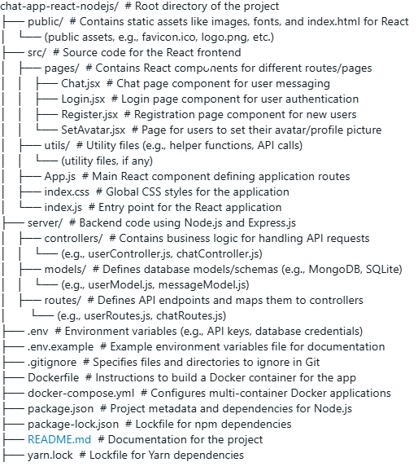

Slide 11
Frontend Implementation:
.
The frontend is built using React.js to create an interactive and dynamic interface.
Steps:
Initialize React App Verify the React setup in the src folder and dependencies in package.json.
Component Setup Create reusable components like Header, Footer, and Chat Box to maintain modularity.
Pages Develop essential pages such as Home, Login/Register, Chat Interface, and Profile.
Routing Use React Router to enable smooth navigation between pages.
Responsive Design Apply Material-UI, Bootstrap, or CSS media queries for a responsive and user-friendly interface.

Slide 12
Backend Implementation:
The backend is built using Node.js and Express.js. It ensures that user data is processed and stored securely.
Steps:
Setup Server: Verify the server/index.js file as the backend entry point, and ensure Express.js is used for handling HTTP requests.
Environment Configuration: Use .env for storing sensitive information (e.g., database credentials, API keys).
Routing: Define API routes in the routes folder for handling functionalities like user authentication, messaging, and profile management.
Database Integration: Use the models folder to define database schemas (e.g., MongoDB with Mongoose). Ensure models like User and Messages are properly structured.
Controller Logic: Implement business logic in the controllers folder to handle data processing and API responses.
Let me know if you'd like assistance with any backend functionality!

Slide 13
RESULTS
Set Up the Backend:
Go to the backend folder: “cd D:\chat-clone\chat-app-react-nodejs\server”
Install backend dependencies: “npm install”
The server will run at: “http://localhost:5000”
Set Up the Frontend:
Go to the frontend folder: “cd D:\chat-clone\ chat-app-react-nodejs\public”
Install frontend dependencies: “npm install”
Start the frontend server: “npm start”
Open your browser and visit “http://localhost:3000” to see the app.

Slide 14
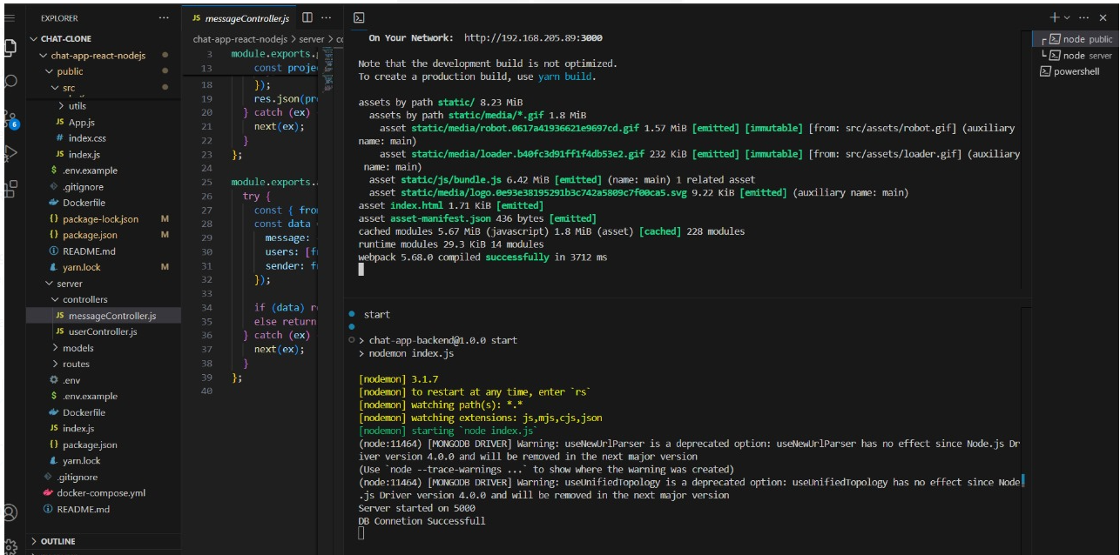
After running both frontend and backend:

Slide 15
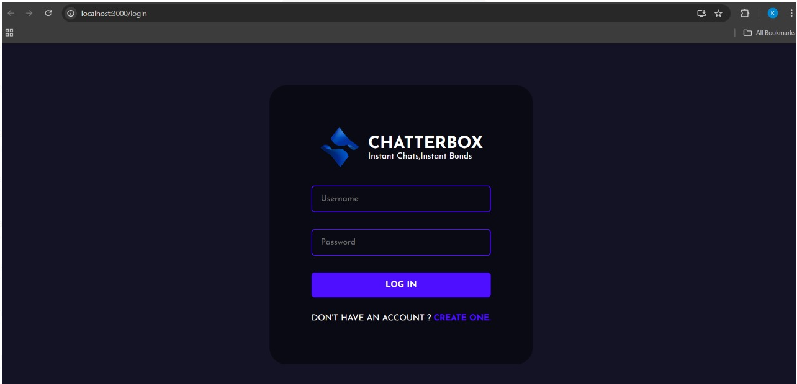
Home Page:

Slide 16
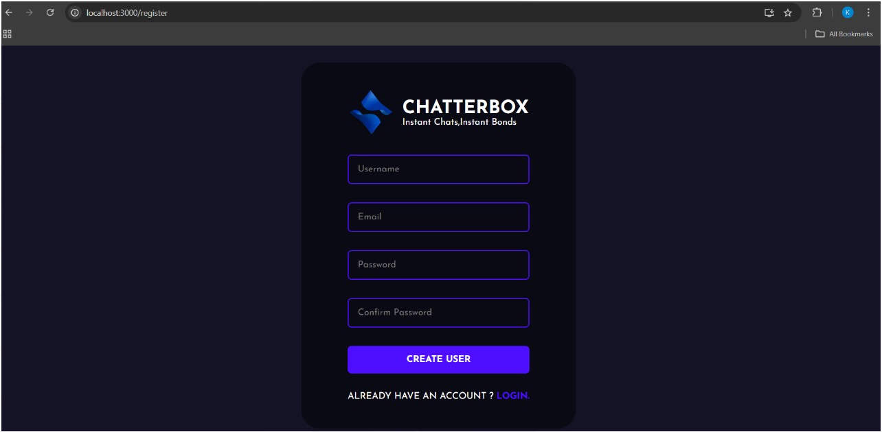
Registration Page:

Slide 17
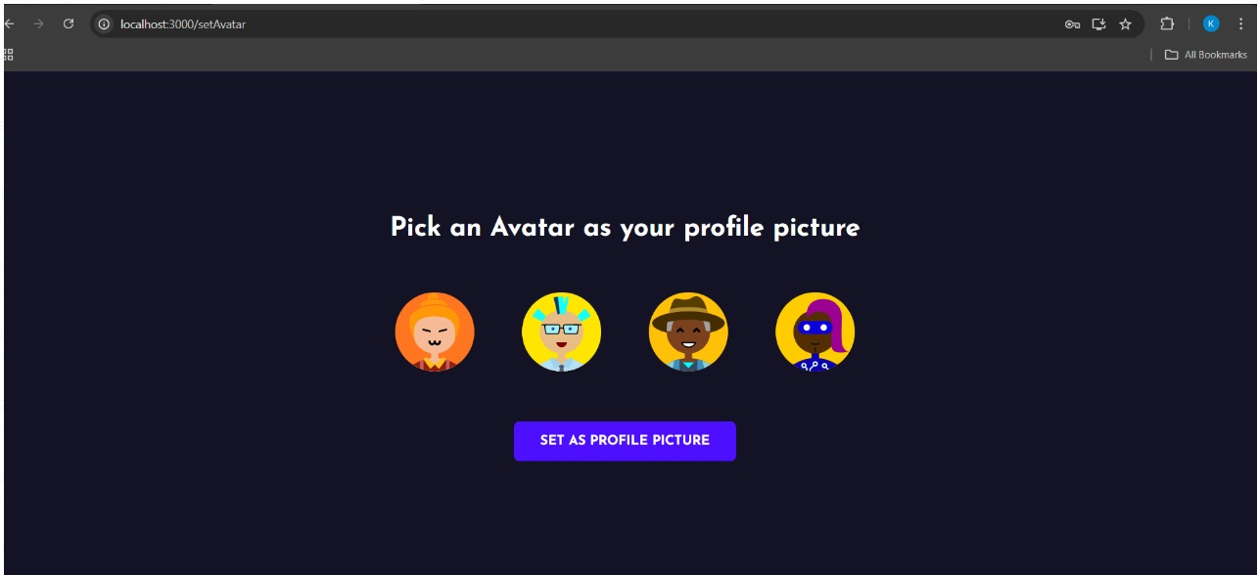
Avatar Selection:

Slide 18
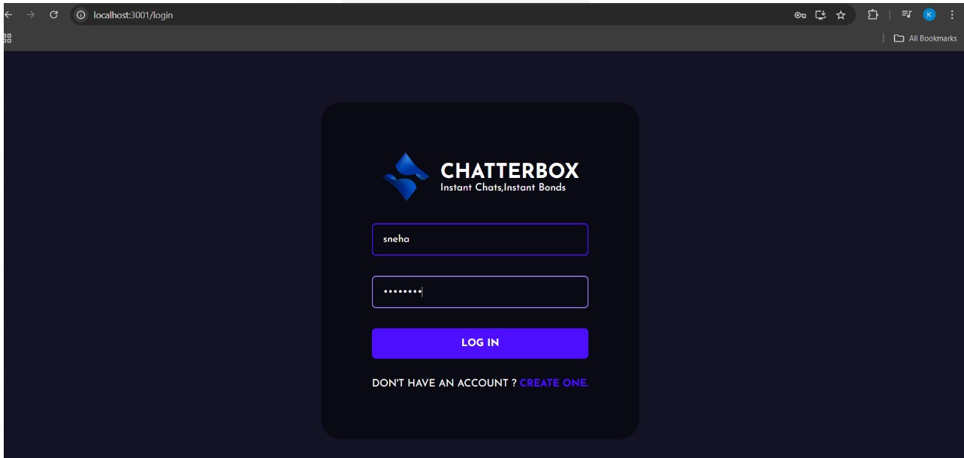
Login Page:

Slide 19
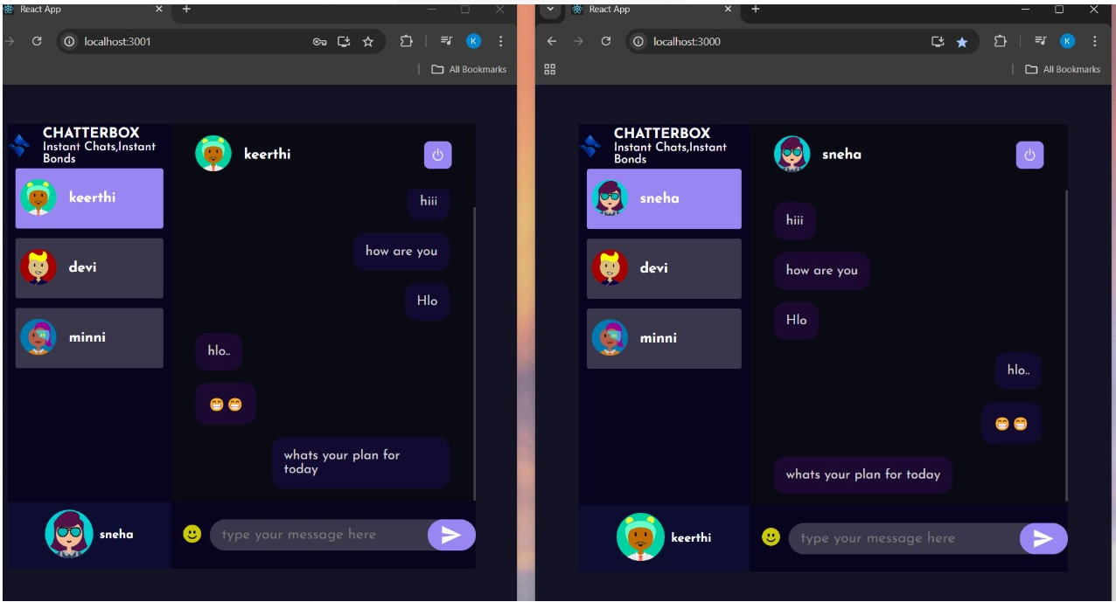
Messages Sent and Received:

Slide 20
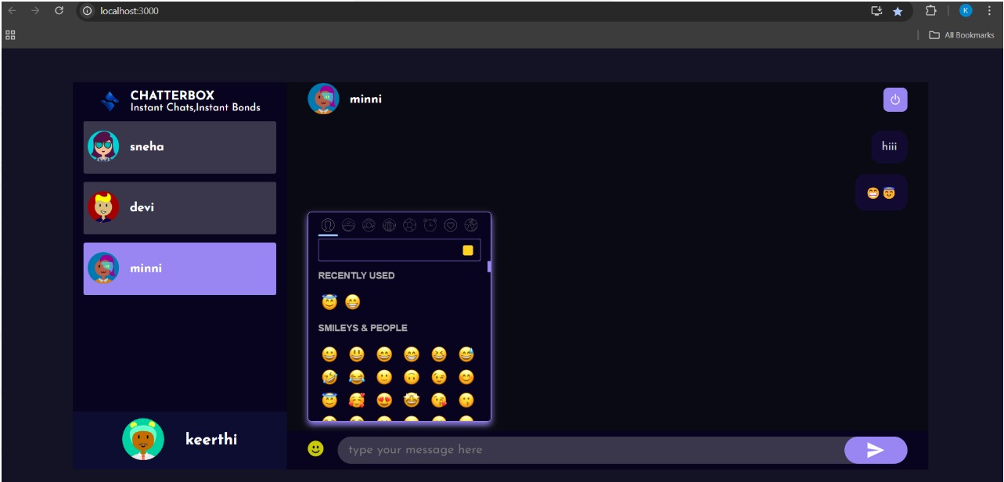
Chat with Emoji’s:

Slide 21
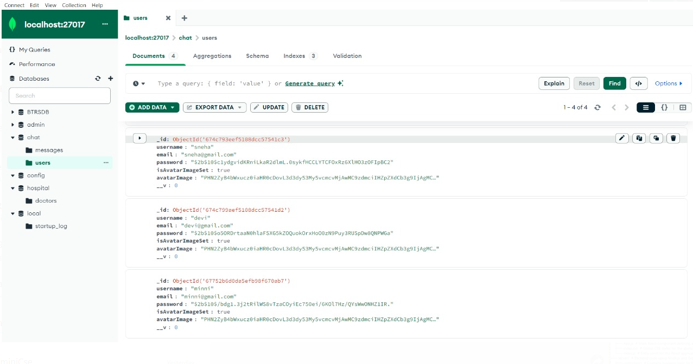
Data Base of Users stored in MongoDB:

Slide 22
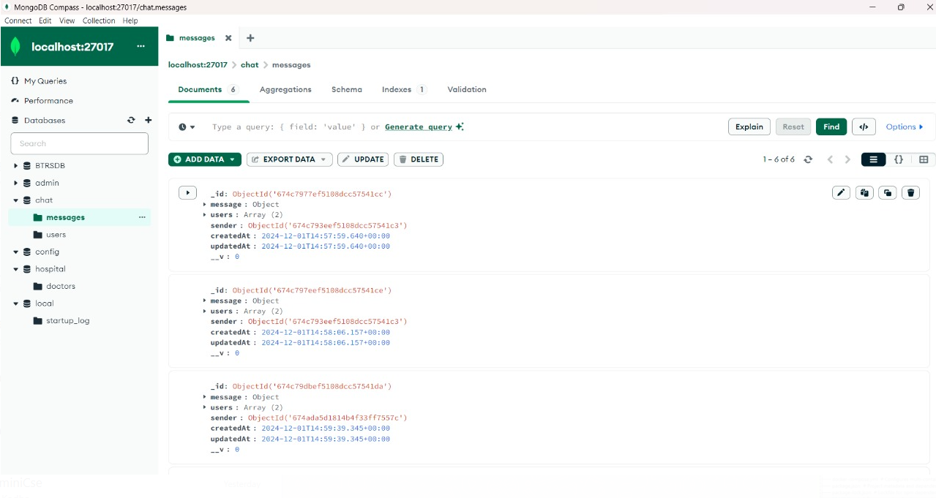
Data Base of Messages stored in MongoDB:

Slide 23
CONCLUSION:
In conclusion, ChatterBox - Instant Chats Instant Bonds represents a dynamic and scalable platform for real-time communication. Built with the MERN stack, this application combines MongoDB’s flexibility, Node.js’s real-time capabilities, Express.js’s reliable routing, and React.js’s interactive user interface. The system enhances communication by offering instant messaging features, ensuring users can build bonds and stay connected. It simplifies communication, boosts user engagement, and provides a solid foundation for future growth and feature enhancements. Suitable for various social interactions, from casual chats to professional conversations, ChatterBox highlights the power of modern web technologies in fostering immediate, meaningful connections.

Slide 24


