Slide 1
Grouped Primitives Constructor
User Manual
Author: Ningkai Mo Email: 499352265@qq.com

Slide 2
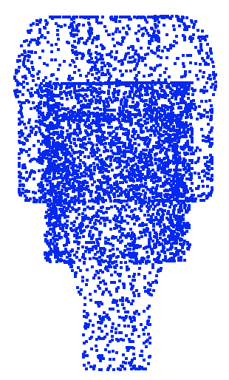

Step 1: Get the model point cloud ready
Use raw point cloud
Two hours later…
grouped_primitives_constructor.py
The recommended way: Use spares representative points
Only 2~5 minutes
Select sparse
representative points
grouped_primitives_constructor.py

Slide 3



Step 1: Get the model point cloud ready

Slide 4
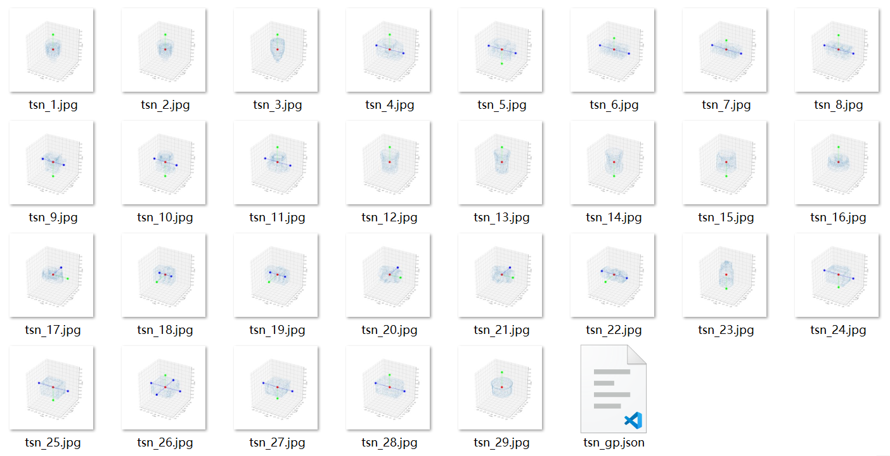
Step 2: Run Script
cd ES6D
python tools\grouped_primitives_tools\grouped_primitives_constructor.py --dataset tless --pcd_dir ${3d_models_dir} --out_dir ${results_dir}
results_dir

