Slide 1
Page Ranking and Web Search
Hemanth kumar Kaluvakuri
Deekshith Reddy Garidi
Beereddy Pranith Reddy
Tanuja Pyneni
Sravani Vallabhaneni

Slide 2
Page Ranking: Information Retrieval
2
Information Retrieval (IR) is finding material (usually documents) of an unstructured nature (usually text) that satisfies an information need from within large collections (usually stored on computers).
These days we frequently think first of web search, but there are many other cases:
E-mail search
Searching your laptop
Corporate knowledge bases
Legal information retrieval

Slide 3
Basic assumptions of Information Retrieval
Sec. 1.1
3
Collection: A set of documents
Assume it is a static collection for the moment
Goal: Retrieve documents with information that is relevant to the user’s information need and helps the user complete a task

Slide 4
Motivation
With so much data in the databases- there is always a need for better techniques to access information.
Most applications of text retrieval focused on bibliographic databases, to text matching and paid little attention to the results of research on topics such as retrieval models, query processing, term weighting and relevance feedback.
Whereas the main idea of IRS is to find useful information within massive data with the help of features like "natural language" queries, ranked retrieval results, term weighting, "query-by-example", and query formulation assistance.

Slide 5
The classic search model
Collection
Queries
Tokenization
Tokenization
Vector cosine similarity
Search
engine
Results
Notes:
5

Slide 6
Initial stages of text processing
Tokenization
Cut character sequence into word tokens
Deal with “John’s”, a state-of-the-art solution
Normalization
Map text and query term to same form
You want U.S.A. and USA to match
Stemming
We may wish different forms of a root to match
authorize, authorization
Stop words
We may omit very common words (or not)
the, a, to, of

Slide 7
Inverted index
Sec. 1.2
7
For each term t, we must store a list of all documents that contain t.
Identify each doc by a docID, a document serial number
Can we used fixed-size arrays for this?
Brutus
1
2
4
11
31
45
173
174
Caesar
1
2
4
5
6
16
57
132
Calpurnia
2
31
54
101

Slide 8

Inverted index construction
Sec. 1.2
Documents to
be indexed
Friends, Romans, countrymen.
Tokenizer
Token stream
Friends
Romans
Countrymen
Linguistic modules
Modified tokens
friend
roman
countryman
Indexer
friend
2
4
roman
1
2
Inverted index
countryman
13
16
Notes:
Document icons from free icon set: http://www.icojoy.com/articles/44/
8

Slide 9
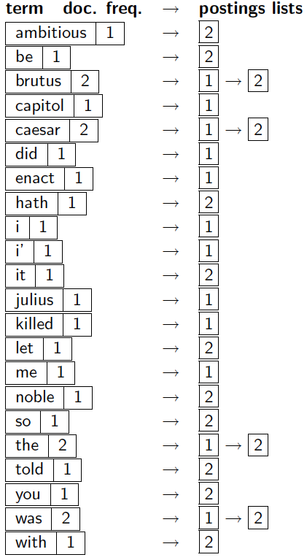
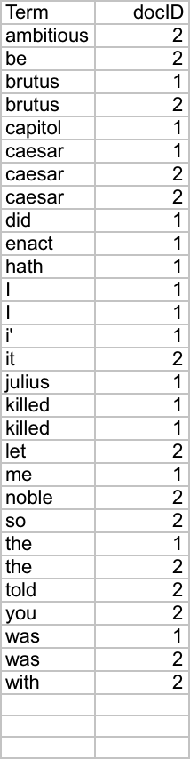
Indexer steps: Dictionary & Postings
Sec. 1.2
Multiple term entries in a single document are merged.
Split into Dictionary and Postings
Doc. frequency information is added.
Why frequency?
Will discuss later.

Slide 10
Design:
Step 1: Getting all the words from the static files we use and performing few restrictions on them to tokenize all the words in it after applying some rules.
The rules were like:
Neglecting words that contain numbers in it.
Splitting words if they contain special characters.
Removing stop words like ‘a’, ‘an’, ’about’ …
Step 2: Obtaining forward index for the tokenized words we have got .
Step3: Calculating Vector Cosine similarity using the term document index and Document frequency we get from inverted index.

Slide 11
Vector Cosine Similarity:
We are using Cosine similarity to measure similarities between two vectors, irrespective of their sizes for information retrieval, text similarity, and recommendation systems.
Cosine similarity measures the cosine of the angle between two vectors in the same direction where smaller cosine angle denotes higher similarity between the vectors. With cosine similarity, you can now measure the orientation between two vectors.
The results from k-NN search with cosine similarity can be further improved in precision, by features like aggregations and filtering.
Step 4: Finally with the respective cosine similarity values we can get top rankings for the queries we have provided as input.

Slide 12
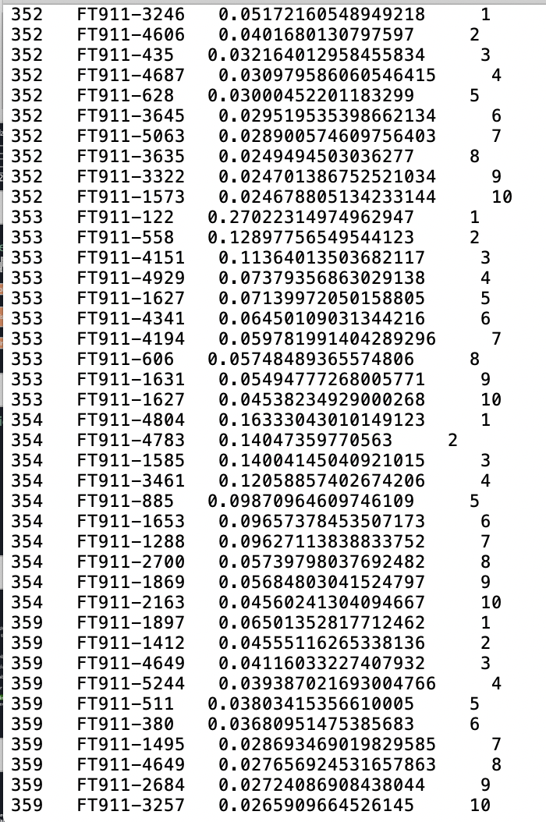
Expected Output:
The output contains the query Id that we have given and the Doc-ID of Documents they are present in and with their corresponding vector cosine similarity value and the ranking of those Documents.

Slide 13
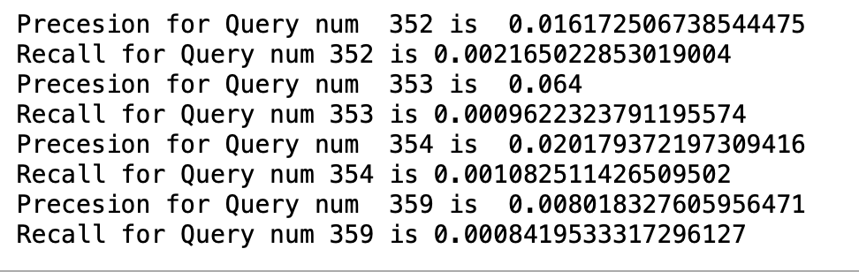
How good are the retrieved docs?
Sec. 1.1
13
Precision : Fraction of retrieved docs that are relevant to the user’s information need
Recall : Fraction of relevant docs in collection that are retrieved

Slide 14
Thank you

