Slide 1
Minor Capstone Project Presentation (2026)
Reimbursement Portal
A role-based web application to submit, review, approve, reject, and track employee reimbursement claims.
ADMIN
MANAGER
EMPLOYEE
By - Garv Singh Chouhan
users + all claims
assigned review
claim request
Submission Date - 28 May 2026

Slide 2
Deck Roadmap
Content
01
Introduction
05
Entity-Relationship Diagram
Objective, scope, and project users
Users, claims, reviewers, managers, status lifecycle
02
Features and Functionality
06
Data Flow Diagrams
Detailed role-wise functions, validation, workflow rules
Context flow and claim processing flow
03
Tech Stack
07
Project Snapshots
Frontend, backend, security, database, testing
Actual screenshots from signup, login, employee, manager, admin screens
04
Architecture Diagram
Layered design and API/service responsibilities
ReimburseHub | 2

Slide 3
Project Overview
Introduction
Purpose
Project Scope
Replace manual reimbursement follow-ups with a structured portal.
Give employees one place to submit expenses and monitor claim status.
Give managers a focused queue for assigned employee claims.
Give admins complete control over users, manager assignment, and all claims.
Maintain auditable reviewer comments for approvals and rejections.
Authentication
Login, signup, session storage, role redirect
Claim Workflow
Submit -> assigned reviewer -> approve/reject -> history
Administration
Create users, assign manager, delete users, view all claims
Quality
Validation, exceptions, pagination, tests, code style checks
ReimburseHub | 3

Slide 4
Capability Map
Features and Functionality
Employee
USER
Manager
REVIEWER
Admin
CONTROL
Public employee signup
Secure login with Basic Auth
Submit claim amount, date, description
View own claim history
Filter by SUBMITTED / APPROVED / REJECTED
View claims assigned to manager
Review employee reimbursement cards
Approve with optional note
Reject with mandatory reason
Filter by status
Track pending queue
Create admin, manager, employee users
Search and filter team members
Assign/clear employee managers
Delete eligible users
View all reimbursement claims
Act on admin fallback claims
ReimburseHub | 4

Slide 5
Workflow Rules and Validation
Features and Functionality
Authentication & Session
Claim Submission
Basic Authentication is used for protected API requests.
The authenticated user profile is fetched through /api/auth/me.
Frontend stores token and user role in localStorage.
Role guard redirects users to the correct dashboard.
Amount must be greater than 0.
Claim date and description are mandatory.
New claims start with SUBMITTED status.
Reviewer is resolved automatically from manager assignment.
Review Governance
Admin Controls
Only the assigned reviewer can act on a claim.
Admin can complete fallback reviews when no manager is assigned.
Processed claims cannot be approved or rejected again.
Reject action requires a reviewer comment.
Company email format is validated with @company.com.
Duplicate email registration is blocked.
Employee manager must be a MANAGER user.
Submitted claims are reassigned when manager assignment changes.
ReimburseHub | 5

Slide 6
Implementation Choices
Tech Stack
Frontend
Backend
Security
HTML5 • CSS3 • JavaScript • role pages • modals
Java 17 • Spring Boot 4 • REST APIs • DTOs • services
Spring Security • Basic Auth • BCrypt • role guards
Database
Quality
Frontend UX
PostgreSQL • JPA • Hibernate • repositories • relationships
JUnit 5 • Mockito • MockMvc • H2 • JaCoCo • Checkstyle
pagination • filters • toasts • status pills • responsive layout
The stack separates UI, API, business rules, persistence, and quality checks so each layer is easier to test, maintain, and extend.
ReimburseHub | 6

Slide 7
Layered System View
Architecture Diagram
JS API Layer
Security
auth.js, api.js, dashboard.js, claims.js
Spring Security, BCrypt, Basic Auth
Client UI
REST Controllers
Repository
DB
signup.html, index.html, employee.html, manager.html, admin.html
AuthController, UserController, ClaimController
Service Layer
UserRepository, ClaimRepository
PostgreSQL
UserServiceImpl, ClaimServiceImpl
UI Logic
forms, filters, tables, modals, toasts
DTO + Mapper
request/response contracts
Cross-cutting behavior: validation, standardized API responses, global exception handling, logging, pagination, and status-based filtering.
ReimburseHub | 7

Slide 8
API Surface and Responsibilities
Architecture Diagram
Authentication
Users
POST /api/auth/signup
GET /api/auth/me
Employee-only public signup
Current-user profile lookup
POST /api/users
GET /api/users
PUT /api/users/{employeeId}/manager
DELETE /api/users/{id}
Claims
Response Design
POST /api/claims
GET /api/claims/employee/{id}
GET /api/claims/reviewer/{id}
PUT /api/claims/{claimId}/action/{reviewerId}
StandardAPIResponse<T>
PageResponseDTO<T>
DTO mapping hides entity internals
GlobalExceptionHandler returns clean errors
ReimburseHub | 8

Slide 9
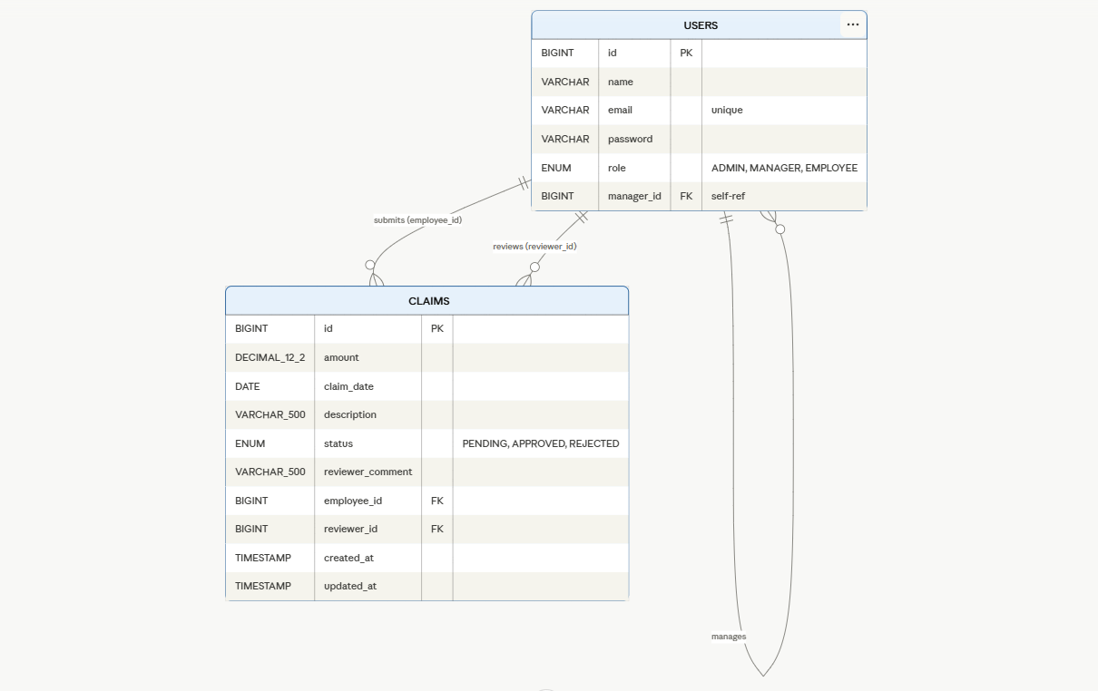
Database Model
Entity-Relationship Diagram
USERS
CLAIMS
id BIGSERIAL PK
name VARCHAR
email VARCHAR UNIQUE
password VARCHAR
role ENUM: ADMIN, MANAGER, EMPLOYEE
manager_id FK -> users.id
id BIGSERIAL PK
amount DECIMAL(12,2)
claim_date DATE
description VARCHAR(500)
status ENUM: SUBMITTED, APPROVED, REJECTED
reviewer_comment VARCHAR(500)
employee_id FK -> users.id
reviewer_id FK -> users.id
created_at / updated_at
1 employee -> many claims
1 reviewer -> many reviewed claims
manager hierarchy self-reference
ReimburseHub | 9

Slide 10
Relationship Rules
Entity-Relationship Diagram
User -> Manager
Employee -> Claim
A user may reference another user as manager. Manager assignment is allowed only for EMPLOYEE users and target must have MANAGER role.
Every claim must belong to exactly one employee. Employee claim history is fetched by employee_id with pagination.
Reviewer -> Claim
Claim Status
Reviewer is either the employee's assigned manager or admin fallback when no manager exists.
A claim starts as SUBMITTED and can transition to APPROVED or REJECTED. Once processed, it cannot be actioned again.
Comment Rules
Audit Fields
Reviewer comment is optional for approval but mandatory when a claim is rejected.
createdAt and updatedAt are maintained by Hibernate timestamps for claim lifecycle tracking.
ReimburseHub | 10

Slide 11
Level 0 Context Diagram
Data Flow Diagram
Employee
Admin
signup, login, submit, track
manage users, all claims
Reimbursement Portal System
Authentication, claim submission, claim review, user management, status tracking
Manager
login, review, comment
PostgreSQL Database
users and claims tables
ReimburseHub | 11

Slide 12
Level 1 Claim Processing
Data Flow Diagram
1. Authenticate
2. Submit Claim
3. Validate
4. Resolve Reviewer
Email + password -> Basic Auth -> current user + role
amount, date, description, employeeId
amount limit, date required, description required
assigned manager or admin fallback
5. Store Claim
6. Review Action
7. Track Status
save SUBMITTED claim in database
approve / reject + comment
employee history and reviewer/admin lists refresh
Status lifecycle: SUBMITTED -> APPROVED or REJECTED. Rejection requires a comment; processed claims cannot be actioned again.
ReimburseHub | 12

Slide 13
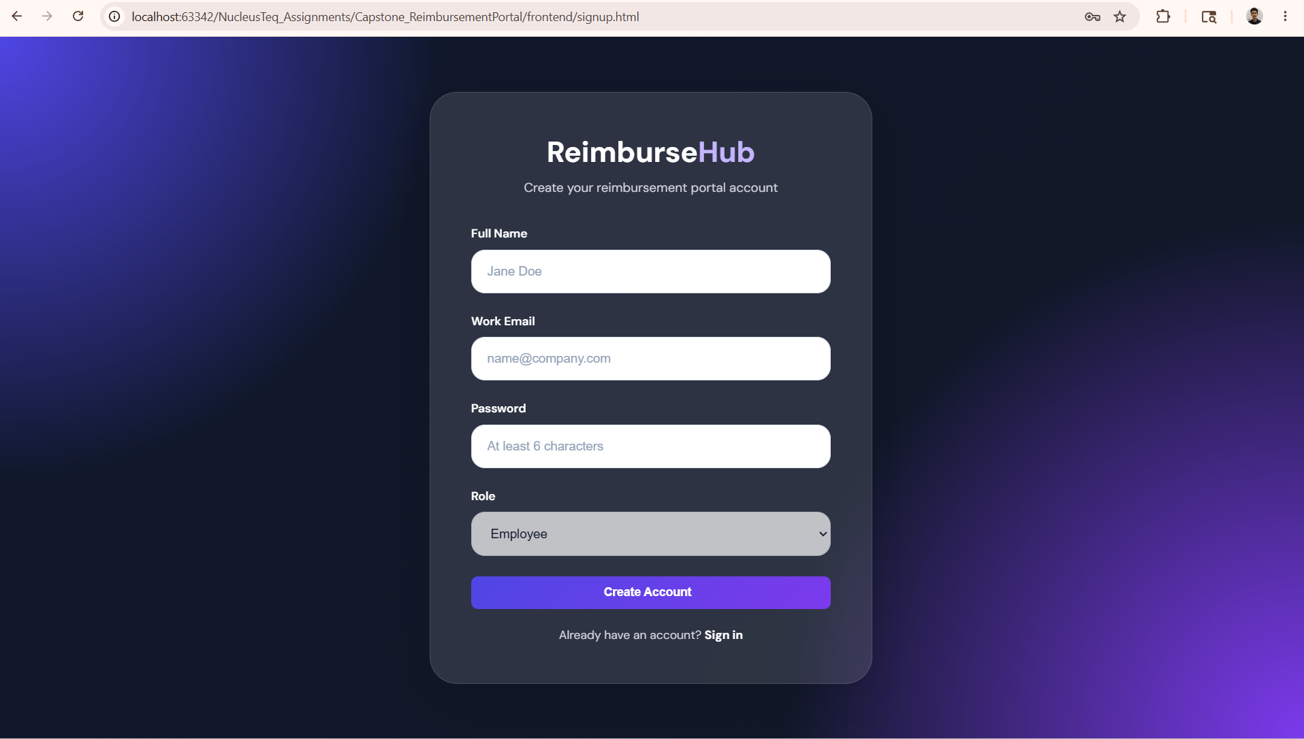
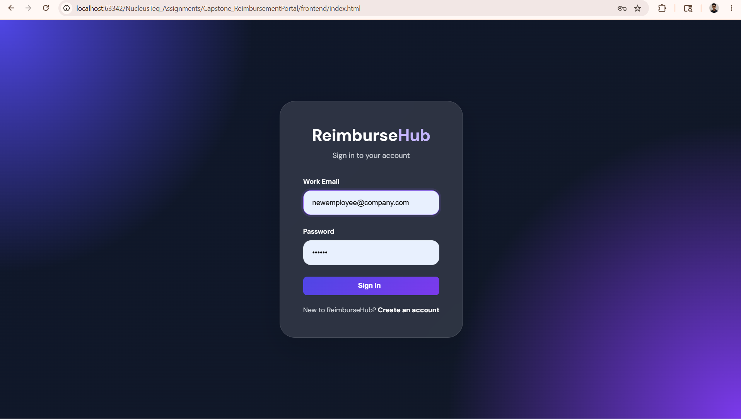
Signup and Login
Project Snapshots
Signup Page - Employee Registration
Login Page - Secure Sign In
ReimburseHub | 13

Slide 14
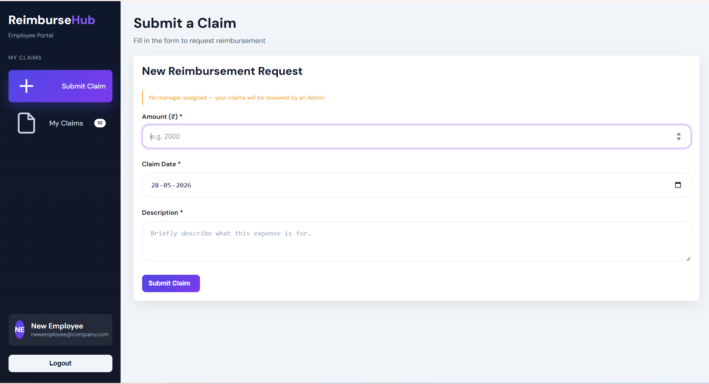
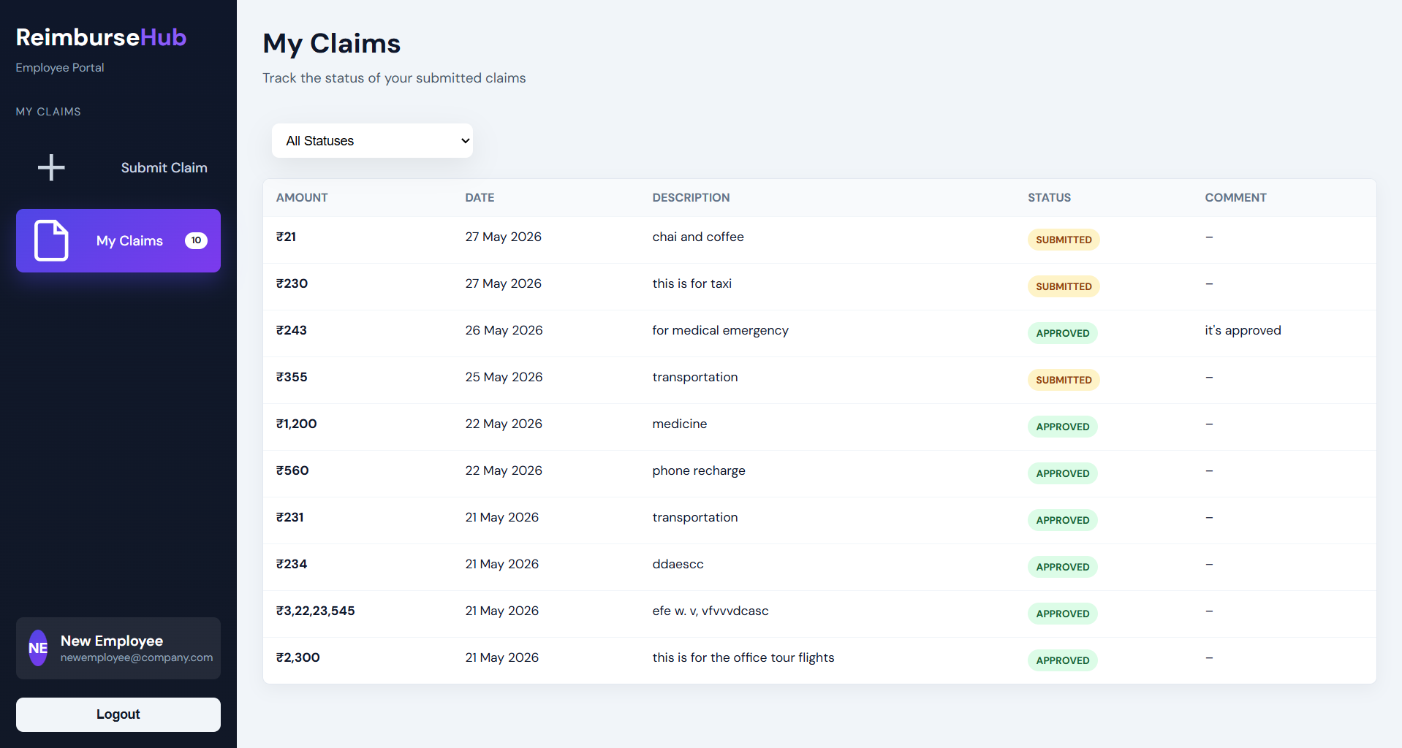
Employee Portal
Project Snapshots
Employee - Submit a Claim
Employee - My Claims History
ReimburseHub | 14

Slide 15
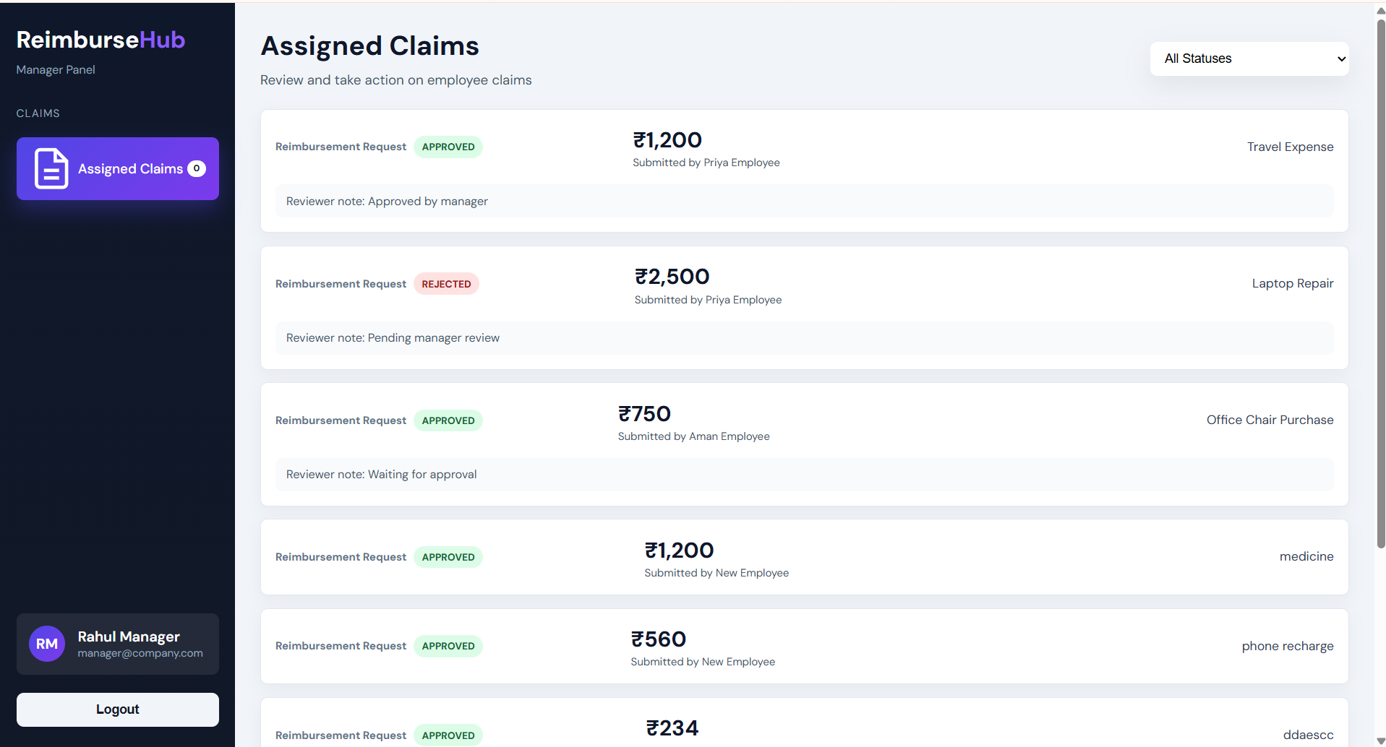
Manager Review Queue
Project Snapshots
Manager - Assigned Claims with Status Filter
ReimburseHub | 15

Slide 16
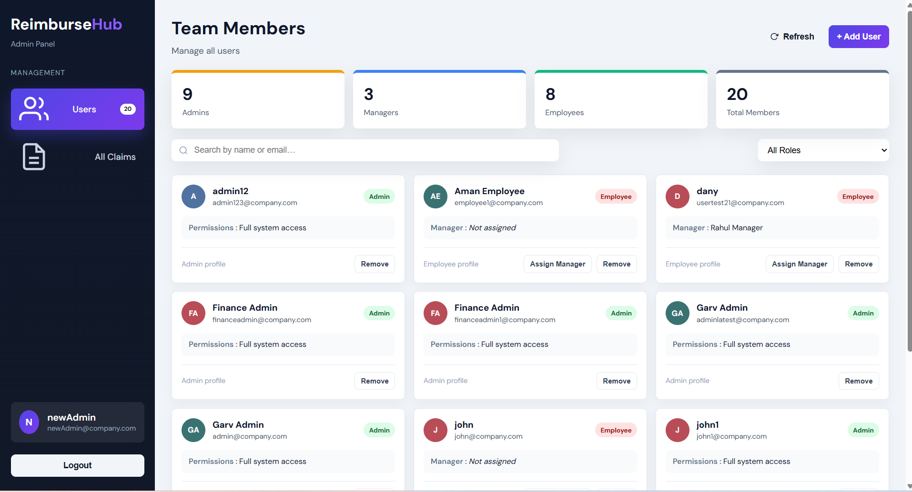
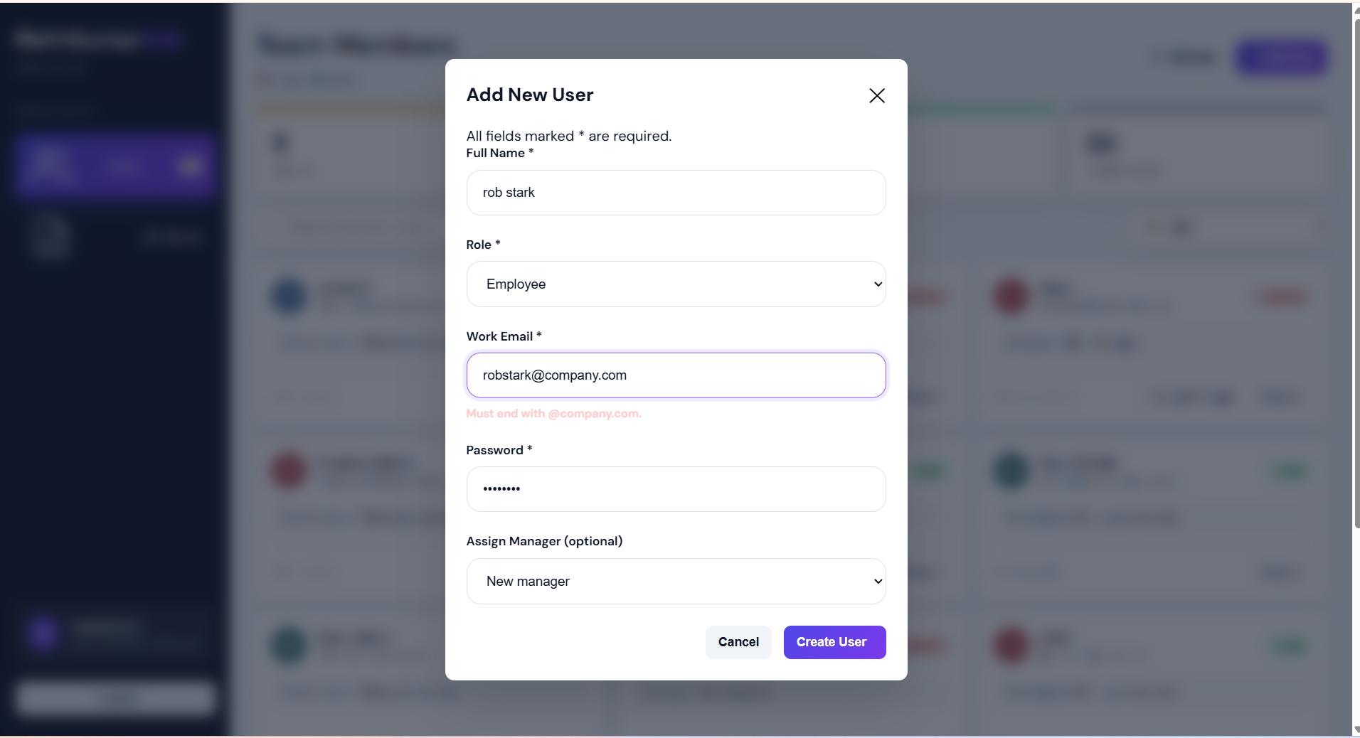
Admin User Management
Project Snapshots
Admin - Team Members Dashboard
Admin - Add New User Modal
ReimburseHub | 16

Slide 17
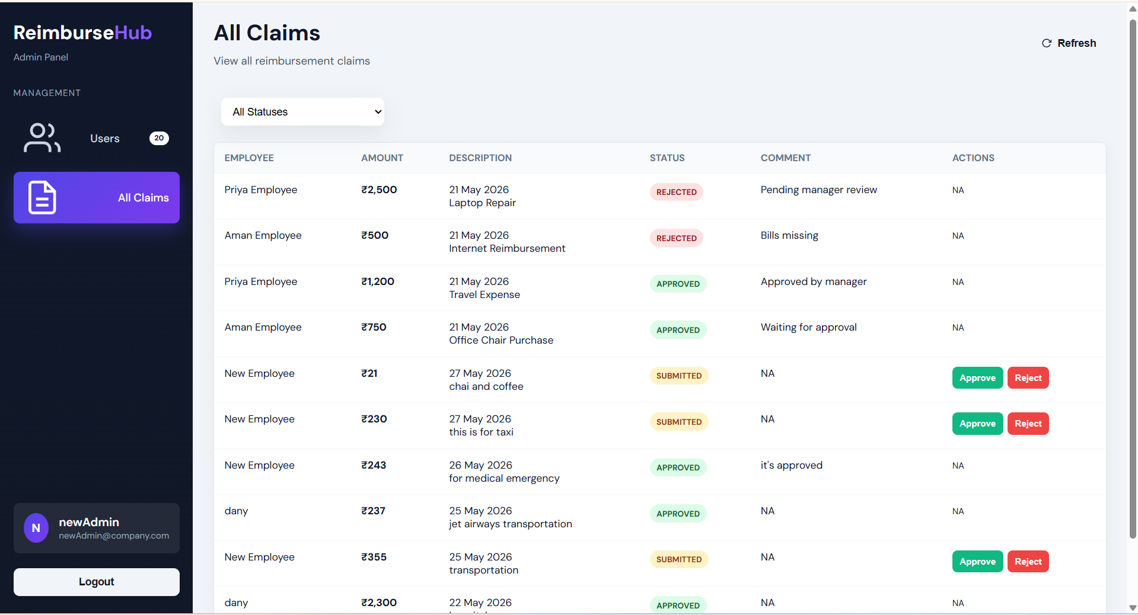
Admin Claim Management
Project Snapshots
Admin - All Claims Review Table
ReimburseHub | 17

Slide 18
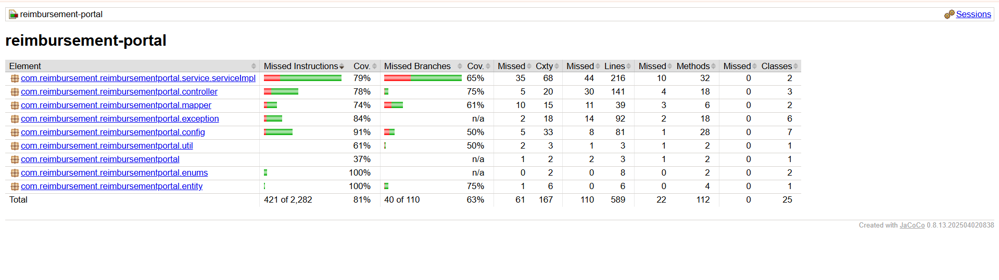
Testing Results

Slide 19
Thank You
Reimbursement Portal
Secure
Traceable
Managed
auth + role guard
status + comments
users + reviewers
A complete role-based reimbursement workflow with user management, reviewer assignment, claim lifecycle tracking, and auditable comments.
Garv Singh Chouhan
Minor Capstone Project 2026

