Slide 1
Design Thinking
Garvit Kumar Gupta (1659914)
Anshul (1660326)
Deepam Kumar Gupta (1660156)
Anurag Singh (1660154)
Group B (Batch B)

Slide 2
Framing a question
Can we improve the backup processing system without affecting user privacy?

Slide 3
Gather Inspiration
Fog Computing is the term coined by Cisco that refers to extending cloud computing to an edge of the enterprise’s network. Thus, it is also known as Edge Computing or Fogging. It facilitates the operation of computing, storage, and networking services between end devices and computing data centers.
Multi-Cloud is a term for the use of more than one public cloud service provider for virtual data storage or computing power resource

Slide 4
Architecture
Multi-Cloud methods are used to provide the most reliable and secure storage environment, whereas Fog Computing is used to provide better throughput and lower latency for the backup process.
A personal Fog node is owned and controlled by the end-user, similar to the rest of his personal devices like smartphones and laptops.

Slide 5
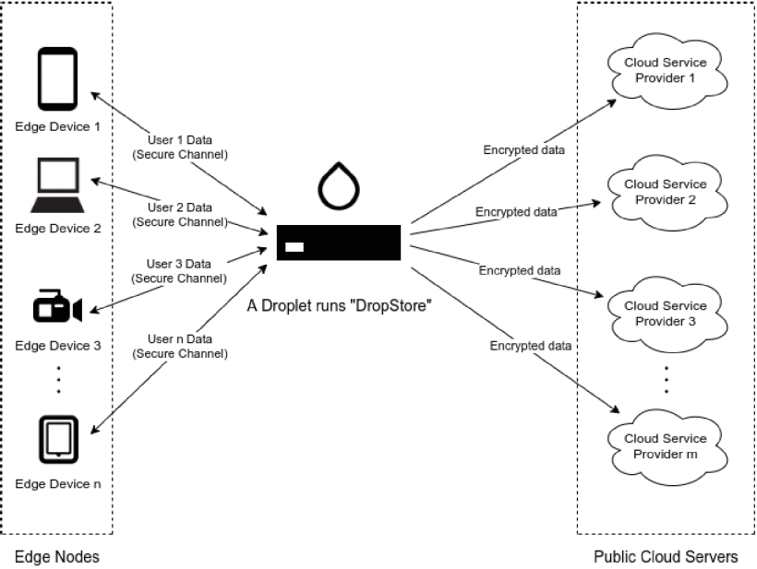
Basic Prototype

Slide 6
Make tangible Ideas
For this we can implement the above system by breaking it into tangible smaller components 1. Building the software: Handling multi-cloud data propagation etc and other stages
2. Building the necessary hardware

Slide 7
Stages:
Data Delta Calculation: At each periodic backup, it calculates the delta from the last backup instant and only backs up the new delta.
Data Encryption and Compression: it encrypts and compress the data delta using the keys assigned by owner.
Data Partitioning: The encrypted data from stage 2 will be split into several chunks. This also makes it harder for Cloud Service Provider to understand the encrypted chunks.
Data Redundancy: Number of replicas can be specified and replicated accordingly.
Data upload: itadopts a round-robin scheme to preserve the balance of storage usage on each CSP account. Metadata are distributed and replicated in the same manner as the user data. This scheme has been shown to keep the storage balanced on all the CSPs over the long term and avoid overwhelming specific CSP.

Slide 8
Test to learn
We can test the system based on multiple benchmarks such as performance, latency, throughput
Based upon the results we can tune our system, and iterate variables to improve the performance of our system

Slide 9
THANK YOU

