Slide 1
Python – #1 in many popularity lists; huge in AI, data science, scripting, automation. (Pluralsight)
JavaScript – Essential for web development; still one of the most used languages worldwide. (Pluralsight)
Java – Classic enterprise and Android language; OOP foundation language (
C++ – Widely used in systems, games, performance-critical apps. (Pluralsight)
C# – Popular in enterprise and game dev (Unity). (Pluralsight)
TypeScript – JavaScript with types; growing fast in web/enterprise. (Pluralsight)
SQL – Standard language for databases. (Pluralsight)
C – Still foundational for OS, embedded systems. (Wikipedia)
Go (Golang) – Cloud and modern backend services. (Pluralsight)
PHP / Swift / Kotlin – These are often in top-10 lists depending on the ranking, with PHP strong for web backends and Swift/Kotlin strong for mobile. (Pluralsight)

Slide 2
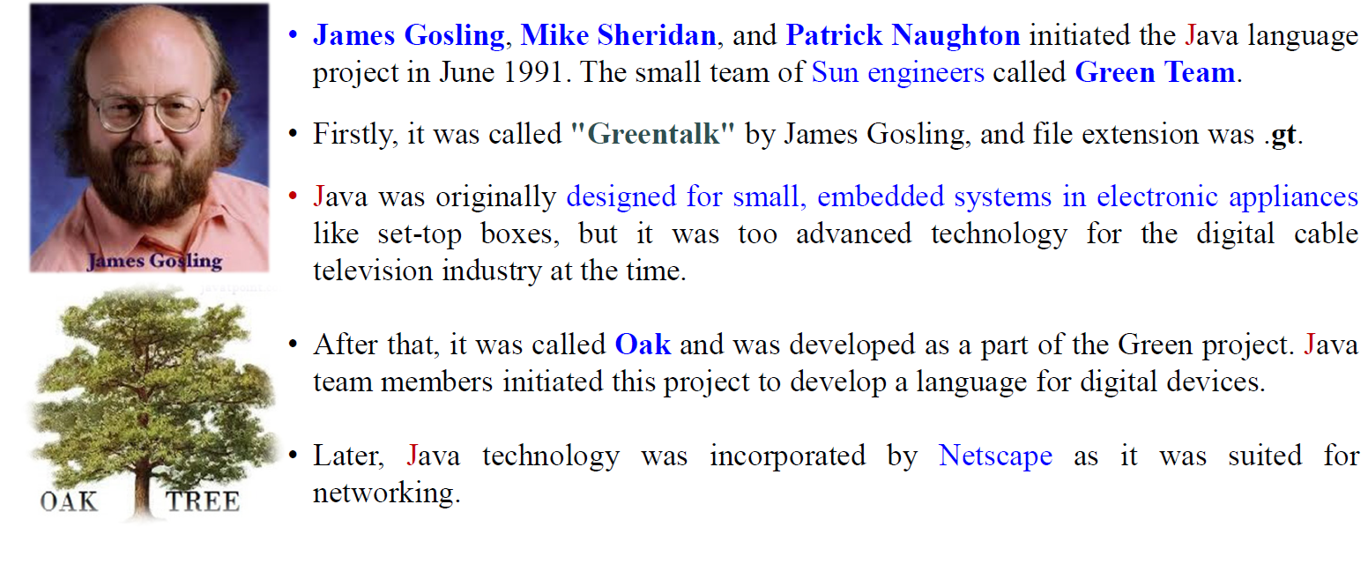
In 1995 Oak was renamed as Java

Slide 3
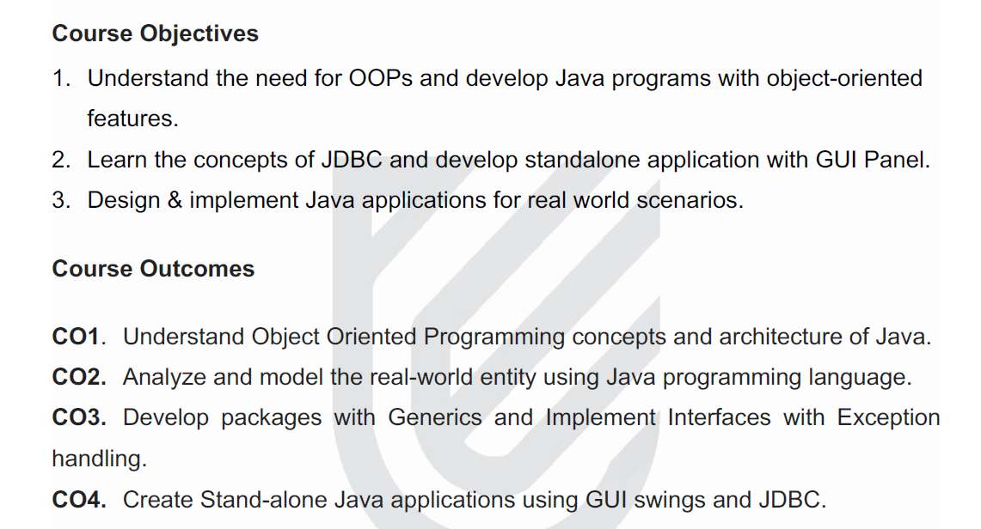

Slide 4
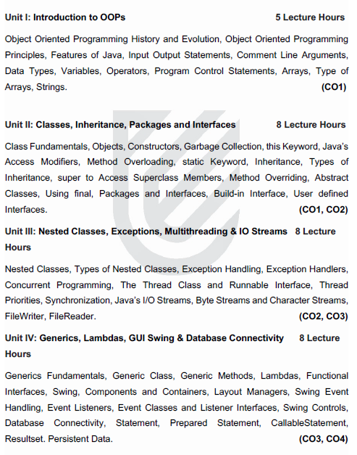

Slide 5
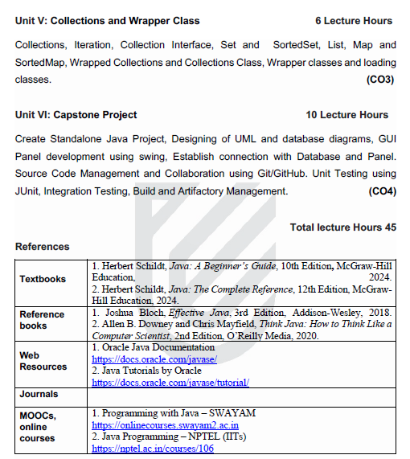

Slide 6
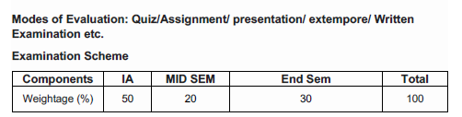

Slide 7
Attendance Rules
No Manual Attendance – 94 Students
Proxy – 3 –ve attendance for person doing proxy
Lab & Theory
Lab Teacher for B7 B8

Slide 8
Homework
Write Once – Run Anywhere ----- How ??

