Slide 1
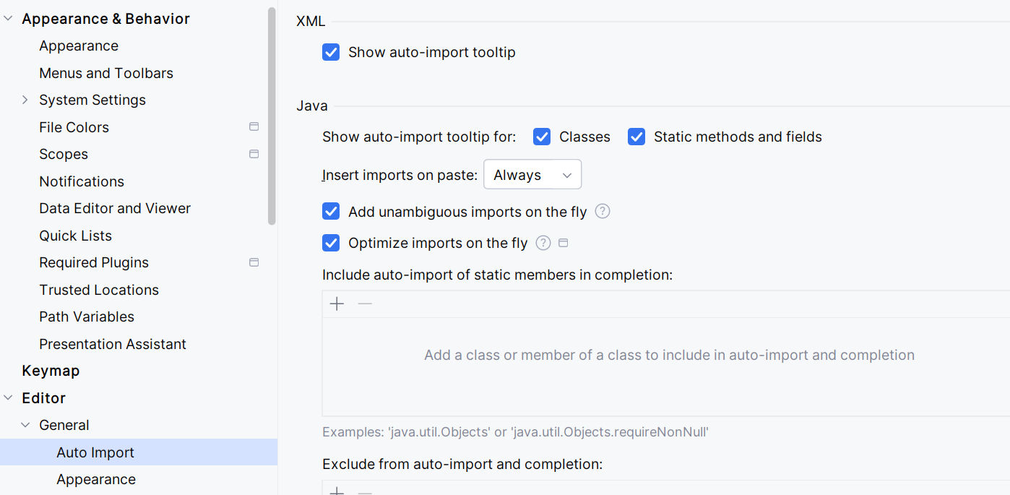

Slide 2
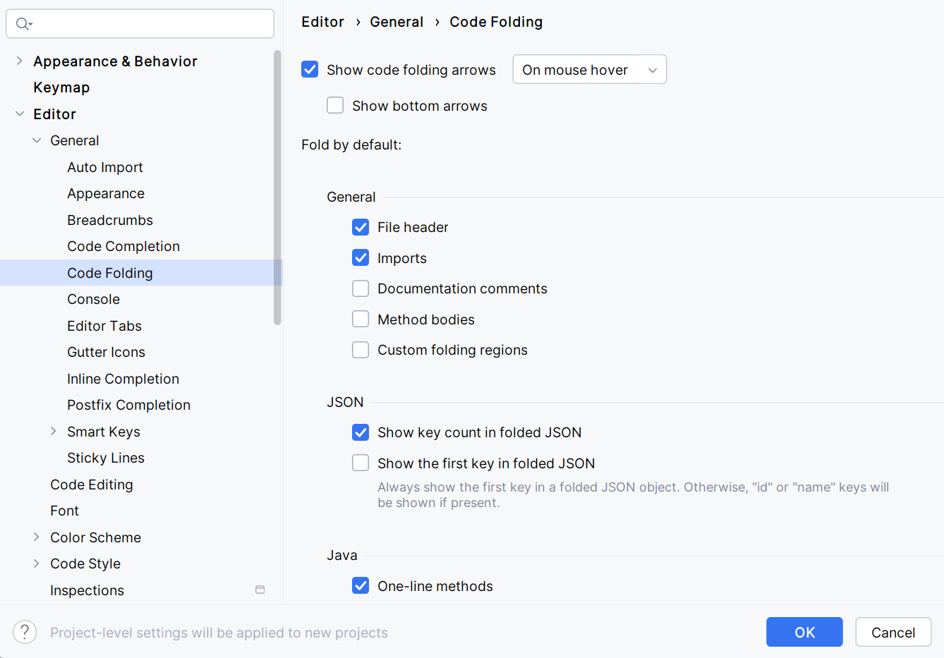

Slide 3
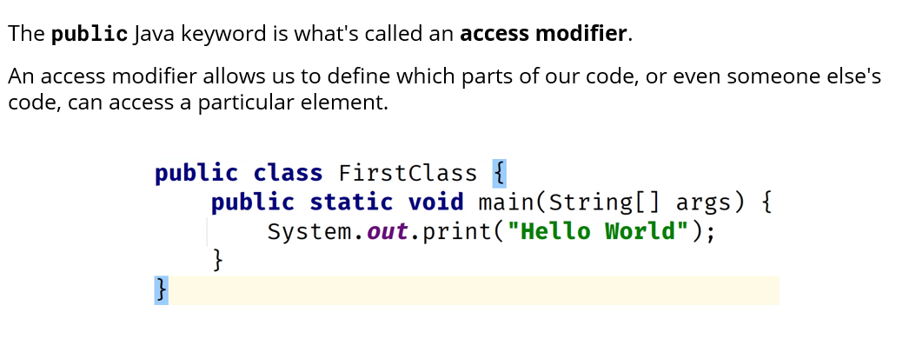

Slide 4
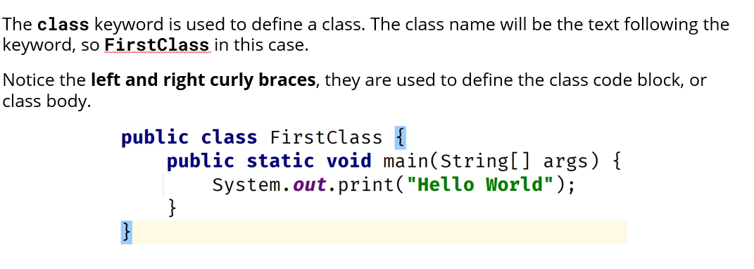

Slide 5
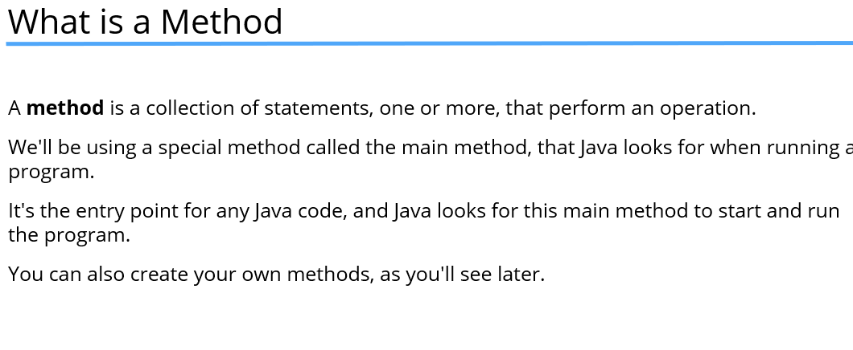

Slide 6
if (condition) {
// runs if condition is true
} else {
// runs if condition is false
}
Condition must be Boolean
int age = 20;
if (age >= 18) {
System.out.println("Eligible to vote");
}
else {
System.out.println("Not eligible to vote");
}

Slide 7
args.length
.length gives the number of elements in the array
Type: int
Arrays in Java know their own size
args[0] = "Rahul"
args[1] = "Sharma"
args.length = 2

Slide 8
public class HelloName {
public static void main(String[] args) {
if (args.length == 0) {
System.out.println("Please enter your name");
} else {
System.out.println("Hello " + args[0]);
}
}
}

