Slide 1
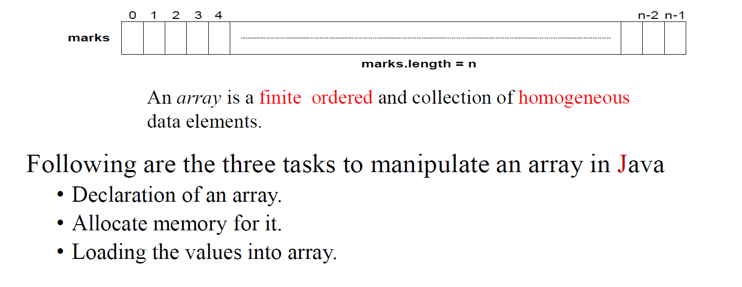

Slide 2
Key Points of Arrays in Java
An array is a fixed-size collection of elements of the same data type.
Array access is fast because elements are accessed using index values. Array elements are stored in contiguous memory locations. Array size is decided at creation time and cannot be changed later. Arrays use zero-based indexing (first element at index `0`).
Arrays in Java are objects, not primitive variables. The `length` property gives the size of the array (not a method). Arrays are created using the `new` keyword. Java automatically initializes array elements with default values.
Primitive arrays store values directly, whereas object arrays store references to objects.

Slide 3
SET 1: PRIMITIVE ARRAY (int, double, char, etc.)
Declare Array
<type> <arrayName>[];
e.g.
int x[];
Allocate Memory to array
<arrayName> = new <type>[<size>];
e.g.
x = new int[100];
Define and allocate memory together
<type> <arrayName>[] = new <type>[<size>];
e.g.
int x[] = new int[100];
Initialize Array: Option 1
<arrayName>[<subscript>] = <value>;
e.g.
x[5] = 100;
Using loop:
For (int i = 0; i < 100; i++)
x[i] = <value>;
Initialize Array: Option 2
<type> <arrayName>[] = { <list of values> };
e.g.
int x[] = {12, 13, 14};
Size of array
int i = x.length;
SET 2: OBJECT ARRAY (class type)
Declare Array
<className> <arrayName>[];
e.g. Book books[];
Allocate Memory to array (references only)
<arrayName> = new <className>[<size>];
e.g. books = new Book[3];
Define and allocate memory together
<className> <arrayName>[] = new <className>[<size>];
e.g. Book books[] = new Book[3];
Initialize Array: Option 1 (IMPORTANT – object creation required)
<arrayName>[<index>] = new <className>();
books[0] = new Book();
books[1] = new Book();
Assign values to object fields:
books[0].title = "Java";
books[1].title = "OOP";
Initialize Array: Option 2 (array + objects together)
<className> <arrayName>[] = { new <className>(), new <className>() };
e.g.Book books[] = { new Book(), new Book() };
Size of array
int i = books.length;

Slide 4
Write a Java program that:
Declares an integer array
Allocates memory for the array (size 5)
Initializes the array elements with any integer values
Prints all array elements using a loop
Create a class named IntArrayDemo.
Define the main method as the program entry point.
Inside main, declare an integer array variable.
Allocate memory to the array for 5 integer elements.
Initialize the array elements with integer values using a loop.
Use a loop to access each array element.
Print each element to the console.
Declare Int Array : int[] x ;
Allocate memory: x = new int[5];
Initialize Array:
for (int i=0; i<x.length;i++)
X[i]= i+ 1;
mportantYears = new int[] {800, 1066, 1492,};

Slide 5
class IntArrayDemo {
public static void main(String[] args) {
int[] x = new int[5];
for (int i = 0; i < x.length; i++) {
x[i] = i + 1;
}
for (int i = 0; i < x.length; i++) {
System.out.println(x[i]);
}
}
}

Slide 6
Primitive Array Specific Points
Primitive arrays store actual values (int, double, char, etc.).
Only one `new` operation is required.
Default values:
`int` → `0`
`double` → `0.0`
`boolean` → `false`
e.g int[] a = new int[3];
Object Array Specific Points
Object arrays store references to objects, not the objects themselves.
Creating an object array does not create objects automatically.
Each object must be created separately using `new`.
Default value for object references is `null`.
Accessing an object before creation causes `NullPointerException`.
Example:
Book[] books = new Book[2];
books[0] = new Book();

Slide 7
class TestArray{ String title ; public static void main(String args[]) { TestArray[] myBooks = new TestArray[2]; int x = 0; myBooks[0].title = "b1"; myBooks[1].title = "b2"; while(x < 2) { System.out.println( "book "+ myBooks[x].title ); x++ ; } }
class Hobbits { String name ; public static void main(String args[]) { Hobbits[] h = new Hobbits[2] ; int z = 0 ; while (z < 2) { z = z + 1 ; h[z] = new Hobbits() ; h[z].name ="H" + z ; System.out.println("name "+ h[z].name ); } } }

Slide 8
Feature | Java | C | Python
Nature of Array | Array is an object | Array is not an object | List is an object
Size | Fixed at creation | Fixed at declaration | Dynamic (can grow/shrink)
Memory Allocation | Heap memory using new | Stack / static memory | Heap memory (managed by interpreter)
Bounds Checking | Yes (runtime check) | No | Yes
Error on Invalid Index | ArrayIndexOutOfBoundsException | Undefined behavior | IndexError
Default Initialization | Yes (0, false, null) | No (garbage values) | Yes (None for new slots)
Syntax to Create | int[] a = new int[5]; | int a[5]; | a = [1,2,3]
Size Access | a.length | Manual tracking | len(a)
Object Arrays | Supported (stores references) | Not supported | Built-in support

Slide 9
Program Requirements – Object Array
• Declares an object array
• Allocates memory for the array (size 5)
• Creates objects inside the array
• Prints all object values using a loop
Class Creation
class Book
{
String title;
}
Declare Object Array
Book[] books;
Allocate Memory
books = new Book[5];
Initialize Array, Assign and Read Values
for (int i = 0; i < books.length; i++)
{
books[i] = new Book();
books[i].title = "Book " + (i + 1);
}
for (int i = 0; i < books.length; i++)
{
System.out.println(books[i].title);
}
Low Level Design – Object Array
• Create a class named Book
• Add one data member title
• Create a class named ObjectArrayDemo
• Define the main method
• Inside main, declare an object array
• Allocate memory for 5 objects
• Create objects using a loop
• Assign values to object fields
• Use a loop to print object values

Slide 10
class Book {
String title;
}
class ObjectArrayDemo {
public static void main(String[] args) {
Book[] books;
books = new Book[5];
for (int i = 0; i < books.length; i++) {
books[i] = new Book();
books[i].title = "Book " + (i + 1);
}
for (int i = 0; i < books.length; i++) {
System.out.println(books[i].title);
}
}
}

Slide 11
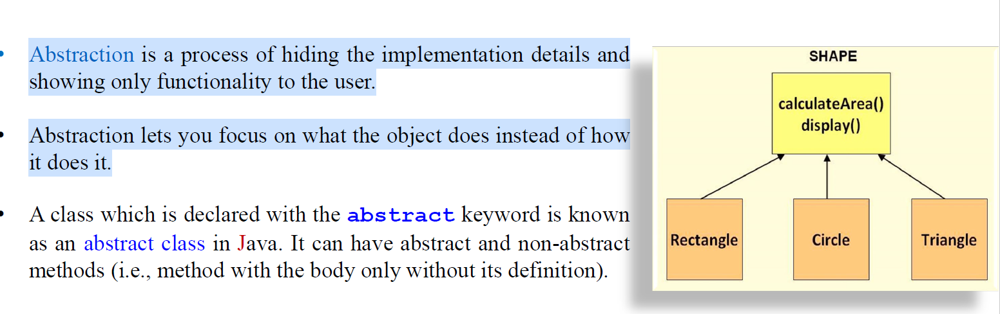
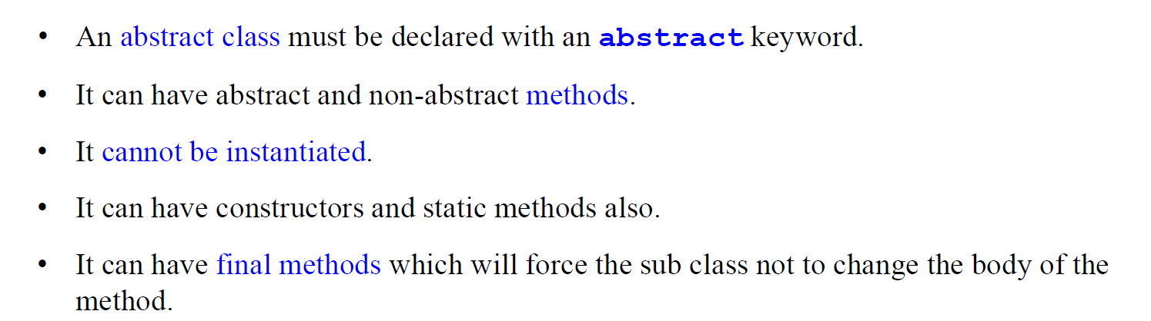

Slide 12
Abstract class Bike{
Abstract void run();
}
Class Honda extends Bike{
void run() {
System.out.println(“run safely”);
}
Public static void main() {
Bike obj = new Honda() ;
obj.run() ;
}

