Slide 1
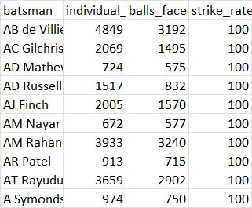
Question 1:
select a.batsman, a.individual_runs, b.balls_faced, ((a.individual_runs/b.balls_faced)*100) as strike_rate from (select batsman,sum(batsman_runs) as individual_runs from IPL_Ball group by batsman) as a inner join (select batsman,count(ball) as balls_faced from IPL_Ball where extras_type not in ('penalty','wides') group by batsman) as b on a.batsman = b.batsman where balls_faced >=500
order by strike_rate desc
limit 10;

Slide 2
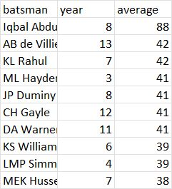
Question 2:
create view Q2 as
select distinct a.batsman,extract (year from b.date) as season from IPL_ball as a Left join IPL_matches as b on a.id=b.id order by 2 asc;
select x1.batsman,x1.year,y1.averagefrom (select batsman, count(*) as year from Q2 group by batsman) as x1 inner join
(select batsman,y.x/y.z as average from (select batsman,sum(batsman_runs) as x, sum (is_wicket) as z from IPL_Ball group by batsman) as y where not y.z =0) as y1 on x1.batsman = y1.batsman where year>2 order by 3 desc
limit 10;

Slide 3
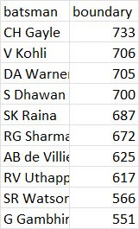
Question 3 :
select batsman, count (*) as boundary from IPL_ball where batsman in(
select batsman from IPL_matches group by batsman having count(distinct extract(year from date)) > 2)and batsman_runs in (4, 6) group by batsman order by boundary desc limit 10;

Slide 4
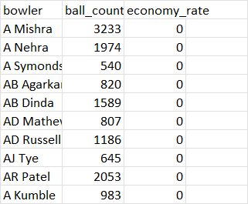
Question 4 :
create view TestQ4 as
SELECT bowler, SUM(total_runs) / (count(over)) AS economy_rate,count(ball) as ball_count FROM IPL_ball GROUP BY bowler;
select bowler,ball_count,economy_rate from TestQ4 where ball_count = 500 or ball_count >500 ORDER BY economy_rate asc limit 10;

Slide 5
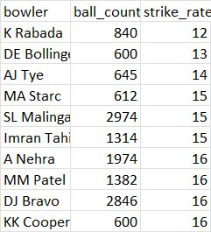
Question 5 :
create view Q5 as
Select bowler, (count(ball) / sum(is_wicket)) AS strike_rate, count (ball) as ball_count FROM IPL_ball GROUP BY bowler;
Select bowler, ball_count, strike_rate from Q5 where ball_count =500 or ball_count>500order by strike_rate asc limit 10;

Slide 6
Question 6:
SELECT batsman, (SUM(total_runs) / COUNT(DISTINCT ball)) AS batsman_strike_rate, (SUM(is_wicket) / COUNT(DISTINCT ball)) AS bowler_strike_rate FROM ipl_ball GROUP BY batsman HAVING sum( ball) >= 500
ORDER BY batsman_strike_rate DESC,
bowler_strike_rate desc limit 10;

Slide 7

Additional Question 1:
select count (distinct city) from ipl_matches;

Slide 8
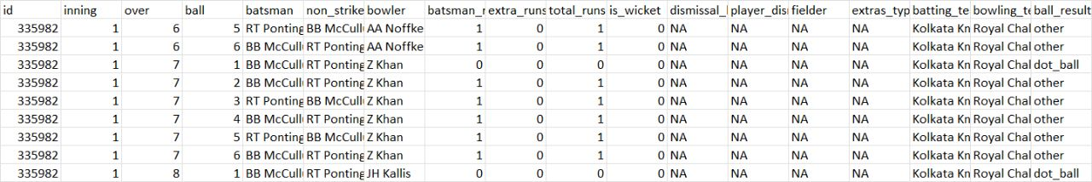
Additional Question 2:
CREATE TABLE deliveries_v02 AS SELECT *, CASE WHEN total_runs >= 4 THEN 'boundary' WHEN total runs = 0 THEN 'dot_ball' ELSE 'other' END AS ball_result from ipl_ball;

Slide 9

Additional Question 3:
select count (ball_result) from deliveries_v02 where ball_result not in ('other');

Slide 10
Additional Question 4
select batting_team,count (ball_result) as total_boundaries from deliveries_v02 where ball_result NOT IN ('other','dot') group by batting_team order by total_boundaries desc;

Slide 11
Additional Question 5
select bowling_team ,count (ball_result) as total_dot_balls from deliveries_v02 where ball_result NOT IN ('other','boundary') group by bowling_team order by total_dot_balls desc;

Slide 12

Additional Question 6:
select count (dismissal_kind) as total_dismissal from deliveries_v02 WHERE dismissal_kind NOT IN ('NA');

Slide 13
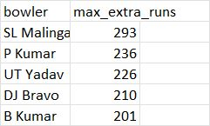
Additional Question 7:
select bowler,sum(extra_runs) as max_extra_runs from ipl_ball group by bowler order by max_extra_runs desc limit 5;

Slide 14
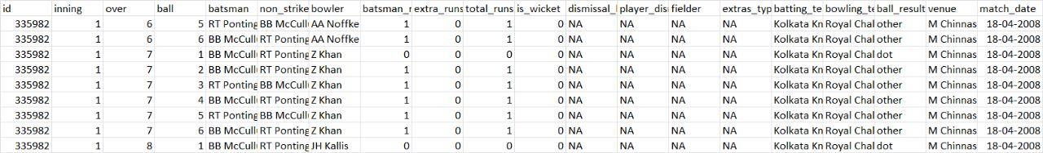
Additional Question 8:
CREATE TABLE deliveries_v03 AS SELECT deliveries_v02.*, m.venue, m.date AS match_dateFROM deliveries_v02 innerJOIN ipl_matches AS m ON deliveries_v02.id = m.id;SELECT * from deliveries_v03;

Slide 15
Additional Question 9:
SELECT venue, SUM(total_runs) AS total_runs_scored from deliveries_v03 GROUP BY venue ORDER BY total_runs_scored desc;

Slide 16
Additional Question 10:
SELECT EXTRACT(YEAR FROM match_date) AS match_year, SUM(total_runs) AS total_runs FROM deliveries_v03 WHERE venue = 'Eden Gardens' GROUP BY match_year
order by total_runs desc;

