Slide 1
GASPI Tutorial
Christian Simmendinger
Mirko Rahn
Daniel Grünewald

Slide 2
Goals
Get an overview over GASPI
Learn how to
Compile a GASPI program
Execute a GASPI program
Get used to the GASPI programming model
one-sided communication
weak synchronization
asynchronous patterns / dataflow implementations

Slide 3
Outline
Introduction to GASPI
GASPI API
Execution model
Memory segments
One-sided communication
Collectives
Passive communication

Slide 4
Outline
GASPI programming model
Dataflow model
Fault tolerance
www.gaspi.de
www.gpi-site.com

Slide 5
Introduction to GASPI

Slide 6
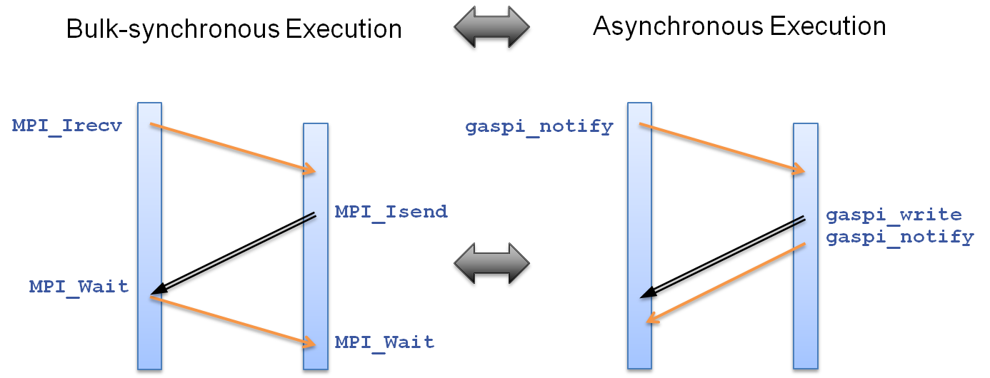
Motivation
A PGAS API for SPMD execution
Take your existing MPI code
Rethink your communication patterns !
Reformulate towards an asynchronous data flow model !

Slide 7
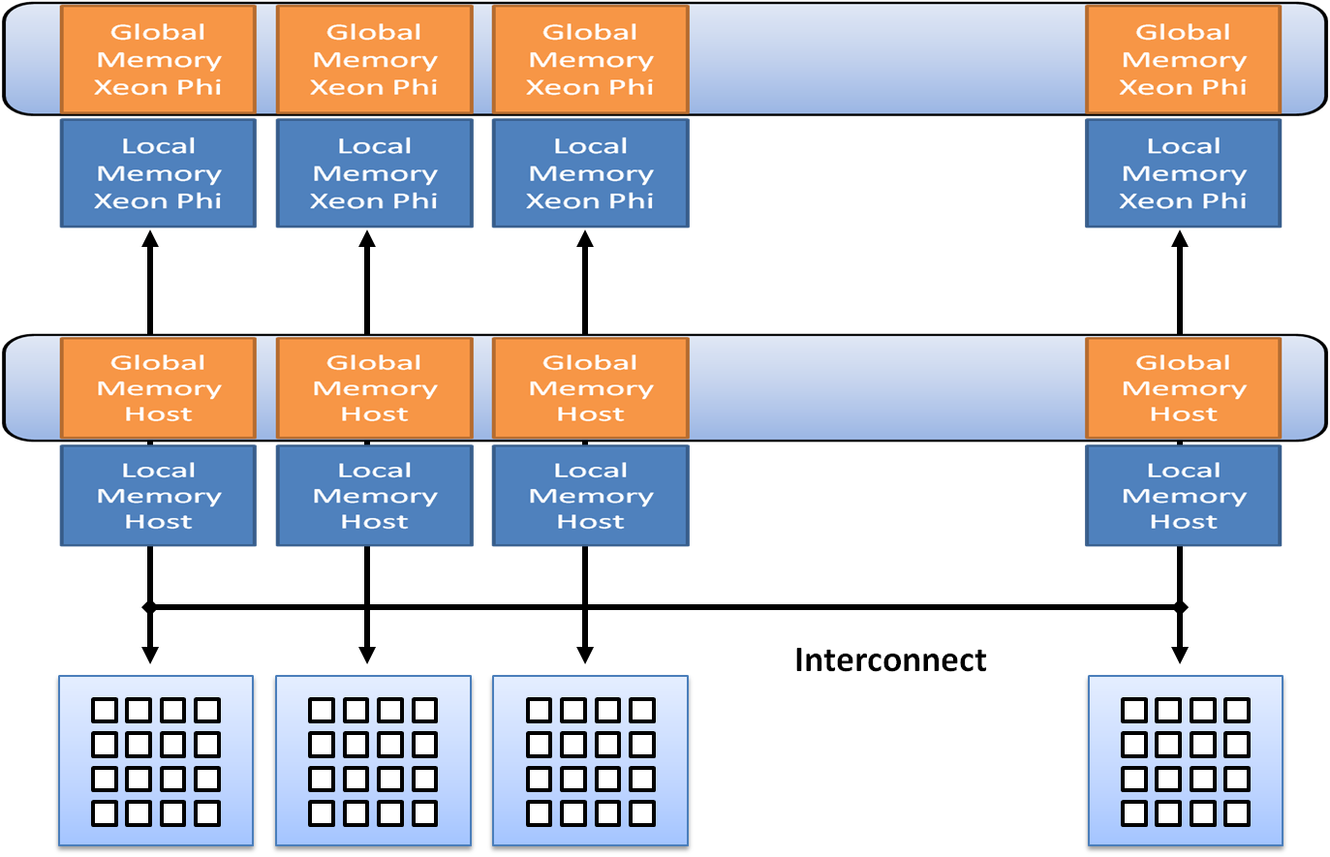
Key Objectives of GASPI
Scalability
From bulk–synchronous two sided communication patterns to asynchronous one-sided communication
remote completion
Flexibility and Versatility
Multiple Segments,
Configurable hardware ressources
Support for multiple memory models
Failure Tolerance
Timeouts in non-local operations
dynamic node sets.

Slide 8

GASPI history
GPI
originally called Fraunhofer Virtual Machine (FVM)
developed since 2005
used in many of the industry projects at CC-HPC of Fraunhofer ITWM
GPI: Winner of the „Joseph von Fraunhofer Preis 2013“
www.gpi-site.com

Slide 9
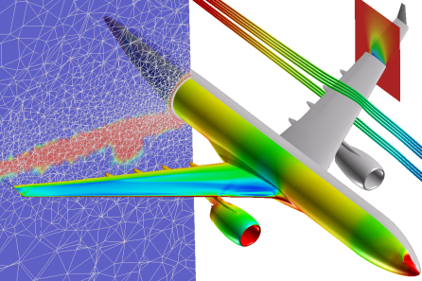
Scalability
Performance
One-sided read and writes
remote completion in PGAS with notifications.
Asynchronous execution model
RDMA queues for one-sided read and write operations, including support for arbitrarily distributed data.
Threadsafety
Multithreaded communication is the default rather than the exception.
Write, Notify, Write_Notifiy
relaxed synchronization with double buffering
traditional (asynchronous) handshake mechanisms remain possible.
No Buffered Communication - Zero Copy.

Slide 10
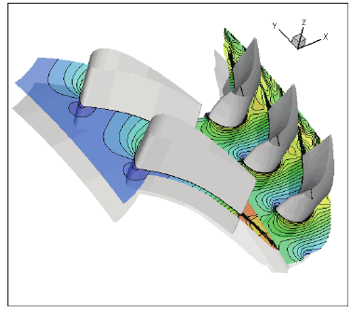
Scalability
Performance
No polling for outstanding receives/acknowledges for send
no communication overhead, true asynchronous RDMA read/write.
Fast synchronous collectives with time-based blocking and timeouts
Support for asynchronous collectives in core API.
Passive Receives two sided semantics, no Busy-Waiting
Allows for distributed updates, non-time critical asynchronous collectives. Passive Active Messages, so to speak ☺.
Global Atomics for all data in segments
FetchAdd
cmpSwap.
Extensive profiling support.

Slide 11

Flexibility and Versatility
Segments
Support for heterogeneous Memory Architectures (NVRAM, GPGPU, Xeon Phi, Flash devices).
Tight coupling of Multi-Physics Solvers
Runtime evaluation of applications (e.g Ensembles)
Multiple memory models
Symmetric Data Parallel (OpenShmem)
Symmetric Stack Based Memory Management
Master/Slave
Irregular.

Slide 12

Flexibility
Interoperability and Compatibility
Compatibility with most Programming Languages.
Interoperability with MPI.
Compatibility with the Memory Model of OpenShmem.
Support for all Threading Models (OpenMP/Pthreads/..)
similar to MPI, GASPI is orthogonal to Threads.
GASPI is a nice match for tile architecture with DMA engines.

Slide 13

Flexibility
Flexibility
Allows for shrinking and growing node set.
User defined global reductions with time based blocking.
Offset lists for RDMA read/write (write_list, write_list_notify)
Groups (Communicators)
Advanced Ressource Handling, configurable setup at startup.
Explicit connection management.

Slide 14

Failure Tolerance
Failure Tolerance.
Timeouts in all non-local operations
Timeouts for Read, Write, Wait, Segment Creation, Passive Communication.
Dynamic growth and shrinking of node set.
Fast Checkpoint/Restarts to NVRAM.
State vectors for GASPI processes.

Slide 15
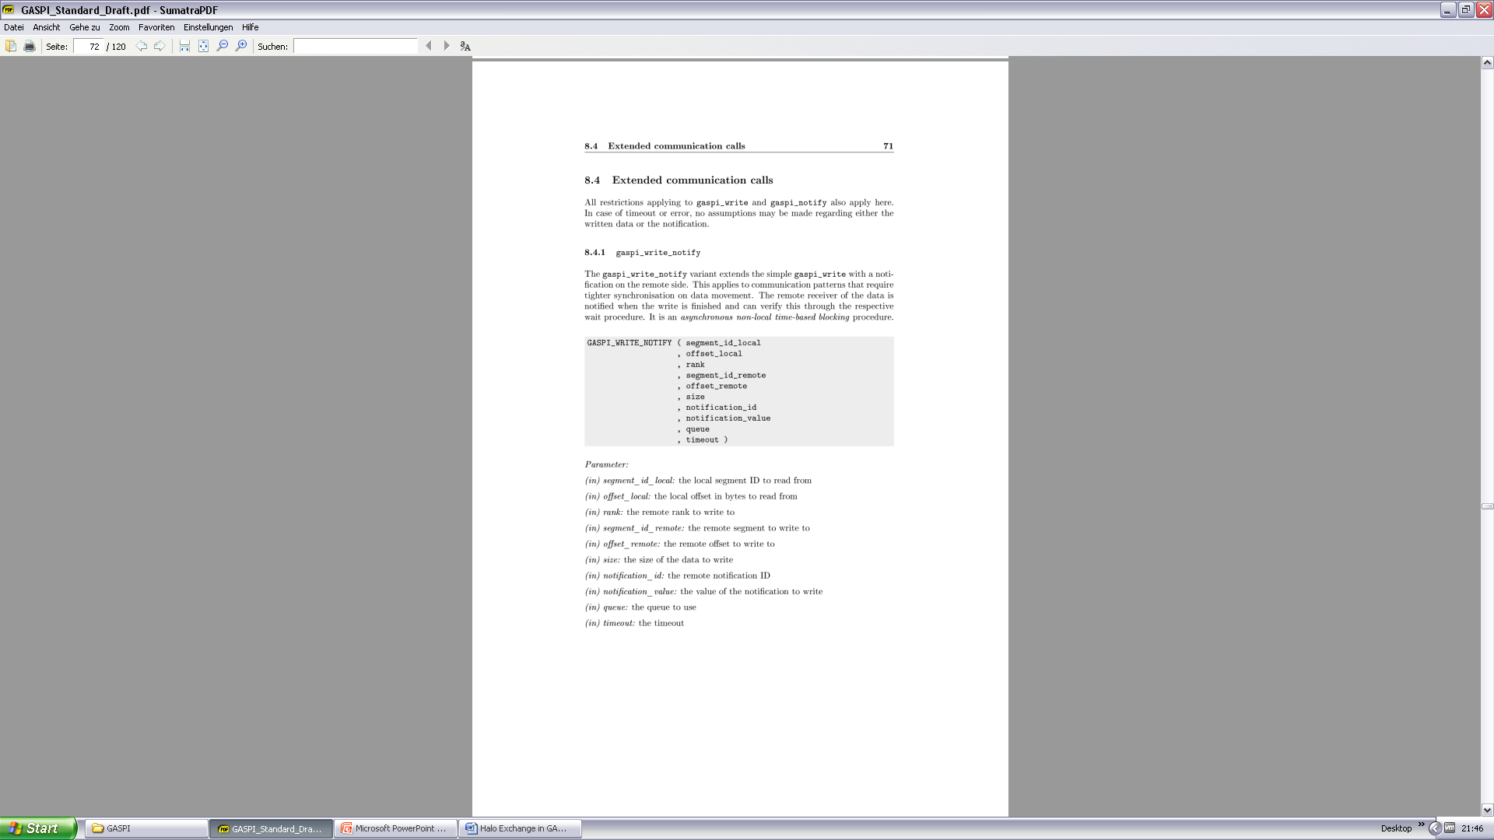
The GASPI API
52 communication functions
24 getter/setter functions
108 pages
… but in reality:
Init/Term
Segments
Read/Write
Passive Communication
Global Atomic Operations
Groups and collectives
www.gaspi.de

Slide 16
GASPI Implementation
AP1

Slide 17
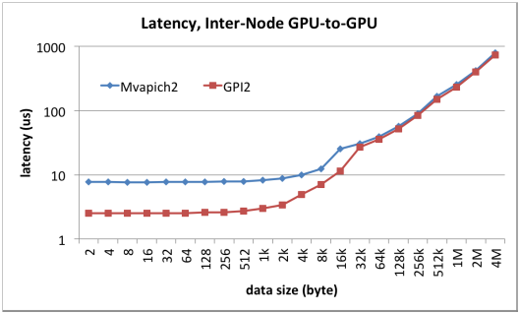
GASPI Implementation
AP1
(MVAPICH2-1.9) mit GPUDirect RDMA.

Slide 18
GASPI Execution Model

Slide 19
GASPI Exection Model
SPMD / MPMD execution model
All procedures have prefix gaspi_
All procedures have a return value
Timeout mechanism for potentially blocking procedures

Slide 20
GASPI Return Values
Procedure return values:
GASPI_SUCCESS
designated operation successfully completed
GASPI_TIMEOUT
designated operation could not be finished in the given period of time
not necessarily an error
the procedure has to be invoked subsequently in order to fully complete the designated operation
GASPI_ERROR
designated operation failed -> check error vector
Advice: Always check return value !

Slide 21
Timeout Mechanism
Mechanism for potentially blocking procedures
procedure is guaranteed to return
Timeout: gaspi_timeout_t
GASPI_TEST (0)
procedure completes local operations
Procedure does not wait for data from other processes
GASPI_BLOCK (-1)
wait indefinitely (blocking)
Value > 0
Maximum time in msec the procedure is going to wait for data from other ranks to make progress
!= hard execution time

Slide 22
GASPI Process Management
Initialize / Finalize
gaspi_proc_init
gaspi_proc_term
Process identification
gaspi_proc_rank
gaspi_proc_num
Process configuration
gaspi_config_get
gaspi_config_set

Slide 23
GASPI Initialization
initialization of resources
set up of communication infrastructure if requested
set up of default group GASPI_GROUP_ALL
rank assignment
position in machinefile ⬄ rank ID
no default segment creation
gaspi_proc_init

Slide 24
GASPI Finalization
clean up
wait for outstanding communication to be finished
release resources
no collective operation !
gaspi_proc_term

Slide 25

GASPI Process Identification
gaspi_proc_num
gaspi_proc_rank

Slide 26
GASPI Process Configuration
gaspi_config_set
Retrieveing and setting the configuration structure has to be done before gaspi_proc_init
gaspi_config_get

Slide 27
GASPI Process Configuration
Configuring
resources
sizes
max
network

Slide 28
GASPI „hello world“
#include "success_or_die.h“
#include <GASPI.h>
#include <stdlib.h>
int main(int argc, char *argv[])
{
SUCCESS_OR_DIE( gaspi_proc_init(GASPI_BLOCK) );
gaspi_rank_t rank;
gaspi_rank_t num;
SUCCESS_OR_DIE( gaspi_proc_rank(&rank) );
SUCCESS_OR_DIE( gaspi_proc_num(&num) );
printf("Hello world from rank %d of %d\n",rank, num);
SUCCESS_OR_DIE( gaspi_proc_term(GASPI_BLOCK) );
return EXIT_SUCCESS;
}

Slide 29
success_or_die.h
#ifndef SUCCESS_OR_DIE_H
#define SUCCESS_OR_DIE_H
#include <GASPI.h>
#include <stdlib.h>
#define SUCCESS_OR_DIE(f...) \
do \
{ \
const gaspi_return_t r = f; \
\
if (r != GASPI_SUCCESS) \
{ \
printf ("Error: '%s' [%s:%i]: %i\n", #f, __FILE__, __LINE__, r);\
exit (EXIT_FAILURE); \
} \
} while (0)
#endif

Slide 30

Hands-On

Slide 31
Memory Segments

Slide 32
Segments
Software abstraction of hardware memory hierarchy
NUMA
GPU
Xeon Phi
One partition of the PGAS
Contiguous block of virtual memory
no pre-defined memory model
memory management up to the application
Locally / remotely accessible
local access by ordinary memory operations
remote access by GASPI communication routines

Slide 33
GASPI Segments
GASPI provides only a few relatively large segments
segment allocation is expensive
the total number of supported segments is limited by hardware constraints
GASPI segments have an allocation policy
GASPI_MEM_UNINITIALIZED
memory is not initialized
GASPI_MEM_INITIALIZED
memory is initialized (zeroed)

Slide 34
Segment Functions
Segment creation
gaspi_segment_alloc
gaspi_segment_register
gaspi_segment_create
Segment deletion
gaspi_segment_delete
Segment utilities
gaspi_segment_num
gaspi_segment_ptr

Slide 35
GASPI Segment Allocation
allocate and pin for RDMA
Locally accessible
gaspi_segment register
segment accessible by rank
gaspi_segment_alloc

Slide 36
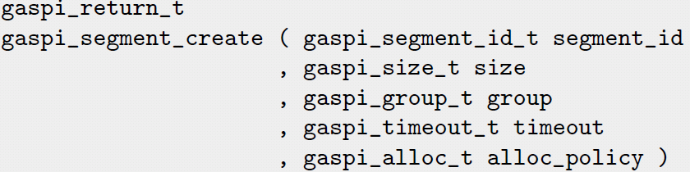
GASPI Segment Creation
Collective short cut to
gaspi_segment_alloc
gaspi_segment_register
After successful completion, the segment is locally and remotely accessible by all ranks in the group
gaspi_segment_create

Slide 37
GASPI Segment Deletion
free segment memory
gaspi_segment_delete

Slide 38
GASPI Segment Utils
gaspi_segment_list
gaspi_segment_ptr
gaspi_segment_num

Slide 39
Using Segments (I)
// includes
int main(int argc, char *argv[])
{
static const int VLEN = 1 << 2;
SUCCESS_OR_DIE( gaspi_proc_init(GASPI_BLOCK) );
gaspi_rank_t iProc, nProc;
SUCCESS_OR_DIE( gaspi_proc_rank(&iProc));
SUCCESS_OR_DIE( gaspi_proc_num(&nProc));
gaspi_segment_id_t const segment_id = 0;
gaspi_size_t const segment_size = VLEN * sizeof (double);
SUCCESS_OR_DIE ( gaspi_segment_create ( segment_id, segment_size , GASPI_GROUP_ALL, GASPI_BLOCK
, GASPI_MEM_UNINITIALIZED ) );

Slide 40
Using Segments (II)
gaspi_pointer_t array;
SUCCESS_OR_DIE( gaspi_segment_ptr (segment_id, &array) );
for (int j = 0; j < VLEN; ++j)
{
( (double *)array )[j]= (double)( iProc * VLEN + j );
printf( "rank %d elem %d: %f \n„
, iProc,j,( (double *)array )[j] );
}
SUCCESS_OR_DIE( gaspi_proc_term(GASPI_BLOCK) );
return EXIT_SUCCESS;
}

Slide 41
Hands-On

Slide 42
One-sided Communication

Slide 43
GASPI One-sided Communication
Post a put request into a given queue for transfering data from a local segment into a remote segment
gaspi_write

Slide 44
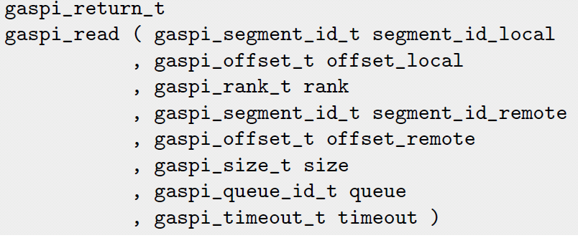
GASPI One-sided Communication
Post a get request into a given queue for transfering data from a remote segment into a local segment
gaspi_read

Slide 45
GASPI One-sided Communication
wait on local completion of all requests in a given queue
After successfull completion, all involved local buffers are valid
gaspi_wait

Slide 46
Queues (I)
Different queues available to handle the communication requests
Requests to be submitted to one of the supported queues
Advantages
more scalability
channels for different types of requests
similar types of requests are queued and synchronized together but independently from other ones
separation of concerns

Slide 47
Queues (II)
Fairness of transfers posted to different queues is guaranteed
No queue should see ist communication requests delayed indefinitely
A queue is identified by its ID
Synchronization of calls by the queue
Queue order does not imply message order on the network / remote memory
A subsequent notify call is guaranteed to be non-overtaking for all previous posts to the same queue and rank

Slide 48
Weak Synchronization
One sided-communication:
Entire communication managed by the local process only
Remote process is not involved
Advantage: no inherent synchronization between the local and the remote process in every communication request
Still: At some point the remote process needs knowledge about data availability
Managed by weak synchronization primitives

Slide 49
Weak Synchronization
Several notifications for a given segment
Identified by notification ID
Logical association of memory location and notification

Slide 50
GASPI Weak Synchronization
posts a notification with a given value to a given queue
remote visibility guarantees remote data visibility of all previously posted writes in the same queue, the same segment and the same process rank
gaspi_notify

Slide 51
GASPI Weak Synchronization
monitors a contiguous subset of notification id‘s for a given segment
returns successfull if at least one of the monitored id‘s is remotely updated to a value unequal zero
gaspi_notify_waitsome

Slide 52
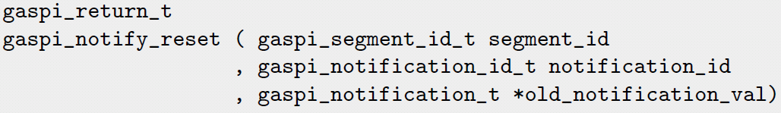
GASPI Weak Synchronization
Atomically resets a given notification id and yields the old value
gaspi_notify_reset

Slide 53
Communication example
init local buffer
write to remote buffer
wait for data availability
print
write_notify
notify_waitsome

Slide 54
onesided.c (I)
// includes
int main(int argc, char *argv[])
{
static const int VLEN = 1 << 2;
SUCCESS_OR_DIE( gaspi_proc_init(GASPI_BLOCK) );
gaspi_rank_t iProc, nProc;
SUCCESS_OR_DIE( gaspi_proc_rank(&iProc));
SUCCESS_OR_DIE( gaspi_proc_num(&nProc));
gaspi_segment_id_t const segment_id = 0;
gaspi_size_t const segment_size = 2 * VLEN * sizeof (double);
SUCCESS_OR_DIE ( gaspi_segment_create ( segment_id, segment_size , GASPI_GROUP_ALL, GASPI_BLOCK
, GASPI_MEM_UNINITIALIZED ) );
gaspi_pointer_t array;
SUCCESS_OR_DIE ( gaspi_segment_ptr (segment_id, &array) );
double * src_array = (double *)(array);
double * rcv_array = src_array + VLEN;
for (int j = 0; j < VLEN; ++j) {
src_array[j]= (double)( iProc * VLEN + j ); }

Slide 55
onesided.c (II)
gaspi_notification_id_t data_available = 0;
gaspi_queue_id_t queue_id = 0;
gaspi_offset_t loc_off = 0;
gaspi_offset_t rem_off = VLEN * sizeof (double);
wait_for_queue_entries_for_write_notify ( &queue_id );
SUCCESS_OR_DIE ( gaspi_write_notify ( segment_id, loc_off
, RIGHT (iProc, nProc)
, segment_id, rem_off
, VLEN * sizeof (double)
, data_available, 1 + iProc, queue_id
, GASPI_BLOCK ) );
wait_or_die (segment_id, data_available, 1 + LEFT (iProc, nProc) );
for (int j = 0; j < VLEN; ++j)
{
printf("rank %d rcv elem %d: %f \n", iProc,j,rcv_array[j] ); }
wait_for_flush_queues();
SUCCESS_OR_DIE( gaspi_proc_term(GASPI_BLOCK) );
return EXIT_SUCCESS;
}

Slide 56
waitsome.c
include "waitsome.h„
#include "assert.h„
#include "success_or_die.h„
void wait_or_die ( gaspi_segment_id_t segment_id
, gaspi_notification_id_t notification_id
, gaspi_notification_t expected )
{
gaspi_notification_id_t id;
SUCCESS_OR_DIE (gaspi_notify_waitsome (segment_id, notification_id,
1, &id, GASPI_BLOCK) );
ASSERT (id == notification_id);
gaspi_notification_t value;
SUCCESS_OR_DIE (gaspi_notify_reset (segment_id, id, &value));
ASSERT (value == expected);
}

Slide 57
Hands-On

Slide 58
Extended One-sided Calls
gaspi_write_notify
gaspi_write + subsequent gaspi_notify
gaspi_write_list
several subsequent gaspi_writes to the same rank
gaspi_write_list_notify
gaspi_write_list + subsequent gaspi_notify
gaspi_read_list
several subsequent gaspi_reads

Slide 59
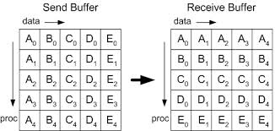
Matrix Transpose
Matrix Transpose => Global Transpose + Local Transpose
=> MPI_Alltoall + Local Transpose

Slide 60
MPI Matrix Transpose
// pseudocode
#pragma omp parallel
{
#pragma omp master
MPI_Alltoall()
#pragma omp barrier
for_all_threadprivate_tiles
do_local_transpose(tile);
}

Slide 61
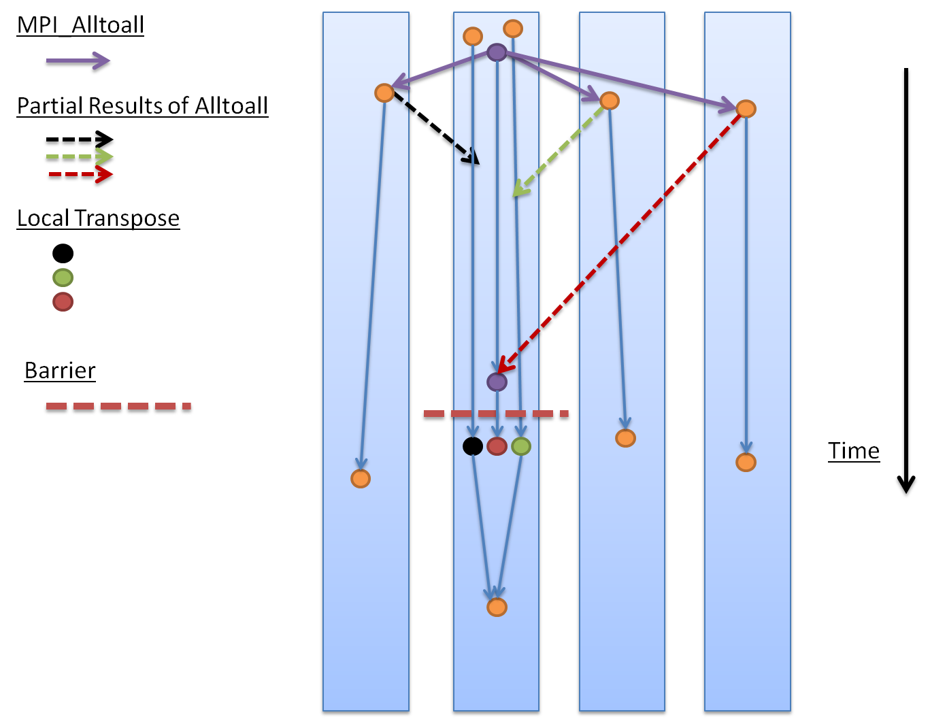
MPI - Alltoall

Slide 62
Infiniband FDR Fat Tree. Flat MPI vs. Hybrid OpenMP/MPI

Slide 63
Hands-On

Slide 64
GASPI Matrix Transpose
// pseudocode – write_notify
#pragma omp parallel
{
#pragma omp master
for_all_other_ranks
gaspi_write_notify(tile)
while (!complete)
{ test_or_die(thread_local tile) // test for notifications for // thread local tiles do_local_transpose(tile)
}
}

Slide 65
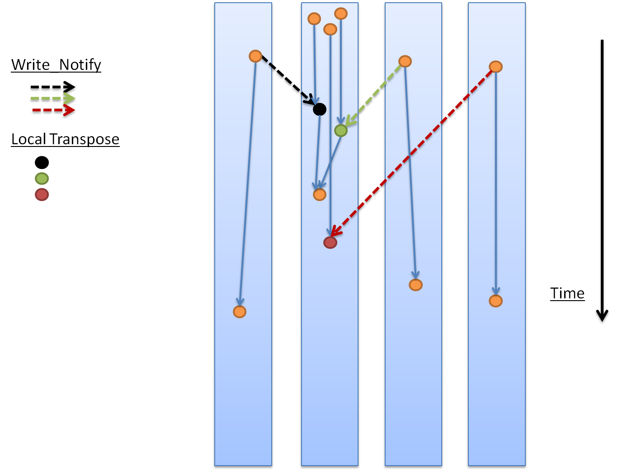
GASPI - Notification

Slide 66
Hands-On

Slide 67
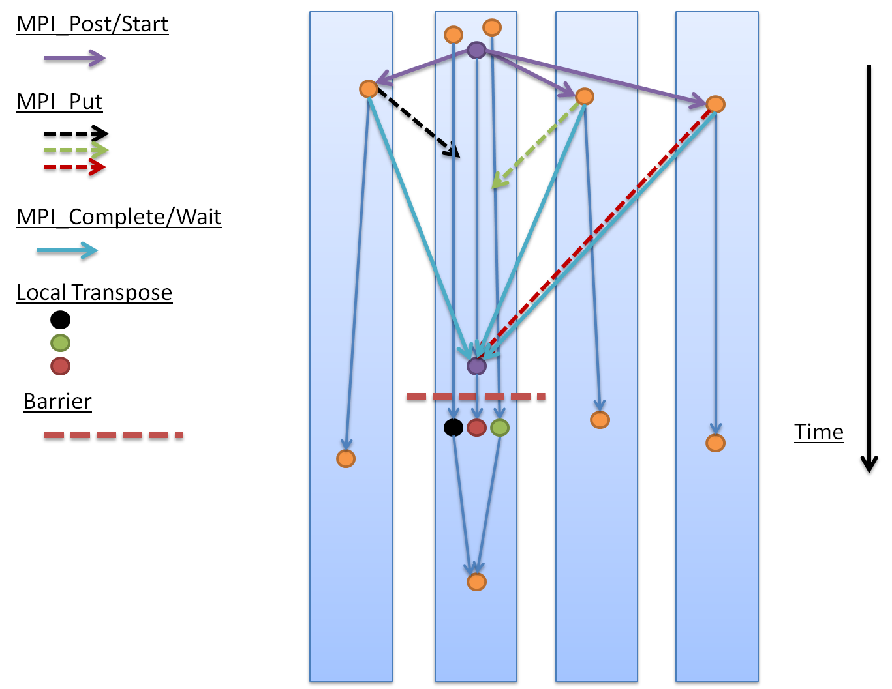
MPI - GATS/PSCW

Slide 68
https://github.com/PGAS-community-benchmarks

Slide 69
GASPI Matrix Transpose
// pseudocode – read
#pragma omp parallel
{
#pragma omp master
for_all_other_ranks
gaspi_read(tile) // flip queue, wait and read !
while (!complete)
{ test_or_die(thread_local tile) // test for notifications for // thread local tiles do_local_transpose(tile)
}
}

Slide 70
Infiniband 7D Enhanced hypercube. GASPI read vs notified write.

Slide 71
Hands-On

Slide 72

Task (Graph) Models
Bottom up: Complement local task dependencies with remote data dependencies.
Targets
Node local execution on (heterogeneous) manycore architectures.
Scalability issues in Fork-Join models
Vertically fragmented memory, separation of access and execution, handling of data marshalling, tiling, etc.
Inherent node local load imbalance
Task (Graph) Models
Targets:
Latency issues, overlap of communication and computation.
Asynchronous fine-grain dataflow model
Fault tolerance, system noise, jitter.
GASPI
Top Down: Reformulate towards asynchronous dataflow model.
Overlap communication and computation.

Slide 73
Dataflow model
Hands On Session The MPI/GASPI Ring Exchange
Ghost Cell Exchange with Double Buffering

Slide 74
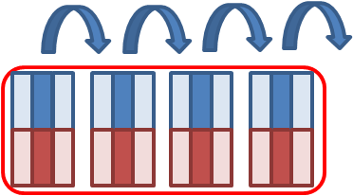
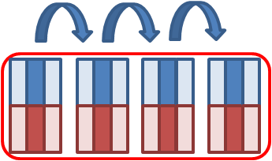
The MPI Ring Exchange
MPI – MPI_Issend/MPI_Recv
NITER iterations of Ring Exchange with „nProc“ cores
Shift upper half of vector to the right
Shift lower half of vector to the left
Example: 4 Sockets/16 cores – each core holds a vector of length 2*VLEN

Slide 75
The MPI Ring Exchange
MPI – left_right_double_buffer.c
for (int i = 0; i < nProc; ++i) {
MPI_Request send_req[2], recv_req[2];
const int left_halo = 0; slice_id = 1; right_halo = 2;
MPI_Irecv ( &array_ELEM_right (buffer_id, left_halo, 0), VLEN, MPI_DOUBLE, left, i, MPI_COMM_WORLD, &send_req[0]);
MPI_Irecv ( &array_ELEM_left (buffer_id, right_halo, 0), VLEN, MPI_DOUBLE, right, i, MPI_COMM_WORLD, &send_req[1]);
MPI_Isend ( &array_ELEM_right (buffer_id, slice_id, 0), VLEN, MPI_DOUBLE, right, i, MPI_COMM_WORLD, &recv_req[0]);
MPI_Isend ( &array_ELEM_left (buffer_id, slice_id, 0), VLEN, MPI_DOUBLE, left, i, MPI_COMM_WORLD, &recv_req[1]);
MPI_Waitall (2, recv_req, MPI_STATUSES_IGNORE);
data_compute (NTHREADS, array, 1 - buffer_id, buffer_id, slice_id);
MPI_Waitall (2, send_req, MPI_STATUSES_IGNORE);
buffer_id = 1 - buffer_id;
}

Slide 76
The MPI Ring Exchange
MPI – left_right_double_buffer_req_free.c
for (int i = 0; i < nProc; ++i) {
MPI_Request send_req[2], recv_req[2];
const int left_halo = 0; slice_id = 1; right_halo = 2;
MPI_Irecv ( &array_ELEM_right (buffer_id, left_halo, 0), VLEN, MPI_DOUBLE, left, i, MPI_COMM_WORLD, &send_req[0]);
MPI_Irecv ( &array_ELEM_left (buffer_id, right_halo, 0), VLEN, MPI_DOUBLE, right, i, MPI_COMM_WORLD, &send_req[1]);
MPI_Isend ( &array_ELEM_right (buffer_id, slice_id, 0), VLEN, MPI_DOUBLE, right, i, MPI_COMM_WORLD, &recv_req[0]);
MPI_Isend ( &array_ELEM_left (buffer_id, slice_id, 0), VLEN, MPI_DOUBLE, left, i, MPI_COMM_WORLD, &recv_req[1]); MPI_Request_free(&send_req[0]);
MPI_Request_free(&send_req[1]);
MPI_Waitall (2, recv_req, MPI_STATUSES_IGNORE);
data_compute (NTHREADS, array, 1 - buffer_id, buffer_id, slice_id);
buffer_id = 1 - buffer_id;
}

Slide 77
The MPI Ring Exchange
buffer_id = 0
buffer_id = 0
buffer_id = 1
buffer_id = 1
buffer_id = 0
Bi-directional halo exchange – implicit synchronization

Slide 78
Hands-On

Slide 79
The MPI Ring Exchange
MPI – HYBRID MPI/OpenMP
Shift upper half of the vector to the right
Shift lower half of the vector to the left
Example: 4 Sockets/16 cores – each core holds a vector of length 2*VLEN

Slide 80
The MPI Ring Exchange
MPI – left_right_double_buffer_funneled.c
for ( int i = 0; i < nProc * NTHREADS; ++i ) {
const int left_halo = 0, slice_id = tid + 1, right_halo = NTHREADS+1;
if (tid == 0) {
MPI_Request send_req[2], recv_req[2];
MPI_Irecv ( &array_ELEM_right (buffer_id, left_halo, 0), VLEN, MPI_DOUBLE, left, i, MPI_COMM_WORLD, &recv_req[0]);
MPI_Irecv ( &array_ELEM_left (buffer_id, right_halo, 0), VLEN, MPI_DOUBLE, right, i, MPI_COMM_WORLD, &recv_req[1]);
MPI_Isend ( &array_ELEM_right (buffer_id, slice_id, 0), VLEN, MPI_DOUBLE, right, i, MPI_COMM_WORLD, &send_req[0]);
MPI_Isend ( &array_ELEM_left (buffer_id, slice_id, 0), VLEN, MPI_DOUBLE, left, i, MPI_COMM_WORLD, &send_req[1]);
MPI_Request_free(&send_req[0]);
MPI_Request_free(&send_req[1]);
MPI_Waitall (2, recv_req, MPI_STATUSES_IGNORE);
}
#pragma omp barrier
data_compute (NTHREADS, array, 1 - buffer_id, buffer_id, slice_id);
#pragma omp barrier
buffer_id = 1 - buffer_id; }

Slide 81
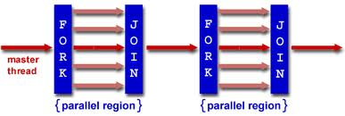
The MPI Ring Exchange
MPI – left_right_double_buffer_funneled.c
Fork-join model

Slide 82
The MPI Ring Exchange
MPI – left_right_double_buffer_multiple.c
if (tid == 0) {
MPI_Request request;
MPI_Isend ( &array_ELEM_left (buffer_id, slice_id, 0), VLEN,
MPI_DOUBLE, left, i, MPI_COMM_WORLD, &request);
MPI_Request_free(&request); MPI_Recv ( &array_ELEM_right (buffer_id, left_halo, 0), VLEN, MPI_DOUBLE, left, i, MPI_COMM_WORLD, MPI_STATUS_IGNORE);
data_compute (NTHREADS, array, 1 - buffer_id, buffer_id, slice_id);
} else if (tid < NTHREADS - 1){
data_compute (NTHREADS, array, 1 - buffer_id, buffer_id, slice_id);
} else {
MPI_Request request;
MPI_Isend ( &array_ELEM_right (buffer_id, slice_id, 0), VLEN, MPI_DOUBLE, right, i, MPI_COMM_WORLD, &request);
MPI_Request_free(&request); MPI_Recv ( &array_ELEM_left (buffer_id, right_halo, 0), VLEN, MPI_DOUBLE, right, i, MPI_COMM_WORLD, MPI_STATUS_IGNORE);
data_compute (NTHREADS, array, 1 - buffer_id, buffer_id, slice_id);
}
#pragma omp barrier
buffer_id = 1 - buffer_id;

Slide 83
Hands-On

Slide 84
The GASPI Ring Exchange
GASPI – HYBRID GASPI/OpenMP
Shift upper half of the vector to the right
Shift lower half of the vector to the left
Example: 4 Sockets/16 cores – each core holds a vector of length 2*VLEN

Slide 85
The GASPI Ring Exchange
if (tid == 0) {
wait_for_queue_max_half (&queue_id);
SUCCESS_OR_DIE ( gaspi_write_notify
( segment_id,array_OFFSET_left(buffer_id, slice_id, 0), left,
segment_id,array_OFFSET_left(buffer_id,right_halo,0),VLEN* sizeof(double),
right_data_available[buffer_id], 1 + i, queue_id, GASPI_BLOCK));
wait_for_queue_max_half (&queue_id);
SUCCESS_OR_DIE ( gaspi_write_notify
( segment_id, array_OFFSET_right (buffer_id, slice_id, 0), right,
segment_id,array_OFFSET_right(buffer_id,left_halo,0),VLEN*sizeof (double),
left_data_available[buffer_id], 1 + i, queue_id, GASPI_BLOCK));
wait_or_die (segment_id, right_data_available[buffer_id], 1 + i);
wait_or_die (segment_id, left_data_available[buffer_id], 1 + i);
}
#pragma omp barrier
data_compute ( NTHREADS, array, 1 - buffer_id, buffer_id, slice_id);
#pragma omp barrier
buffer_id = 1 - buffer_id;
GASPI – left_right_double_buffer_funneled.c

Slide 86
The GASPI Ring Exchange
GASPI – left_right_double_buffer_multiple.c
if (tid == 0) {
wait_for_queue_max_half (&queue_id);
SUCCESS_OR_DIE ( gaspi_write_notify
(segment_id, array_OFFSET_left (buffer_id, slice_id, 0), left,
segment_id,array_OFFSET_left(buffer_id, right_halo,0),VLEN*sizeof(double),
right_data_available[buffer_id], 1 + i, queue_id, GASPI_BLOCK));
wait_or_die (segment_id, left_data_available[buffer_id], 1 + i);
data_compute ( NTHREADS, array, 1 - buffer_id, buffer_id, slice_id);
} else if (tid < NTHREADS - 1) {
data_compute ( NTHREADS, array, 1 - buffer_id, buffer_id, slice_id);
} else {
wait_for_queue_max_half (&queue_id);
SUCCESS_OR_DIE ( gaspi_write_notify
( segment_id, array_OFFSET_right (buffer_id, slice_id, 0), right,
segment_id,array_OFFSET_right(buffer_id,left_halo, 0),VLEN*sizeof(double),
left_data_available[buffer_id], 1 + i, queue_id, GASPI_BLOCK));
wait_or_die (segment_id, right_data_available[buffer_id], 1 + i);
data_compute ( NTHREADS, array, 1 - buffer_id, buffer_id, slice_id);
}
#pragma omp barrier
buffer_id = 1 - buffer_id;

Slide 87
Hands-On

Slide 88
The GASPI Ring Exchange
GASPI – left_right_double_buffer_multiple.c
One message instead of three (MPI Rendezvouz)
No waiting for late MPI_Recv
No waiting for acknowledge for MPI_Issend
Overlap of communication with computation

Slide 89
The GASPI Ring Exchange
#pragma omp parallel default (none) firstprivate (buffer_id, queue_id) \ shared (array, data_available, ssl, stderr) { slice* sl; while (sl = get_slice_and_lock (ssl, NTHREADS, num)) { handle_slice(sl, array, data_available, segment_id, queue_id, NWAY, NTHREADS, num);
sl->stage = sl->stage + 1; omp_unset_lock (&sl->lock); } }
typedef struct slice_t
{
omp_lock_t lock;
volatile int stage;
int index;
enum halo_types halo_type;
struct slice_t *left;
struct slice_t *next;
} slice;
GASPI – Dataflow - left_right_dataflow_halo.c

Slide 90
The GASPI Ring Exchange
void handle_slice ( …)
if (sl->halo_type == LEFT){
if (sl->stage > sl->next->stage) {return;}
if (! test_or_die (segment_id, left_data_available[old_buffer_id], 1))
{ return; }
} else if (sl->halo_type == RIGHT) {
if (sl->stage > sl->left->stage) { return; }
if (! test_or_die (segment_id, right_data_available[old_buffer_id], 1))
{ return; }
} else if (sl->halo_type == NONE) {
if (sl->stage > sl->left->stage || sl->stage > sl->next->stage) {return;}
} data_compute (NTHREADS, array, new_buffer_id, old_buffer_id, sl->index);
if (sl->halo_type == LEFT) {
SUCCESS_OR_DIE ( gaspi_write_notify …)
} else if (sl->halo_type == RIGHT)
SUCCESS_OR_DIE ( gaspi_write_notify …)
}
}
GASPI – Dataflow - slice.c

Slide 91
Hands-On

Slide 92
The GASPI Ring Exchange
NITER
GASPI – Dataflow
Locally and globally asynchronous dataflow.

Slide 93
Collectives

Slide 94
Collective Operations (I)
Collectivity with respect to a definable subset of ranks (groups)
Each GASPI process can participate in more than one group
Defining a group is a three step procedure
gaspi_group_create
gaspi_group_add
gaspi_group_commit
GASPI_GROUP_ALL is a predefined group containing all processes

Slide 95
Collective Operations (II)
All gaspi processes forming a given group have to invoke the operation
In case of a timeout (GASPI_TIMEOUT), the operation is continued in the next call of the procedure
A collective operation may involve several procedure calls until completion
Completion is indicated by return value GASPI_SUCCESS

Slide 96
Collective Operations (III)
Collective operations are exclusive per group
Only one collective operation of a given type on a given group at a given time
Otherwise: undefined behaviour
Example
Two allreduce operations for one group can not run at the same time
An allreduce operation and a barrier are allowed to run at the same time

Slide 97
Collective Functions
Built in:
gaspi_barrier
gaspi_allreduce
GASPI_OP_MIN, GASPI_OP_MAX, GASPI_OP_SUM
GASPI_TYPE_INT, GASPI_TYPE_UINT, GASPI_TYPE_LONG, GASPI_TYPE_ULONG, GASPI_TYPE_FLOAT, GASPI_TYPE_DOUBLE
User defined
gaspi_allreduce user

Slide 98
GASPI Collective Function
gaspi_allreduce
gaspi_barrier

Slide 99
Passive communication

Slide 100
Passive Communication Functions (I)
2 sided semantics send/recv
gaspi_passive_send
time based blocking

Slide 101
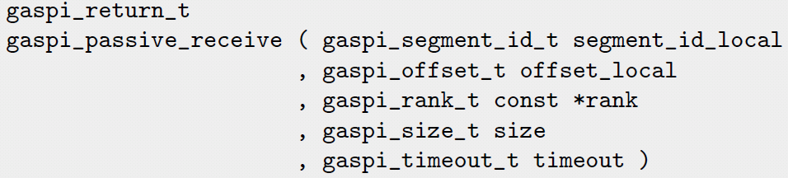
Passive Communication Functions (II)
Gaspi_passive receive
Time based blocking
Sends calling thread to sleep
Wakes up calling thread in case of incoming message or given timeout has been reached

Slide 102
Passive Communication Functions (III)
Higher latency than one-sided comm.
Use cases:
Parameter exchange
management tasks
„Passive“ Active Messages (see advanced tutorial code)
GASPI Swiss Army Knife.

Slide 103
Fault Tolerance

Slide 104
Features
Implementation of fault tolerance is up to the application
But: well defined and requestable state guaranteed at any time by
Timeout mechanism
Potentially blocking routines equipped with timeout
Error vector
contains health state of communication partners
Dynamic node set
substitution of failed processes

Slide 105
Questions?
Thank you for your attention
www.gaspi.de
www.gpi-site.com

