Slide 1
Mechanisms to Raise Awareness about Smartwatch Data Collection
Mehmed Mustafa, Chris Warin
Lab Course on Computer Security and Privacy

Slide 2
Summary
Introduction
Foundations
Related Work
Approach
Demo
Discussion
Conclusion

Slide 3
Introduction
Privacy paradox
Users have concerns about smartwatches [1],[2]
They do not act accordingly/misunderstand them [8]
How do we raise awareness?
Our solution:
Application that collects data in a transparent way
Shows feedback to the user when sensor data is collected

Slide 4
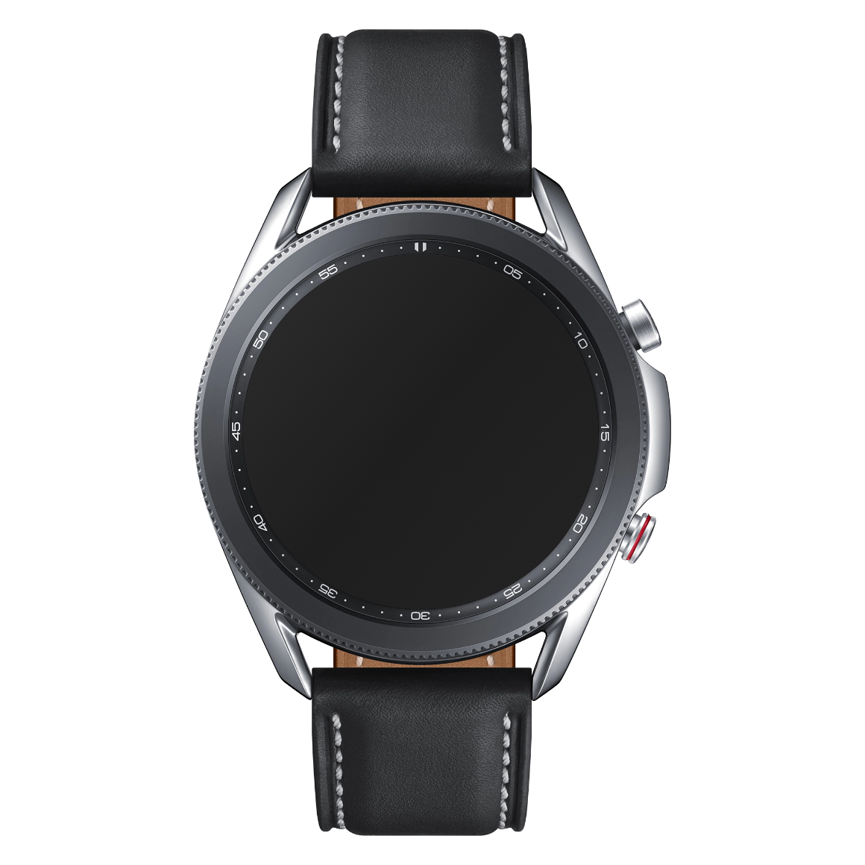
Foundations – Smartwatches
What is a smartwatch ?
Features
Have WiFi/Bluetooth connectivity
Support mobile applications
Have their own operating system
Peripheral devices (sensors)
Our research: Samsung Galaxy Watch 3
Uses Tizen OS
Source: https://commons.wikimedia.org/wiki/File:Samsung_Galaxy_Watch_3.png

Slide 5

Foundations – Tizen Applications
.NET applications – C# based
Managed run-time
Safe code
Fast development
Xamarin Forms
TizenFX
Source: https://commons.wikimedia.org/wiki/File:Samsung_Galaxy_Watch_3.png

Slide 6
Related work
Users have wearable privacy concerns [1], [2]
But also misunderstandings and false beliefs [8]
Important to raise awareness
Various apps giving context-dependent feedback
Haptic feedback for pedestrian navigation [3]
Visual and haptic feedback to assist deaf people [4]
Visual feedback to assist rescuers during CPR [5]
Both together?
Study to question the impact of timing of privacy feedback on UX [7]
Serious game to raise awareness [6]

Slide 7
Approach – System requirements
System → Detect sensor accesses → Notify the user
User → Suspend the sensor usage
User Interface → Designed following the general principles
Feedbacks → Adapted to the core settings of the device
Communication → Minimal, fast and efficient
User → Should feel comfortable and have control over their privacy

Slide 8
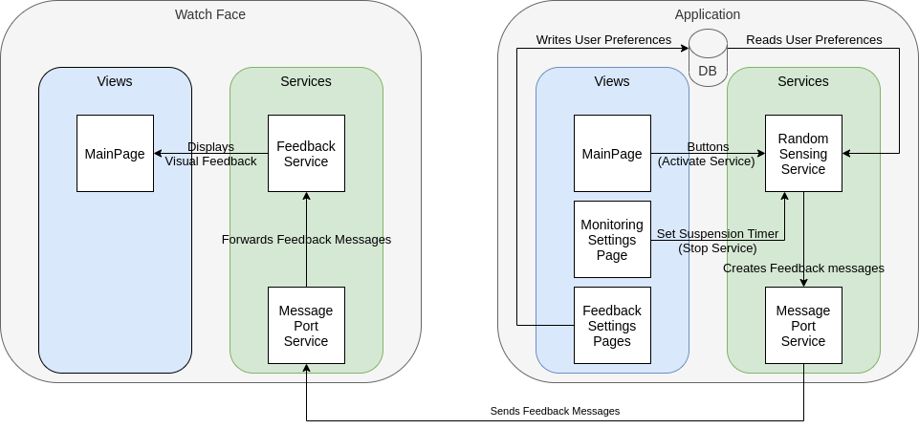
Approach – System Overview

Slide 9
Approach – Services I
Human activity services:
Health – Heart rate monitor
Location – GPS
Activity – Pedometer
Privacy permission service
Checks and asks the user for privileges
E.g. Sensor access privilege

Slide 10
Approach – Services II
Random sensing service – 4 different actions:
Start one random service
Start the max amount of services
Stop one random service
Stop all services
Message port service
Creates a communication channel between Watch Face and Main App
Feedback service
Receives feedback messages
Transforms them into actual feedback

Slide 11
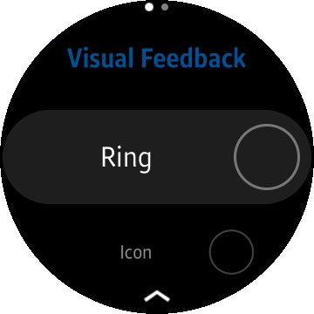
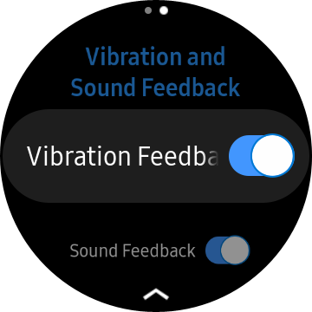
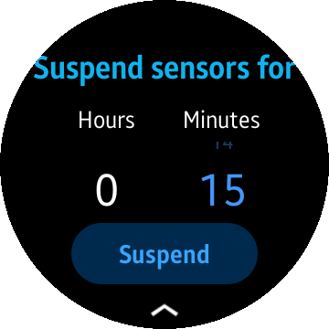
Approach – Main Application
Main page
Single button:
Triggers random sensing
For testing purposes
Visual feedback settings
Radio box list to choose feedback
Other feedback settings
Switches to toggle vibration and sound
Sensors suspension setting

Slide 12
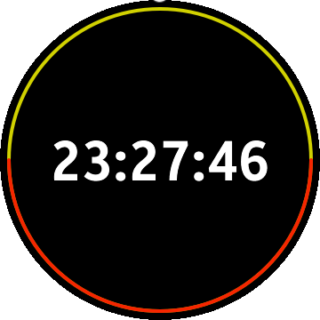
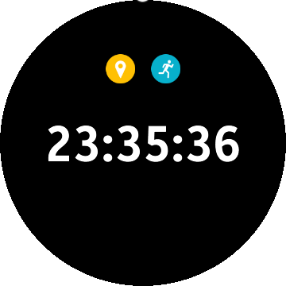
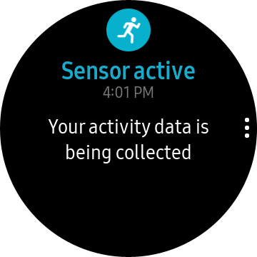
Approach – Watch Face
Shows time
Shows visual feedback:
Ring feedback
Icon feedback
Notification feedback
Can trigger other feedback:
Vibration
Sound
Ambient mode

Slide 13
Discussion - First approach
Global sensor monitoring application
Detects when a sensor is accessed by other apps
Triggers feedback
Not feasible
No API to know if a sensor is being used outside of the app
Required info present in system log
But app has no read access

Slide 14
Demo

Slide 15
Discussion - Second approach
Advantages
Good granularity of feedback
Different combinations/intensities of feedback
Gives control to user
Can suspend sensor access with timer
Designed to be shared
Separated Watch Face + Main App
Limits
Less generic than first approach
Still only a prototype
Can be bypassed by user

Slide 16
Conclusion
Lack of APIs to have global information about sensors
Developers must implement transparency mechanisms themselves
Our solution:
Aims to put users in control + raise data collection awareness
Case Study necessary to assess efficiency
To be shared to community?

Slide 17
Thanks for your attention!
Do you have any questions?

Slide 18
References
[1] P. Datta, A. S. Namin, and M. Chatterjee, “A survey of privacy concerns in wearable devices,” in 2018 IEEE International Conference on Big Data (Big Data), IEEE, 2018, pp. 4549–4553.
[2] V. G. Motti and K. Caine, “Users’ privacy concerns about wearables,” in International Conference on Financial Cryptography and Data Security, Springer, 2015, pp. 231–244.
[3] D. Dobbelstein, P. Henzler, and E. Rukzio, “Unconstrained pedestrian navigation based on vibro-tactile feedback around the wristband of a smartwatch,” in Proceedings of the 2016 CHI Conference Extended Abstracts on Human Factors in Computing Systems, 2016, pp. 2439–2445.
[4] S. Goodman, S. Kirchner, R. Guttman, D. Jain, J. Froehlich, and L. Findlater, “Evaluating smartwatch-based sound feedback for deaf and hard-of-hearing users across contexts,” in Proceedings of the 2020 CHI Conference on Human Factors in Computing Systems, 2020, pp. 1–13.
[5] J. Lee, Y. Song, J. Oh, Y. Chee, C. Ahn, H. Shin, H. Kang, and T. H. Lim, “Smartwatch feedback device for high-qualit chest compressions by a single rescuer during infant cardiac arrest: A randomized, controlled simulation study,” European Journal of Emergency Medicine, vol. 26, no. 4, p. 266, 2019.
[6] M. Williams, J. R. Nurse, and S. Creese, “(smart) watch out! encouraging privacy-protective behavior through interactive games,” International Journal of Human-Computer Studies, vol. 132, pp. 121–137, 2019.
[7] S. Patil, R. Hoyle, R. Schlegel, A. Kapadia, and A. J. Lee, “Interrupt now or inform later? comparing immediate and delayed privacy feedback,” in Proceedings of the 33rd Annual ACM Conference on Human Factors in Computing Systems, 2015, pp. 1415–1418.
[8] E. S. Udoh and A. Alkharashi, “Privacy risk awareness and the behavior of smartwatch users: A case study of indiana university students,” in 2016 Future Technologies Conference (FTC), IEEE, 2016, pp. 926–931.

